Slide 1
The Incredible You
Sky Gabel M.A.
North Dakota Vision Services
School for the Blind

Slide 2
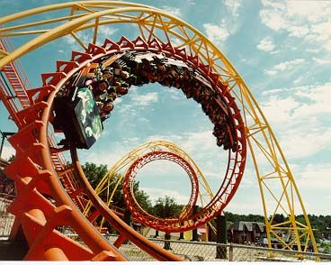
The possibilities are endless
Life is an adventure
There are so many things to try
Being scared of new things is normal, but trying new things makes us braver, smarter, and well-rounded.
Can you think of a new experience you’ve always wanted to try?
Maybe horseback riding or going on a rollercoaster.
Those things can be scary, but it doesn’t mean you won’t enjoy them!

Slide 3
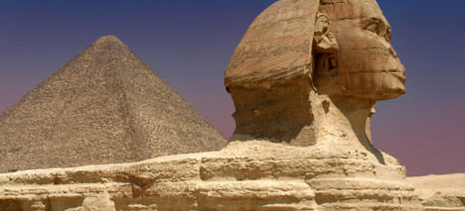
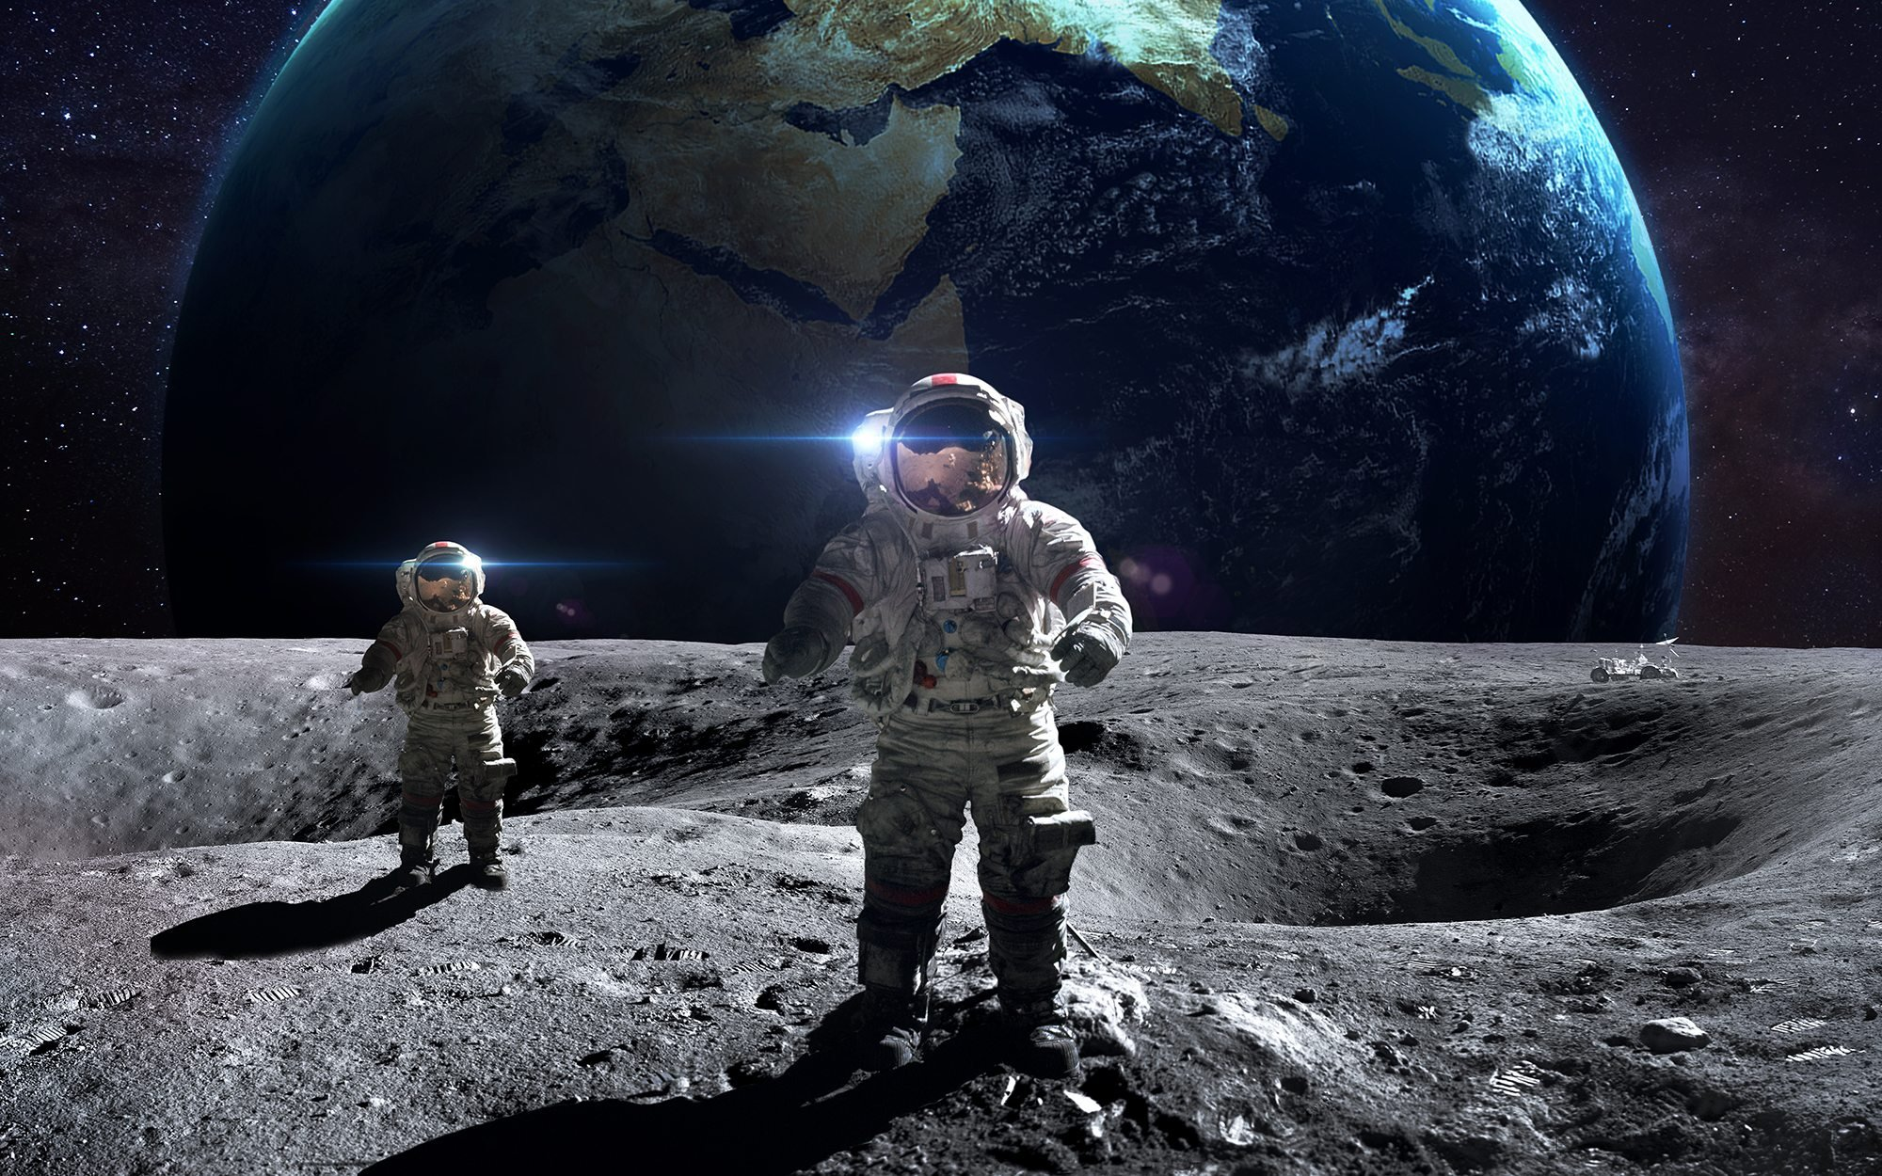
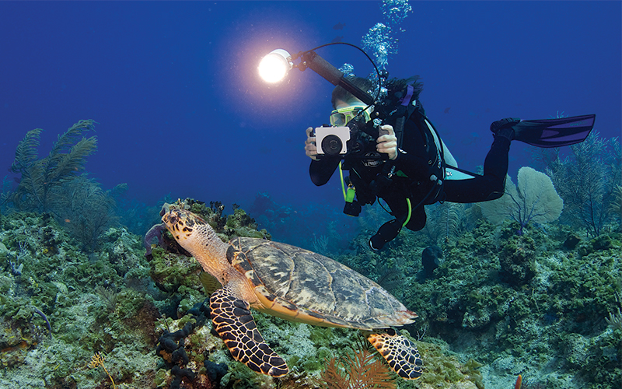
Never stop exploring
Life is meant to be filled with exciting experiences.
Exploring new areas, new friends, and new situations keeps us from getting bored
Meeting new friends may end up showing you how much you like acting from playing make-believe
Going on your first hike may lead you to love nature and study it in the future
Visiting different states or countries opens your mind to new and exciting cultures

Slide 4
There is never a dumb question
Asking questions allows us to learn new information
It’s normal to have questions and it’s ok to not know everything
Think of all the interesting things there are to learn about!

Slide 5
Look at things in different ways
Sometimes we get frustrated because we can’t find a fix to a problem.
Much of the time we can discover new ways around problems if we take a different point of view.
Maybe you feel sad because playing basketball is harder with a visual impairment
You could just say I’m going to sit and be by myself and not play anything
Or you could find a way to participate in the game or find a new way to play!
Putting yourself in other people’s shoes is also important
It makes it easier being a good friend and a nice person
How would you feel in different situations if you were them
You may be able to connect better

Slide 6
Positive attitudes can go a long way
Sometimes bad things happen and it’s ok to feel bad about it
What’s important is to look at what is good in your life
The clouds are still fluffy, your family still loves you, you are still a great musician. There is always something that is going right, you just have to look!

Slide 7
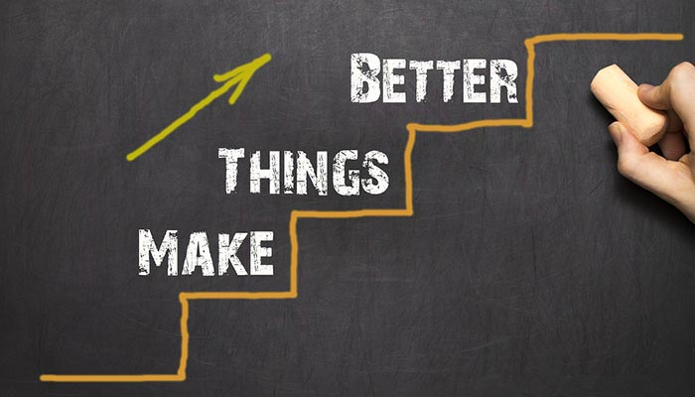
Failing doesn’t mean failure
If you trip, you get up. So if you fail, try again. You never know what you can do unless you keep trying.
Just because you did poorly on a math test doesn’t mean that you are stupid or bad at math. It just means that you could benefit from studying more or asking for help at school. You can keep working and improving. That’s what life is all about. Improvement!

Slide 8
There are so many things you can do!
If you put your mind to it, you can do almost anything!
Molly Burke is a famous YouTuber who is visually impaired
There are so many things that you can do! The possibilities are endless!

Slide 9
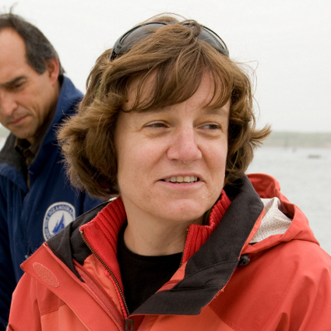
Amy Bower
Dr. Amy Bower completed her Bachelor of Science in Physics at Tufts University and her Ph.D in Oceanography at the University of Rhode Island. Since then, she has been a prolific researcher, educator, and advocate for blind individuals in the sciences.

Slide 10
Marla Runyan
She was the first legally blind American track & field athlete to qualify and compete for the United States Olympic Team. She is a three-time national champion in the women’s 5,000 meters and a 5-time Paralympic Gold Medalist.

Slide 11
Harriet Tubman had impaired vision due to her overseer hitting her with a rock, she went on to create the Underground Railroad to help other slaves
Helen Keller worked tirelessly for the rights of people who are blind to have full access to education, employment, and the rights and responsibilities of citizenship

Slide 12
Ray Charles was an amazing musician who was also known as “the genius.”
Stevie Wonder is famous for his hit songs including “Signed, Sealed, Delivered”

Slide 13
David Paterson
New York Governor David Paterson got an ear infection at age 3 that left him legally blind but now helps pass important laws for New York

Slide 14
Think “I can,” not “I can’t”
Sometimes we doubt ourselves and that’s ok
But remember to speak to yourself like you would a friend.
Would you tell a friend they are bad, or stupid, or that they can’t do something that is important to them?
Think of ways that you can do things, ways you will do things, and ways that you have done things that you never thought you could do.

Slide 15
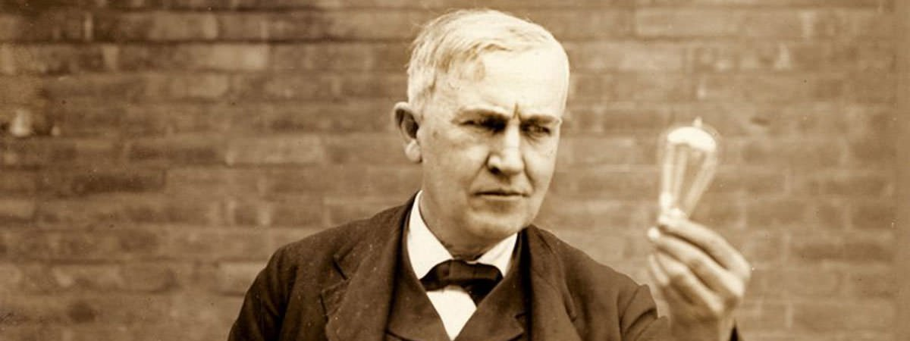
Great minds make mistakes
Thomas Edison, a famous inventor, once said “I have not failed. I've just found 10,000 ways that won't work.”
Had Mr. Edison given up after 1, 10, or 100 tries, we would not have many of the great technological luxuries we have now, like lights and movies!

Slide 16
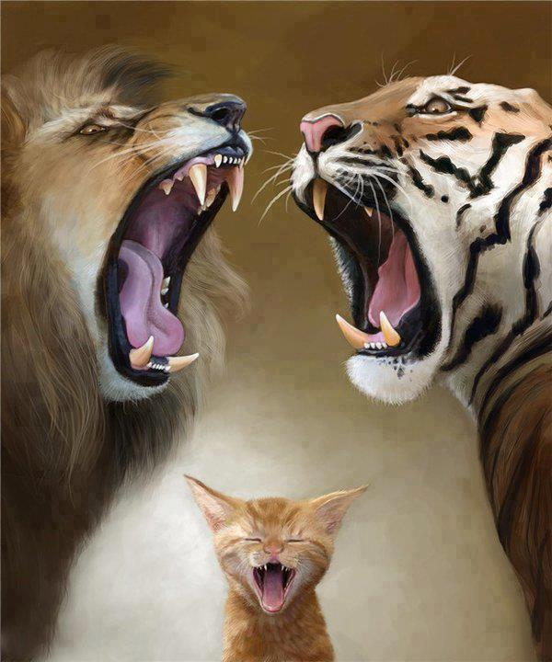
Believe in yourself
If you make a really hard effort you can do almost anything. (Maybe not fly without help from technology) but most everything.
Keep trying and never underestimate what you are capable of

Slide 17
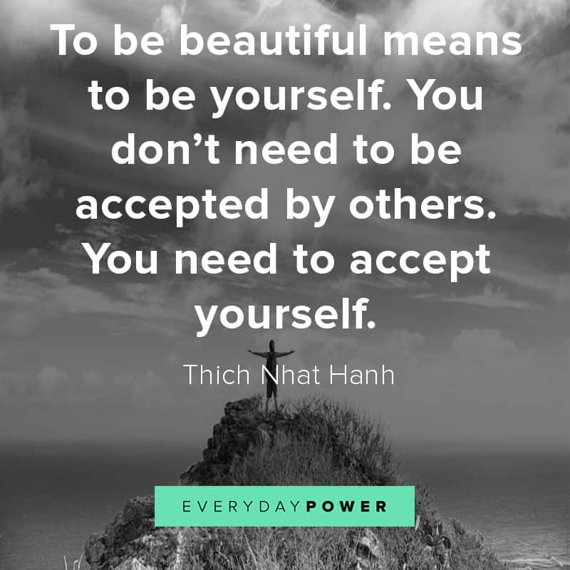
You are unique
Being yourself is something that everyone wants to be able to do
Even adults have a hard time being themselves
But having the courage to stay true to yourself makes the world a fun, interesting, and amazing place to live
So, dream big, dream often, and remember to be unapologetically you

