Slide 1
What is Teasing?
NDVS/SB
Sky Gabel M.A.

Slide 2

Teasing is when someone annoys you or makes fun of you in playful ways.
Notes:
NOTE: To change images on this slide, select a picture and delete it. Then click the Insert Picture icon in the placeholder to insert your own image.

Slide 3


Teasing can be positive if…
It takes place in a strong relationship with two people who appreciate the teasing as affectionate.
The teaser is using a “joking” (rather than aggressive) tone of voice and smiling.
The person being teased does not look distressed.
Notes:
NOTE: To change images on this slide, select a picture and delete it. Then click the Insert Picture icon in the placeholder to insert your own image.

Slide 4
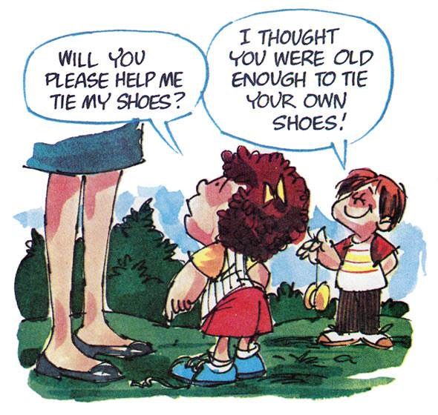

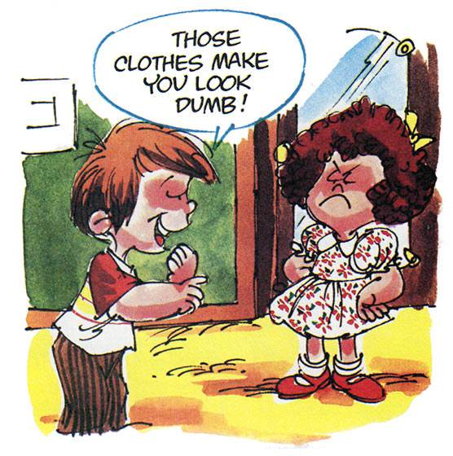
Teasing can turn hurtful. That’s called bullying.
Notes:
NOTE: To change images on this slide, select a picture and delete it. Then click the Insert Picture icon in the placeholder to insert your own image.

Slide 5

Teasing turns to bullying when…
The teasing turns from affectionate to mean
There is a power imbalance: the person teasing has more power compared to the person being teased.
Notes:
NOTE: To change images on this slide, select a picture and delete it. Then click the Insert Picture icon in the placeholder to insert your own image.

Slide 6

Teasing is bullying when…
The teasing occurs repeatedly.
The child who is teasing means to upset or hurt the person being teased.

Slide 7
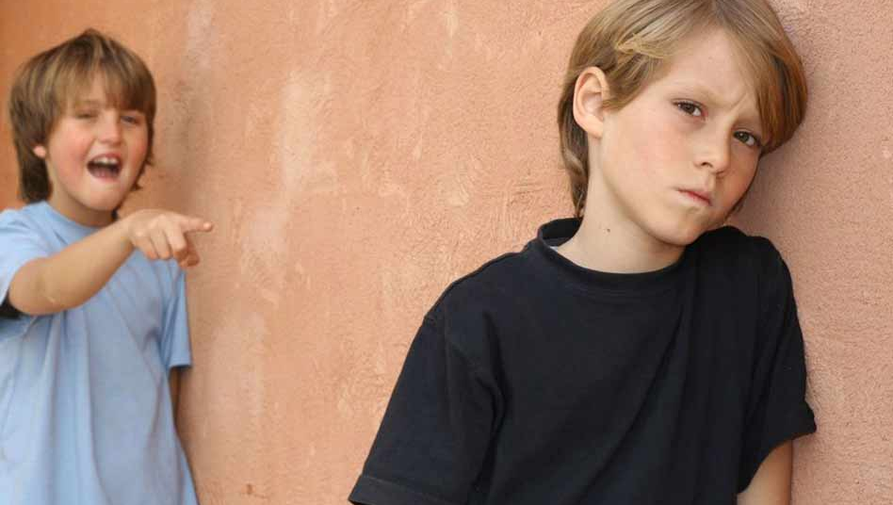
Bullying hurts others when…
Being teased upsets or hurts someone.
Keep in mind that some children, boys especially, may not show that their feelings are hurt.
If you are not sure whether the teasing is hurtful to your friend, ask how they feel about it.

Slide 8

Teasing hurts
When someone teases you, you might feel frustrated or embarrassed
You might get upset and become angry

Slide 9
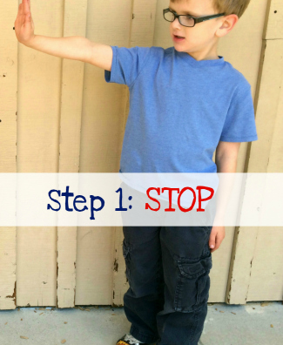
How to handle bullying: STEP ONE
Ask them to stop
Use the hand signal for stop to make it clear
Say something like:
  I feel mad when you say that about me

Slide 10
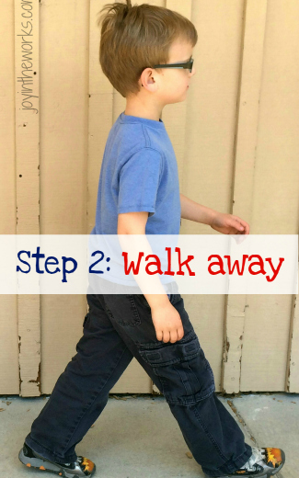
STEP TWO: Walk Away
If the bully does not stop when you ask them to, it’s time to walk away
You may need to switch to a different activity or play with other kids
A bully is hungry to steal your emotional power. By disengaging, you send a clear message … you don’t work that way!

Slide 11
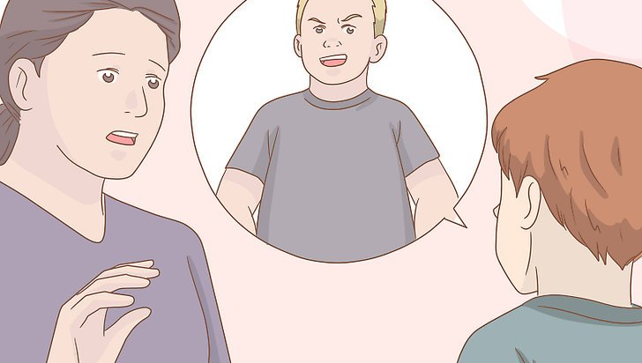
STEP THREE: Tell an Adult
Report the bully to a trusted adult
Go with friends to support you
Be specific, what happened?

Slide 12
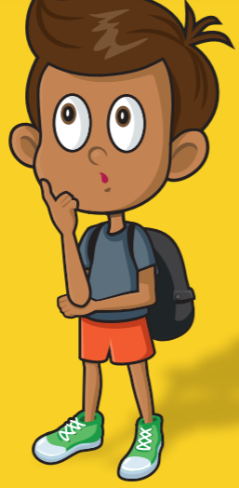
When thinking about telling you may wonder…
• Will anything change if I tell?
• Would I be a tattletale?
• I don’t want to get anyone in trouble.
Know that bullying is a big deal and you have the right to speak up and be heard.

Slide 13

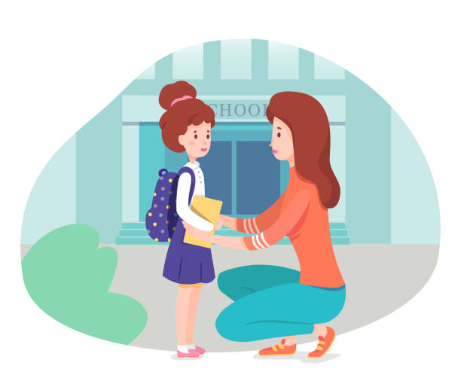
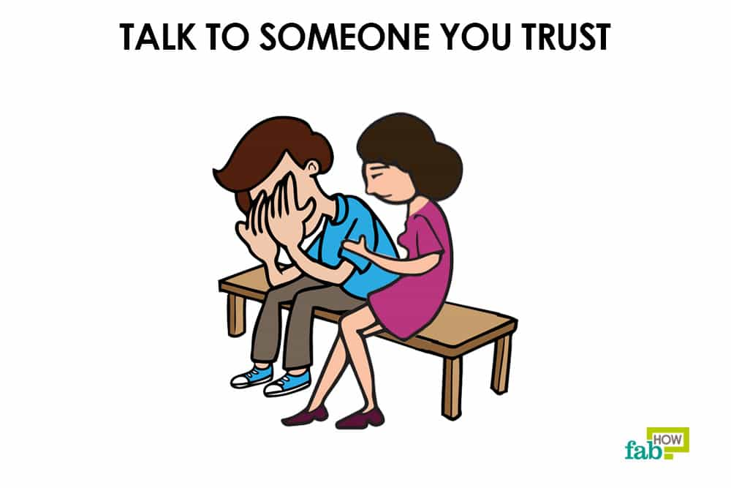
What to Say
“I think someone might be bullying me or someone I know, will you help me?”
“I want to tell you about something that happened, can we talk more?”
“Somebody did something that made me feel….”

Slide 14
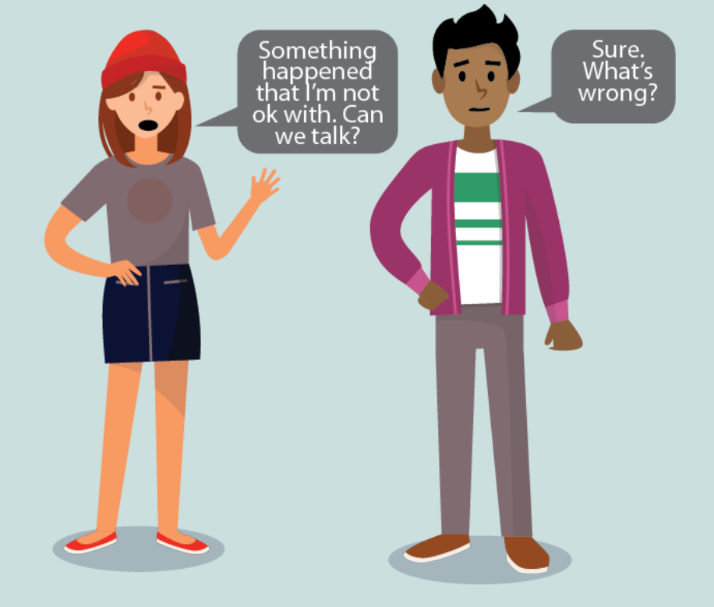
It can be hard to tell an adult about something emotional or serious.
You may want to share what’s happening and how you’re feeling all at once, or you may need more time.
Know that your feelings are important and that it’s your story to tell

Slide 15


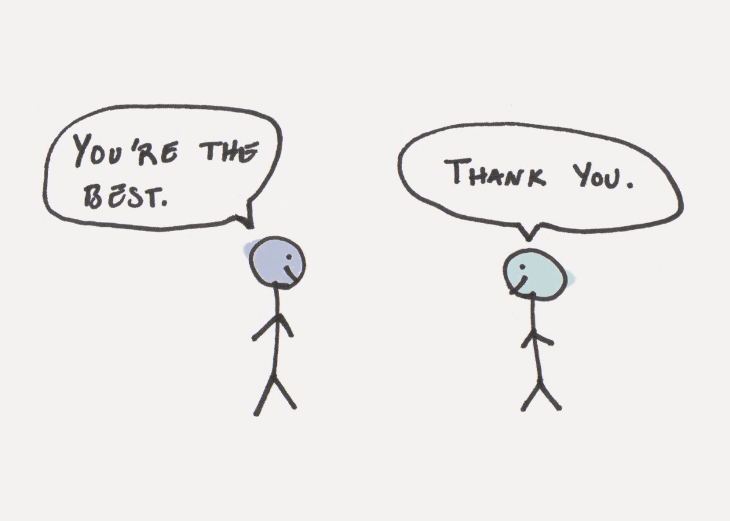
Treat Others How You Want To Be Treated
Try not to tease
Avoid saying things that might hurt someone’s feelings
If you can’t say anything nice….
It’s important to treat other people the way you want to be treated

