Slide 1
Parenting a Child with Low Vision
Presented by Sky Gabel at NDVS/SB

Slide 2
Getting the diagnosis
Whether your child is a baby or toddler, preschooler, grade schooler, or a teenager, learning that your child has a visual impairment can be a shocking event that affects you and your entire family.
If you’re feeling a wide range of strong emotions, including confusion, you’re not alone.
Most parents of children who are visually impaired can recall the day they first suspected their child couldn’t see, the day they were given the diagnosis of their child’s eye condition, who told them, and how the news was delivered.

Slide 3
Questions to Ask the Doctor
You can expect an eye specialist to examine, diagnose, and explain in detail what you need to know about your child’s eye condition. Here are some basic questions to ask:
What is the diagnosis?
What caused the eye problem?
Was my child born with it?
Is it an inherited condition?
What is the prognosis?
Is it stable? Will it get better? Will it get worse?
Is there any treatment for the condition?
Will eyeglasses or contact lenses help?
Are there any other problems associated with this condition?
Can you tell how much my child can see?
What kind of lighting is best for my child?
Are there any restrictions on my child’s activities?
What else do we need to know?

Slide 4
What non-medical services are available
https://familyconnect.org/after-the-diagnosis/overview-of-services/downloadable-toolkit/
Teacher of students with visual impairment (TVI)
Orientation and mobility (O&M) specialist
Early Interventionist
Classroom teacher
Para-educator
Occupational, physical, and/or speech therapist
Psychologists, assistive technology specialists, pediatricians, etc.

Slide 5
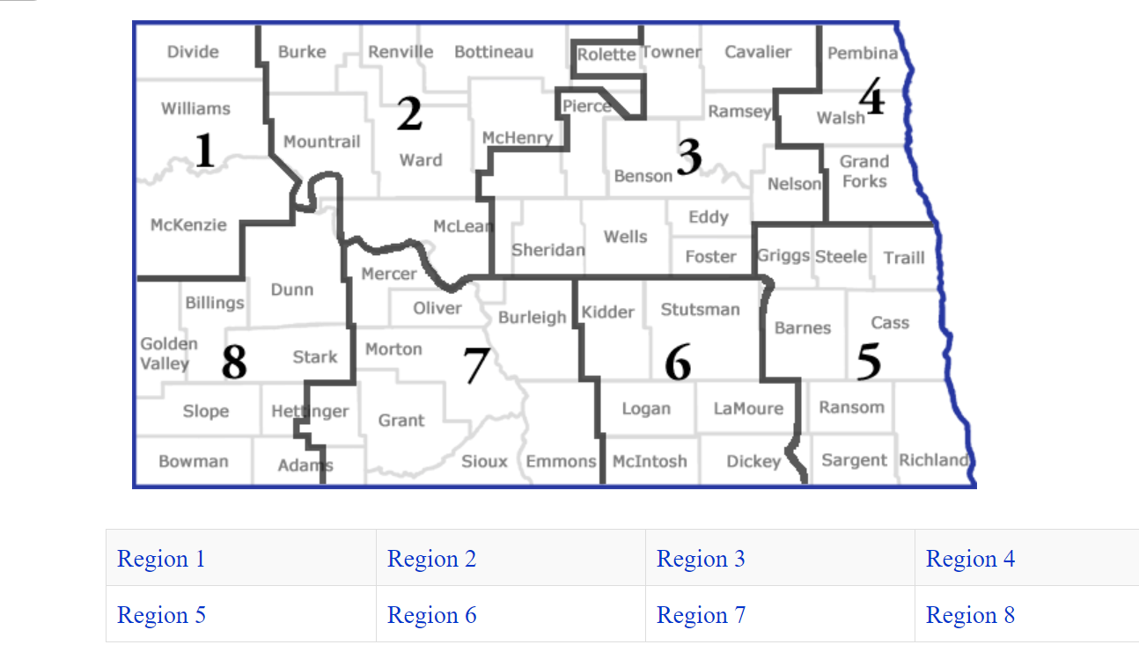
For services offered by NDVS/SB visit this link

Slide 6
A Parent’s Experience
There is no right or wrong way to cope with the news that your child is blind or visually impaired. Whatever you’re feeling—anger, sorrow, guilt, confusion, anxiety, or fear—you need to know that your emotions are natural.

Slide 7
Coping Skills for Parents
Acknowledge your feelings; don’t compare your emotions to others’
Take care of yourself; you can’t take care of someone else when you aren’t in good health
Stay connected; reach out for emotional support from friends, family, and community resources
Give yourself time to adjust; this is a new situation and it will take different amounts of time for different people to process the news
Work with knowledgeable professionals; ex. NDVS/SB, FamilyConnect, NAPVI (National Association for Parents of Children with Visual Impairments)
Become informed about your child’s eye condition and the medical professionals you will form relationships with
Keep good records (e.g. doctor’s reports, IEPs, correspondence between school or doctors, assessment results)
Know the law; unfortunately discrimination is something you and your child may experience, be aware of your rights and be able to advocate for your child (IDEA, ADA, etc.)
Stay positive; remember that first and foremost your child is a child and not a disability. Enjoy him for who he is. Nurture, play, discipline, and give your child the love and attention he needs.

Slide 8
A Parent’s Perspective
A parent’s story and emotional experience of learning their child was blind
Handling Your Child’s Diagnosis of Blindness

Slide 9
Talking to Family about your Child’s Vision
State the facts; Tell people the name of your child’s eye condition and how it affects how he sees. Depending on your relationship and how much information you want to share, you can also tell them what you’ve learned about raising a child who has a visual impairment.
Let them know what you want from them; Tell them what your child needs. If you want them to treat your son the same as they treat other children his age, tell them. If you want them to understand how to interact with a visually impaired child, ask them to talk to your son and explain what they’re doing.
Share what you need; If you want a friend to just listen, tell the person you’re not asking for advice, just a sympathetic ear. If you want some time to yourself to work through difficult feelings, let family and friends know that having them watch your kids for an occasional afternoon would be a big help.
Share what you don’t need; If you don’t need advice or don’t want to hear stories about medical miracles that happened to other families, let others know.

Slide 10
Encouraging Healthy Relationships between Siblings
Have the same expectations. For example, if you are a parent that has your children help with chores, make sure your visually impaired child helps, too. This is not only important to avoid sibling rivalry, but it’s simply a good education.
Inclusion goes both ways. Children who are blind benefit when they can be included with their peers, which means their siblings, too. Parents work really hard to not leave out their blind child. I suggest you do the same for the sighted kids. If you are working on braille or cane skills, teach the siblings, too. Most kids LOVE to learn braille because it is like a secret code.
Find activities that are fun for the whole family. This is difficult for all families, regardless of who their children are because every kid is different. However, we know that family activities are the most fun when they are fun for everyone.

Slide 11
Encouraging Healthy Relationships between Siblings
Teach your visually impaired child how to interact with their siblings. Social interactions are often learned visually when a child is very young and are, therefore, picked up faster by those with sight. Children who are blind may have to be taught how to be polite and what is appropriate.
Be an open book. Make sure you are always available to answer questions. Explain your child’s diagnosis with all the children in your family, which will lead to discussion. Start young with the basics and continually provide them with more as they’re old enough to understand.

Slide 12
Incidental learning
Much of what children learn is acquired almost automatically and instantaneously as they watch other children and adults interact with the environment and imitate their actions.
Incidental learning is learning gained by observing people and activities around us, day by day.
If your child has limited vision, he’ll need extra explanations, descriptions, and repeated experiences in order to learn what other children learn simply by watching others and imitating them.
Involve your child, even when he’s very young, in things you do around the house.
When you want to show your child something, try to relate it to what he knows; For example, if you have a cat at home and your child likes to pet the cat and touch its legs and ears, relate the lion at the zoo to the cat.
Give your child hands-on experiences. The more your child touches, the more he’ll learn.
When you show your child an object, use the techniques called hand-under-hand or hand-over-hand. In hand-under-hand, your child’s hands are placed on top of yours, and he can feel your movements. In hand-over-hand, your hands are placed over his to guide him.
Look for places to take your child that have things for him to touch. Petting zoos, science museums, and botanical gardens are often child-friendly and open to touching. If you do go to a place where touching isn’t part of the program, don’t be afraid to ask if your child may touch.

Slide 13
Understanding How Children with Visual Impairments Learn
Children with visual impairments use accommodations to learn as incidental learning, which comes to sighted children naturally, will be taught and described to a child who is visually impaired.
Hands are a primary information-gathering tool for children with visual impairments. So are the senses of smell, touch, taste, and hearing. They need to have as many opportunities as possible to experience objects directly and sensorially.
Families, friends, and others can support sensorial learning in many ways.
“Mmmm. Do you smell dinner?” appeals to the child’s sense of smell.
“Listen to that bird singing outside” calls to the child’s hearing. You might also say, “That’s a robin,” which gives the child a name for the bird that sings the song he or she is hearing.
“Your clothes are so soft today” speaks to the child’s sense of touch and helps the child build a picture of the “whole” from the many details.
Try not to point out what the child can't see. That is, instead of saying something like, "It's a shame you can't see the pretty kitty!" you could say, "Here, pet the kitty. Isn't it soft?”
source

Slide 14
Helping Your Child Interact with the World

Slide 15
Social Skills
A blind or visually impaired child cannot automatically copy typical social gestures, such as waving goodbye. You need to intentionally teach these skills to your child.
In addition, they cannot see that other kids aren't doing certain things that aren't socially acceptable, such as nose-picking and thumb-sucking, so you have to verbally discourage these behaviors. source

Slide 16
Dealing with Peers – bullying, inappropriate conversations
Most children have to deal with insults from other kids, but children who are visually impaired are especially susceptible. The best approach is to let your child know that insults show more about the other kids than they do about the them.
For instance, you could say, "Kids say mean things sometimes. Usually, it's because they're not feeling good about themselves. Try to ignore them next time."
Help your child recognize bullying. While a few insults here and there aren't great, they're not enough to rush off to the principal. Nonetheless, when it turns into bullying, it's important that your child tell an adult.
Teach a visually impaired child to respond to awkward questions with calm answers. For instance, if someone says, "Can't you see this?" the child could say, "Well, not from that distance. If you let me have it for a minute, I'll be able to see it better."
Rehearse these answers with your child so that it will be easy for them to respond when they need to.

Slide 17
Self-Esteem
Focus on the positive. In any child, but especially one who's visually impaired, focusing on what the child can do is essential to building self-esteem, as it helps them build confidence in their talents.
For example, maybe the child has a terrific singing voice. Complimenting this skill and encouraging it can help build confidence.
Help them understand that everyone has something to contribute.
That is, they may have a disability, but others are challenged in other ways. Your child has something to offer the world, and they may have strengths where others have weaknesses.
Have them meet others who are like them.
Having a positive example can help children build self-esteem, which is why it's important for visually impaired kids to meet other kids, teens, and adults who are like them. When your child sees what others like them can do, it will help them have the confidence to strive for those goals themselves.
Get them involved in activities they enjoy.
When they express interest in an activity, encourage that interest by taking them to a class or seeing if they want to join an after-school club. Once they find something they love and have a great interest in, it can help to build their self-confidence.
source

Slide 18
Self-Esteem
Having a visual impairment doesn’t define who you are, it just encourages you to do things in a different way, or changes the way you do things!
For instance, if your child says, "I can't do this. I suck at life," you could say, "You don't suck at life. You can do many things I can't do. For instance, you can play the piano way better than I can. Here, let's try this again. I'll help you, and then you can try it on your own again.“
Encourage your child to try out lots of different activities that interest them so that they can find what they love and identify their natural talents. This will help to build their self-esteem.
Praise perseverance. Sometimes, things will be more difficult for a visually impaired child. It can help them to have encouragement to work through the hard parts. Plus, once they learn something new, it will give them a sense of accomplishment, which in turn can help build self-esteem. Source
It can also help a child to know that everyone struggles with hard tasks.
For example, you could say something like, "I noticed you're working really hard on your homework! I'm so proud of you for pushing through. Many people have a hard time with math, but you're doing your best to learn some tough material. Good job!"

Slide 19
Preparing Your Visually Impaired Teen for Independence
Orientation and Mobility: Do your child’s recreational activities depend on you as driver?
Work with your child to establish mobility goals.
Team up with your child’s orientation and mobility specialist.
Look for opportunities for your child to reach his goals.
Take public transportation together and ease him into independent mobility.
Discuss and prepare additional strategies for getting around as a non-driver.
Additionally, your child is nearing the age when he can pursue guide dog use. Discuss the pros and cons of a guide dog with your child and seek information from experts.
Daily Living Skills
Help him focus on learning to cook nutritionally; caring for his body, clothes, and belongings; and maintaining a clean living environment. Don’t forget to take the time to teach your child to shave independently.

Slide 20
Preparing Your Visually Impaired Teen for Independence
Money Management
How prepared is your child to earn money, use a bank, and make wise financial decisions? In addition to supporting his efforts to earn money, you may choose to give him a monthly income for certain purchases. Set appropriate boundaries, but allow your child to learn from natural consequences.
Time Management
Can your child arrive to school or appointments on time without a parent managing the calendar and clock?
Organizational Skills
Does your child rely on your organizational skills to care for personal items?
Compensatory Skills
Is your teen independently note-taking, signature-writing, keyboarding, listening, accessing print, and using a computer? Work with a teacher of students with visual impairments (TVI) and support opportunities to learn, use tools, practice skills, and seek out resources that lead to greater independence.

Slide 21
What kind of jobs do people who are blind have?
All kinds!!
The American Foundation for the Blind has a web program for those seeking employment called APH CareerConnect.
Take a moment to read these success stories, and you will learn that people who are visually impaired work in a wide variety of careers.

Slide 22
Your Child’s Future is Bright
If you have questions about available resources in North Dakota please contact NDVS/SB at
701-795-2700

