Slide 1
How to Succeed when Working with Vocational Rehabilitation
Damian Schlinger, Director
Aimee Volk, Vision & IL Services Administrator

Slide 2

Objectives
History of Vocational Rehabilitation (VR)
Who is Eligible
How ND VR is doing
VR Programming

Slide 3
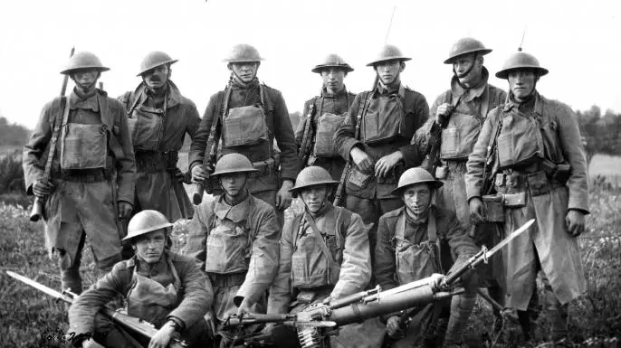
The History of Vocational Rehabilitation
100+ years of VR in the US!!!
The Soldiers Rehabilitation Act of 1918
  (Smith-Sears Act)
    Provides federal funds to providing vocational assistance and employment support services to those returning home from war with newly acquired disabilities.
The National Civilian Vocational Rehabilitation Act of 1920 (Smith-Fess Act)
    This law made possible the first federally funded program assisting people with disabilities who had not acquired their disabilities during military service.
The Rehabilitation Act of 1973,as amended
    Landmark legislation that expanded the rights of individuals with disabilities. Provides grants for VR services, supported employment, independent living, and client assistance.

Slide 4
What is Vocational Rehab and Who Do We Serve?
North Dakota Businesses
  Assist employers in connecting to an untapped labor pool of people with disabilities
  Retaining existing, well-trained and productive workers who may have developed or have a worsening disability
Assist North Dakotans with disabilities (injury, illness or impairment) in seeking, maintaining, or advancing in employment

Slide 5
Who might seek Vocational Rehab Services?
Individual seeking service can have a congenital or acquired disability
Services are inclusive of all types of disability – learning, developmental, physical, cognitive, behavioral
Barrier to seeking, maintaining, or advancing in employment due to disability
Jobs acquired are from entry-level to professional
Clients can come back through the process for career progression, change in career goal or job situation

Slide 6
Successful Hiring increased by 31% from 2022-2023
VR Clients Enrolled/In Process
VR Clients Successfully Hired
ND is #1 state in the nation in employing people w/disabilities at 58%
(US Avg 40%); ND general population labor participation rate = 69%

Slide 7
FFY 2022 - Clients Hired by ND Businesses by Job Class

Slide 8
Services to Businesses
In FFY 2022, VR staff provided 3,383 services to 1,850 different businesses
Oil and Gas
Construction
Hospitality
Administrative & Support
Education
Health
Finance
Government
Manufacturing
Retail

Slide 9
Vocational Rehabilitation
– An Essential Part of the Workforce Solution
People w/Disabilities in ND
81,826
People w/Disabilities of Work Age
43,668
People w/Disabilities Not Working
17,646

Slide 10
Vision in North Dakota -2023
People w/Vision Impairments in ND
15,401
People w/Vision Impairments Served by VR FFY 2023
180
People w/Vision Impairments 55+
9,733
People w/Vision Impairments 55+
The Older Individuals who are Blind Program in FFY 2023 Served
691

Slide 11
Service Delivery Improvements – 21-23
Sound Investments
Doubled Client Financial Participation limits = more working families qualify
Increased hourly rate to Community Rehab Providers (CRPs) by 15%
Increased client tuition minimum from $600 to $1,000 per semester
Satisfaction and Engagement
Client satisfaction – 90% in 2022
Re-imagined eligibility process – 35 days faster

Slide 12



VR Programs
VR has three main programs
  Employment
  Older Individuals Who are Blind Program (OIB)
  Senior Community Service Employment Program (SCSEP)

Slide 13
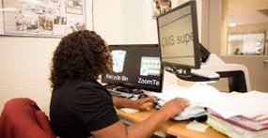
VR and Clients with Vision Impairments
If a client has a vision impairment
  The client will work their VR counselor (VRC) and the vision rehabilitation specialist (VRS)
    The VRC and the VRS will work with the client throughout the life of the case as needed

Slide 14
Case Collaboration
Participate in the intake
Consult in interpretation of medical/vision records
Identify functional limitations
Determine barriers and solutions to employment
Complete a visual assessment based on the individual’s unique needs in their home, work, and/or school environment
Worksite assessment
Vision related training or referral for specialized training
Educate the VRC and client on understanding vision prognosis

Slide 15

Student Services
VR works with students 14 years and up with disabilities, to determine their strengths, interests, and abilities, as well as develop employment goals that will ultimately help them find work in their communities.
  We have counselors assigned to every high school in ND.

Slide 16
Student Services Continued
Goal of VR is to assist students achieve long-term success during and after high school.
  Prior to graduation the VRC, VRS, school personnel and student will work together to come up a good transition plan.
    Barriers to employment
    Barriers to successfully navigating post-secondary school or training
    Accommodations/AT that have worked in the past or have not worked in the past

Slide 17
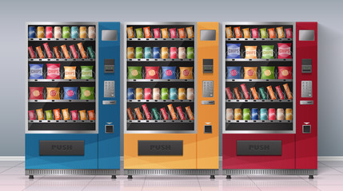
Self-Employment Program
Business Enterprise Program (BEP) helps people who are blind become self-employed. VR can assist with training, licensing, and buying equipment to start a small vending business.
Eligibility
  Legally blind
  18 and over
Vending Operations
  Snack bars
  Automatic vending machines or self-serve micro markets
Benefits of the Program
  Learn how to run a business
  Earn income
  Receive profits from vending machines at ND rest areas.

Slide 18

Older Individuals who are Blind Program
The Older Individuals who are Blind (OIB) Program is available to individuals age 55+ who have a visual impairment and are not employed or living in a nursing home.
  Examples of visual impairments: macular degeneration, cataracts, glaucoma, diabetic retinopathy, detached retina, retinitis pigmentosa, etc.
Goal: To improve the individual’s independence in their homes and communities while enhancing their quality of life.

Slide 19




OIB Services
Communication Skills
Telling Time
Using Phone
Money Mang.
Computer Skills
Daily Living Skills
Meal Prep
Clothing Care
Leisure Act
Personal Care
Low Vision Assessment
Magnifiers
Lighting
Glare Control
Contrast
Information and Referral
NDVS/SB
ND Assistive
Talking Books
Lions Programs

Slide 20

Senior Community Service Employment Program (SCSEP)
The Senior Community Service Employment Program (SCSEP) is a job training program. It is for qualifying people 55 and older who are low-income and not working. People gain confidence and skills by working part-time.
Training Opportunities:
  Child care centers
  Customer service
  Teachers aide
  Healthcare workers
  Maintenance workers
  Many other positions
Training sites must be not-for-profit or public facilities

Slide 21

Thank You for Your Time
Questions

Slide 22
Contact Information
For more information or questions:
Website - hhs.nd.gov/vr
Call 1-800-755-2745 or 711 (TTY)
Email: dhsvr@nd.gov

