Slide 1

Technology and Accommodations: Employment Experiences of U.S. Adults who are Blind, Have Low Vision, or are Deafblind
Arielle M Silverman, L. Penny Rosenblum, Elizabeth Bolander, Carlie R. Rhoads, and Kelly Bleach
Afb.org/WorkplaceTech

Slide 2

The Importance of Technology
In the midst of daily struggles, it's easy to forget how lucky we are to have the technology and opportunity we have today as blind people. I often remind myself to be grateful for that. However, we as blind people have to function in a workplace and compete with sighted peers using tools that are designed specifically for them and not us. This is every tool, every day, all the time, from the coffee maker to the calendar app to the very architecture of the building.
White male in his 40s who became visually impaired in childhood
3

Slide 3

The Research Question
How does technology and the need for accommodations shape the employment experiences of U.S. adults who are blind, low-vision, or deafblind?

Slide 4
To Answer Our Research Question
Literature review
Focus groups with 52 participants in Fall 2020
Survey in February 2021
    Employed participants, n=323
Interviews in Summer 2021
    25 participants who took part in the survey

Slide 5
Participants’ Demographic Information
Gender:
  58% female / 42% male / >.01% nonbinary
Race Ethnicity:
  80% non-White Hispanic / 20% BIPOC
Age:
  21-78 years, M = 47 years
When Became Visually Impaired:
  65% congenital / 18% childhood / 17% adulthood
Education:
  85% College degree or higher
56% of participants
who had a change in vision in the last 5 years requested accommodations

Slide 6
Participants’ Employment
Job sector:
  Education and instruction (n=94)
  Government, community, and human services (n=92)
  Information technology (n=57)
  Healthcare (n=36)

Slide 7
Assistive Technology Training
Three-fourths of participants received formal tech training:
  When requesting to learn new technology (n=143)
  As part of K-12 education (n=137)
  When a VR staff member recommended the training (n=92)
  When an employer introduced new technology (n=69)
  Most participants sought training multiple times in their professional lives.

Slide 8


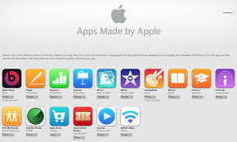
Mainstream Products Used in the Workplace

Slide 9
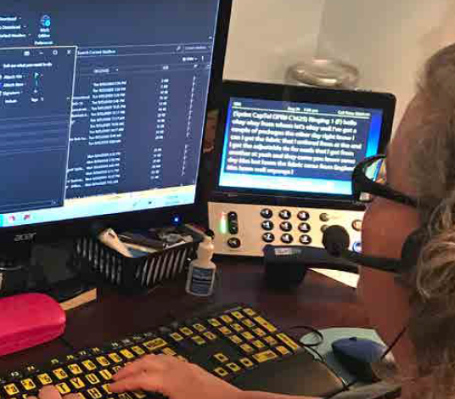
Other Mainstream Products
Nearly all participants used email and Web browsers.
Most participants used videoconferencing software.
Over half used file sharing, and
40% used instant messaging.

Slide 10
Access Challenges: Onboarding

Slide 11
Access Challenges: Employer Provided Training
78% of participants had to complete online training
40% of participants reported online training was not accessible.
67% of participants had to complete in-person training.
39% of participants reported in-person training was not accessible.
How do employees get
the training they
need if it is not
accessible?

Slide 12
Challenges with Employer Provided Training
Lack of description of visual information (e.g., slides)
Not receiving material ahead of time for in-person training
Lack of alternative text on images or videos
Components of online training not accessible (e.g., buttons, login screen, quiz)
Having to use sighted assistance and feeling uncomfortable (e.g., subordinate, sensitive information)

Slide 13
Access Challenges: Web Conferencing
Screen Reader Users:
Content shared from another user’s screen is inaccessible
Difficulty following chat
Difficulty locating files being shared by others
Distracting announcements of who enters and exits the room
Difficulty muting and unmuting
Print Readers:
Content shared may be difficult to enlarge or manipulate
Difficult to view another window and video conference window simultaneously

Slide 14
Accommodations in the Workplace
Coming to a new company as somebody who has accessibility needs is usually a nightmare to navigate processes that are optimized for the 99th percentile and they just don’t know how to handle people who have different needs.
White male in his 40s who became visually impaired as an adult
3

Slide 15
Accommodations are Not Always Timely
With my work computer being a 'managed device' it was very difficult to obtain approvals to get ZoomText installed as it required ADMIN rights and wasn't on their list of approved software. Getting IT to assist and bypass approvals was very difficult at the time.
White male who became visually impaired as an adult
3

Slide 16
Telework
Changes in work responsibilities as a teleworker:
  Attending meetings online
  Learning to use a web conferencing tool
  Changing how one used web conferencing tools
  Meeting with clients using online meeting tools
  Presenting to others
  Working jointly on projects
  Learning to use instant messaging
  Learning to file share
39% of
teleworkers wanted
to continue to
telework post-pandemic

Slide 17
Teleworking as a Person who is Visually Impaired
I think [the] COVID-19 [pandemic] has demonstrated that we are rethinking the conventional workplace model. Working from home is an attractive choice for all, not just the disabled community. Technology is overcoming the sense of disconnectedness typically associated with working from home.
White male in his 40s who became visually impaired in childhood
3

Slide 18
Self-Employment
I already have an established online reputation. There are certain types of clients I don't work with, some teaching pedagogies are very visual. I can request things sent ahead of time, it's policy so nobody questions it… I feel less anxious when framing it this way: "We'll have a productive hour if I can read materials ahead of time."
Asian-American female in her 20s who is self-employed as an online English language teacher
3

Slide 19
Importance of Advocacy
Being one's own advocate should be one of the first lessons visually impaired people learn right up there with mobility training. I believe this is a skill that needs to be taken more seriously with the vocational rehabilitation organizations.
White female in her 50s who is congenitally visually impaired
3

Slide 20
Recommendations for Educators
Prioritize training for students in:
  Keyboarding and PC skills.
  Ability to problem-solve and self-teach new technology.
  Self-advocacy skills and ability to explain their tech to others.

Slide 21
Recommendations for Vocational Professionals
Maintain professional development on accommodations and assistive technology needed by those who are blind, have low vision, or are deafblind in the workplace.
Connect clients with technology workshops and other AT users.
Educate clients about their legal rights and responsibilities.
Ensure clients receive AT training if needed.

Slide 22
Recommendations for Employers
Develop a centralized, comprehensive accommodations policy.
Ensure that employee hiring, onboarding and training procedures are fully accessible.
Only procure technology tools that are accessible and usable.
Consult with employees who use AT before adopting new technologies.

Slide 23
How It Should Work!
My company is massive, and they have onboarded blind people before. Most important though was the culture of enthusiastic continued learning. Everyone just wanted to know more about what they could do, if something didn't work, and how we could fix things together. This allows me to have an open channel of communication with the IT folks, where I document software issues with narrated screen recordings for them, and with HR, for the rare situations when my blindness affects my employment in human-related ways.
White female in her 20s who is congenitally visually impaired
3

Slide 24
Final Thoughts
Just because you have vision loss doesn't mean you're not capable. It's transforming and educating the employers that visually impaired people are capable.
White male in his 70s who became visually impaired as an adult
3

Slide 25
Study Sponsors
eSight
Google
Hadley
James H. and Alice Teubert Foundation
JPMorgan Chase
LCI Foundation
Microsoft
Vispero
Thank you!

