Slide 1

Reflecting on the COVID-19 Pandemic Experience for Those with Vision Loss
Dakotas AER Meeting
October 22nd, 2021
Dr. Carlie R. Rhoads
Program Metrics and Evaluation Specialist
American Foundation for the Blind
crhoads@afb.org

Slide 2
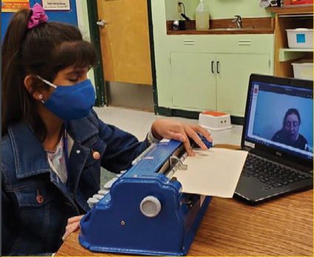
Five Studies Exploring Experiences During the COVID-19 Pandemic
Flatten Inaccessibility and Journey Forward
Access and Engagement 1-2-3

Slide 3


How has the COVID-19 pandemic impacted the lives of adults with vision loss in the United States?
FI: 1,921 respondents
JF: 488 respondents

Slide 4
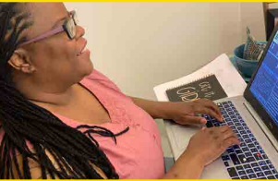
Technology
I am concerned that visual information about the COVID-19 pandemic is being shown on the television and that this information is not accessible to me.
Average: 3.51
Notes:
A total of 1,692 participants selected their level of agreement for the statement, “I am concerned that visual information about the COVID-19 pandemic is being shown on the television and that this information is not accessible to me.” The mean (M) on this item was 3.51 and the standard deviation (SD) on this item was 1.23. These values indicate that the average response was close to a neutral sentiment.
A total of 1,542 participants selected their level of agreement for the statement, "As a result of the COVID-19 pandemic, I have increased my use of apps designed to connect people with visual impairments with sighted assistance (e.g., Aira, Be My Eyes)." The mean (M) was 2.77 and the standard deviation (SD) was 1.20. These values indicate that most participants did not have an increase in use of apps designed to connect people with visual impairments with sighted assistance.
At least one technology tool was selected by 1,879 participants.
Of these participants, almost all (99%) reported using a smartphone.
Four out of 5 (83%) use an iPhone and 287 (15%) use an Android phone.

Slide 5

Technology
Technology has played a huge part; instead of face to face learning, I’m doing it online which cuts out my need to commute on the city bus to school and back.
I use my technology more to access information or services that I either used less or didn’t use at all before the COVID-19 crisis.
We need accessible healthcare mobile apps and websites.

Slide 6
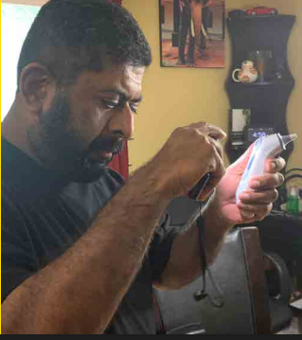
Healthcare Challenges
Not being allowed to have an additional person present for appointments and procedures
Inaccessible telehealth
“Drive thru” testing and vaccine sites

Slide 7
Healthcare
I am concerned about the prevalent policy decisions made thus far regarding using "drive thru" testing sites and various other curbside or drive thru service delivery systems. I doubt I could get anyone willing to drive me or ask them to take on that responsibility if I were that ill. Leaves one feeling “left out” and “forgotten.”

Slide 8
Healthcare
I was told that no one was allowed in with me, and I needed the support for communication and so on. I was left with not fully understanding where to go or what was being said. I have no idea what took place fully and I am angry about it.

Slide 9

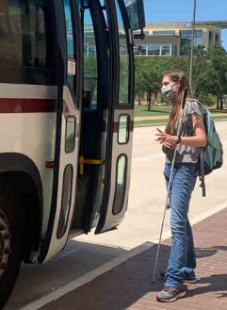
Transportation
I am concerned that because I do not drive, I will not be able to get myself or a family member to a hospital or healthcare facility if they have severe COVID-19 symptoms.
4.18

Slide 10
Transportation
Not driving is the reason we had to relocate during this pandemic. We don’t trust the bus and having to touch everything on it and its limited services. Uber has been more costly. Access-A-Ride extremely limited their services. …We talk every day about how disadvantaged we are for not being able to drive.

Slide 11
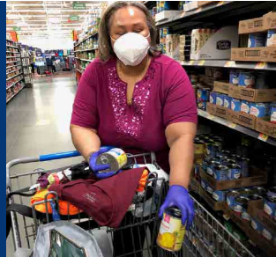
Access to Food, Meals, and Supplies
Did you experience any challenges with having food, groceries, or supplies delivered during the pandemic?
65% answered yes!
Notes:
336 answers in Journey Forward
118 or 35% answered no
218 or 65% answered yes

Slide 12
Access to Food, Meals, and Supplies
There are a number of food delivery services in my area. For several weeks I have been trying to get an available delivery slot, but to no avail.
Some delivery services are accessible, but not nearly enough and almost none of them accept SNAP.

Slide 13

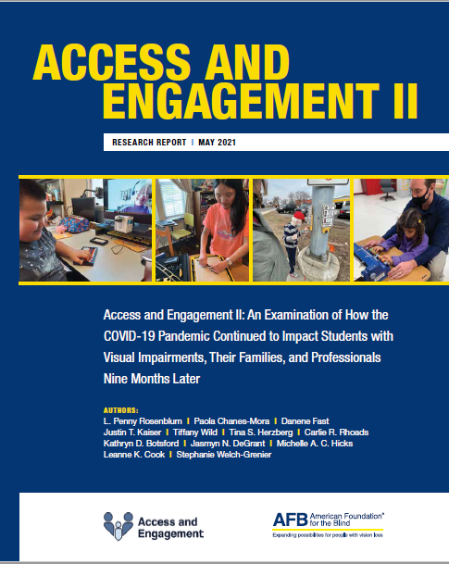
How has the COVID-19 pandemic impacted the education of students with visual impairments, their families, TVIs, and O&M specialists in the United States and Canada?
Access and Engagement III:
In progress
https://www.afb.org/AccessEngagement

Slide 14
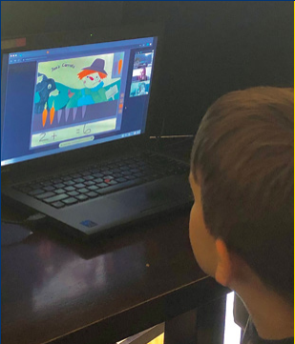
Access to Online Learning
Families lacked resources in the home (e.g., electricity, internet)
Inadequate hardware (e.g., older laptops, not enough devices for each child in the home)

Slide 15
Access to Online Learning
Learning platforms or tools not fully accessible
  Colleagues worked out supplemental solutions
  Created partnership with district level instructional materials warehouse
Varying comfort levels and skills of professionals using technology
  Ongoing training for TVIs and O&M specialists

Slide 16
Challenges of Online Education
For students with very complex needs, the virtual classroom is not beneficial to them. We have provided materials for home use, but it certainly does not replicate what they would have access to in the special education classroom at school. This is particularly true for our [multiply sensory disabled] high school students who would have work placements and community activities in a typical school year.
White female TVI
16

Slide 17
Pandemic Hills and Valleys: Challenges
Young learners had difficulty focusing on instruction for time equivalent to a full school day
Students with vision and multiple impairments had a range of experiences dependent on familial resources, need for hands on learning and ability to attend to screen based learning
Students in multi-children families or homes with parents who work or struggled to help support the e-learning model did not see the same level of success as those with different home resources
Learning platforms selected by Districts at various levels not fully accessible to all learners
Varying comfort levels for teachers with new technology requirements, additional trainings
Inadequacies of technology (laptops that couldn't run Zoom plus other programs, not enough to go around at first)
Braille delivery

Slide 18
Growing Technology Awareness and Skills
Professionals
Stepped up to the challenge
Sought out resources
Came to recognize ways they can use technology in their lessons, data collection, and organization
Empowered families to understand the value of technology for their child
Advocate with administrators to meet student technology needs
Students
Rose to the challenge of using tech at younger ages
Learned to use more tools and products
Learned to solve their own problems
Built their advocacy skills with classroom teachers
Gained skills that will allow them to succeed in post-secondary education and employment

Slide 19
It’s So True!
Everybody has had to adapt to crazy things that are not very normal. People are getting tired of this [COVID-19] stuff but we have to move forward with the education of our young people with all the organizations and programs and services offered.
Family member of a child with low vision 2.5 to 3 years old, and a preschool child who is blind with additional disabilities
3

Slide 20
Meeting the Needs of Students with Additional Disabilities
More difficult for students to maintain focus during online instruction.
Many students required a family member to provide support during online instruction.
Professionals were able to provide instruction in ECC skills when students were in their homes.
During in-person instruction, maintaining COVID-19 safety protocols was difficult when students did not understand protocols and/or required hands-on instruction.

Slide 21
A&E II Participants: Educating Students with Additional Disabilities
Vision professionals recognized that families had competing demands.
Online education enabled some family members to better understand how to support their child’s learning.
Many students were not able to “engage” with a screen, limiting their participation in their education.
In-person instruction required careful planning to maintain safety yet provide individualized hands-on instruction.
Notes:
I think prior to the pandemic, we as professionals often forgot our students didn’t live in a bubble. But we got a much closer view as to all the demands families have going on. We got a better perspective, but families were better able to learn ways to support their child in the home. The need for face to face interaction is really required to have engaged students.

Slide 22
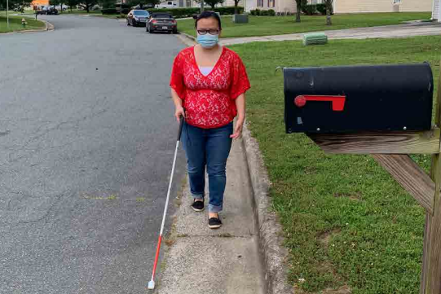
Recommendations

Slide 23
Recommendations from Access & Engagement
The importance of teamwork
Full access to digital learning
Providing students access to the curriculum
Meeting the needs of students with additional disabilities
Provision of orientation and mobility instruction
Continuing to build on successes that have resulted from the COVID-19 pandemic
Supporting the mental health and safety of students, families, and professionals

Slide 24
The Importance of Teamwork
Communication between students, family members, vision professionals, other educators, and administrators must be ongoing, clear, and individualized to the needs of the student and family members.
Provide interpreters for non-English speakers.
Ensure funding and resources are available to allow all children to receive services.
Ensure assessments continue to occur for children.
Help connect families to resources to obtain reduced/free meals and/or childcare.

Slide 25
Full Access to Digital Learning
Mechanisms are needed to provide students, family members, and vision professionals instruction and ongoing support with technology including replacing and/or repairing technology in a timely manner.
Over the 9 months of the pandemic, both vision professionals and students gained skills in using digital learning tools and video conferencing platforms.
Students need the same AT when online as they have in school.
One size does not fit all!

Slide 26
Advocating for Students’ Technology Needs
All students in the school district that I work in were given Chromebooks as their point of school access this year. The battle is to convince and prove to the district [administration] that this is not the appropriate option for JAWS [users]. Braille Notetakers, really any accessible technology...has been very tough [to acquire for students].
White female TVI

Slide 27
A&E II Participants: Digital Learning Tools
Attend online classes with the student to ensure access.
Work with administration to get needed equipment (e.g., an external monitor to pair with a Chromebook).
Technology selection committees need to become well educated about the accessibility of education technology and the legalities of purchasing inaccessible tools in advance of making procurement decisions.
Notify companies with specific information about accessibility and usability issues with their product.
Notes:
I know I found it very helpful when I could be added to the virtual classroom even just to go an observe to judge how my student was able to participate. We made sure to spend time learning what worked. Liked external moitors and keyboards. Also, giving specific ideas that are causing problems for our students. One of mine, his mom actually tweeted about a learning platform and the company reached out and asked could they get information and they were able to make the platform more accessible .

Slide 28
Supporting the Mental Health and Safety of Students, Families, and Professionals
Students who are restricted to their home environment need outlets to share their feelings.
Encourage physical activity for the student and family members, which can be beneficial to all.
Vision professionals have to meet families where they are at and acknowledge that when a family is experiencing food, housing, and/or employment insecurity, education may not be a priority.

Slide 29
Continuing to Build on Successes
Vision professionals have built communities of practice and online support networks (e.g., TSBVI Coffee Hour).
Vision professionals and students have had to learn new technology skills that will benefit them in the future.
Many family members and vision professionals have been able to work more closely together when education is delivered online.
Some administrators have increased their understanding of the specific needs of our students.

Slide 30
The Importance of Access & Engagement II
I am the parent of a blind child and certified as a TVI, but working as a Superintendent at a school for the blind. I feel like this has been a very difficult time for our students and that remote learning is inaccessible to many without 100% parental/family support. [Remote learning] is specifically challenging for young students and those with multiple disabilities. I think data like this survey is critical because gaps identified during the pandemic will be relevant in years to come. With an ever-increasing digital component to employment, the pandemic very much models many job opportunities for our students.
White female family member of a child who is blind with additional disabilities, 13-15 years old

Slide 31
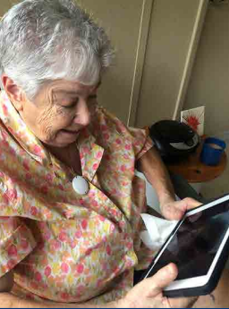
Flatten Inaccessibility and Journey Forward: Recommendations
Technology:
  Accessibility, accessibility, accessibility
  Visual interpreting services, such as Aira and Be My Eyes, need to be easily available for everyone who could benefit from them

Slide 32
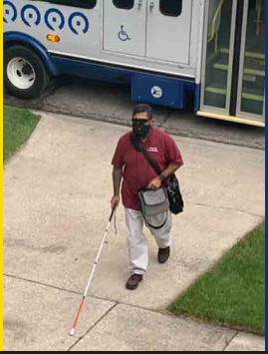
Flatten Inaccessibility and Journey Forward: Recommendations
Transportation:
  Inclusive planning
  Transportation in underserved areas
  Must go beyond minimum requirements
  Need alternatives for “drive thru” only options

Slide 33
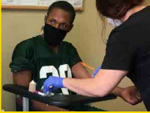
Flatten Inaccessibility and Journey Forward: Recommendations
Healthcare
  Websites, apps, and information need to be accessible
  Policies must be modified to include appropriate accommodations such as allowing someone to accompany a person with visual impairment to an appointment

Slide 34
Flatten Inaccessibility and Journey Forward: Recommendations
Access to Food, Meals, and Supplies
  Websites and apps must be accessible
  Underserved areas need access to these services
  Online purchasing with SNAP benefits should be extended to every U.S. state and territory, and eligible retailers should be expanded.
  Delivery service personnel must notify customers when they have arrived and are making a delivery.

Slide 35
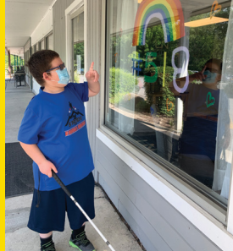
Final Thoughts
Include individuals with disabilities in the conversations from the very beginning
Do not wait for a disaster to occur – inclusion from the start!
Timely and appropriate accommodations
Resources for underserved areas
Accessibility is key!

Slide 36
Journey Forward
Data is currently still being analyzed
Website and information:
  https://www.afb.org/research-and-initiatives/flatten-inaccessibility-survey/journey-forward

Slide 37
Flatten Inaccessibility
The report is available at:
  https://www.afb.org/research-and-initiatives/flatten-inaccessibility-survey

Slide 38
Access & Engagement II
The report is available at
  https://www.afb.org/ae2/
Blog post
  It Takes a Village: Join the Access and Engagement Village and Advocate for the Education of Students with Visual Impairments
Access & Engagement III is currently being analyzed
Share your ideas with us
  access_report@afb.org

Slide 39
We So Agree with This Participant!
We keep thinking we can outwit [the Pandemic], and that things will ‘go back to normal.’ Let's overwrite ‘normal’ and use this opportunity to make it BETTER for us. Lemons to lemonade.

Slide 40
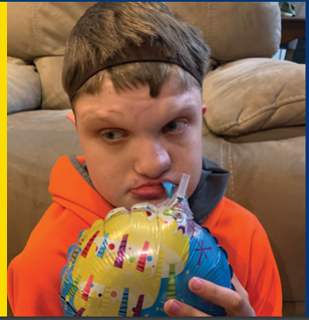
Thank You and Questions

