Slide 1
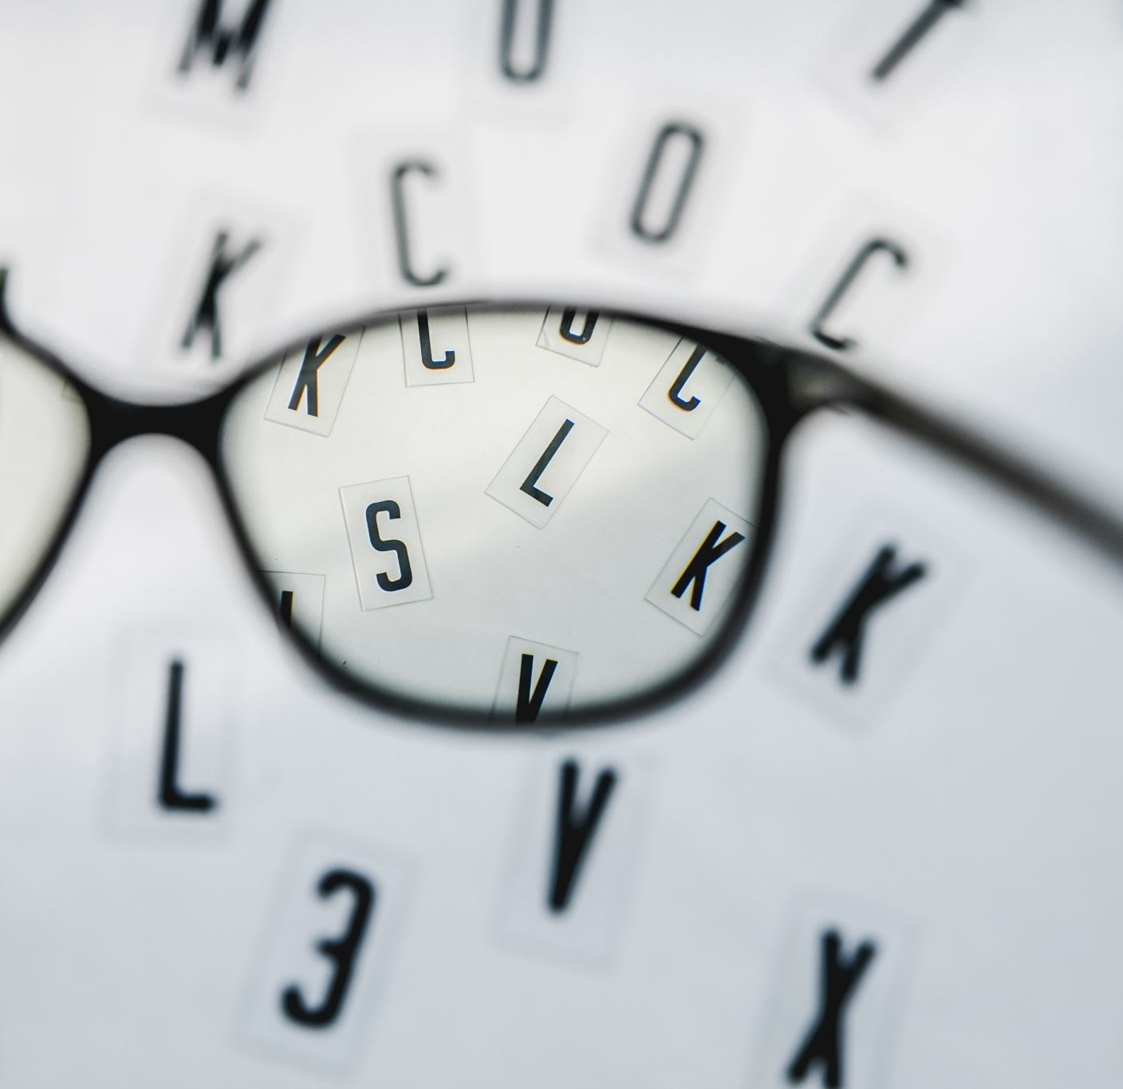
Optometric Low Vision
Simple to Complex Solutions to help your clients
Cindy Roles O.D.
Dakota Eye Institute
Bismarck, ND

Slide 2
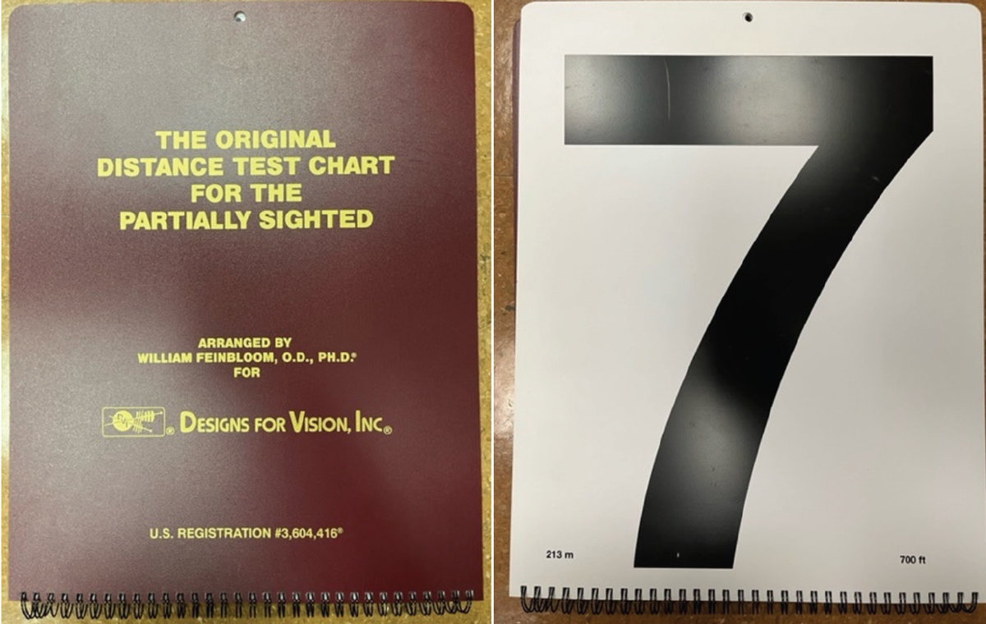
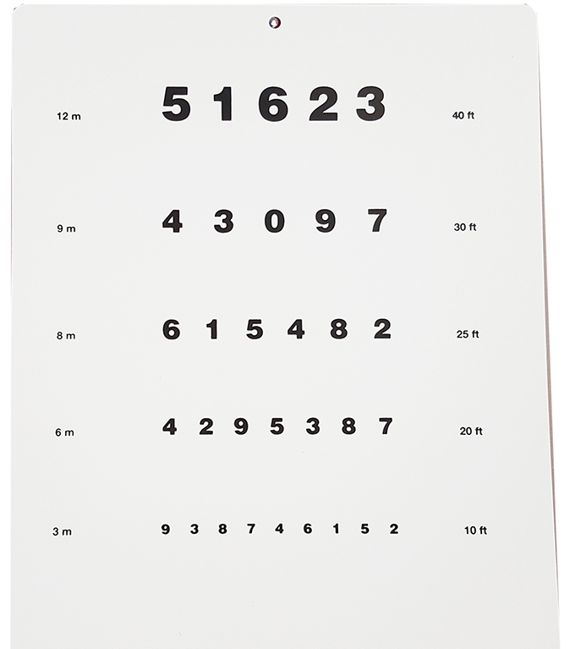
Home Vision Assessment Low Vision Distance Acuity
Feinbloom Chart
Held at 10’ or closer
Record test distance/letter size
Example
If the 3rd row is read at 5 feet
Acuity is 5/25 or 20/100
Conversion to 20 feet
5
×
4
=
20
25
4
100

Slide 3
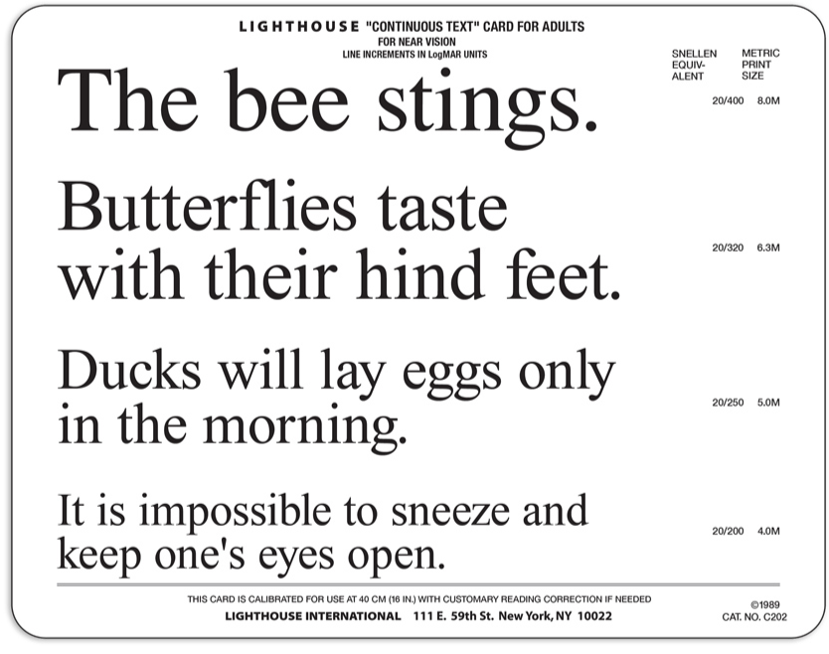
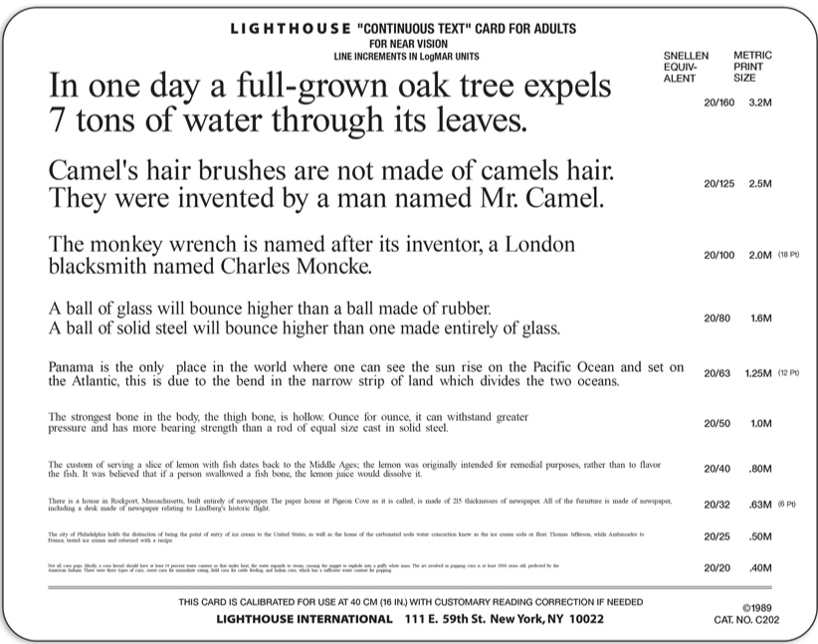
Home Vision Assessment Near Acuity
Test each eye if you think one eye may be interfering with the other
Helps determine if LV aid should be a monocular or binocular device

Slide 4
Home Vision Assessment How Does Reading Work?
We think text looks like this:
What our brain actually sees is this:
leader
Try this Exercise:
Keep your fixation on the 7 in the middle of these numbers and see how well you can read the numbers to either side
Notice how hard it is to keep your attention from jumping to the other numbers
This is why eccentric fixation is easier said than done
4569 7 2837
Notes:
It doesn’t seem that way, because as soon as we switch our fixation and attention to the next section, our brain creates an integrated composite image that is full of detail

Slide 5
Home Vision Assessment Scotoma and Reading
Scotoma to right of fixation is significant for reading fluency
Ring Scotoma – may need less magnification
From Patient’s Point of View
Something is blocking their view
Letters or words are disappearing and reappearing

Slide 6
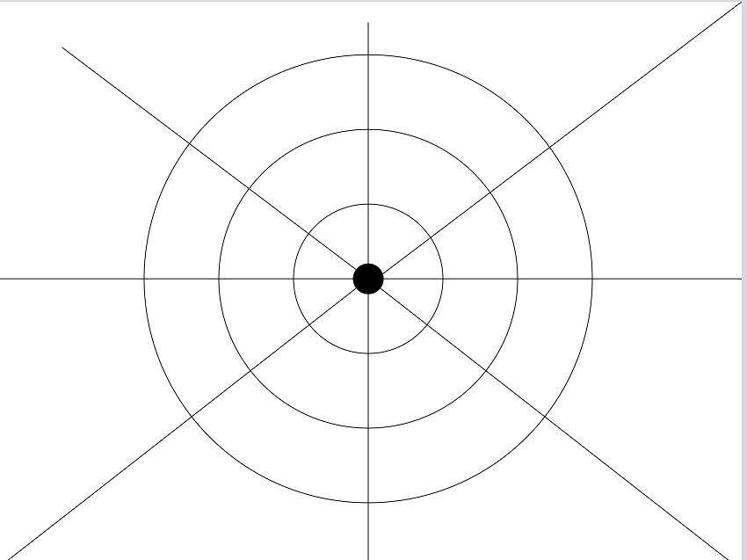
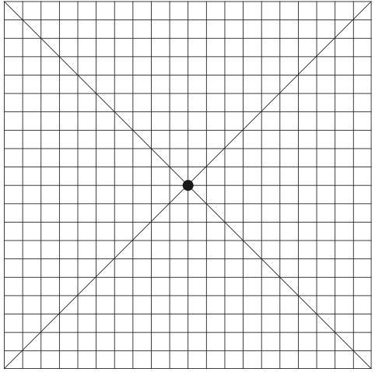
Home Vision Assessment Finding Reading Scotomas
California Central Field Test
Central 15 degrees
Sheet at 57 cm (about 2 feet)
Use laser pointer on the target
Amsler Grid
www.macularsociety.org

Slide 7
Home Vision Assessment Eccentric Fixation Training Tips
Use pictures - move eye slowly in direction of PRL and pay attention to missing details appearing
Watching the News – finding faces on the TV, picking out features of news readers
Practice with a clock at home
Practice with food on plate
Reading
Build up from single words to well-spaced words to normal text
Teach line changing techniques
Read to end of one line, trace back to beginning of that line, move straight down to the next line
Use line guides and reading boards

Slide 8
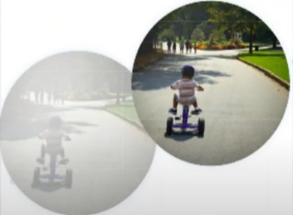
Home Vision Assessment Contrast Sensitivity
Two patients with these views may test equally on visual acuity chart but function very differently.
Degree to which one can separate an object from its background
Think about normal vision on a foggy day
Symptoms of poor contrast sensitivity
Difficulty identifying faces or features in a face
Trouble reading newsprint
Difficulty seeing food on a plate (potatoes on white plate)
Trouble with steps, stairs and curbs
History of trips and falls
Vision described as foggy, cloudy & hazy
Normal Contrast
Decreased Contrast

Slide 9
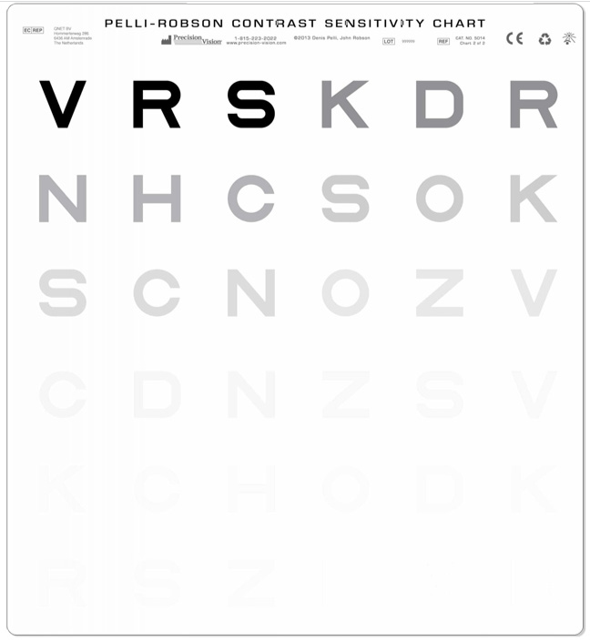
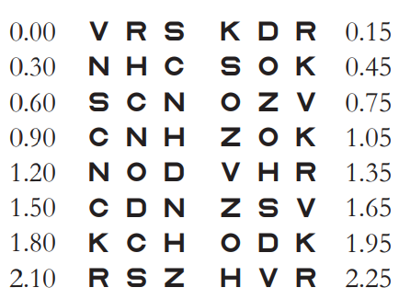
Home Vision Assessment Contrast Sensitivity
Normal Contrast Sensitivity is 2 log units
Moderate impairment is less than 1.5 log units
Severe vision impairment is less than 1 log unit
Pelli-Robson Contrast Sensitivity Chart

Slide 10
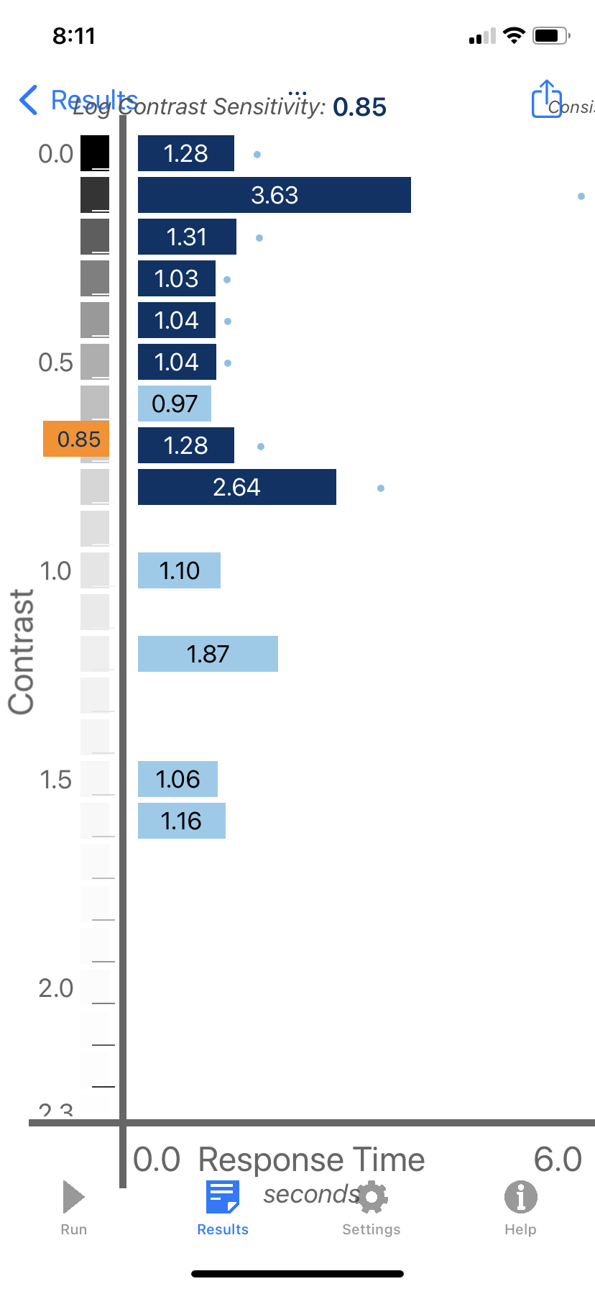
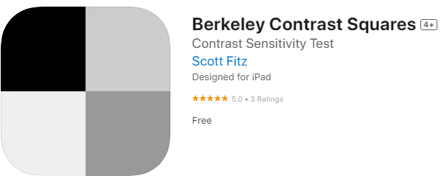
Home Vision Assessment Contrast Sensitivity
Normal Contrast Sensitivity is 2 log units
Moderate impairment is less than 1.5 log units
Severe vision impairment is less than 1 log unit
Berkley Contrast Squares App

Slide 11
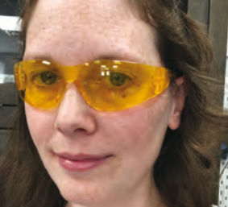
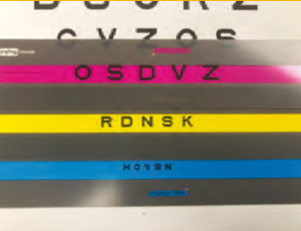
Glare
Defined as: Sensitivity to Light
Not just reflective glare that you see bouncing off a surface
Discomfort glare - Causes pain or discomfort
Disabling Glare
Impairs function
Can see a reduction in visual acuity
Blinding Glare
Impairs function
Can cause loss of vision for short to extended periods of time
Strategies
Use filters
Change or reduce lighting
Multiple strategies for areas in the home
Outdoor strategies will be different

Slide 12
Home Vision Assessment Absorptive Filters – Tint
The sicker the optic nerve,
the yellower the lens
Glaucoma
Optic neuritis
Optic neuropathy
Optic atrophy
Optic nerve hypoplasia
Psuedotumor
Retinal pathology
Orange, amber, yellow
AMD
Diabetic retinopathy
Achromatopsia
Retinitis pigmentosa
Concussion, brain injury, migraine
FL-41
Dark plum

Slide 13
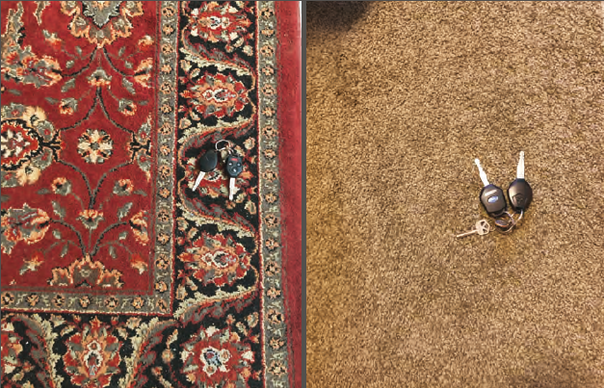
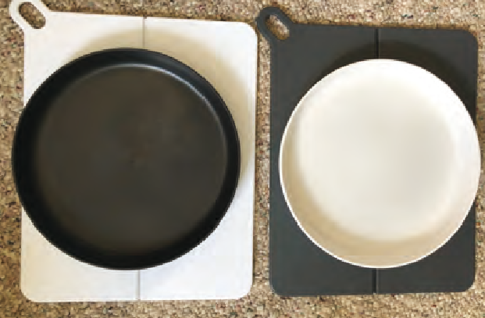
Enhance Contrast
Increase Light but limit glare
Modify figure-ground relationship
Move light source
Adjust intensity
Reduce background reflectivity
Use appropriately tinted lenses
Medicine over a black mat
Use a white plate with dark food

Slide 14
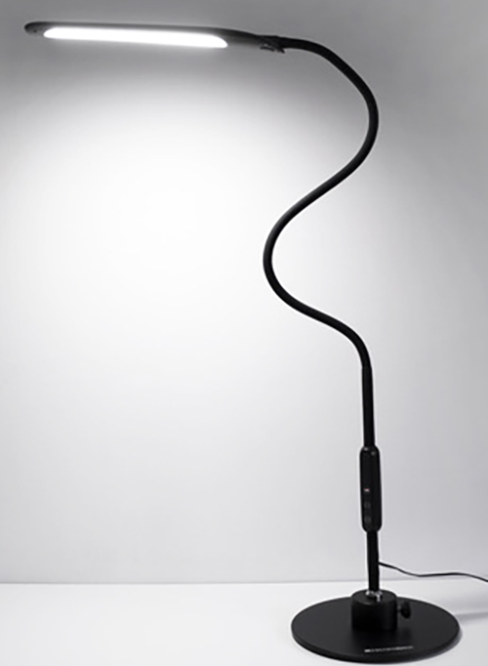
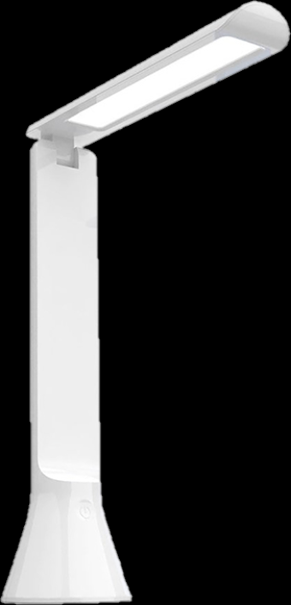
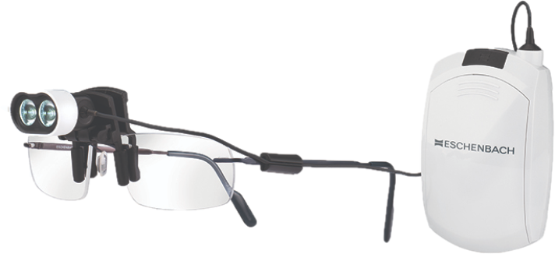
Task Lighting Training
Reduces the required magnification
Light should be at or below eye level
If set above eye level, should be rotated away from eyes
Light should be set off to side so light reflecting off the object doesn’t bounce into user’s eyes
Adjustable Brightness
Inverse Square Rule
2x as close = 4x as bright
Color Temperature – more for comfort
Demonstrate different color options to patient
Gooseneck Arm - bend at many angles (to reduce glare)

Slide 15
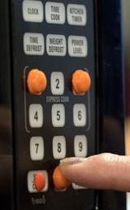
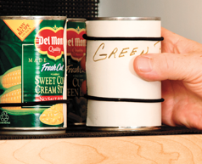
Low Tech
Things you can feel
Bump Dots
Rubber Bands
Safety Pins
Puffy Paint
Velcro
Twist Ties
Sock Locks

Slide 16
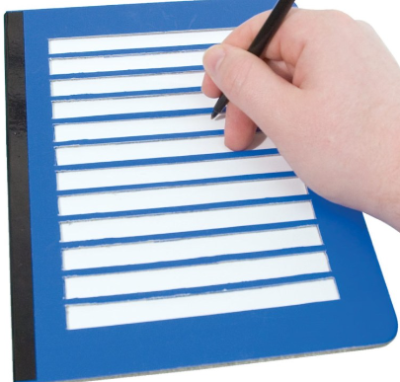
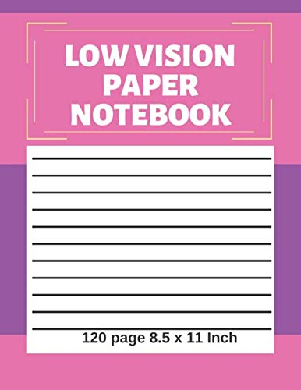
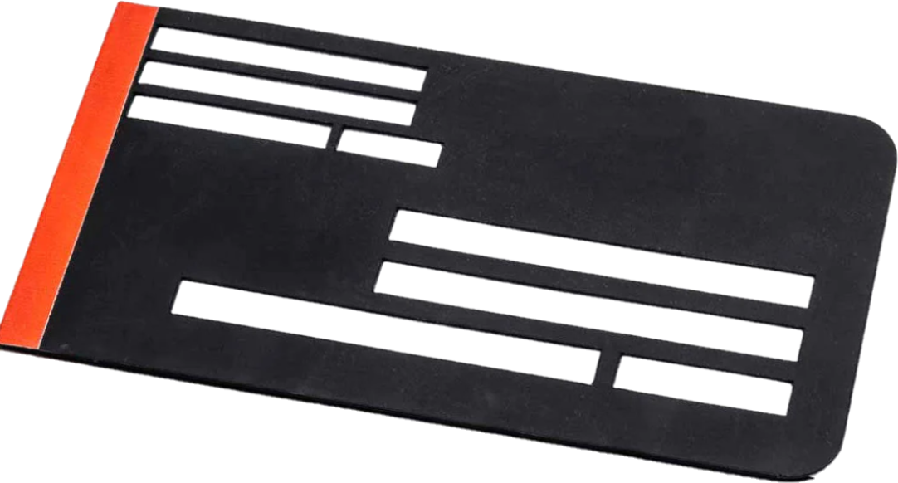
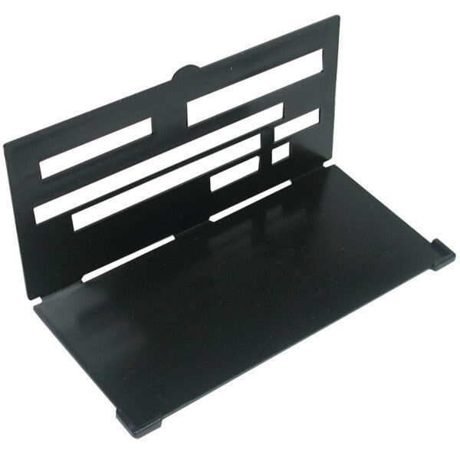
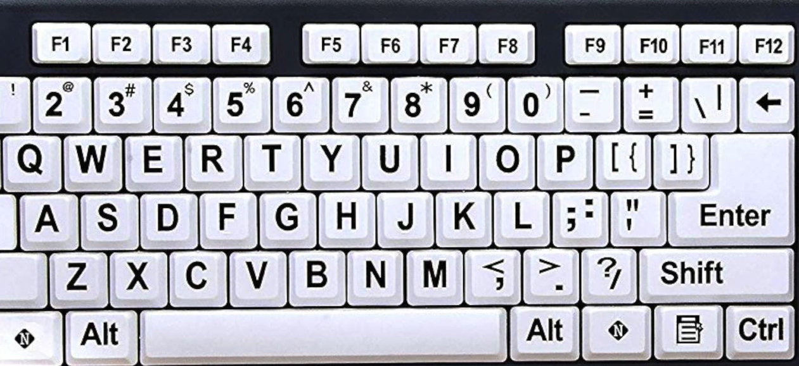
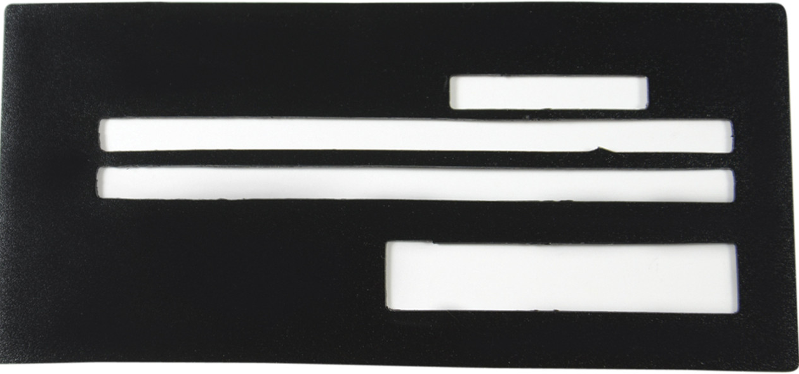
Writing and Typing
Bold Pens & Paper
Paper Guides
Check Guides
Envelope Guides
Signature Guides
Large Print Checks with tactile lines
Large Print keyboard stickers
High contrast keyboard stickers
Not always aligned
Reusable
Cost Effective

Slide 17
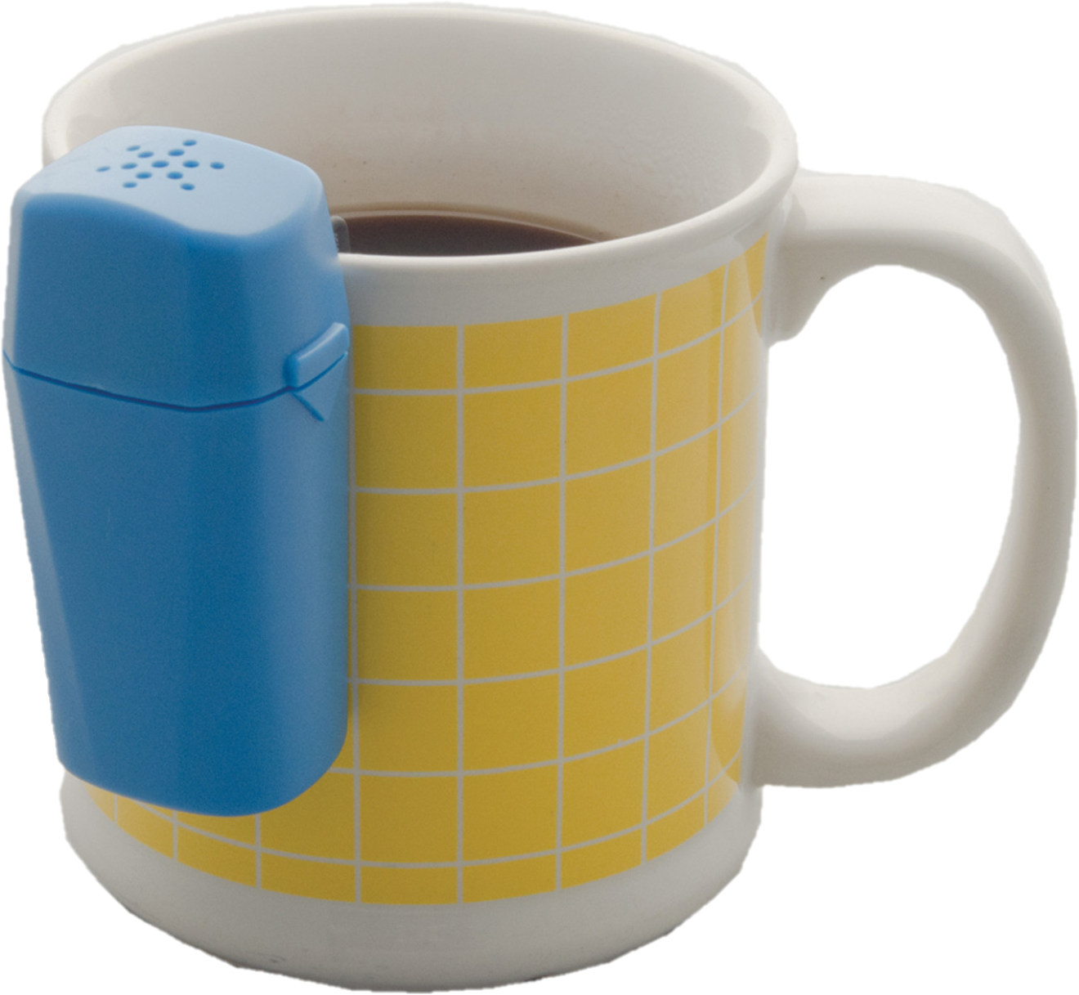
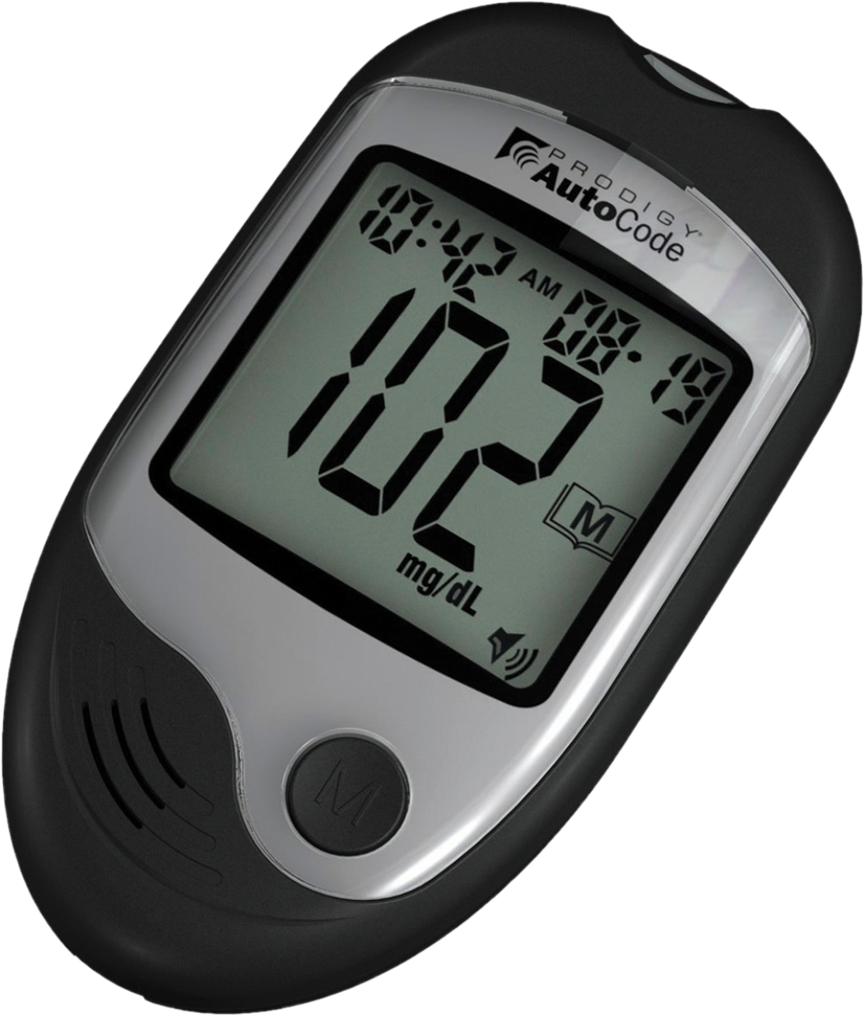
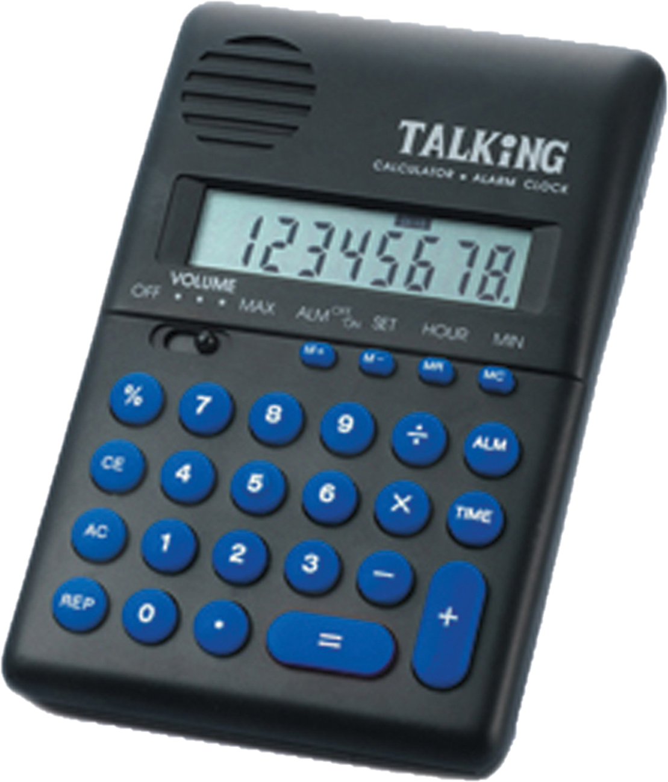
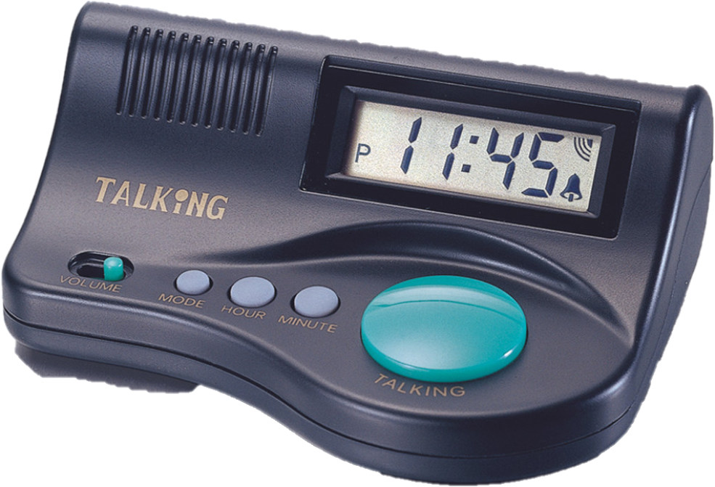
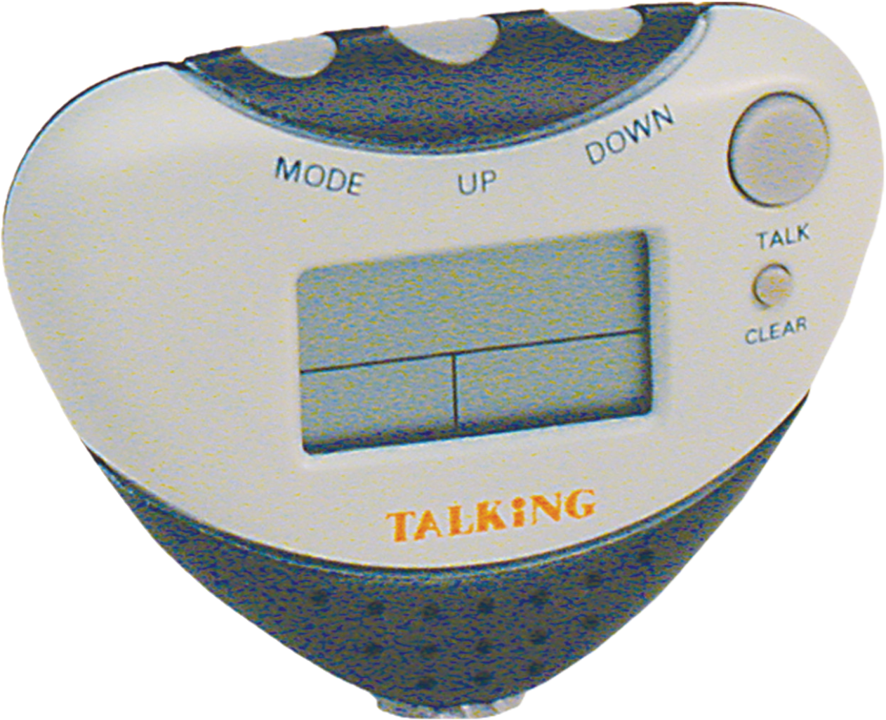
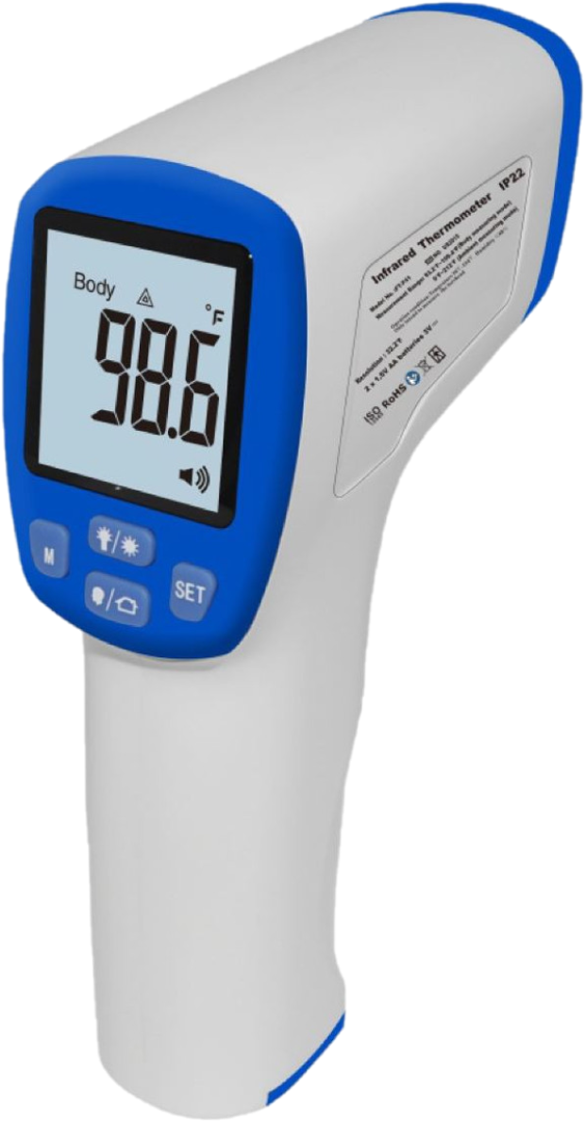
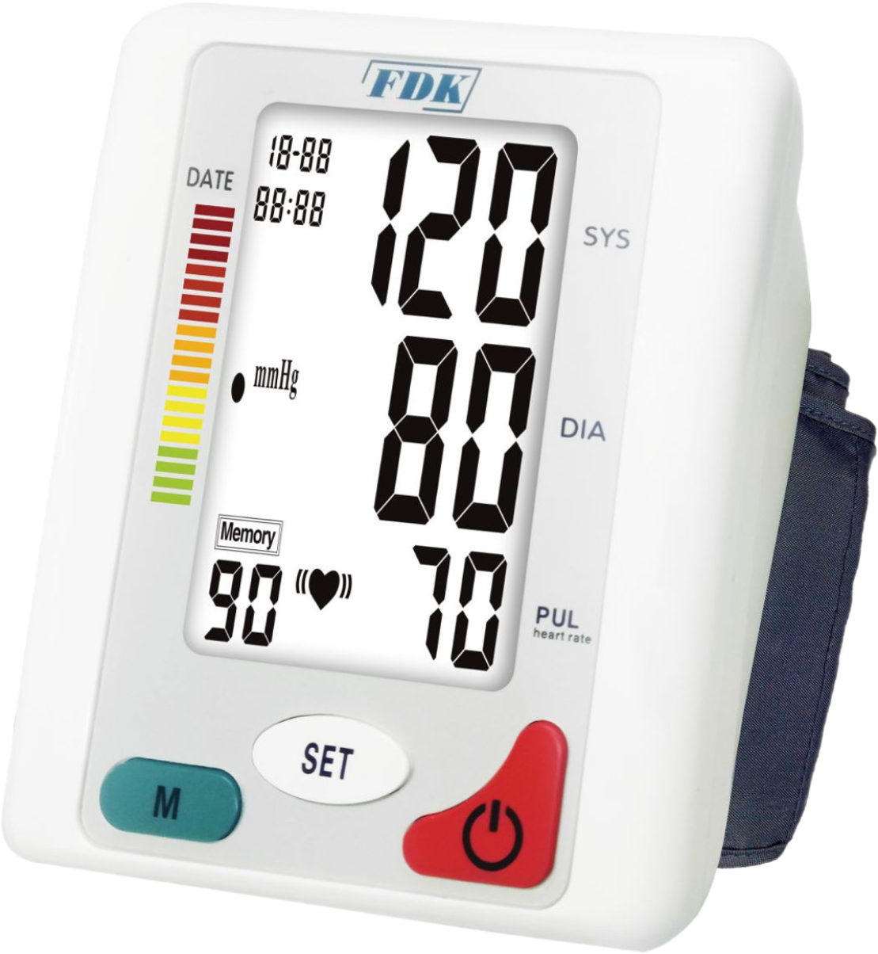
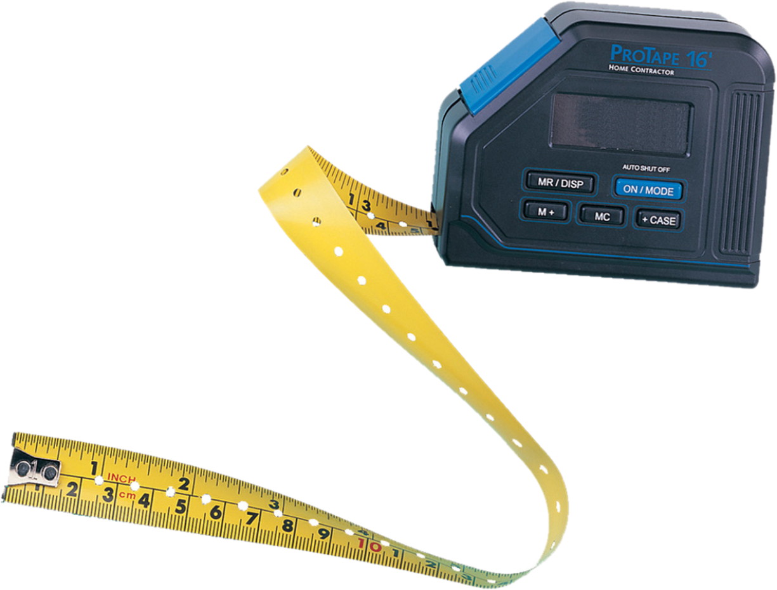
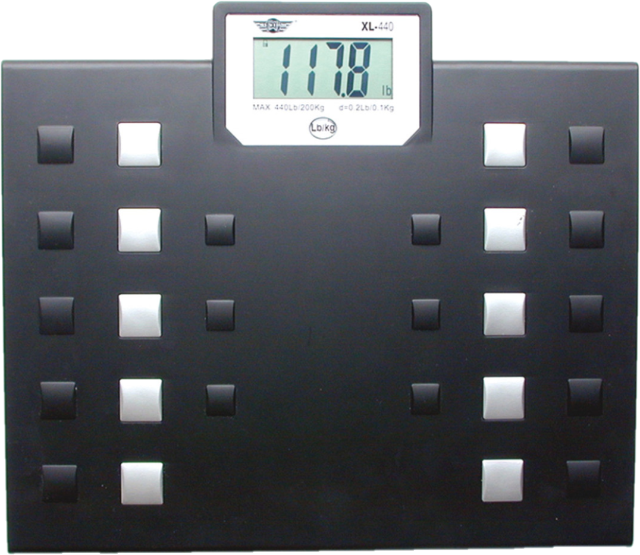
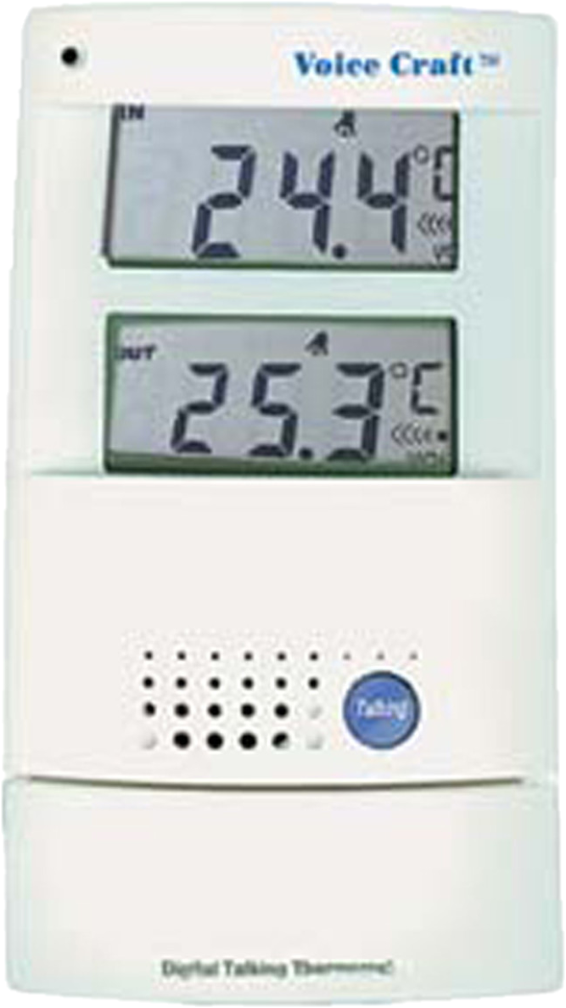
Talking Devices

Slide 18
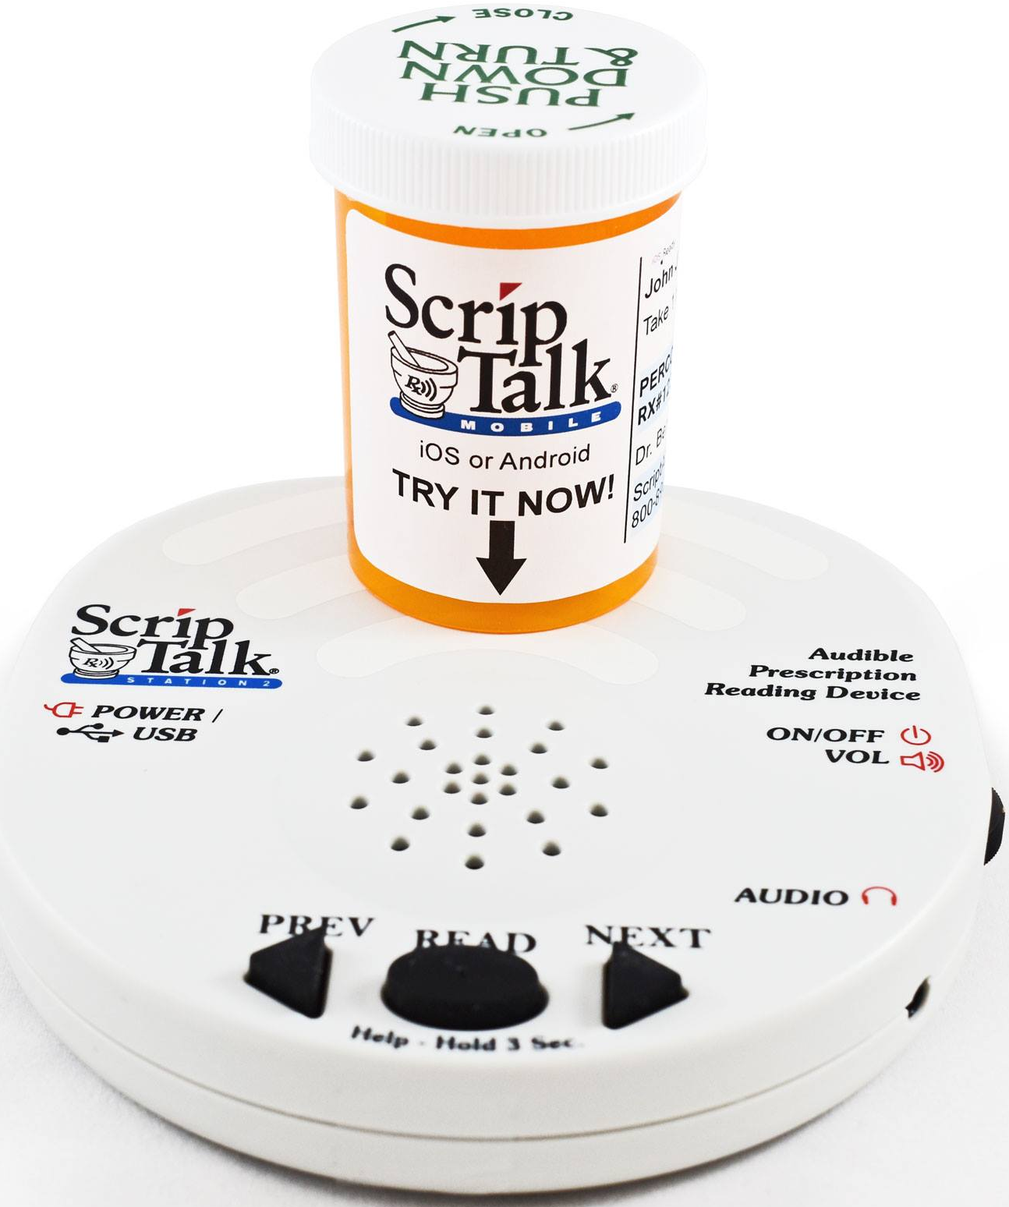
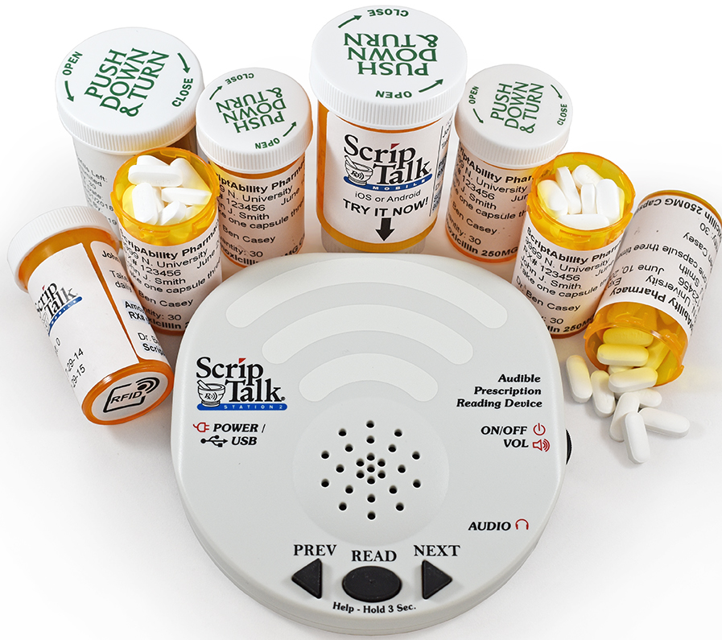
ScripTalk
Pharmacy adds a small electronic tag to prescription bottles
Patient places bottle on a little listening station at home
Listening station reads all the information out loud
Drug Name, dosage, instructions, warnings
Pharmacy info, Doctor’s name, prescription number
Can jump forward/back through all the information
ScripTalk Station is provided on loan at no charge by En-Vision America
Option to download a FREE ScripTalk Mobile App from Google Play or the Apple App Store to access their prescription info
www.envisionamerica.com

Slide 19
Magnifying Devices
Relative Distance Magnification
Spectacles
Relative Size Magnification
Binocular Correction
Progressives
Bifocals
Reading Glasses
Prism Eyewear
Monocular Correction
Microscopic Spectacles
Optical Magnifiers
Hand-held magnifiers
Stand magnifiers
Video Magnifiers
Telescopes

Slide 20
Magnification
How Much Magnification Does My Patient Need?
Magnification required = Vision achieved
Vision required
Example from Feinbloom Chart
If the patient read the 3rd row on the chart from 5’ away
Visual Acuity is 5/25 or 20/100
If the goal acuity is 20/40
100 ÷ 40 = 2.5 x magnification needed

Slide 21
Relative Distance Magnification Reading Glasses
Add Power | Working Distance (inches) | Relative Distance Magnif.
+1.00 | 40 | 0.4x
+1.50 | 26 | 0.6x
+2.00 | 20 | 0.8x
+2.50 | 16 | 0
+3.00 | 13 | 1.25x
+3.50 | 11 | 1.45x
+4.00 | 10 | 1.6x
+5.00 | 8 | 2x
+6.00 | 7 | 2.3x
+7.00 | 6 | 2.7x
+10.00 | 4 | 4x
+12.50 | 3 | 5x
Bringing and object 3x closer makes it 3x larger
Assume normal working distance of 40 cm (about 16 inches)
If the patient can read 2.5M print at 40 cm but wants to read 1M print
The reading material must be moved 2.5x closer
Needed Working Distance
40
=
=
16 cm (about 6 inches)
2.5
Needed Reading Glasses Power
1
1
=
=
=
+6.25 diopter
Readers
Distance in meters
0.16

Slide 22
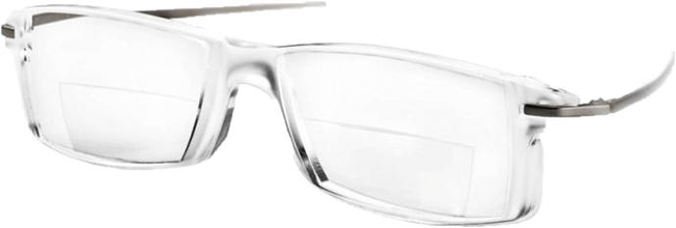
Near Magnification Dispensing Reading Glasses
Add Power | Working Distance (inches) | Relative Distance Magnif.
+1.00 | 40 | 0.4x
+1.50 | 26 | 0.6x
+2.00 | 20 | 0.8x
+2.50 | 16 | 0
+3.00 | 13 | 1.25x
+3.50 | 11 | 1.45x
+4.00 | 10 | 1.6x
+5.00 | 8 | 2x
+6.00 | 7 | 2.3x
+7.00 | 6 | 2.7x
+10.00 | 4 | 4x
+12.50 | 3 | 5x
Ensure required print size, lighting and contrast
Put the reading glasses on the patient and have them read at the required distance
Make sure they will be comfortable with that distance
Hint: Cut straw or pipe cleaner to the appropriate working distance and give it to the patient to use to keep at the needed distance
Base in Prism – will be needed in higher power reading glasses to support the high amount convergence at close distances
Usually higher than +4.00 needs BI prism

Slide 23
Spectacle Magnifiers
Binocular viewing
Prism eyewear
Diffractive eyewear
Reading glasses
Monocular Viewing
Microscopic spectacles
Diffractive microscopic spectacles
Advantages
Disadvantages
Familiar
Hands-free
Wide field of view
Inconspicuous
Short working distance
Conspicuous
Not Illuminated

Slide 24
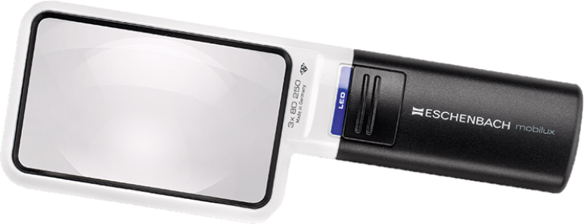
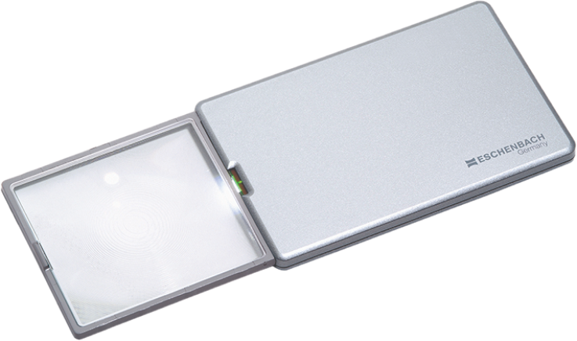
Hand-Held Magnifiers
A Strong Plus Lens and a Handle
1X Magnification = 4 Diopters
ANSI Standard
Advantages
Disadvantages
Familiar
Versatile
Economical
Portable
Not Hands-free
Fatiguing
Stronger powers – Smaller lens

Slide 25
Rules for Using Hand-Held Magnifiers
Mag | Diopters | Lens Size | Lens to object | Eye to lens
3x | 12 | 2.4" | 2" | 10"
3.5x | 10 | 2"x3" | 2" | 10"
4x | 16 | 2"x3" | 1.75" | 6"
4x | 16 | 2.4" | 1.4" | 6"
5x | 20 | 2.4" | 1.2" | 5"
6x | 24 | 2.4" | 1.2" | 4"
7x | 28 | 1.4" | 1.2" | 2"
10x | 38 | 1.4" | .8" | 2"
12.5x | 50 | 1.2" | .6" | 2"
Hold Lens Parallel to the object being viewed
Hold the lens at its focal length
Hold lens at proper eye to lens distance (as labeled on the magnifier)
Magnification
Diopters
Eye to Lens Distance
140 mm = 1.2”

Slide 26
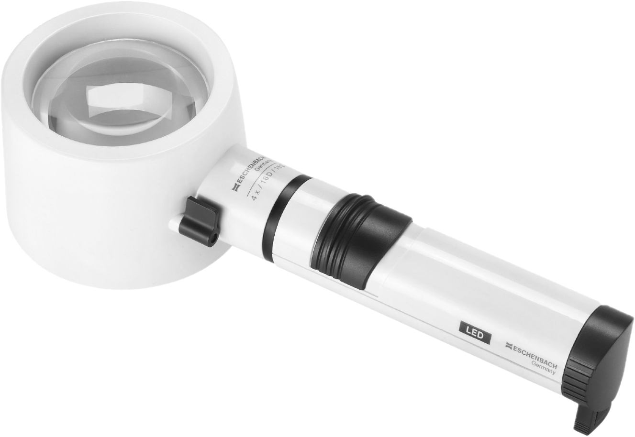
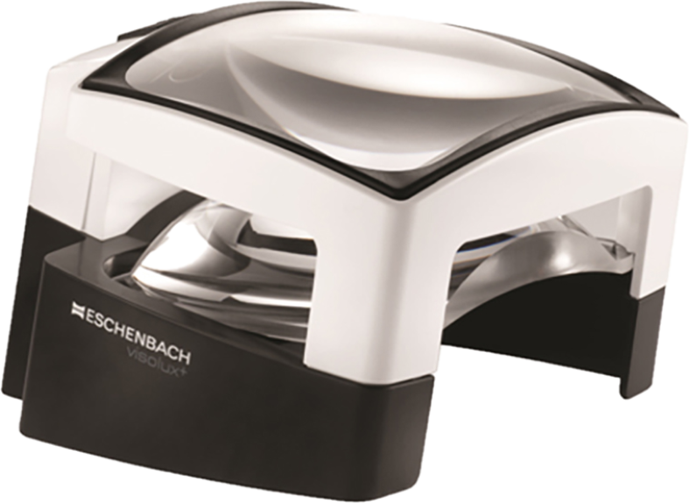
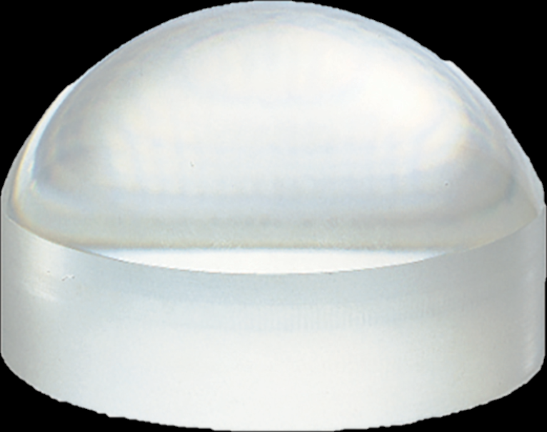
Stand Magnifiers
Plus Lens mounted on “legs” that fix the distance from lens to object
Advantages
Disadvantages
Fixed focal length
Lens mounted parallel to object
Great for reading
Less fatiguing
Not hands-free
Less portable
Limited field of view

Slide 27
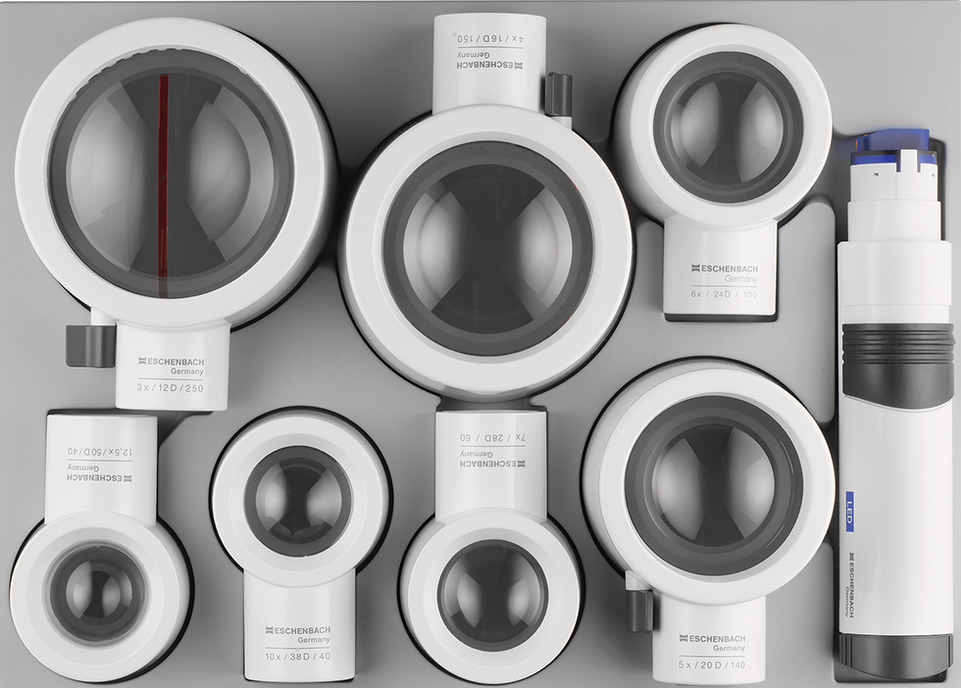
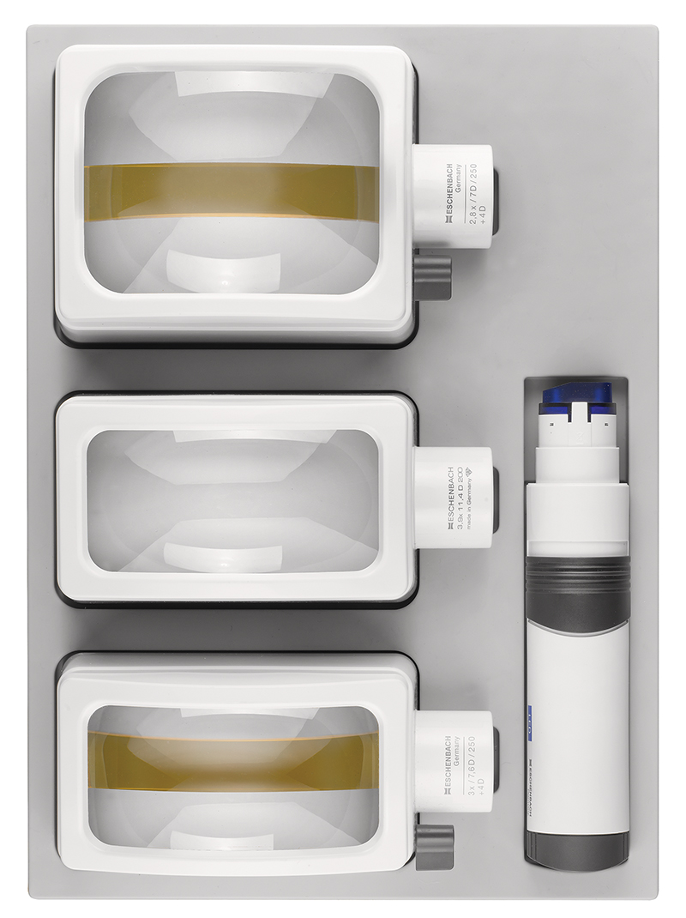
Rules for Using Stand Magnifiers
System VarioPlus
Mag | Lens Size | Eye to Lens
3x | 2" x 4" | 10"
3.9x | 2" x 4" | 8"
3x | 3.2" | 10"
4x | 2.8" | 6"
5x | 2.4" | 5"
6x | 2" | 4"
7x | 1.4" | 2"
10x | 1.4" | 2"
12.5x | 1.2" | 2"
Hold the stand magnifier firmly against the object to be viewed
Adjust eye to lens distance appropriately
Divergent light rays emerge from Stand Magnifier lenses.
Users must accommodate or wear a bifocal

Slide 28
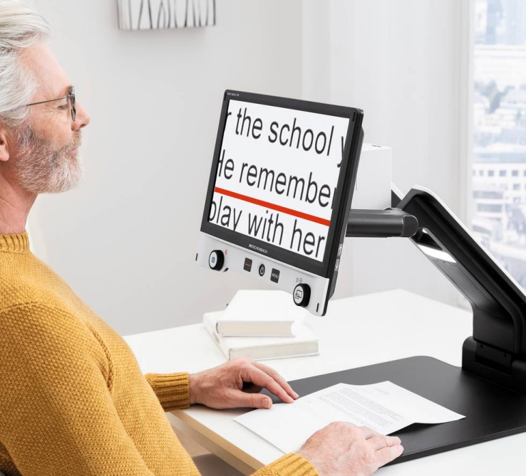
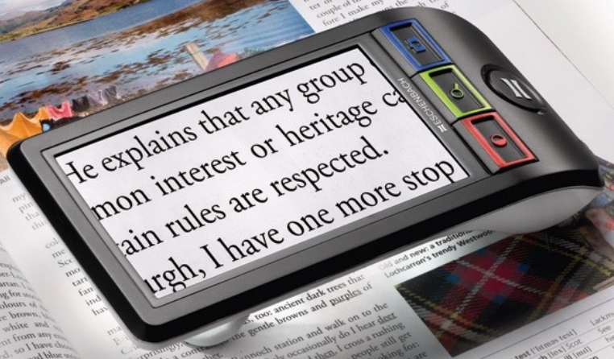
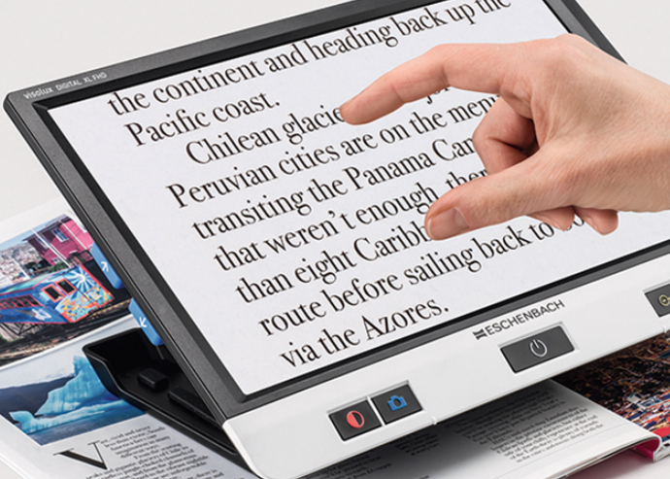
Video magnifiers
An electronic device that magnifies by using a camera that projects an enlarged image on a screen or monitor
Equivalent Power
Screen magnification x accommodation
Add power multiplies the magnification effect

Slide 29
Video Magnifier for Distance Viewing
Video Magnifier for Distance Viewing

Slide 30
Telescopes
Hand-Held
Spotting Tasks
Eyeglass Mounted
Extended Viewing (TV & Reading)
Driving
Advantages
Disadvantages
Multiple Task Solution
Long working distance at near
Hands-Free
Distance Magnification
Conspicuous
Loss of peripheral field / field of view
Heavy for longer term wear

Slide 31
Telescopes

Slide 32
Custom-Mount Telescopic Glasses
Inferior Mount for Reading
Superior Mount for Distance Spotting
Bioptics
Bioptics
Custom-Mount Telescopic Glasses
Full Field Mount for Long-term Viewing

Slide 33
Smart Phone Apps
Magnification Apps & Smartphone Adaptations
Text to Speech Apps & Voice Assistants
Visor - iOS & Android
Install magnifier on iOS or Android phone
Super Vision + -iOS & Android
Adjust Color & Brightness on iOS or Android phone
Seeing AI – iOS
Google Lookout -Android
Sullivan + -iOS & Android
Hey Google –Android
Envision AI-Android
Siri- iOS
Bixby- Android
Google Assistant -Android & iOS

Slide 34
Smart Phone Apps
Live person Assistance Apps
Money Reader Apps
Be My Eyes -iOS & Android - free
AIRA iOS & Android
costs $ but free trial
Cash Reader - iOS & Android
Seeing AI – iOS
EyeNote – iOS
Blind-Droid Wallet – Android
Darwin Wallet – Android
IDEAL Currency Identifier - Android
Object Identifier Apps
TapTapSee- iOS & Android
need to turn on voice over
WayAround- Tag & Scan- iOS
need to purchase tags

Slide 35
Windows Computer Accessibility
Set up “Ease of Access”
Ease of Access Features
In Windows XP & Windows 7
Found in the control panel
In Windows 8 and Windows 10
Found in the App section
Change the contrast of the display to 4 different high-contrast
Change the size and color of the mouse cursor.
Open a floating magnifier that enlarges part of the screen
Easily access this feature by pressing the Windows "Start" button on the keyboard and "+".
Key combination
"Crtl +" to zoom in
"Crtl -" to zoom out
Can also roll mouse wheel forward or back
Ease of Access Features
Change the default font to a clearer font such as Arial or Verdana
Change the size of the scroll bars and window borders
Change the size of the desktop icons from normal to large to extra large.

Slide 36
Windows Computer Accessibility
Change Email Settings
Internet Settings
Microsoft Outlook
Changes font, font size, and font color
Applied to all incoming and outgoing emails
Found in Options under the File dropdown menu
Always set the default font to a clear, easy to read font such as Arial or Verdana.
Web browsers (Internet Explorer, Google Chrome, Mozilla Firefox, Safari, etc.) have the option to change the default font and font size
Extensions are available from third-party companies that add special features to your web browser
Found under your web browser's Settings and they include:
Menus with easy access to most-visited websites and bookmarked pages
Changes in menu designs, colors, and fonts
Applications such as large clocks, calendars, note pads, calculators, and many more

Slide 37
Thank You

