Slide 1
Leveling the Educational Playing Field in the Dakotas
Break down barriers and ensure your students have the tools and resources they need to succeed.

Slide 2
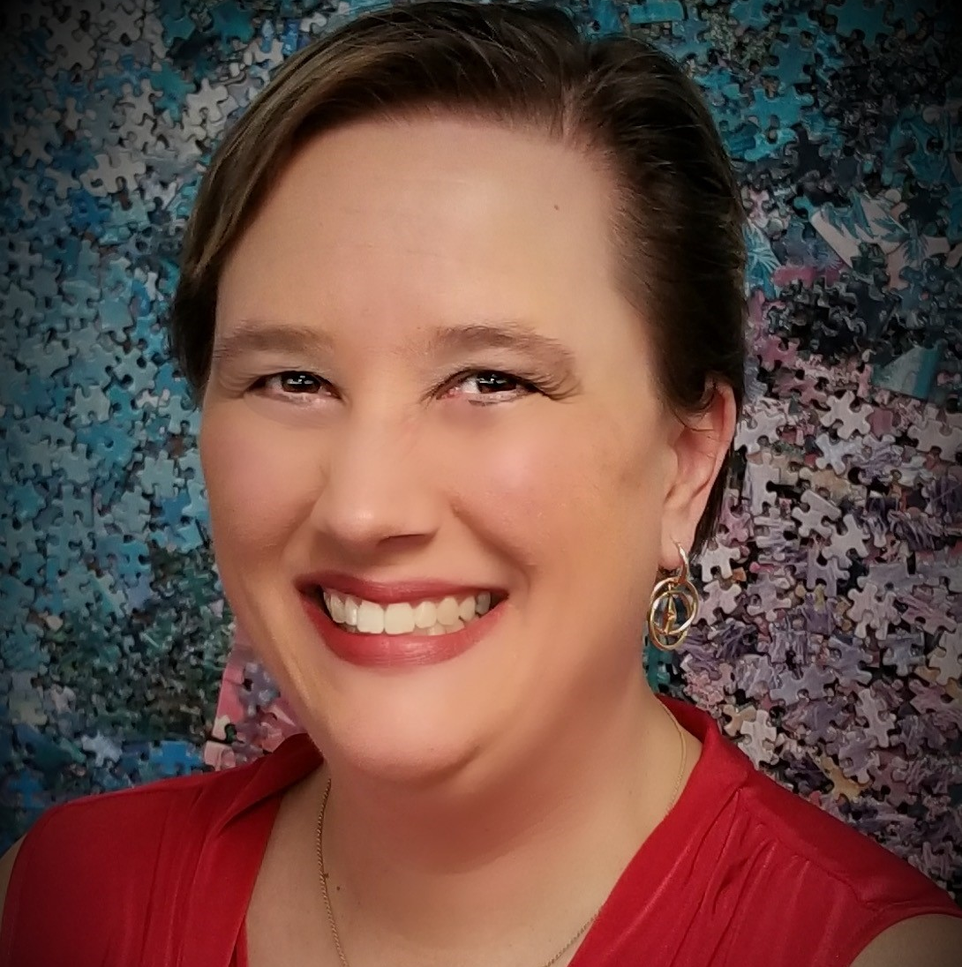
Leanne Grillot
National Director of Outreach Services

Slide 3
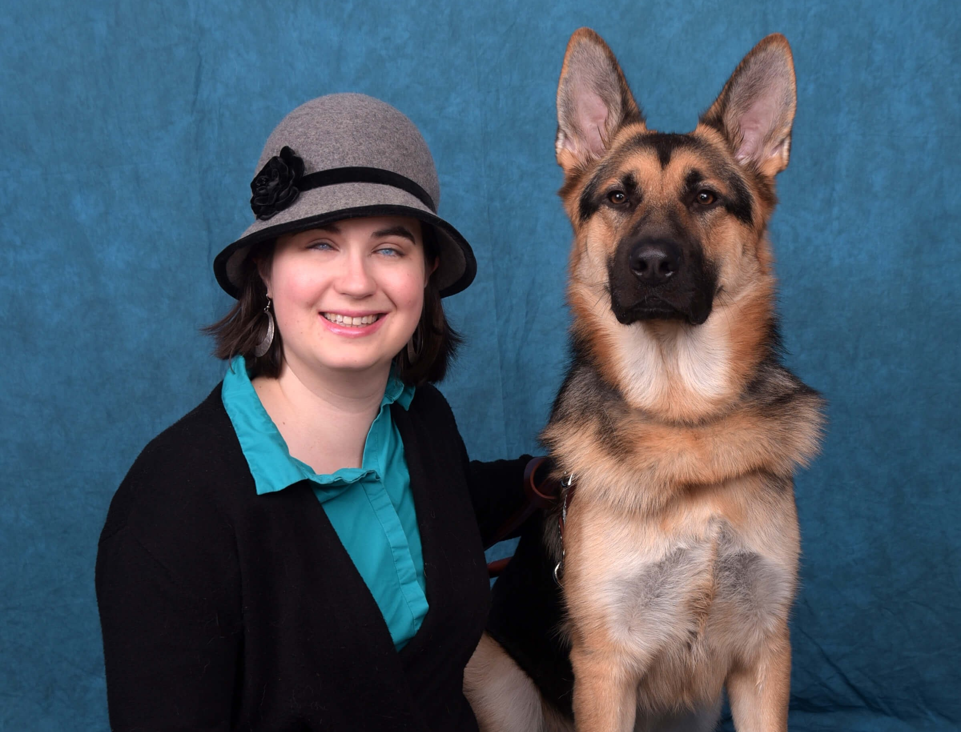
Leslie Weilbacher
Regional Specialist - Northwest

Slide 4
Learning Objectives
Analyze the Act to Promote the Education of the Blind, Ex Officio Trustees, and Federal Quota Funds and explain their importance.
Examine the history, including present day, of APH’s books and apparatus available to modify core curriculum as well as address the expanded core curriculum for the education of someone with a visual impairment.
Differentiate the audience and usability of the various training opportunities offered by APH.

Slide 5
Which state joined Kentucky to charter the American Printing House for the Blind?
A. Mississippi
B. Tennessee
C. Indiana
D. Ohio

Slide 6

All States Wanted Books
Kentucky, Mississippi and Louisiana, 1860
All 38 states joined in 1879 with The Act to Promote the Education of the Blind
Notes:
By 1878, Louisiana, Mississippi, Tennessee, Kentucky, New Jersey and Delaware had made appropriations for APH.

Slide 7
Why Louisville?
“Twenty-three out of the thirty institutions for the blind are in the South and the West. Railroad and water connections with those sections are direct and numerous, from no other point could the books and apparatus be so quickly and cheaply distributed.”
  Congressman Albert W. Willis, January 17, 1879

Slide 8
What did The Act dictate?

Slide 9
The Act of 1879
Printing books and making apparatus for general distribution with no profit made from books or tangible apparatus.
Authentication of the total number of pupils in all public institutions for the education of the blind (Census).
Ratio between pupils in each institution and total number of pupils in the nation be computed the first Monday in January of each year (quota).
Superintendents of those institutions are ex officio members of the APH board of trustees.

Slide 10
Federal Appropriation
1879, $250,00 held in trust with annual interest of $10,000 paid to APH
Approximately 2000 students almost exclusively at the 30 residential schools

Slide 11
Students and Money Added
1906, Adult rehabilitation center students ruled eligible for federal quota funds
1912, public school day programs for student eligible for federal quota funds
1919, direct $40,000 annual appropriation
1927, $65,000
1937, $115,000
1952, $250,000
1956, $400,000

Slide 12
Books and Products
Before the 1960s

Slide 13
Tactile Books
First books in raised print, such as Boston Line.
In 1882, Ex Officio Trustees directed APH to devote half the federal subsidy to New York Point and the rest to Boston Line.
1893, first American Braille books produced at APH.
1932, War of the Dots ended; Standard English Braille Grade Two became the standard at APH.
1935, interpoint braille was common practice at APH.

Slide 14
Books Needed in Different Formats
1936, first large print publication.
1937, phonographic talking books.
1947, Large type department established.

Slide 15
Products of APH
1875 products: writing guides, tactile maps, alphabet sheets, multiplication cards, spelling frames
1921, wanted to increase products to include braille writers and slates.
1923, Treasury Department ruled the prohibition of APH purchasing commercially available aids and offering them through quota.
1930, beginning of expanding the production of educational aids.
Notes:
APH Superintendent Susan Merwin worked with the Kentucky legislature for $25,000 to double the size of the pressroom and bindery room to make room for producing educational aids as no part of the federal funds could be used for the erection or leasing of buildings. She died suddenly in 1923 of influenza.

Slide 16
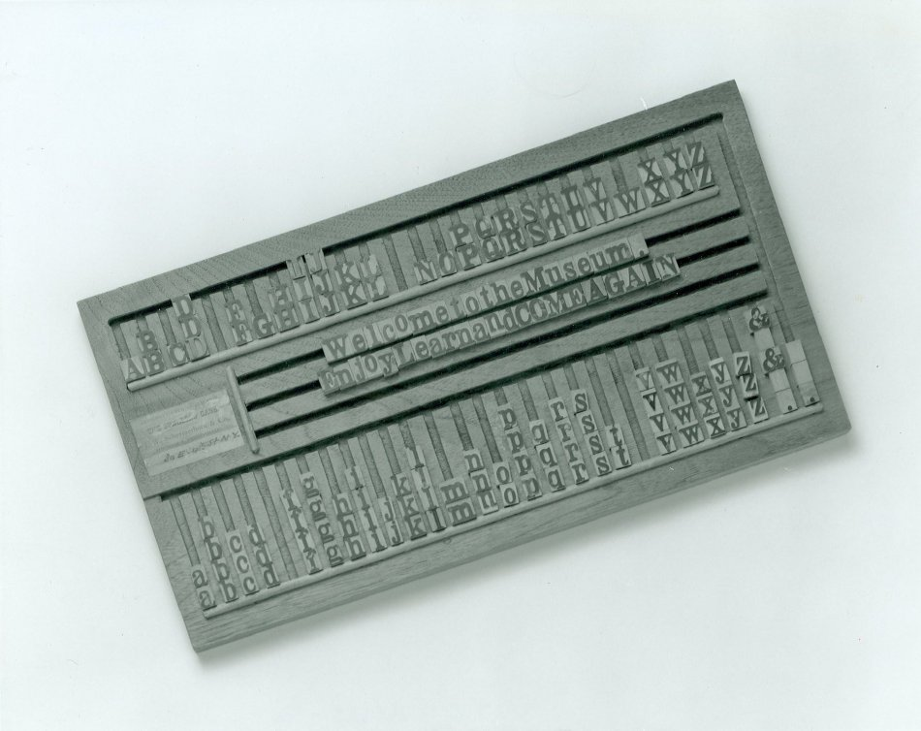
Tangible Aids of the 1940s and 50s
Cubarithm Arithmetic Frame
Patterns Reading Series
Brown Slate
Updated wooden spelling frame to magnesium alloy
New Hall Braille Writer
Lavender Braille Writer
Perkins Brailler
Cranmer Abacus

Slide 17
Large Changes in The Act
Created changes at APH

Slide 18
1961 – An Active Year for The Act
Allowed ALL CHILDREN who are blind who attend a public institution of any kind to be eligible for federal quota funds.
Congress may determine the size of the annual appropriation.
Ex Officio Trustees specified as superintendents at Schools for the Blind and chief State school officers of each state and territory.
Notes:
1961, majority of students receiving federal quota funds are served in public school programs.

Slide 19
Additional 1961 Changes
Ability to appoint special committees of EOTs
Allowance to pay for work of special committees
Allowance to pay salaries for experts and other staff to assist special committees in the performance of their functions
Notes:
Majority of EOTs might or might not have experience working with people who are blind or visually impaired.
Textbook decisions for those students are being made from increasingly diverse sources.

Slide 20
1970s
1977, first time federal funds could be used for product research.
Mid 1970s, research to prioritize the needs of children with multiple disabilities led to Sensory Stimulation Kit introduced in 1978.
1980, sales of educational aids outpaced braille, large print, and talking book departments.
Notes:
The rubella epidemic of 1963-65, had these children reaching school age in the late 60s and early 70s.

Slide 21
Who Else has Books?
1968, Central Catalog of Volunteer-Produced Textbooks
1987, it became the APH-CARL (Central Automated Resource List)
1997, APH –CARL renamed Louis Database
2004, establishment of the NIMAC

Slide 22
What about Tests?
1970, APH became a national leader in editing and transcription of tests.
Accessible Test and Textbooks Departments
  Collaboration with test developers and publishers
  Conduct test item bias review and accessibility review
  Back-translation of braille answers
Notes:
Collaborate with test developers, test publishers, school psychologists, test administrators, researchers, teachers, parents, and test takers
Consult on issues related to testing students who are blind and visually impaired
Conduct test item bias review
Conduct accessibility review
Edit tests for presentation in accessible media
Transcribe tests into braille
Design and create tactile graphics and large print masters
Produce tests in braille, large print, and audio formats
Prepare alt-tags and/or text-based descriptions of graphics, and mathematical/scientific equations and symbols as needed
Assist with preparation of electronic files for computer-based or online delivery via assistive technology
Prepare written scripts and/or make recorded version of written scripts
Proofread transcribed braille tests using certified proofreaders
Develop test administration notes for accessible versions of tests
Provide trainings, workshops, information, resources, etc.
Adapt, create, or provide accessible test-related tools and materials (e.g., rulers, protractors, raised line graph paper, etc.)
Provide test preparation materials, practice tests, answer documents, administration manuals and other test-related documents in accessible media
Back-translation of braille: For example, we can take an answer sheet that a student has created in braille and translate it into print.

Slide 23
21st Century Books and Products
Leveling the Modern-Day Playing Field

Slide 24
Access to Literacy

Slide 25

Illinois Braille Series
Classic program used to teach braille to former print readers
Practice activities, writing drills, and a variety of interesting reading selections

Slide 26
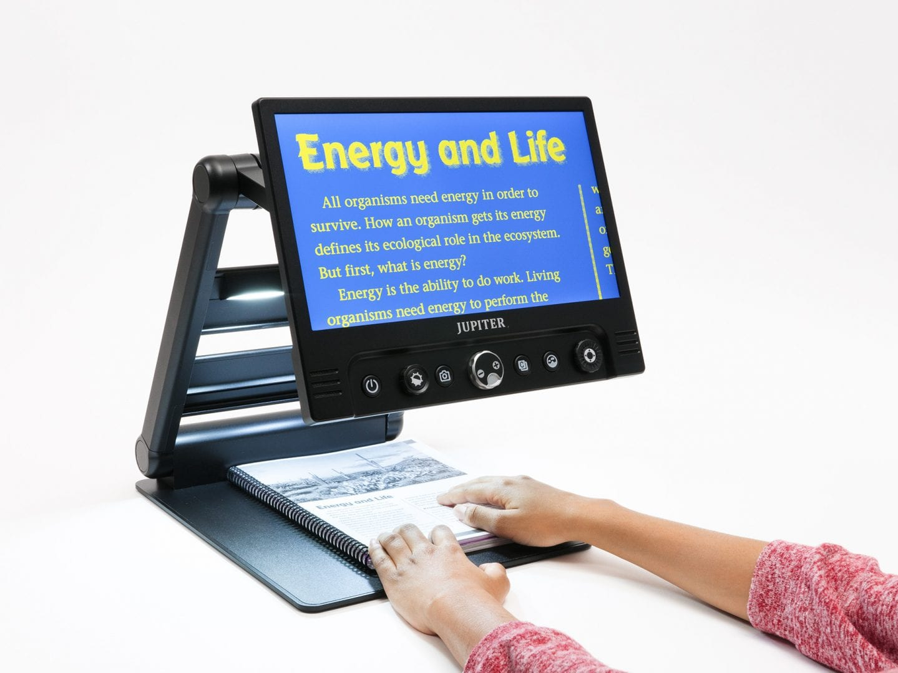
Jupiter
LCD Screen Size: 13"
Weight: Apprx. 8.62 lbs.
Three camera modes: Reading, Distance-view, Self-view
LED screen with adjustable light brightness
35 color contrasting color modes
Durable and portable design

Slide 27

ZoomText
Full range of magnification levels up to 36x
Automatically speaks all program controls, including menus, dialogs, list views and messages
Size and color enhancements make it easy to see the mouse pointer
Notes:
Three verbosity levels give you complete control over the amount of information spoken.
Special locators make it easier to follow the mouse pointer and text cursor as they move across the screen.

Slide 28
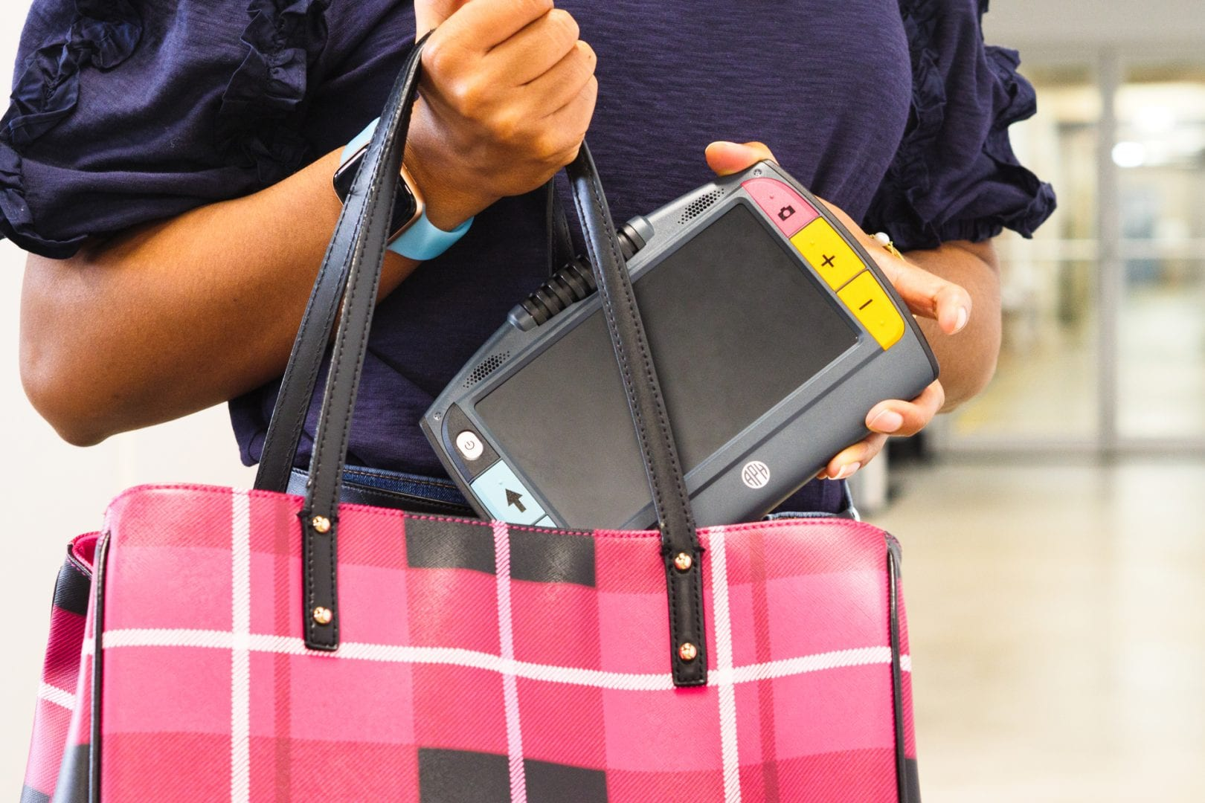
Juno
Self-view: complete grooming tasks.
Reading-view: view documents like books and homework assignments.
Distance-view: read a bulletin board, white board, or poster.
Writing-view: fill out a form, sign your name, write a check, or complete a worksheet.
Hobby-view: sew, knit, paint/color a picture, or view your favorite recipe.
Optical Character Recognition for captured text

Slide 29
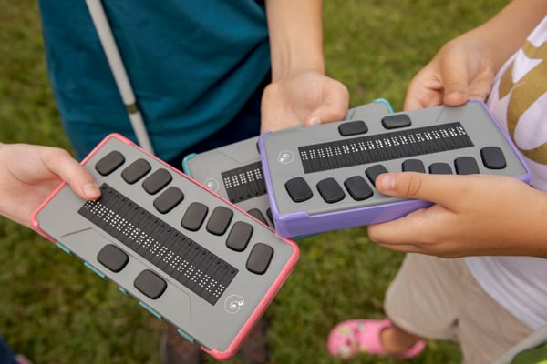
Chameleon 20
20-cell refreshable braille display
Perkins-style keyboard
Connect 5 devices at once
15 hour battery
USB and SD storage ports
Exam mode capable
Notes:
View a comparison chart of APH refreshable braille displays.

Slide 30
Access to Numeracy

Slide 31
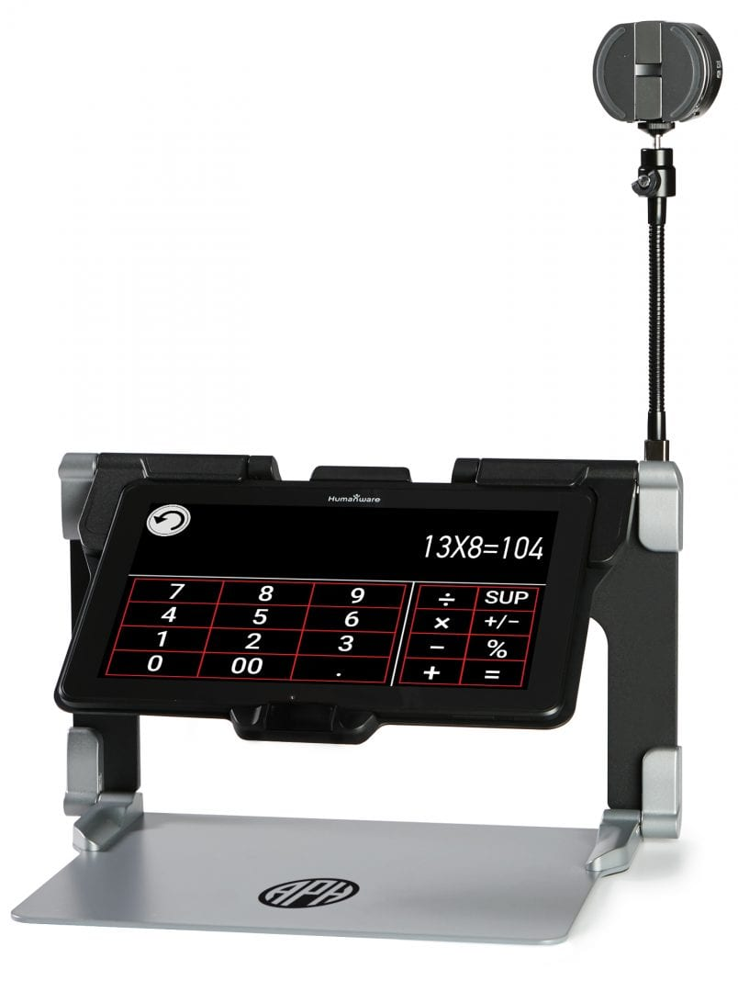
MATT Connect, Desmos graphing calculator
Plots graphs and solve equations with the scientific calculator
Smooth transition between view board, document and calculator

Slide 32

Cranmer Abacus
Learns basics of all arithmetic operations
Understanding of the concepts and methods
Mastery in simple and complex problems
Good knowledge about the place values

Slide 33
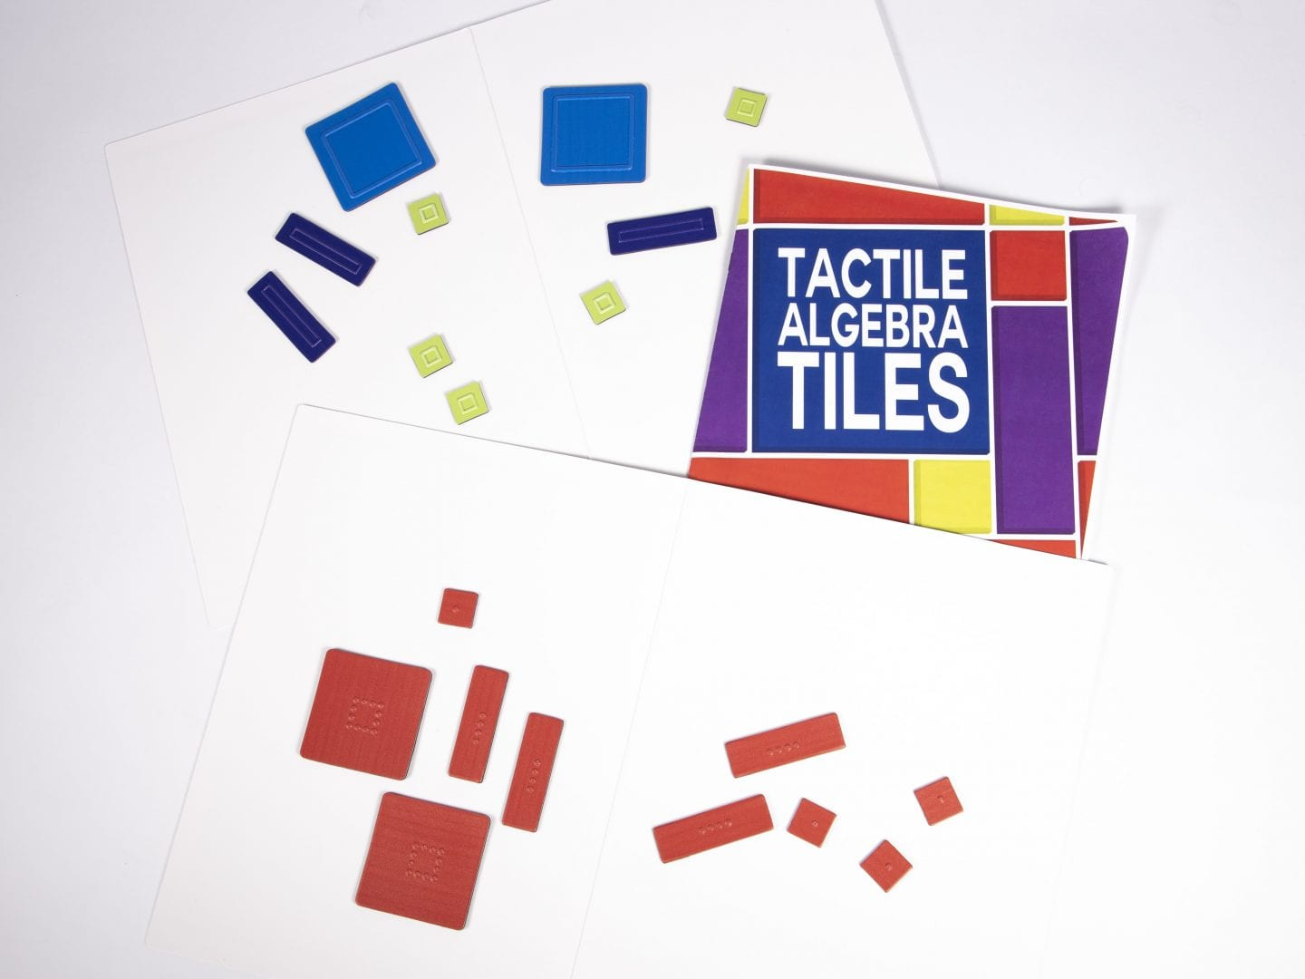
Tactile Algebra Tiles
Adding, subtracting, and multiplying integers
Simplifying expressions
Solving linear and quadratic equations, and
Adding, subtracting, multiplying, and factoring polynomials

Slide 34

Money Talks: Bank Account Management Software
Import and use electronic banking information to reconcile accounts
Remember the last workspace used in the program
Emboss or print the check register in a variety of formats
Print many types of bank checks

Slide 35
Access to the Environment

Slide 36


Using Touch
Teaching Touch -Encourage those who are blind to become active explorers and readers of tactile graphics
Finger Walks - Tactile patterns to develop the sense of touch, clear and settle the mind, and experience calming, rhythmic movements

Slide 37
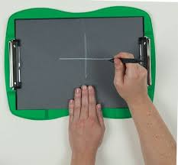
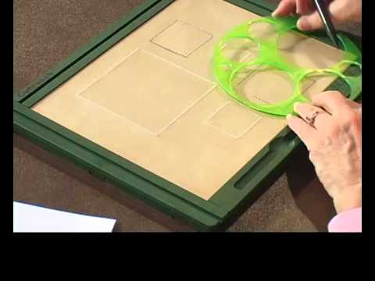
Access to Drawing
TactileDoodle
Draftsman
Notes:
FEATURES:
Frame Design
DRAFTSMAN: Rectangular frame with gutters for add-on/sliding tactile ruler
TactileDoodle: Streamlined/modern appearance with curved frame and resting area for hand
Visual appearance of drawn tactile lines
DRAFTSMAN: Drawn tactile images appear white (or blushed) against a beige padded surface
TactileDoodle: Drawn tactile images appear white against a black background/padded surface for enhanced visual contrast (or chalkboard appearance)
Drawing stylus
DRAFTSMAN: Complemented by a two-ended stylus to generate two different line types
TactileDoodle: Complemented by a short, single-tip drawing stylus (ideal for use by younger students)
Hinge design
DRAFTSMAN: Locking hinges or “wings” for securing drawing film on drawing surface
TactileDoodle: Standard clip-board style clamps (same as used for APH’s ReadWrite stands) for securing drawing film on padded surface
Selling price
DRAFTSMAN: $229.00 (available with Quota funds)
TactileDoodle: $109.00 (available with Quota funds)

Slide 38

Access to Music
Feel the Beat
  By beginning with some already-familiar tunes, your students will have some early successes on which to build
  Lessons focus on reading measures, playing measures, and memorizing measures

Slide 39
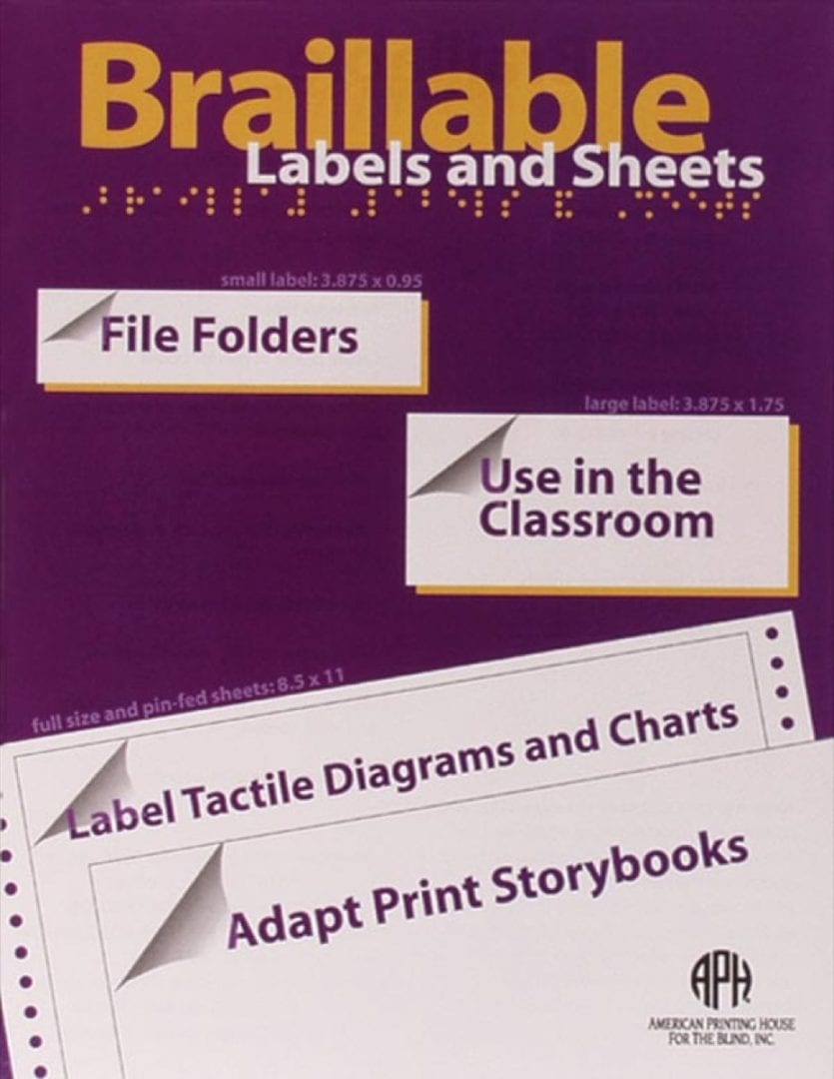
Labeling
Household appliances
Canned goods
Greeting cards
Books
CDs
Folders

Slide 40
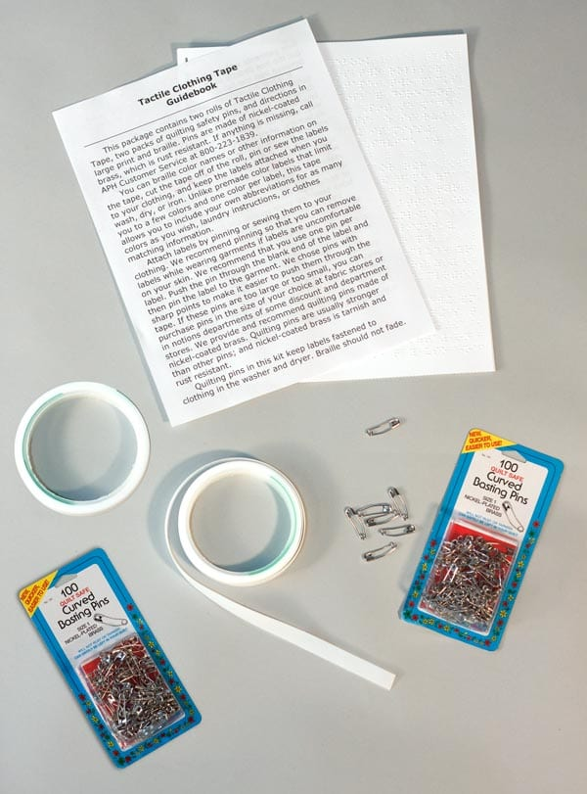
Tactile Clothing Tape
Create labels for color, laundry instructions, or other information about clothing – stays attached through washing, drying, and ironing

Slide 41
Access to the Workplace

Slide 42
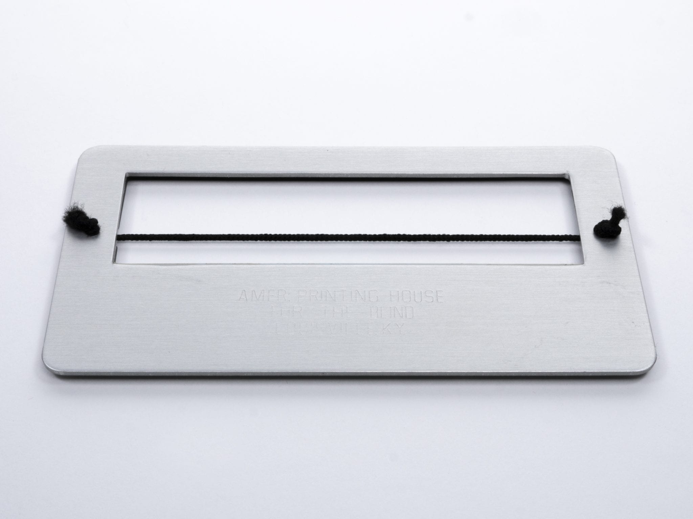
Signature Guide
An elastic or flexible baseline material that allows you to make letters that descend below the writing line, such as “g” or “y.”

Slide 43

JAWS
Read documents, emails, websites and apps
Easily navigate with your mouse
Scan and read all documents, including PDF
Fill out webforms with ease
Easy to use with Daisy formatted basic training
Save time with Skim Reading and Text Analyzer
Surf the net with web browsing keystrokes

Slide 44
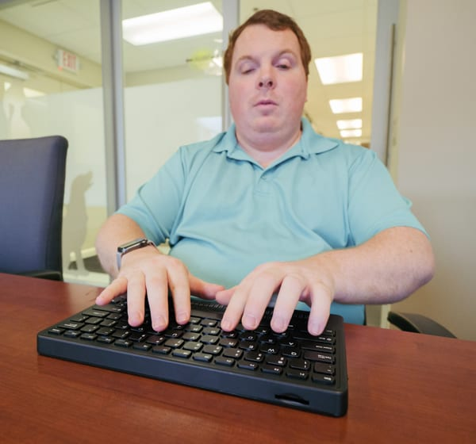
Mantis Q40
40-cell refreshable braille display
QWERTY keyboard
Connect 5 devices at once
15-hour battery
USB and SD storage ports
Exam mode capable

Slide 45

Crossings with No Traffic Control
Through logical, sequenced teaching approaches, independent travelers who are visually impaired will learn to analyze and navigate uncontrolled street crossings
Notes:
Topics Addressed Include:
Essential Concepts
Recognizing Situations of Uncertainty (auditory modules)
Recognizing Situations of Uncertainty (visual modules)
What to Do in a Situation of Uncertainty
Let's Take This Show on the Road: Teaching Students to Apply Skills in Real-Life Settings

Slide 46
Spreading the APH Message
Information and Training for Everyone
Notes:
APH gradually extended its responsibility beyond the provision of educational materials for the blind people. It became a national center for collecting and disseminating information on educational resource available through out he country.

Slide 47
APH Staff Providing Education in the 1980s
Newsletter started
Presented at workshops and exhibits
Increased presence at national meetings
Visited university pre-service students or had them visit APH
Supported publishers and braille organizations
Summer seminars at APH

Slide 48
Training Initiatives in 2000
Collaborative Project with Teacher Training Programs
National Instructional Partnership
Notes:
CIP: This project, funded by Congress as a special initiative, focuses on educating university students on the variety of services and products available to them as they begin their careers in the field of education and rehabilitation of the visually impaired.
NIP: As an example, through this initiative, Suzanne Swaffield, Ex Officio Trustee from South Carolina, partners with APH to coordinate a two-day workshop for 64 vision teachers in Columbia, SC.
In 2001 , contracted experts in the field of blindness and visual impairment partner with APH staff and Ex Officio Trustees to create and present four expanded trainings that included the use of APH products and services.
1. Tactile Graphics for Transcribers and Teachers, Yankton, SD, presented by Miriam Dusenberry, in partnership with Ex Officio Trustee Dan Boyd and the South Dakota Braillists Association.
2. Low Vision Aids and Devices/Teaching Beginning Braille Readers, Joplin, MO, presented by Bryan Gerritsen and Sharon Niemczyk, in partnership with the Joplin Association for the Blind.
3. Gateways to Independence: Technology for Children with Visual Impairments, Louisville, KY, presented by Gerald Abner and APH's staff, in partnership with Ex Officio Trustee Ralph Bartley and the Kentucky School for the Blind.
4. Cortical Visual Impairment: Pathways to Intervention, Los Angeles, CA, presented by Dr. Christine Roman, in partnership with Ex Officio Trustee Vicki Liske and the Braille Institute of America.

Slide 49
2020 and Beyond
Current Education and Outreach

Slide 50

APH Hive, learning management system
One-stop professional development ​
  APH products​
  Educator craft knowledge​
  One-of-a-kind resources
Self-paced learning
ACVREP credit
Free!
www.Aphhive.org
Notes:
Foundations
Assessment
Early Childhood
Core Curriculum
Expanded Core Curriculum

Slide 51
Regional specialists
Providing networking among vision professionals
Promoting the professional learning management system
Being present at regional events such as regional AER conferences, State meetings, Braille Challenge events, etc.
Answering questions about the skills, policies and issues surrounding the education of children and adults with visual impairments
Providing new information to the region to allow for field knowledge to spread quicker
Promoting the field as a career
Notes:
Create in-service trainings to meet the needs of various state, district, school, university or agency needs
Work with groups or individuals on “APH Solutions” for AT, both high tech and/or low-tech equipment and materials
Outreach Specialist are professional from the field with experience and practitioner knowledge
Outreach Specialists are here for YOUR needs

Slide 52
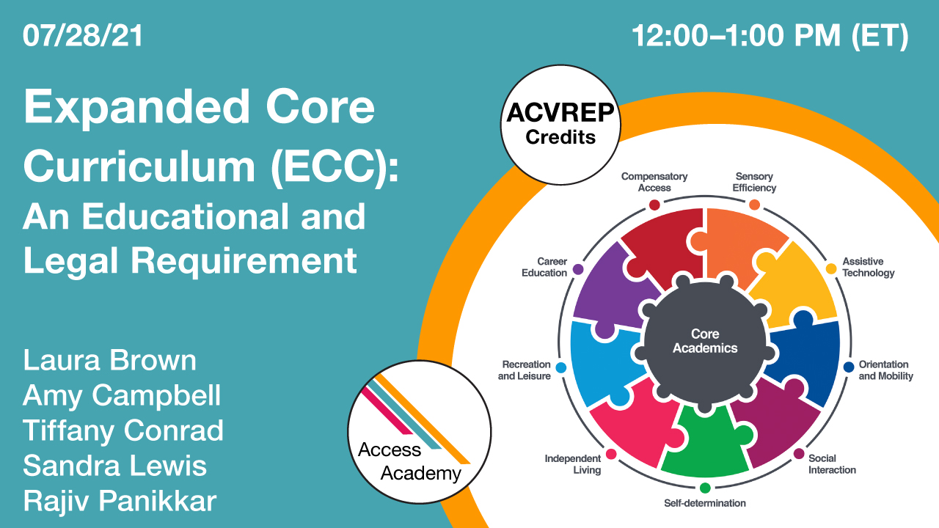
Access Academy
Meaningful education and training webinars you need to get the most out of APH products and services. From tutorials on new products and hacks on how to get the most from your beloved tech, to information on resources, services, and programs: our goal is to give you the info you need for home, the classroom, and the workplace.

Slide 53
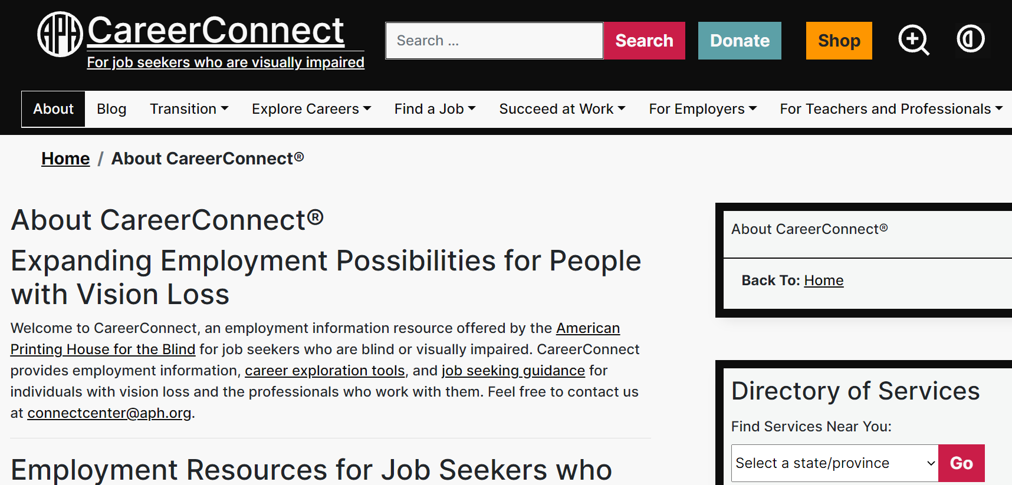
APH ConnectCenter
CareerConnect
VisionAware
FamilyConnect
Braille Bug
APH Transition Hub

Slide 54
Are We Leveling the Educational Playing Field?

