Slide 1

The Store
AT NDVS/SB
AER Conference, September 2025

Slide 2
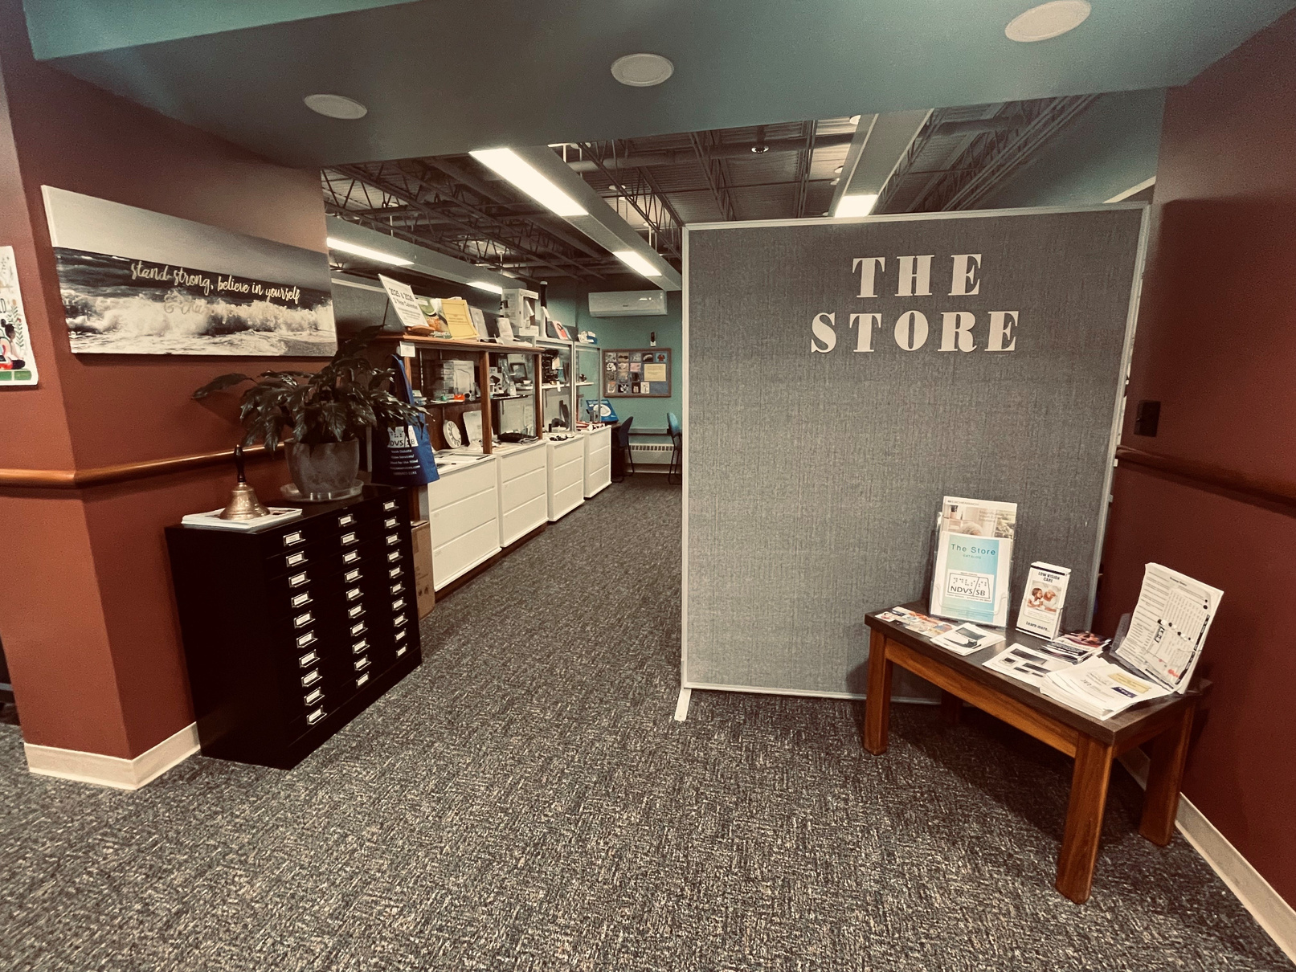
Our Mission Statement
“The Mission of The Store is to provide the blind and visually impaired consumers of North Dakota with faster access to items they may need for daily living. We also provide services to help the blind and visually impaired make informed decisions on product purchases.”

Slide 3
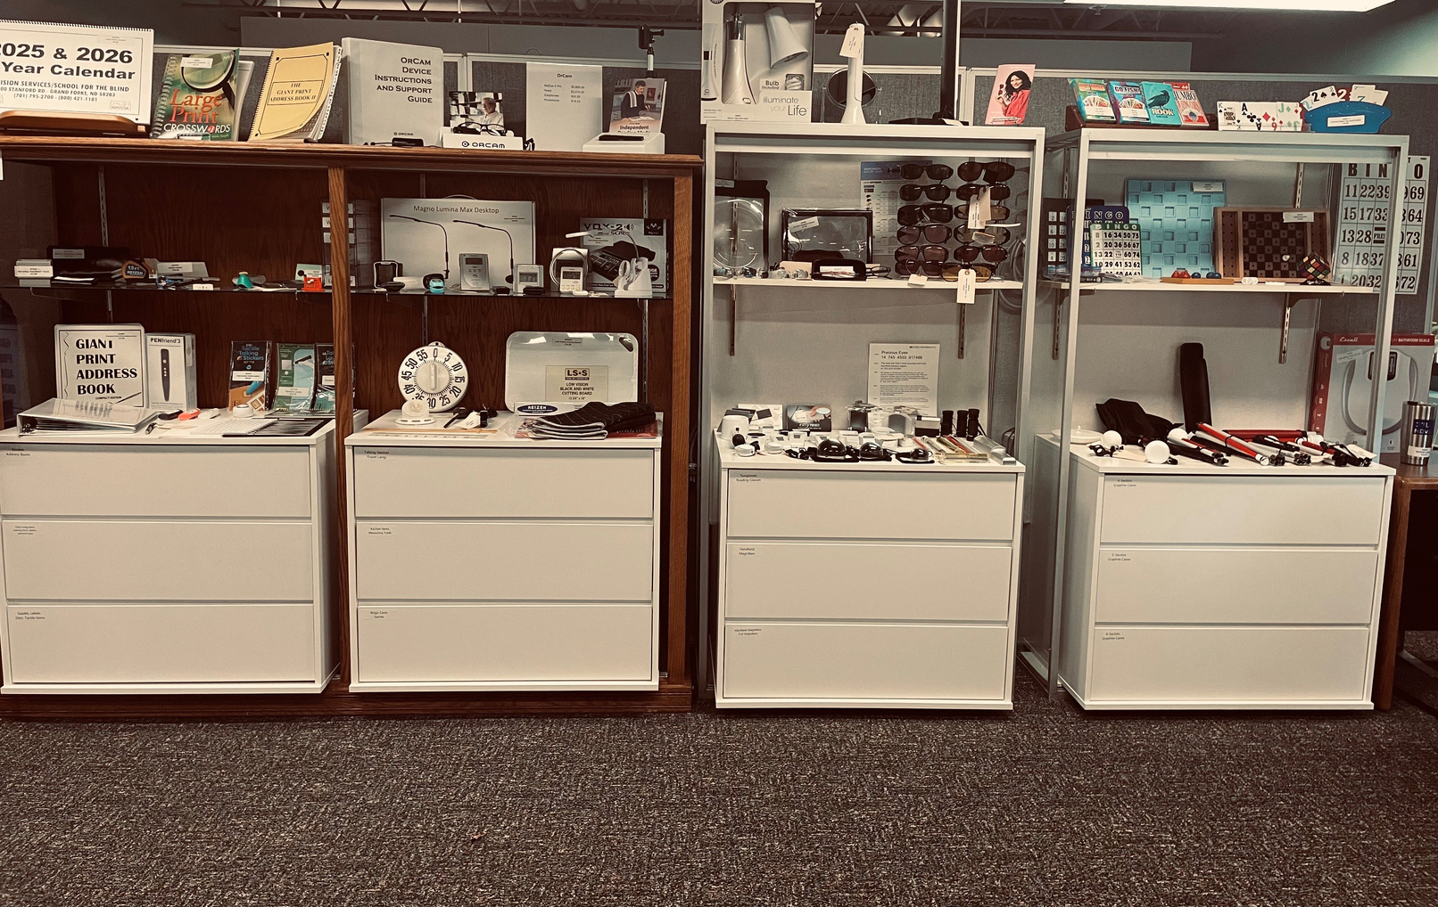
More than just a retail space
The Store is a RESOURCE. Yes, it is a retail space where items can be purchased, but it is so much more.
It is a resource for our patrons and our employees.
It is a place where people can learn about all the different options they have. They can try different products to find what works best for them.
We maintain a large variety of items and a healthy stock of inventory of the items that people want - and need - the most.

Slide 4
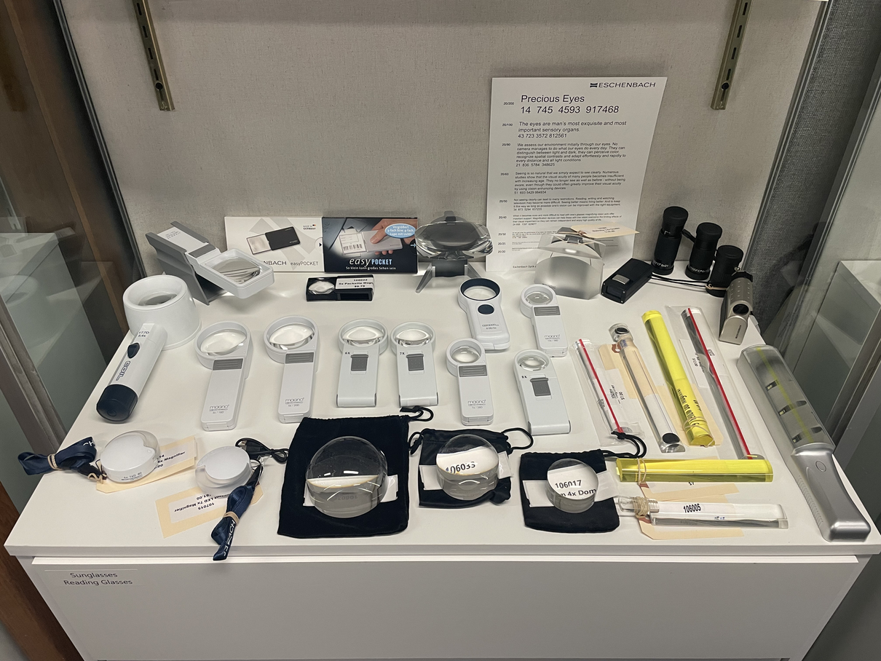
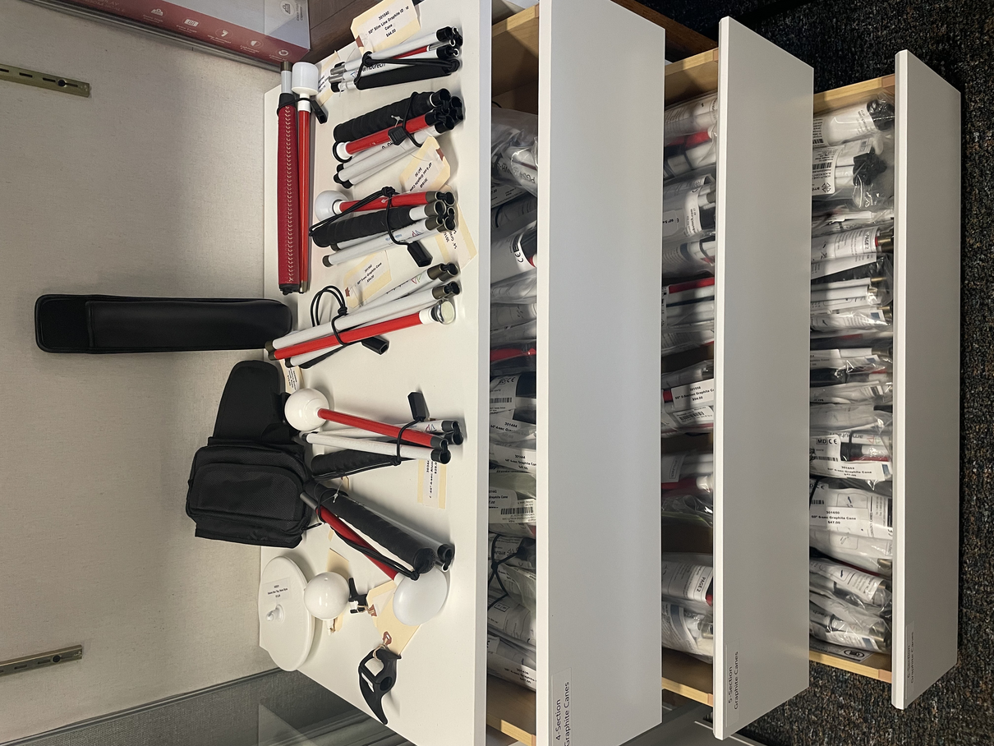
Atomic Watches to Yarn Threaders
Our biggest selections are magnifiers and canes.
We try to carry as many different types of magnifiers as possible, including bar, dome, various handheld, telescope, and digital (to name a few).
We have aluminum and graphite canes, sized 32" - 58" in 3, 4, 5, and 6 sections. We have both slip on and hook style tips as well as a variety of accessories.

Slide 5
And Everything in Between
Other categories and products include:
Daily Living Items
  Health Aids like the Talking Wrist Blood Pressure Monitor
  Kitchen Aids like the Liquid Level Indicator
  Clocks, Watches, and Timers like the Talking Keychain Watch
  And the EZ TV Remote
Touch and Bump Dots
  Various sizes, colors, and textures
Office Supplies
  Various Guides (signature, envelope, etc.)
  Giant Print Check Register
  Braille Paper
Eyewear
  Absorptive filters, solar shields
  Telescopic Glasses
Digital Readers and Recorders
  OrCam products
  Wilson Recorder
Games
  Braille Card Games like Go Fish and Uno
  Braille playing cards and jumbo size playing cards
  Various Bingo cards
  Tactile Chess and Checkers

Slide 6

We Are Here to Help
If a customer wants or needs something, they can ALWAYS call us. If we don’t have it in stock, we will find it and get it to them. We want people to know they can come to us for any type of product they might need to help them live their lives the way they want to.
Customers can take items home to try to ensure it’s what they want. If they decide it’s not the right item, it can be returned.
We also have trained mobility, technology, and vision loss experts on staff to offer information on services and programs. They can help with everything from finding the right magnifier to adapting a personal computer.

Slide 7

Beyond the Front Doors
The physical store is 219 square feet. That’s it. Just 219 square feet to service an entire state.
How do we get the information - and products - into the hands of those that need them?
We have a catalog that is updated every 2 years, but this only covers a small portion of everything we offer.
Solution 1: The Online Store Resource
Solution 2: Traveling Kits

Slide 8
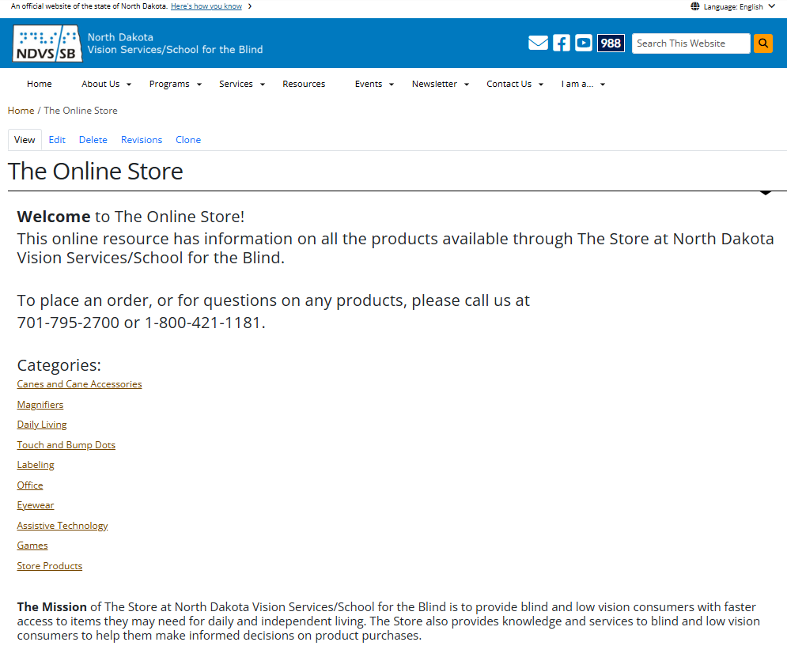
The Online Store Resource
The Online Store
The NEW Online Store Resource is just that - a resource for customers and anyone else to see what we have available.
It is not a retail site. Prices are not listed. Customers are not able to make online purchases. They still need to contact us for ordering.
Why? Because sometimes it’s more than just a magnifier.

Slide 9

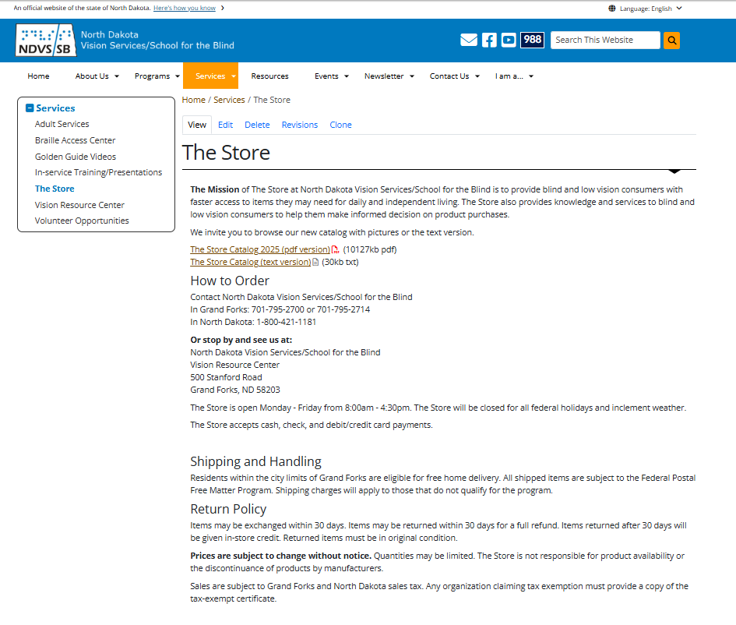

Another Resource
More space for pictures and descriptions of ALL items
Can be updated easily and as often as needed
Accessible
Designed with low vision patrons in mind
Will be found on The Store information page on the NDVS website
Expected to be live in the next 4-6 weeks
North Dakota Vision Services

Slide 10
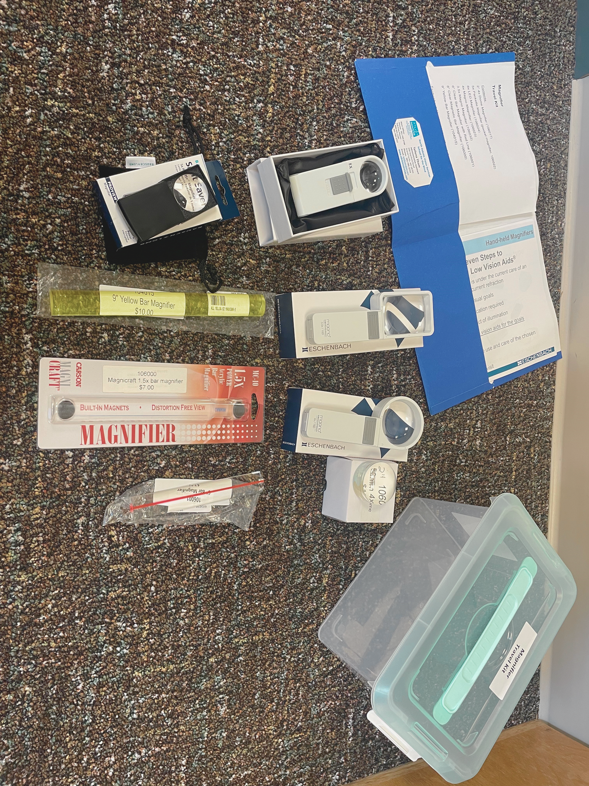
The website allows anyone to know about The Store and what products are available. How do we get products into the hands of consumers?
Traveling Kits allow staff to bring products to those that aren’t able to come visit The Store in Grand Forks.
The kits are arranged by category and include products and information on choosing the best product and best practices for using the products.
Traveling Kits

Slide 11
Next Goals
Continue providing products and services to blind and low vision patrons
Continue connecting people with services to help them live independently and how they want to live
Keep up with innovations for products and technology
Provide a website resource that is accessible to everyone everywhere
Provide traveling kits to get more products into the hands of those that need and want them
We are here to help

Slide 12
Thank You
Tallena Thom
NDVS/SB

