Slide 1


ND Dual Sensory Project
Lacey Long, Project Director
Jodi Patchen, Administrative Assistant
Kelly Prellwitz, Family Engagement Rebecca Sheffield, OSEP Project Officer

Slide 2
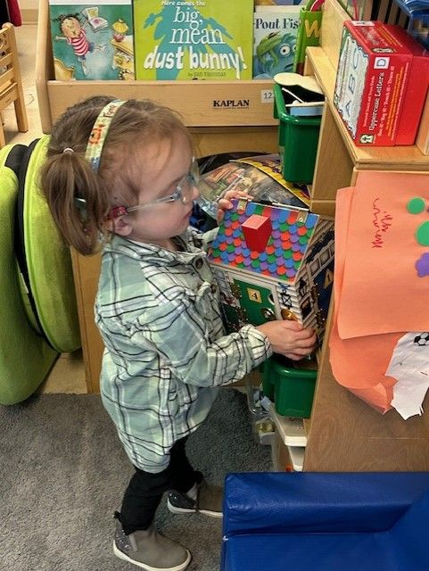
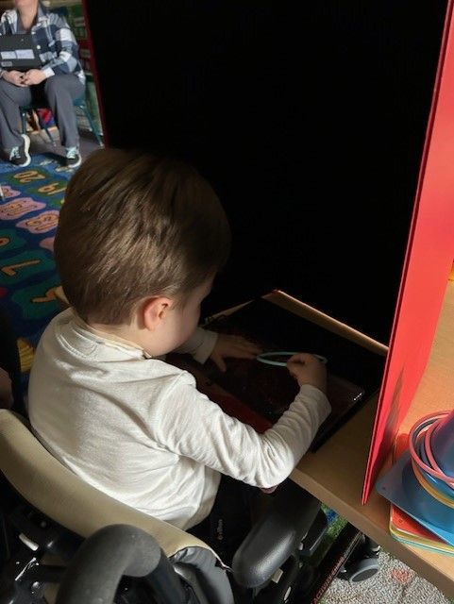
What does Deafblind look like? (1 of 2)

Slide 3
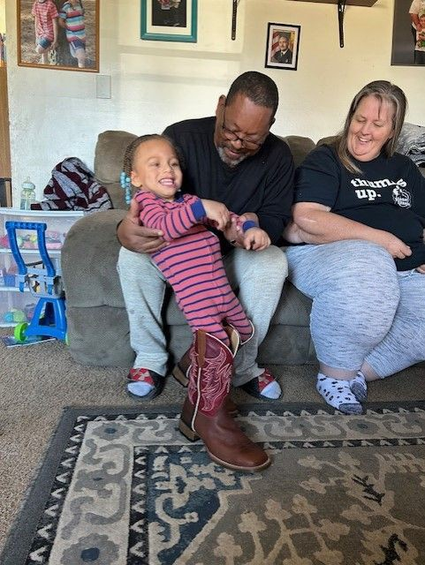
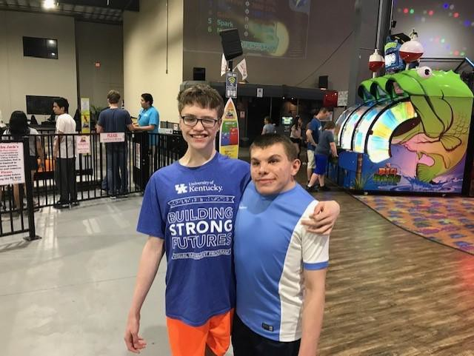
What Does Deafblind Look Like? (2 of 2)

Slide 4
What is Deafblindness?
Combined Vision and Hearing Loss of any level
Combination of distance senses = deaf TIMES blind
Lowest of the low incidence disabilities
Approximately 10,000 children birth - age 22 in the US
Approximately 87% have additional disabilities
Disability of access

Slide 5
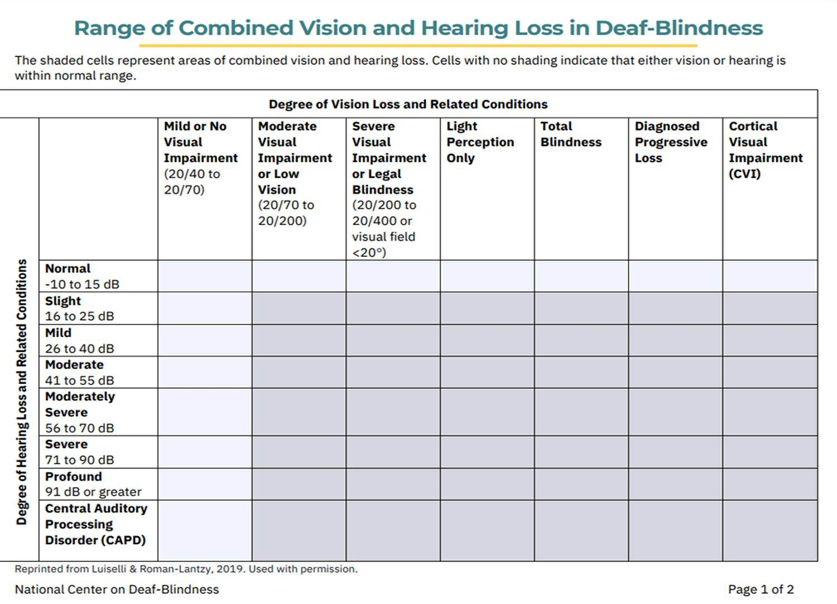

Slide 6
Causes of Deafblindness
Unknown Etiology
Complications of Prematurity
Hereditary
  CHARGE syndrome
  Stickler syndrome
  Dandy-Walker syndrome
  Usher syndrome
  Down syndrome
Prenatal/Congenital Complications
  cCMV
  Microcephaly
  Hydrocephalus
  Prenatal exposure to drugs or alcohol
Postnatal/Non-Congenital
  Lack of oxygen
  Birth Complications
  Meningitis
  Trauma to the brain

Slide 7
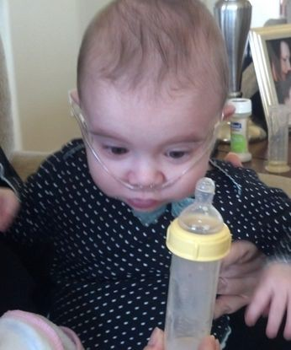
Cerebral/Cortical Visual Impairment
Leading cause of visual impairment (40%) and DeafBlindness (50%)
Visual loss caused by neurological issues and diagnosed by etiologies, cluster of speciﬁc behavioral or visual responses, and caregivers’ observations
First three years are most critical
CVI affects vision, hearing, balance/movement, and executive functioning
Treatment is educational, not medical

Slide 8
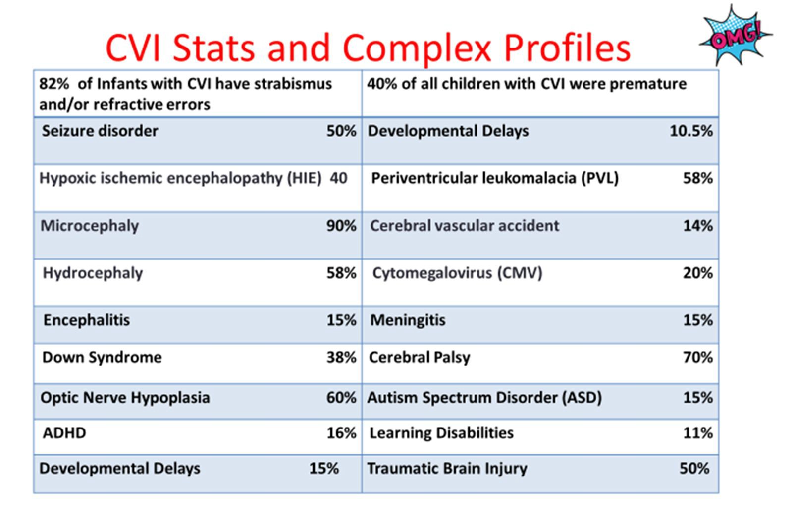

Slide 9
Risk Factors for Vision Loss
Family member concerned about vision
Baby was exposed to alcohol or drugs before birth
Baby was premature and given oxygen in the hospital
Baby had birth weight of less than 3.3 pounds.
Child had meningitis or encephalitis.
Mother had infection (toxoplasmosis, rubella, CMV, syphilis, herpes) during pregnancy.
Family history of vision loss (retinitis pigmentosa).
Child has neurological problems, such as seizures
Child has other medical concerns (hearing loss, cerebral palsy).
Colorado Services for the Deafblind: What does my child see, what does my child hear

Slide 10
Typical Vision Development (1 of 2)
1 month: Looks at mothers or caregivers face. Responds to lights.
2-4 months: Begins to smile at others. Follows a moving person with his/her eyes. Fascinated by lights and bright colors. Begins to look at own hands.
5-8 months: Watches things happening across the room. Reaches for nearby toys. Looks at small objects, such as raisins or small cereal.

Slide 11
Typical Vision Development (2 of 2)
9-12 months: Reacts to facial expressions of others. Looks for fallen toys, even around corners. Is interested in picking up tiny objects, such as lint on carpet.
12-18 months: Marks and scribbles with a crayon. Interested in picture books. Can reach in and pull out objects easily. Builds a short tower with blocks.
1½ -3 years: Sees detail in familiar pictures. Copies a circle with a pencil or crayon. Looks for familiar things in the distance. Can imitate movements of others. Matches objects to pictures.

Slide 12
Risk Factors for Deaf/Hard of Hearing
Family concern about child’s hearing.
Baby was in NICU for 3 days or more, or was given oxygen for 10 days or more.
Baby had unusual ear, head or neck formation.
Baby had birth weight of less than 3.3 pounds.
Baby had severe jaundice and an exchange blood transfusion was recommended.
Mother had infection (toxoplasmosis, CMV) during pregnancy.
Child has had an injury or trauma to the head.
Child had meningitis
Family history of hearing loss.

Slide 13
Typical Listening, Speech, & Language Development (1 of 2)
0-4 months: Startles to loud sounds. Quiets to the sound of a familiar voice.
4-6 months: Turns toward or looks for a familiar or new sound. Likes rattles and objects that make sound.
6-12 months: Turns or looks up when called by name. Imitates sounds and pitches. Understands the meaning of simple words and phrases, such as no and bye bye. Uses voice to get attention.

Slide 14
Typical Listening, Speech, & Language Development (2 of 2)
12-18 months: Uses 4-5 words by 18 months. Points to at least one body part when asked. Understands
one-step instructions, such as Get me your diaper, or Close the door.
18-24 months: Uses 10-15 words and puts 2 words together by age 2 years. Likes music. Points to familiar objects when you name them.
2 -3 years: Uses 200 words by age 3 years. Listens to radio or TV at the same loudness as other people. Hears when called from another room. Uses 2-3 word sentences. Strangers can understand most of your child's speech.

Slide 15
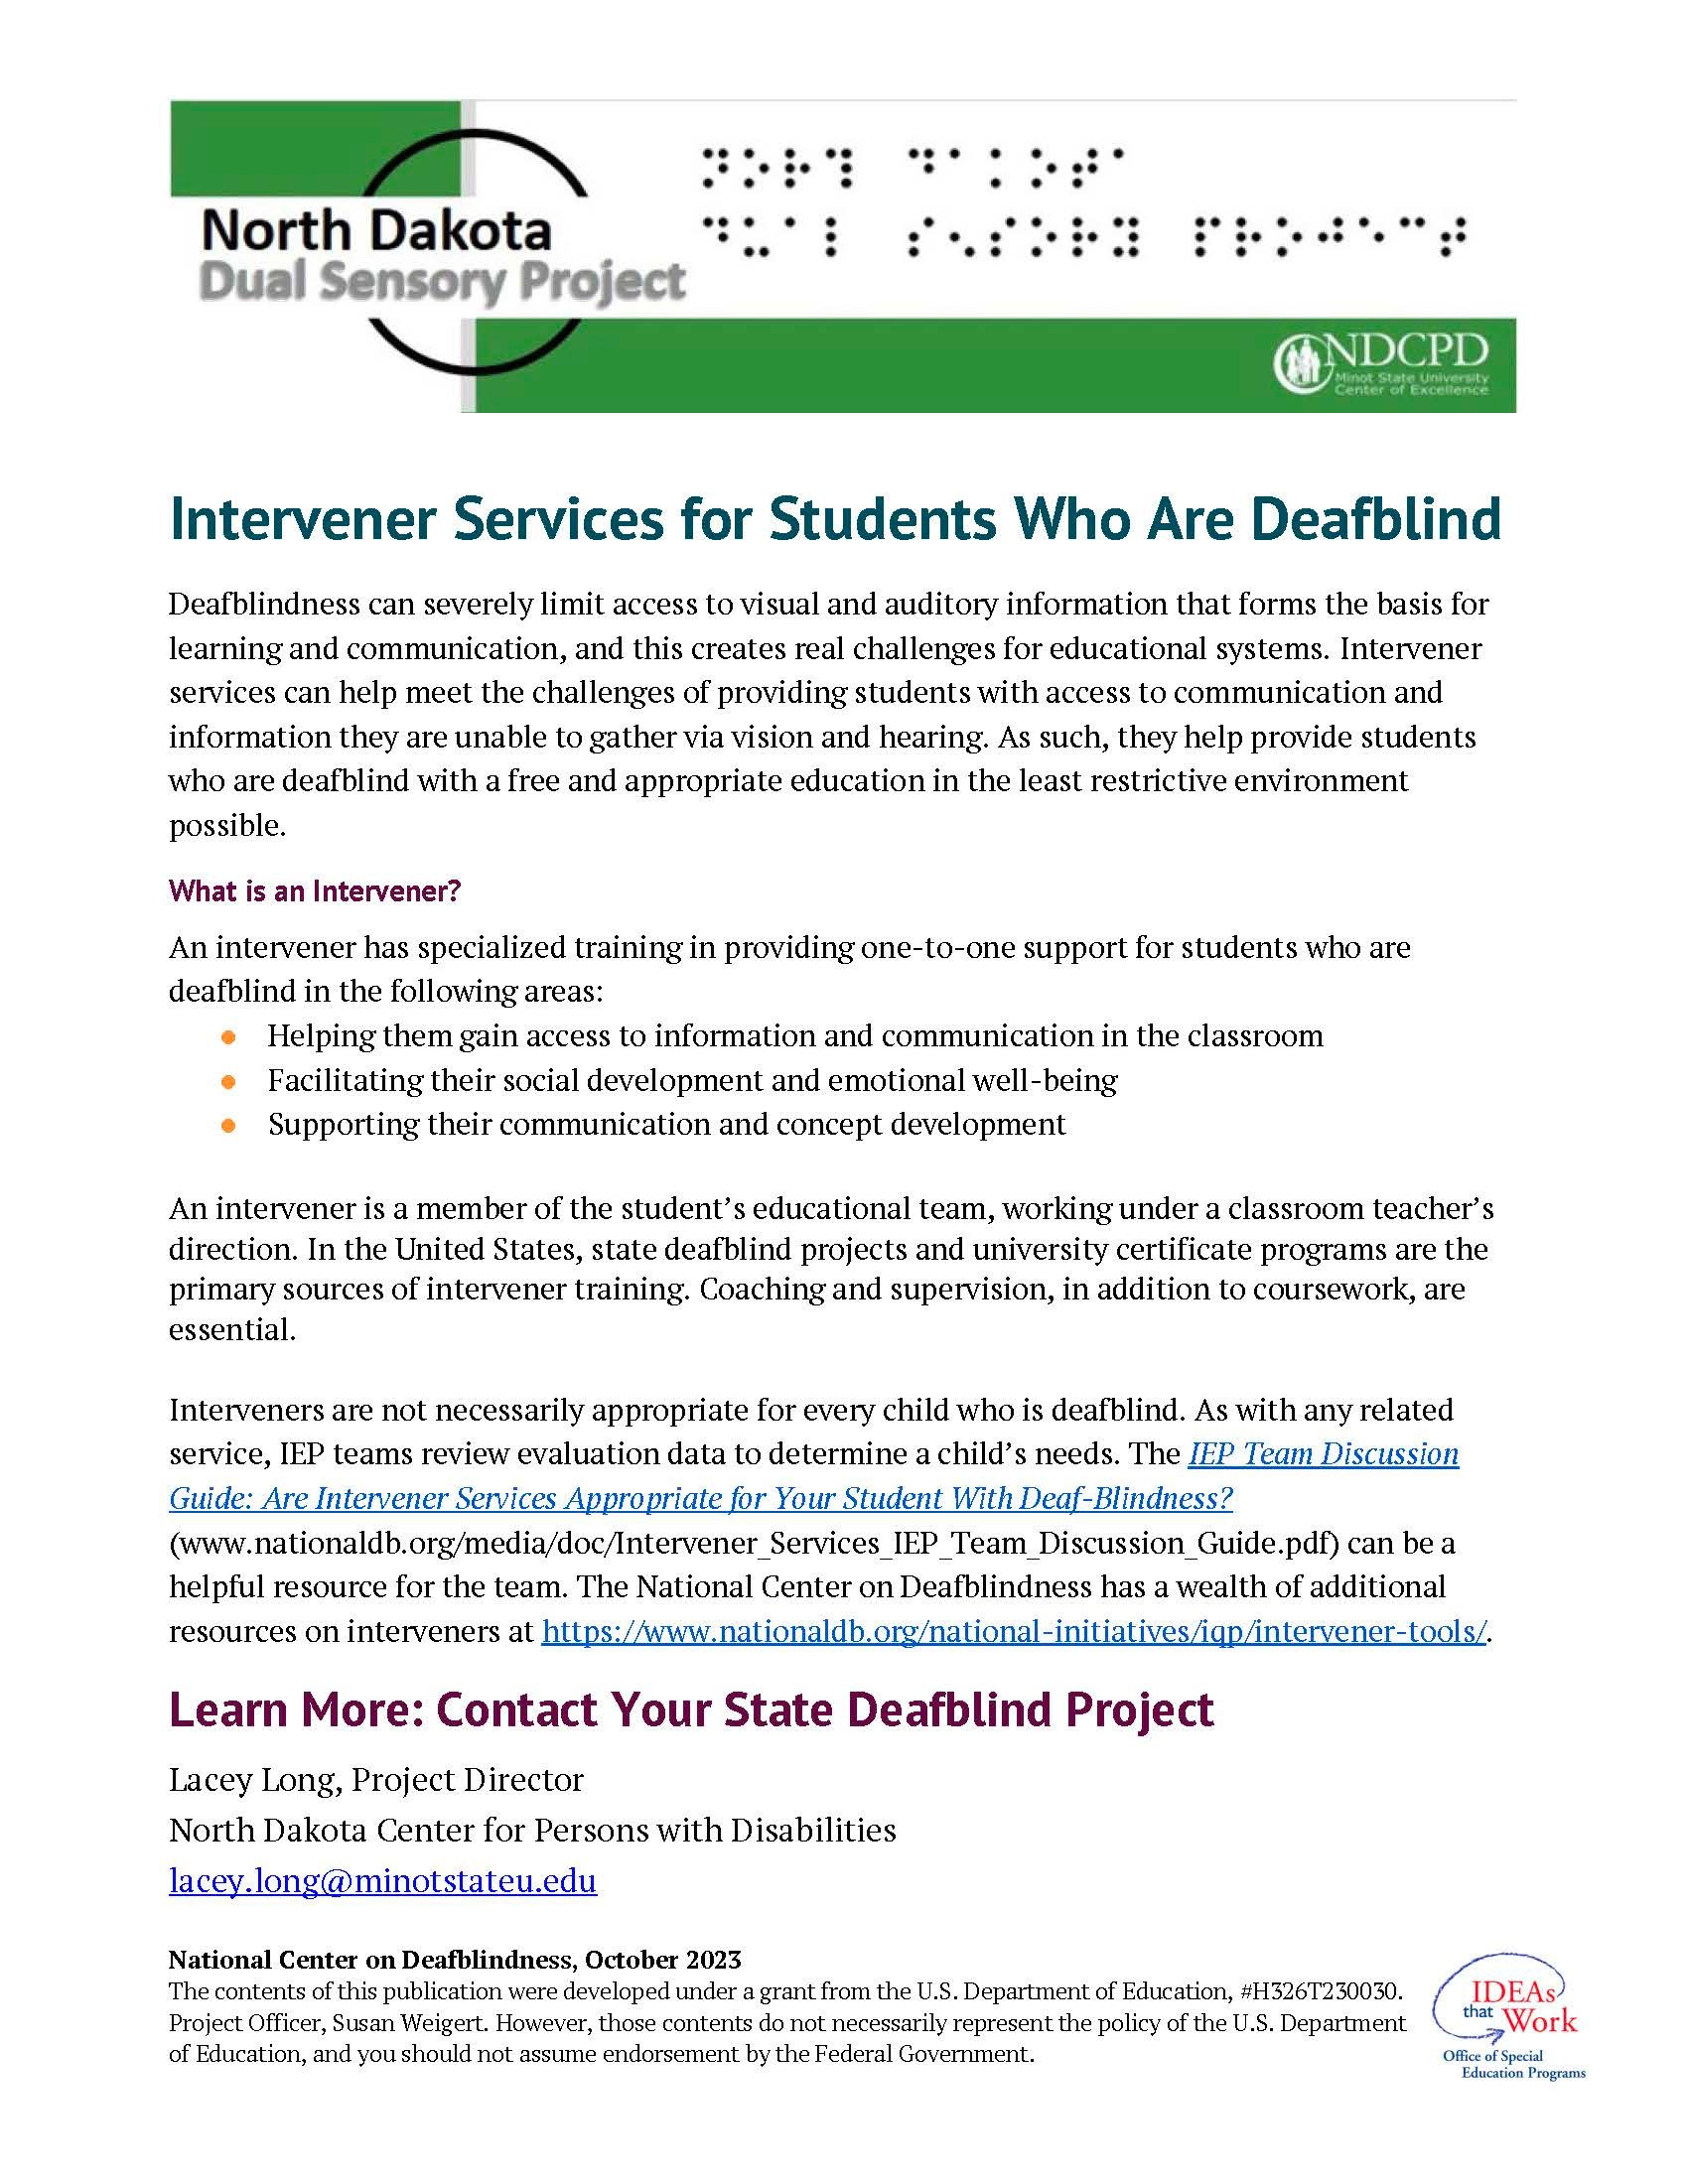
Are Intervener Services Appropriate for Your Student Who Is Deafblind?
Resource: An IEP Team Discussion Guide

Slide 16

Current Grant Cycle:
October 1, 2023-
September 30, 2028
Project Goals:
Early Identification & Referral
Secondary Transition
Increase Access to the General Education Curriculum
Professional Development on Strategies for Inclusion
Family Engagement
Accurate Child Count

Slide 17
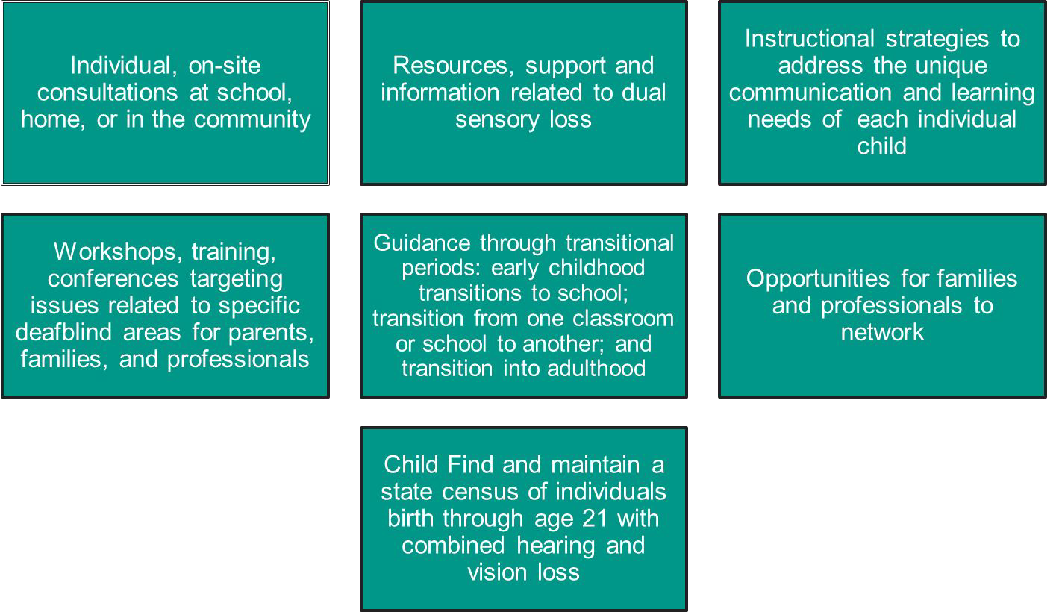
State DeafBlind Projects Provide

Slide 18
Why Refer?
Children who are DeafBlind require specialized teaching strategies to help access their environment to learn
Referral to your state deafblind project can support children with deafblindness and their families across environments to learn these skills strategies
Training & resources can provide providers and families tools to:
  Help young children learn how to access residual vision and hearing
  Learn skills to support the child’s learning, communication, social emotional development, motor development and increase independence

Slide 19
Importance of Collaboration
We’re better together!
Partnering is critical because of limited time and funding
We share these families so knowledge around suspected combined vision and hearing loss is critical for identiﬁcation and referral
Early ID leads to better services and supports for families

Slide 20


The contents of this presentation were developed under a grant from the U.S. Department of Education, #H326T230030, Project Ofﬁcer, Rebecca Shefﬁeld. However, those contents do not necessarily represent the policy of the U.S. Department of Education, and you should not assume endorsement by the Federal Government.

Slide 21
Contact Information
Lacey Long, Project Director
Email: lacey.long@minotstateu.edu
Cell: 701-308-0993
Website: https://ndcpd.org/dualsensory-2/

