Slide 1
Echoidentification – Getting the Most Back From Sound
Sarahelizabeth Baguhn, MA
S.J.Baguhn@wmich.edu
(608) 957-6013
Dawn Anderson, PhD
Dawn.L.Anderson@wmich.edu
(269) 387-5944

Slide 2
What do you know about echolocation?
Who can do it?
How detailed is it?
What can it detect?

Slide 3
Misconceptions
It only is possible for an elite few.
It tells only the locations of objects.
It’s made up. People fake it.
People must have outstanding hearing to learn it.
Only a few people are skilled enough to teach it.
It can detect drop-offs.
All levels of echoidentification, echolocation, or human sonar should be used TOGETHER WITH a primary mobility device. No one can detect drop-offs in the environment auditorily.

Slide 4
The new name: echoidentification
It doesn’t matter which type you teach, as long as you enable clients to use it to increasingly higher abilities.
Sonar (Sonic Navigation and Ranging) implied specific functions, but clients may use these techniques in many broad ways.
Echolocation implied location (though some authors don’t limit it in that way), and people can do much more with echoes.
Some brands trademarked what they teach, we don’t want to infringe on their programs or methods, but support more O&Mers teaching any of them.

Slide 5

Echoidentification umbrella
Human echolocation
Human sonar / biosonar
Active echolocation/sonar
Passive echolocation/sonar
Location of objects
Finding acoustic gaps/openings
Material properties of objects

Slide 6
Who can echoidentify?
Everyone who can hear some of the reflected sound (echoes).
Studies show this can be learned by people with any level of vision (Tonelli, Brayda, & Gori, 2016)
People who are blind tend to perform better (Kolarik, Cirstea, Pardhan, & Moore, 2014; Nilsson & Schenkman, 2016)
Hearing does not need to be perfect.
Hearing does not need to be binaural for all tasks, though when binaural hearing is available, both ears are used in that way.

Slide 7
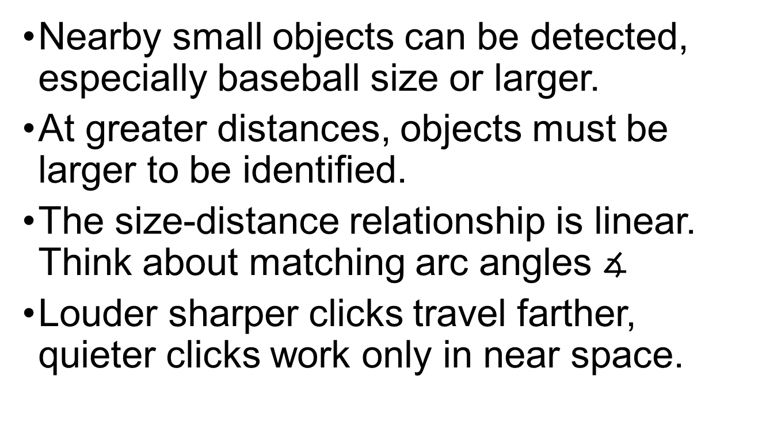
Size and Distance
Nearby small objects can be detected, especially baseball size or larger.
At greater distances, objects must be larger to be identified.
The size-distance relationship is linear. Think about matching arc angles $∡$
Louder sharper clicks travel farther, quieter clicks work only in near space.

Slide 8
Shapes
Finding edges
Determining if a surface is concave or convex
Global shapes make more sense over time, as a person has repeated experiences.

Slide 9
Material Properties
Soft or hard?
This gets refined a lot over a few years of using the skill:
Leafy
Wood
Brick type things
Cloth or soft things
People are soft but a distinctive shape usually, especially the head and shoulders outline
There’s an unexpected relationship:
Felt, smooth glass, shiny hard plastics, and shiny metal sounds the same.
This is because the shiny surfaces scatter energy, and the reflected sound is similar to felt or cloth which absorb sound.

Slide 10
How is this taught?
For kids, don’t unteach it in the first place.
Instead: support and refine.
For older learners, detecting the presence of objects, then edges, then characteristics.
Start close with hard objects, then move out or softer.

Slide 11
Special training for instructors
None is required!
O&Mers teach people to make sense of the environment through all available sensory systems.
Several books are available on it, such as “Beginner’s guide to echolocation: Learning to see with your ears”.
Guest speakers may be available to train professionals: WorldAccess for the Blind.

Slide 12
Shaping the skills
Ask clients what they perceive.
Provide feedback about the environment.
Create opportunities to differentiate between two contrasts (next slide).
Help the client increase the number of features they can differentiate.

Slide 13
Shaping the skills through contrasts
Simple Choice:
object-space
wall-gap
hard-soft
concave-convex
near-far
large-small
Complex Choice:
The trick question setup needs to be used sometimes.
object-object
hard-no object
concave-no object
near-no object
large-no object

Slide 14
Active or passive
It may be easier to start with active, where the person makes a noise and seeks the reflection.
It gives the traveler the power to seek out distance information, and in the desired direction.
Young children may be attending to passive echoes – start with whatever they already do, build it, then expand as needed.

Slide 15
Clicks
Cane tips click, but reflected sound may miss the person’s ears.
Making a sharp loud click is useful, practice makes this easier.
Clickers can work if someone can’t make a click.
Quiet continuous sounds work in near range when first learning edges.

Slide 16


Please teach echoidentification!

Slide 17
Blindness and Low Vision Studies
Dawn Anderson, PhD
Dawn.L.Anderson@wmich.edu
(269) 387-5944
Sarahelizabeth Baguhn, MA
S.J.Baguhn@wmich.edu
(608) 957-6013

Slide 18
References
Johnson, T., & Louchart, J. (2012). Beginner's Guide to Echolocation: Learning to See With Your Ears: CreateSpace Independent Publishing Platform.
Kish, D. (2009). Human echolocation: How to "see" like a bat. New Scientist, 202(2703), 31-33. doi:10.1016/S0262-4079(09)60997-0
Kolarik, A. J., Cirstea, S., Pardhan, S., & Moore, B. C. (2014). A summary of research investigating echolocation abilities of blind and sighted humans. Hearing research, 310, 60-68. doi:10.1016/j.heares.2014.01.010
Nilsson, M. E., & Schenkman, B. N. (2016). Blind people are more sensitive than sighted people to binaural sound-location cues, particularly inter-aural level differences. Hearing research, 332, 223-232. doi:10.1016/j.heares.2015.09.012
Tonelli, A., Brayda, L., & Gori, M. (2016). Depth Echolocation Learnt by Novice Sighted People. PloS one, 11(6), e0156654. doi:10.1371/journal.pone.0156654

