Slide 1
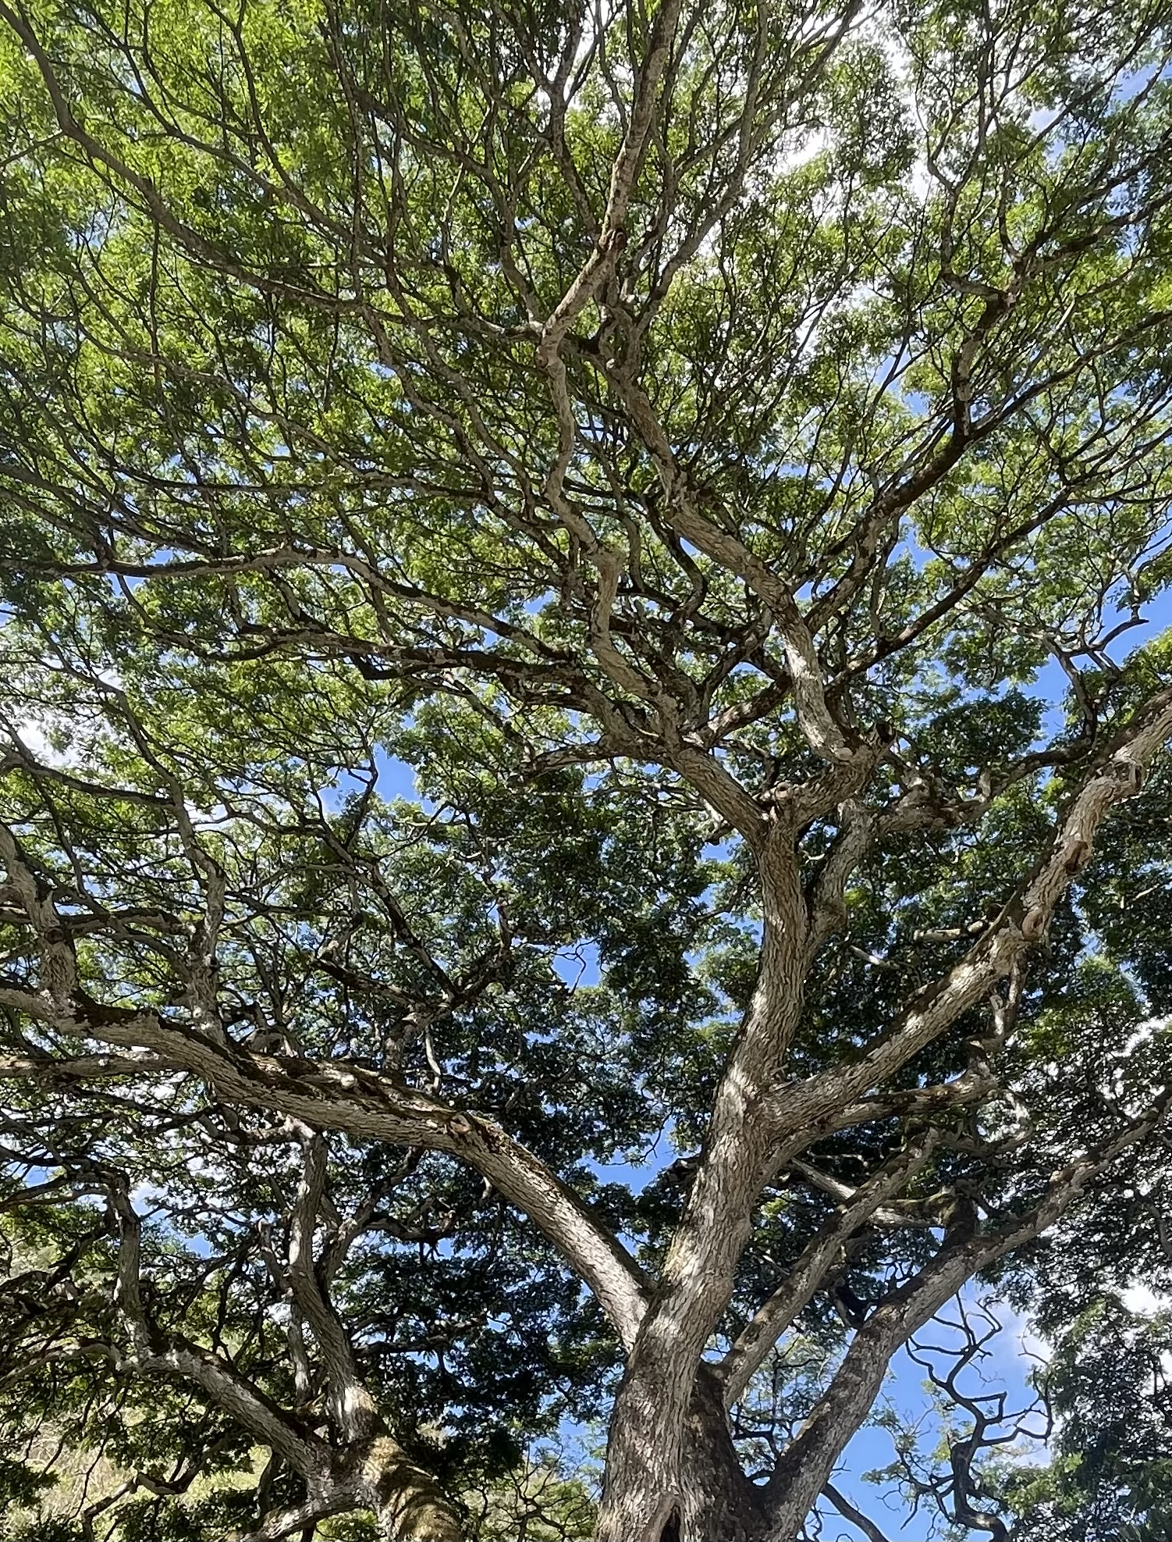
CVI Training
WMU and CViConnect
OSEP STEPPING UP TECHNOLOGY GRANT

Slide 2
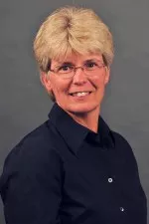

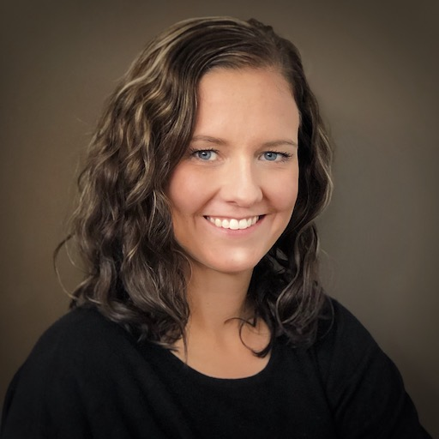
Study Personnel
Dawn Anderson
Principal investigator
West Michigan University
Robert Wall Emerson
Investigator
West Michigan University
Stephanie Steffer
CTVI/CVI Trainer
CViConnect

Slide 3

Presenter and Problem
Dawn Anderson PhD, Professor, is the department Chair for Blindness and Low Vision at Western Michigan University.
The problem to be addressed by this project, get more training to more teachers and teams working with children with brain based visual impairment. The access to information, resources and skills has been uneven across the US with some areas getting lots of training, and some training programs providing lots of content while other areas, training programs, teachers, students and families were left behind.

Slide 4
What is CVI?
CVI stands for Cerebral/Cortical Visual Impairment. CVI is a brain-based visual impairment caused by damage to the visual pathways or visual processing areas of the brain.
Individuals with CVI are neurodiverse, and their perspective on the world is unique and valuable. An individualized multisensory approach to learning and intervention empowers life-changing access.
CVI is the leading cause of blindness in children.

Slide 5
CVI is the leading cause of visual impairment in young children
Roman 2018

Slide 6
CVI Working Definition
l) CVI encompasses a spectrum of visual impairments caused by an underlying brain abnormality that affects the development of visual processing pathways and is characterized by deficits in visual function and functional vision.
2) The visual dysfunction in CVI is greater than expected by any comorbid ocular conditions.
3) The visual dysfunction in CVI may manifest as lower- and/or higher-order afferent visual deficits, leading to characteristic behaviors in affected individuals.
4) While CVI may be comorbid with other neurodevelopmental disorders, CVI is not primarily a disorder of language, learning, or social communication.
5) The underlying neurologic insult of the developing brain may go unrecognized or undiagnosed until later in life.
NEI, PowerPoint Presentation: NEI Strategic Plan: Vision for the Future , 2024

Slide 7
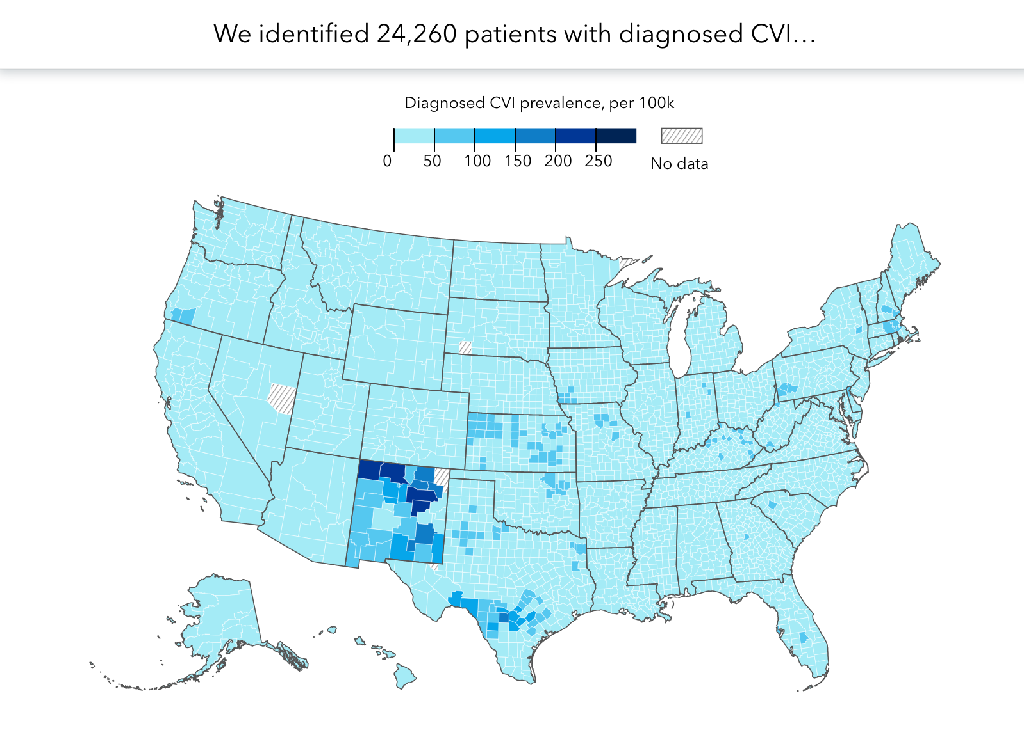
Perkins: CVI By The Numbers

Slide 8
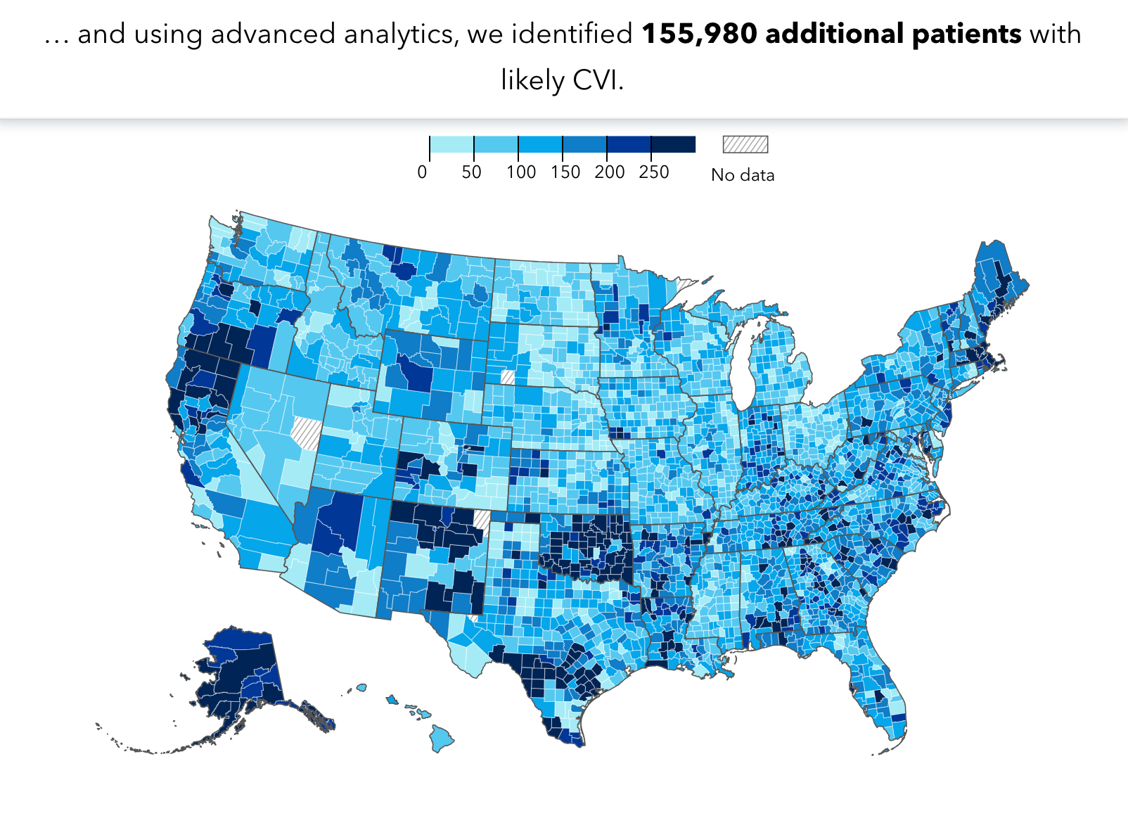
Perkins: CVI By The Numbers

Slide 9
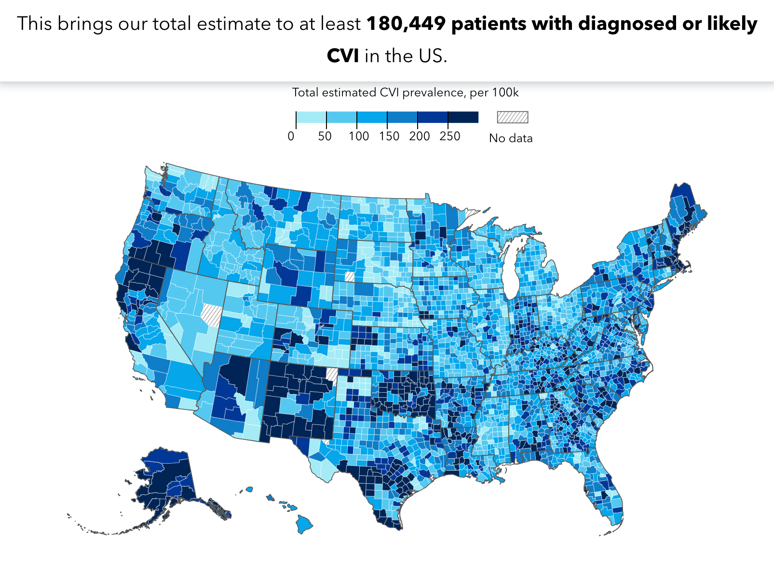
Perkins: CVI By The Numbers

Slide 10
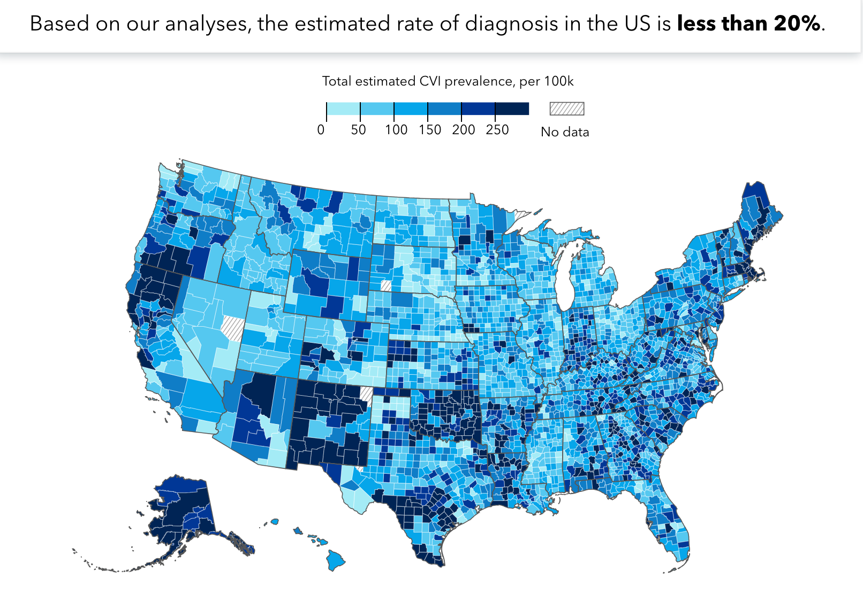
Perkins: CVI By The Numbers

Slide 11

NIH CVI Registry
What might registry data be used for?
Registries can address a variety of questions. Data from this registry may be used to investigate the following research topics:
Diagnose CVI more quickly and accurately
Refine diagnostic batteries
Identify outcomes that are most meaningful to CVIers and their families
Document the scope and prevalence of co-occurring conditions
Understand the neural basis of CVI
Identify biomarkers for CVI
Increase awareness of CVI
Provide data to support policy changes

Slide 12
The Project Model
Providing Professional Development and Structured Mentoring To Vision Professionals
Increase understanding of CVI
Gain Skills in the use of the CViConnect App

Slide 13
The Project Model
Providing Professional Development and Structured Mentoring To Vision Professionals
Increase understanding of CVI
Gain Skills in the use of the CViConnect App
7 States will have training teams
Arizona, Colorado, Hawaii, Michigan, North Dakota, Oregon, and South Dakota,
Notes:
North Dakota
3 TVIs 11 students
South Dakota
5 TVIs 6 students

Slide 14
The Project Model
Providing Professional Development and Structured Mentoring To Vision Professionals
Increase understanding of CVI
Gain Skills in the use of the CViConnect App
7 States will have training teams
We provide training materials and mentorship
(Train the Trainer Model )
Arizona, Colorado, Hawaii, Michigan, North Dakota, Oregon, and South Dakota,
After one year of mentorship, the trainees begin mentoring other CTVI in their state

Slide 15
The Project Model
Providing Professional Development and Structured Mentoring To Vision Professionals
Increase understanding of CVI
Gain Skills in the use of the CViConnect App
7 States will have training teams
We provide training materials and mentorship
(Train the Trainer Model )
Ongoing training and support to meet their state needs
Arizona, Colorado, Hawaii, Michigan, North Dakota, Oregon, and South Dakota,
After one year of mentorship, the trainees begin mentoring other CTVI in their state
Ongoing mentorship, statewide training, NAVEG Training, etc.

Slide 16
The Project Objectives
1. Produce excellent training materials for the use of the CViConnect app.
2. Use web conferencing for group instruction and individualized coaching to ensure instructional efficacy across 5 states and 20 districts or LEAs.
3. Increase TVI confidence in assessing and instructing students with CVI.
4. Improve student access to assessment and interventions for CVI.
5. Improve student outcomes on the CVI range scores for 80% of students.
6. Provide access to CViConnect app and a professional trained in its use in 5 states with at least 20 districts/LEAs.
7. Apply developed training materials and procedures to both rural and urban LEAs, with an emphasis on LEAs that serve areas with high poverty or have high racial and ethnic diversity.

Slide 17
Objective 1:
1. Produce excellent training materials for the use of the CViConnect app.
Professional development and mentorship materials developed in Year 1.
Includes videos, required readings, additional resources, newsletters, and processes to complete the project.
Content in the training modules updated and expanded based on new research and participant feedback.

Slide 18
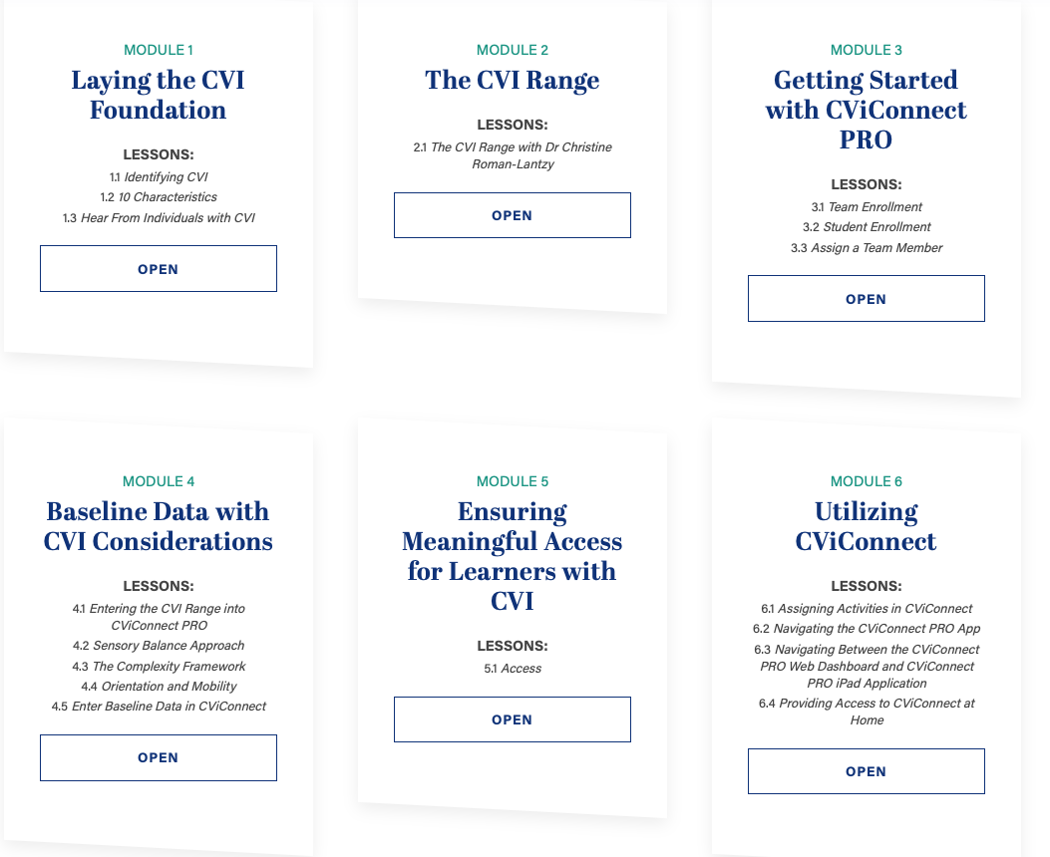
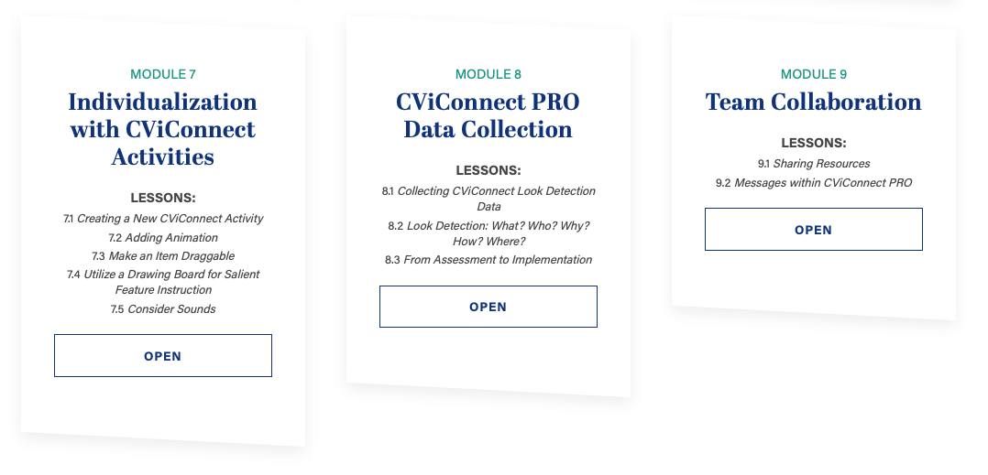
The Learning Modules
9 modules
Research in the Field
Promising Practices

Slide 19
The Project Objectives
1. Produce excellent training materials for the use of the CViConnect app.
2. Use web conferencing for group instruction and individualized coaching to ensure instructional efficacy across 5 states and 20 districts or LEAs.
3. Increase TVI confidence in assessing and instructing students with CVI.
4. Improve student access to assessment and interventions for CVI.
5. Improve student outcomes on the CVI range scores for 80% of students.
6. Provide access to CViConnect app and a professional trained in its use in 5 states with at least 20 districts/LEAs.
7. Apply developed training materials and procedures to both rural and urban LEAs, with an emphasis on LEAs that serve areas with high poverty or have high racial and ethnic diversity.

Slide 20
Objective 2:
2. Use web conferencing for group instruction and individualized coaching to ensure instructional efficacy across 5 states and 20 districts or LEAs.
States Participating: Arizona, Colorado, Hawaii, Michigan, North Dakota, Oregon, and South Dakota
Regular check-in
Revisit learning module content
Goal setting and plan for accomplishment
Extension conversations
Notes:
Communication: Phone, Text, Email, Webinars, In-Person
Goal setting and plan for accomplishment
Regular progress monitor
Extension conversations
Language and Communication
Early Intervention
Transition
New findings in the field

Slide 21
Mentorship Components
Training
Identify Goals
Direction
Agree on meeting cadence
Align Expectations
Motivation
Coaching
Support
Notes:
Research shows these are the required components for successful mentorship programming.

Slide 22
The Project Objectives
1. Produce excellent training materials for the use of the CViConnect app.
2. Use web conferencing for group instruction and individualized coaching to ensure instructional efficacy across 5 states and 20 districts or LEAs.
3. Increase TVI confidence in assessing and instructing students with CVI.
4. Improve student access to assessment and interventions for CVI.
5. Improve student outcomes on the CVI range scores for 80% of students.
6. Provide access to CViConnect app and a professional trained in its use in 5 states with at least 20 districts/LEAs.
7. Apply developed training materials and procedures to both rural and urban LEAs, with an emphasis on LEAs that serve areas with high poverty or have high racial and ethnic diversity.

Slide 23
Objective 3:
3. Increase TVI confidence in assessing and instructing students with CVI.
Most TVIs feel their current practices are moderately to highly effective at improving functional vision (20 out of 27)
Comfort level at assessing a child with CVI (on a 5 point scale) rose from an average of 2.93 before training to 3.63 after training.
Comfort level at planning for and teaching a child with CVI (on a 5 point scale) rose from an average of 2.81 before training to 2.94 after training.
All TVIs rated the training from moderately to extremely useful.

Slide 24
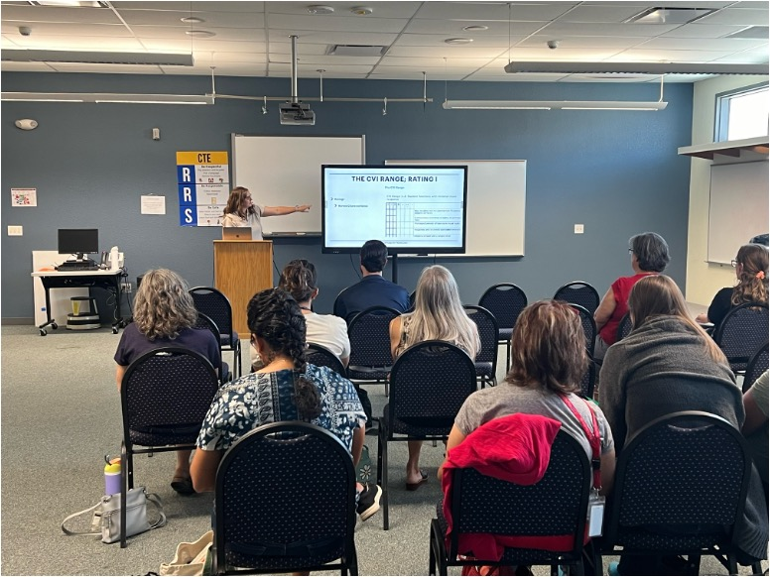
Statewide Initiatives
Brought trainings to participating states
Covered related CVI training to meet their needs
Notes:
Arizona we did 3 different regions in 3 days

Slide 25
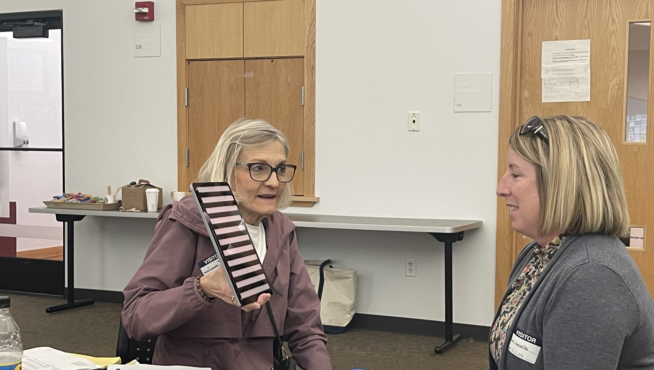
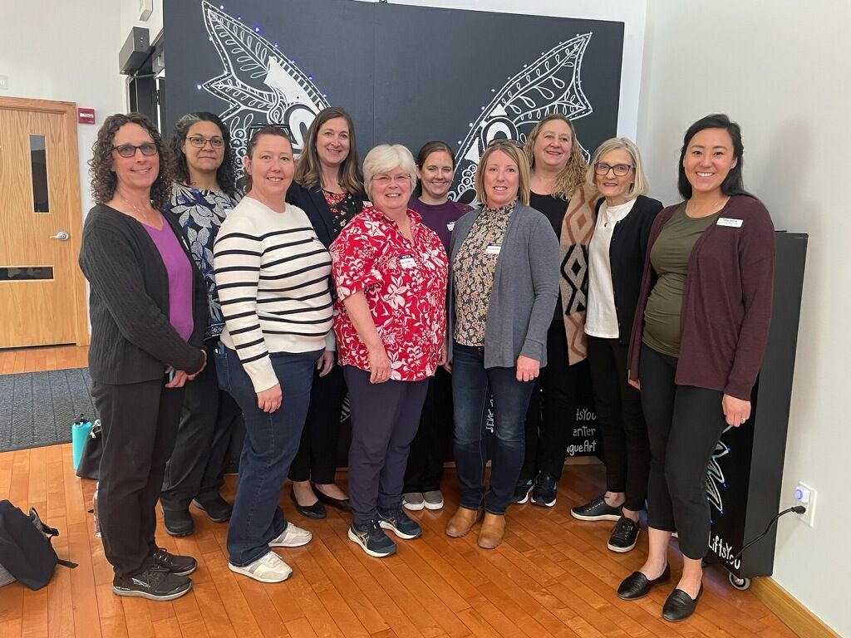
NAVEG Training
(NEONATAL ASSESSMENT VISUAL EUROPEAN GRID)

Slide 26
What is the NAVEG Project?
Validated newborn visual screening tool that indicates neurological risk (Rossi, et al., 2017)
Study (2011-2014) Dept of Neonatology and NICU in Brescia, Italy, with the goal of identifying infants who need early intervention
It has been shown to identify neurological risk for visual impairments in infants born 31 6/7th weeks or less, and the screening can be done at 35-40 weeks
Actively being used by the Anchor Center
The Anchor Center provides training on how to administer the NAVEG
To date we have trained over 100 pediatric interventionists and healthcare professionals on the application and use of NAVEG, including 3 hospitals, 4 state early intervention systems, and 4 private early intervention providers.
Source: Anchor Center for Blind Children. (n.d.). NAVEG. Retrieved (Oct 2024) from https://anchorcenter.org/naveg/

Slide 27
Benefits of the NAVEG
It’s non-invasive, it’s not a medical procedure
If administered correctly, it will not stress the baby
The screening takes about 10 minutes to complete
It’s easy to train, about 2-3 sessions with hands-on portion
Any specialist can be trained; it does not have to be a TVI
Source: Anchor Center for Blind Children. (n.d.). NAVEG. Retrieved (Oct 2024) from https://anchorcenter.org/naveg/
Notes:
Ocular visual component
Motor visual components related
to ocular motor functions
Perceptual visual component
**North Dakota is implementing with their early on teams. They have begun training and practice with any babies to help improve their skills

Slide 28
The Project Objectives
1. Produce excellent training materials for the use of the CViConnect app.
2. Use web conferencing for group instruction and individualized coaching to ensure instructional efficacy across 5 states and 20 districts or LEAs.
3. Increase TVI confidence in assessing and instructing students with CVI.
4. Improve student access to assessment and interventions for CVI.
5. Improve student outcomes on the CVI range scores for 80% of students.
6. Provide access to CViConnect app and a professional trained in its use in 5 states with at least 20 districts/LEAs.
7. Apply developed training materials and procedures to both rural and urban LEAs, with an emphasis on LEAs that serve areas with high poverty or have high racial and ethnic diversity.

Slide 29
Objective 4:
4. Improve student access to assessment and interventions for CVI.
Thus far, we have collected data on 2,819 instructional sessions where TVIs are using the CViConnect app to structure and conduct instruction with students with CVI.

Slide 30
The Project Objectives
1. Produce excellent training materials for the use of the CViConnect app.
2. Use web conferencing for group instruction and individualized coaching to ensure instructional efficacy across 5 states and 20 districts or LEAs.
3. Increase TVI confidence in assessing and instructing students with CVI.
4. Improve student access to assessment and interventions for CVI.
5. Improve student outcomes on the CVI range scores for 80% of students.
6. Provide access to CViConnect app and a professional trained in its use in 5 states with at least 20 districts/LEAs.
7. Apply developed training materials and procedures to both rural and urban LEAs, with an emphasis on LEAs that serve areas with high poverty or have high racial and ethnic diversity.

Slide 31
Objective 5:
5. Improve student outcomes on the CVI range scores for 80% of students.
When comparing students being taught, using the CViConnect app, by trained versus untrained TVIs, students with trained TVIs look at the screen more often (t(2819)=3.70, p<.001, d=.14), have longer sustained looking behavior (t(2819)=7.76, p<.001, d=.29), and spend more overall time looking (t(2819)=3.08, p<.001, d=.12) at the screen.
Students with untrained TVIs touch the screen much more often than trained TVIs. This suggests that when a TVI goes through our training, the result of their instructional sessions leads to more visual behavior in children with CVI whereas simply using the app without training in CVI and the app leads to more “pecking” behavior where children tap on the screen to try and touch a target by luck.
Notes:
Trained Untrained
Look at screen more often touch screen much more often
Longer sustained looking behavior
Spend more time looking

Slide 32
The Project Objectives
1. Produce excellent training materials for the use of the CViConnect app.
2. Use web conferencing for group instruction and individualized coaching to ensure instructional efficacy across 5 states and 20 districts or LEAs.
3. Increase TVI confidence in assessing and instructing students with CVI.
4. Improve student access to assessment and interventions for CVI.
5. Improve student outcomes on the CVI range scores for 80% of students.
6. Provide access to CViConnect app and a professional trained in its use in 5 states with at least 20 districts/LEAs.
7. Apply developed training materials and procedures to both rural and urban LEAs, with an emphasis on LEAs that serve areas with high poverty or have high racial and ethnic diversity.

Slide 33
Objective 6:
6. Provide access to CViConnect app and a professional trained in its use in 5 states with at least 20 districts/LEAs.
26 trained TVIs over 7 sites with data on 88 students
24 untrained TVIs over 8 sites with data on 71 students
Dataset has 6,136 instructional sessions

Slide 34
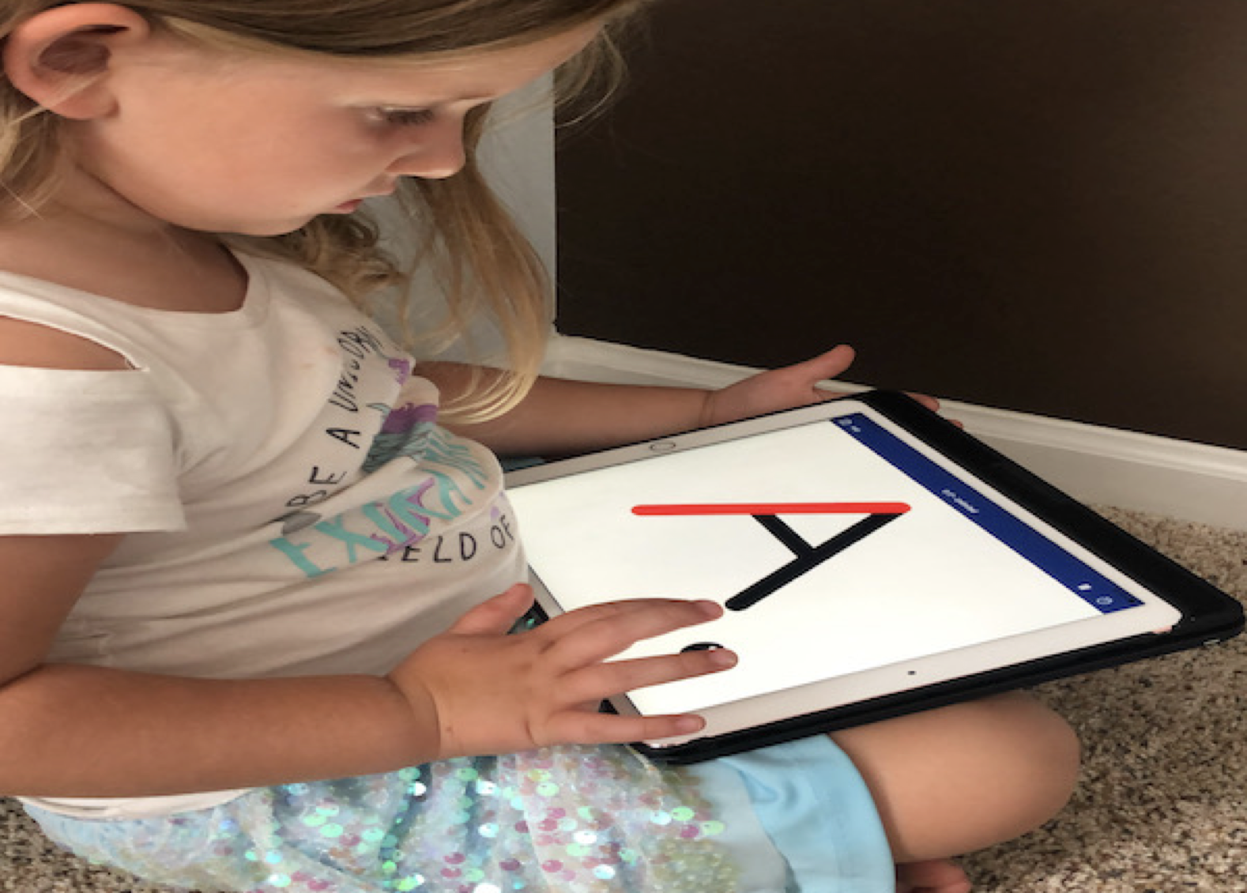
The Technology
CViConnect

Slide 35
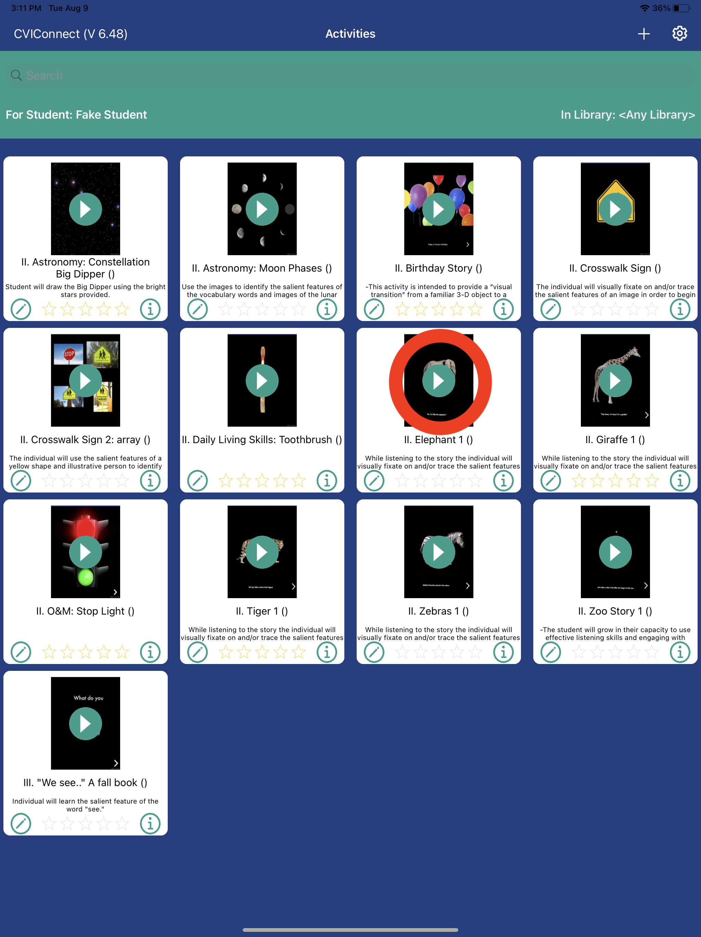
What is CViConnect?
iPad Application:
Library of Activities
Activity Designer
Automatic Data collection
No calibration needed
Room Saliency analysis
Notes:
Activities:
Designed for to meet the visual and behavioral characteristics of CVI
Sorted by Phase of CVI

Slide 36
Data Collected by CViConnect
CViConnect PRO is capturing:
              Session title
              Session date/time
              Session length
              Look/look away detection
              Length of looks
              Eye tracking (heat map)
              Decibel levels
              Touch detection (heat map)
              Screen recording
              Forward facing camera recording
Mediator’s comments capture:
              Body position
              Student health
              Behavior
              Environmental information
              Additional sensory inputs (touch, smell, etc)

Slide 37
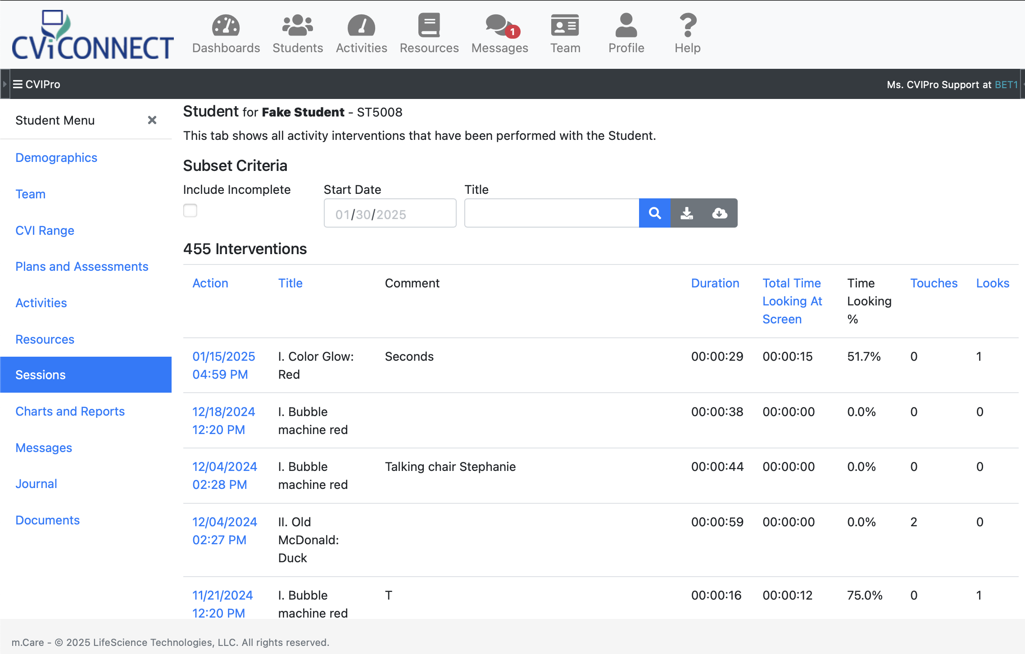
What is CViConnect?
Teacher Dashboard:
Secure Student notebook
Team access
Functional Vision Evaluation (CVI Range)
Activity Assignment
Review Session Data
    Heat Map
    Touch Map
    iPad Screen recording
    Front Camera Recording

Slide 38

Example Student B, Session 1
Position
  Child is positioned in their wheelchair.
Activity
  Student is shown Color Glow Purple Activity.
Preferred Field
  iPad is located at student’s central field at eye level.

Slide 39
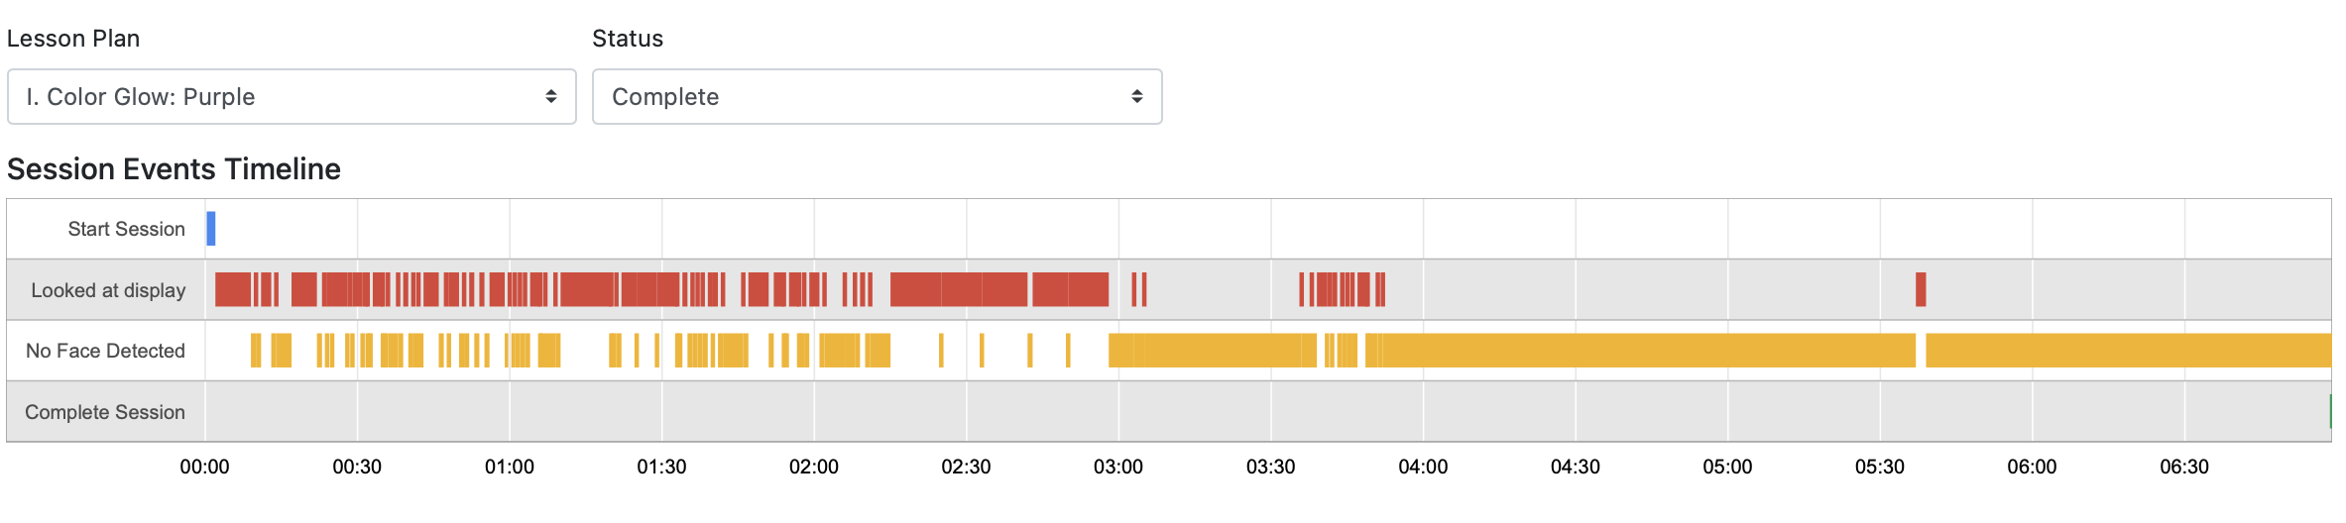
Example Student B, Session 1
Activity
  Student is shown Color Glow Purple Activity.
Session length
  6:59
Number of looks
  124
Longest look
  0:10

Slide 40
Example Student B, Session 1
Activity
  Student is shown Color Glow Purple Activity.
Session length
  6:59
Number of looks
  124
Longest look
  0:10

Slide 41
Example Student B, Session 1
Activity
  Student is shown Color Glow Purple Activity.
Session length
  6:59
Number of looks
  124
Longest look
  0:10

Slide 42

Example Student B, Session 2
Position
  Child is positioned in their wheelchair.
Activity
  Student is shown Color Glow Red Activity.
Session length
  5:31
Number of looks
  251
Longest look
  0:58
Preferred Field
  iPad is located at student’s central field at eye level.

Slide 43
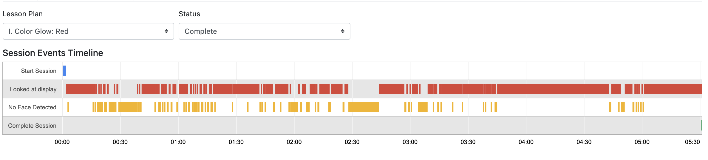
Example Student B, Session 1
Activity
  Student is shown Color Glow Red Activity.
Session length
  5:31
Number of looks
  251
Longest look
  0:58

Slide 46
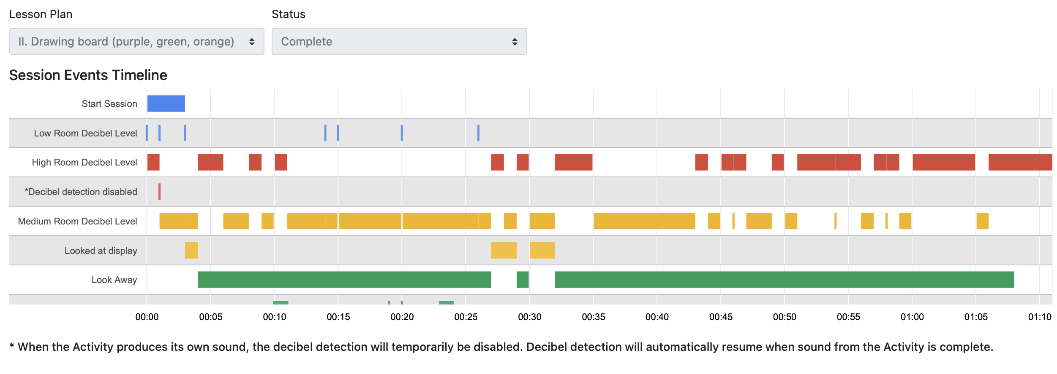
Example Student D
TVI noted high decibel detection and frequent look away
Good reminder for her and mom to limit talking during visual opportunities

Slide 47
The Project Objectives
1. Produce excellent training materials for the use of the CViConnect app.
2. Use web conferencing for group instruction and individualized coaching to ensure instructional efficacy across 5 states and 20 districts or LEAs.
3. Increase TVI confidence in assessing and instructing students with CVI.
4. Improve student access to assessment and interventions for CVI.
5. Improve student outcomes on the CVI range scores for 80% of students.
6. Provide access to CViConnect app and a professional trained in its use in 5 states with at least 20 districts/LEAs.
7. Apply developed training materials and procedures to both rural and urban LEAs, with an emphasis on LEAs that serve areas with high poverty or have high racial and ethnic diversity.

Slide 48
Objective 7:
7. Apply developed training materials and procedures to both rural and urban LEAs, with an emphasis on LEAs that serve areas with high poverty or have high racial and ethnic diversity.
All 7 states have at least one site
Provide iPads and Wi-Fi access as needed
No Wi-Fi Mode
Temporary store encrypted data not accessible on the iPad for data security

Slide 49

Preliminary Results

Slide 50
Activities by Phase
 | Phase 1 | Phase 2 | Phase 3 | Total
Untrained | 1191 (57.0%) | 445 (21.3%) | 454 (21.7%) | 2,090
Trained | 3037 (75.1%) | 671 (16.6%) | 338 (8.4%) | 4,046
Χ²(2) = 272.96, p < .001
Notes:
This shows that there is a significant difference between trained and untrained TVIs on the phase of activities chosen to use with students. All TVIs are using phase 1 sessions much more than phase 2 or phase 3 (but untrained TVIs use phase 2 and 3 lessons much more than trained TVIs).
TVIs use phase 1 sessions much more than phase 2 or phase 3
Untrained TVIs use phase 2 and 3 lessons much more than trained TVIs
Trained TVIs tend to have instructional sessions 3X as long as untrained TVIs
Students with untrained TVIs have students who touch sprites and backgrounds much more than students with trained TVIs BUT students with trained TVIs look at the screen more often, have longer looks, and spend more time looking at the screen than students with untrained TVIs.

Slide 51
All Phases of Activities
 | Untrained | Trained | t value (df) | p value | d
Sessions | 2090 | 4046
Total seconds | 93.33 (102.89) | 246.2 (281.99) | 23.97 (6134) | <.001 | .65
Avg sprites touched/sec | .05 (.13) | .03 (.18) | 4.36 (6134) | <.001 | .12
Avg backgrounds touched/sec | .02 (.05) | .01 (.09) | 1.92 (6134) | .03 | .05
Avg time looking at screen | 9.98 (35.20) | 16.24 (74.92) | 3.62 (6134) | <.001 | .10
Longest look | 19.01 (50.29) | 43.74 (112.68) | 9.55 (6134) | <.001 | .26
Avg looks/sec | .08 (.14) | .11 (.14) | 7.17 (6134) | <.001 | .19
Notes:
Here we are looking at stats For all levels of activities
Trained TVIs tend to have instructional sessions 2.5X as long as untrained TVIs
Students with untrained TVIs have students who touch sprites and backgrounds much more than students with trained TVIs BUT students with trained TVIs look at the screen more often, have longer looks, and spend more time looking at the screen than students with untrained TVIs.

Slide 52
Most Popular Lessons
 | Lesson level 1 | Lesson level 2 | Lesson level 3
Untrained TVIs | Bubble machine purple (11.3%) Bubble machine - general (9.8%) Bubble machine yellow (7.9%) | Birthday story (6.7%) Constellation creation (6.3%) Musical instruments (5.6%) | Letter J (21.1%) Letter R (18.0%) Letter O (17.8%)
Trained TVIs | Color glow: red (20.5%) Color glow: yellow (13.1%) Bubble machine - general (6.9%) | Shapes: circle (18.2%) Very hungry caterpillar (15.8%) Birthday story (12.8%) | Word BIG (8.6%) Square (7.1%) Rhyming -at (6.8%)
Notes:
Most popular lessons by lesson level and TVI training

Slide 53
Analysis of Improvement Over Time
 | Kids with untrained TVIs (n=12) |  |  |  | Kids with trained TVIs (n=27)
 | Min | max | avg | Slope | min | max | avg | slope
Events per second | .05 | 1.99 | .59 | .02 | .04 | 1.75 | .49 | .01
Highest brightness | 1.0 | 3.17 | 1.26 | .001 | 1 | 3.22 | 1.18 | 0
Lowest brightness | 1.0 | 3.17 | 1.26 | .001 | 1 | 3.22 | 1.18 | 0
Avg sprites touched per second | .002 | .25 | .05 | .002 | 0 | .26 | .03 | 0
Avg backgrounds touched per second | 0 | .01 | .02 | .001 | 0 | .12 | .01 | 0
Average time looking | .25 | 69.19 | 13.93 | .22 | 0 | 271.73 | 26.01 | .54
Longest look | 1.38 | 97.6 | 23.87 | .21 | .41 | 513.94 | 70.35 | .24
Average looks per second | .001 | .39 | .08 | .003 | 0 | .41 | .49 | 0
Notes:
This table reflects kids with at least 20 days of data. Data from all sessions on a given day were averaged to give a single score for each day of data.
Although no slopes for anything for any student are statistically significant, a slope of .5 or more would arguably demonstrate consistent progress on a measure across days of working with a TVI.

Slide 54
Analysis of Improvement Over Time
 | Kids with untrained TVIs |  | Kids with trained TVIs
 | Negative slopes (n=1) | Positive slopes (n=2) | Negative slopes (n=5) | Positive slopes (n=14)
Events per second
Highest brightness
Lowest brightness
Avg sprites touched per second
Avg backgrounds touched per second
Average time looking | -.5 | .52, 2.84 | -1.33, -.73, -2.76 | 1.39, .56, 7.57, 2.73, 2.64, 2.16
Longest look | -1.83 | 1.22, 2.97 | -.61, -5.11, -1.34, -.58, -20.95 | 2.83, 1.11, .82, .51, .94, 10.37, 2.42, 2.50, 1.99, 1.44, 1.64, 1.19, 2.17, 4.19
Average looks per second
Notes:
The following table shows any slopes for any measure in students with at least 20 days of data, where the slope is more than .50 or less than -.50.
In the group of students working with untrained TVIs, while two students did show improvement in average time looking and longest look, this is a success rate of 16.7% while with the trained TVIs, 14/27 or a 51.9% success rate at improving the longest look.

Slide 55

Frequency of CViConnect use by TVIs

Slide 56
Across All Data
 | Average school months | Average days | Average sessions | Average days/month | Average sessions/month
Untrained | 6.55 | 9.89 | 32.25 | 12.32 | 20.19
Trained | 9.59 | 22.14 | 47.86 | 8.23 | 26.53
Notes:
But this includes students only seen for 1 day, etc. so…

Slide 57
Across All Data
(>3 months)
 | Average school months | Average days | Average sessions | Average days/month | Average sessions/month
Untrained (26 students) | 15.25 | 20.58 | 69.77 | 1.62 | 5.23
Trained (56 students) | 14.70 | 32.94 | 70.37 | 2.23 | 5.04
Notes:
For data with school months > 3

Slide 58
Across All Data
(> 1 year+20 days of data)
 | Average school months | Average days | Average sessions | Average days/month | Average sessions/month
Untrained (10 students) | 19.60 | 38.80 | 133.60 | 2.51 | 8.01
Trained (26 students) | 18.92 | 58.04 | 117.35 | 3.25 | 6.63
Notes:
And, to compare students for whom we have the most consistent data over time, for those with at least a calendar year of data and at least 20 days of data

Slide 59
TVI Survey Results
⚠️. Note: After-training data reflects responses from 21 of 54 participants (39%). Additional responses are still being collected.

Slide 60
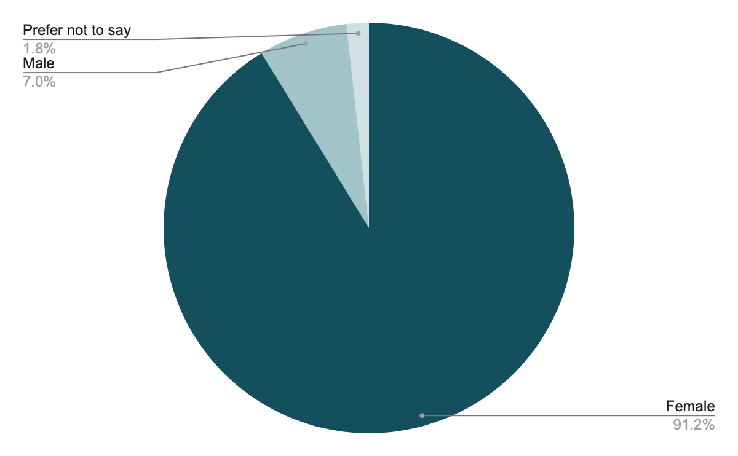
Demographics: Gender

Slide 61
Demographics: Gender

Slide 62
Pre/Post TVI Survey
How comfortable were you in teaching or providing targeted interventions for a child with CVI after training?
Average confidence increased by 0.77 points (from 2.75 to 3.52) after training.
The mode increased by 2
The training eliminated the lowest confidence level (1) from responses.
Notes:
After participating in CVI-specific professional development, teachers of the visually impaired showed a 28% increase in average self-reported confidence (from 2.75 to 3.52 on a 5-point Likert scale) in planning for and delivering targeted instruction to learners with CVI. The most common rating improved from ‘a bit comfortable’ to ‘fairly comfortable,’ with no teachers rating themselves as ‘not at all comfortable’ post-training.

Slide 63
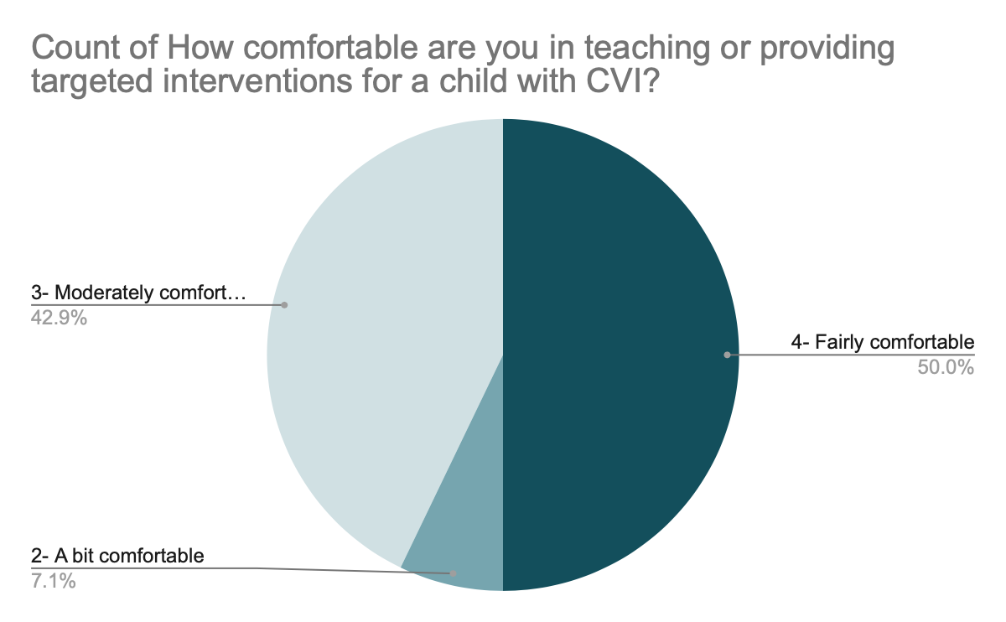
Pre/Post TVI Survey
Note: After-training data reflects responses from 21 of 54 participants (39%). Additional responses are still being collected.
Notes:
After participating in CVI-specific professional development, teachers of the visually impaired showed a 28% increase in average self-reported confidence (from 2.75 to 3.52 on a 5-point Likert scale) in planning for and delivering targeted instruction to learners with CVI. The most common rating improved from ‘a bit comfortable’ to ‘fairly comfortable,’ with no teachers rating themselves as ‘not at all comfortable’ post-training.

Slide 64
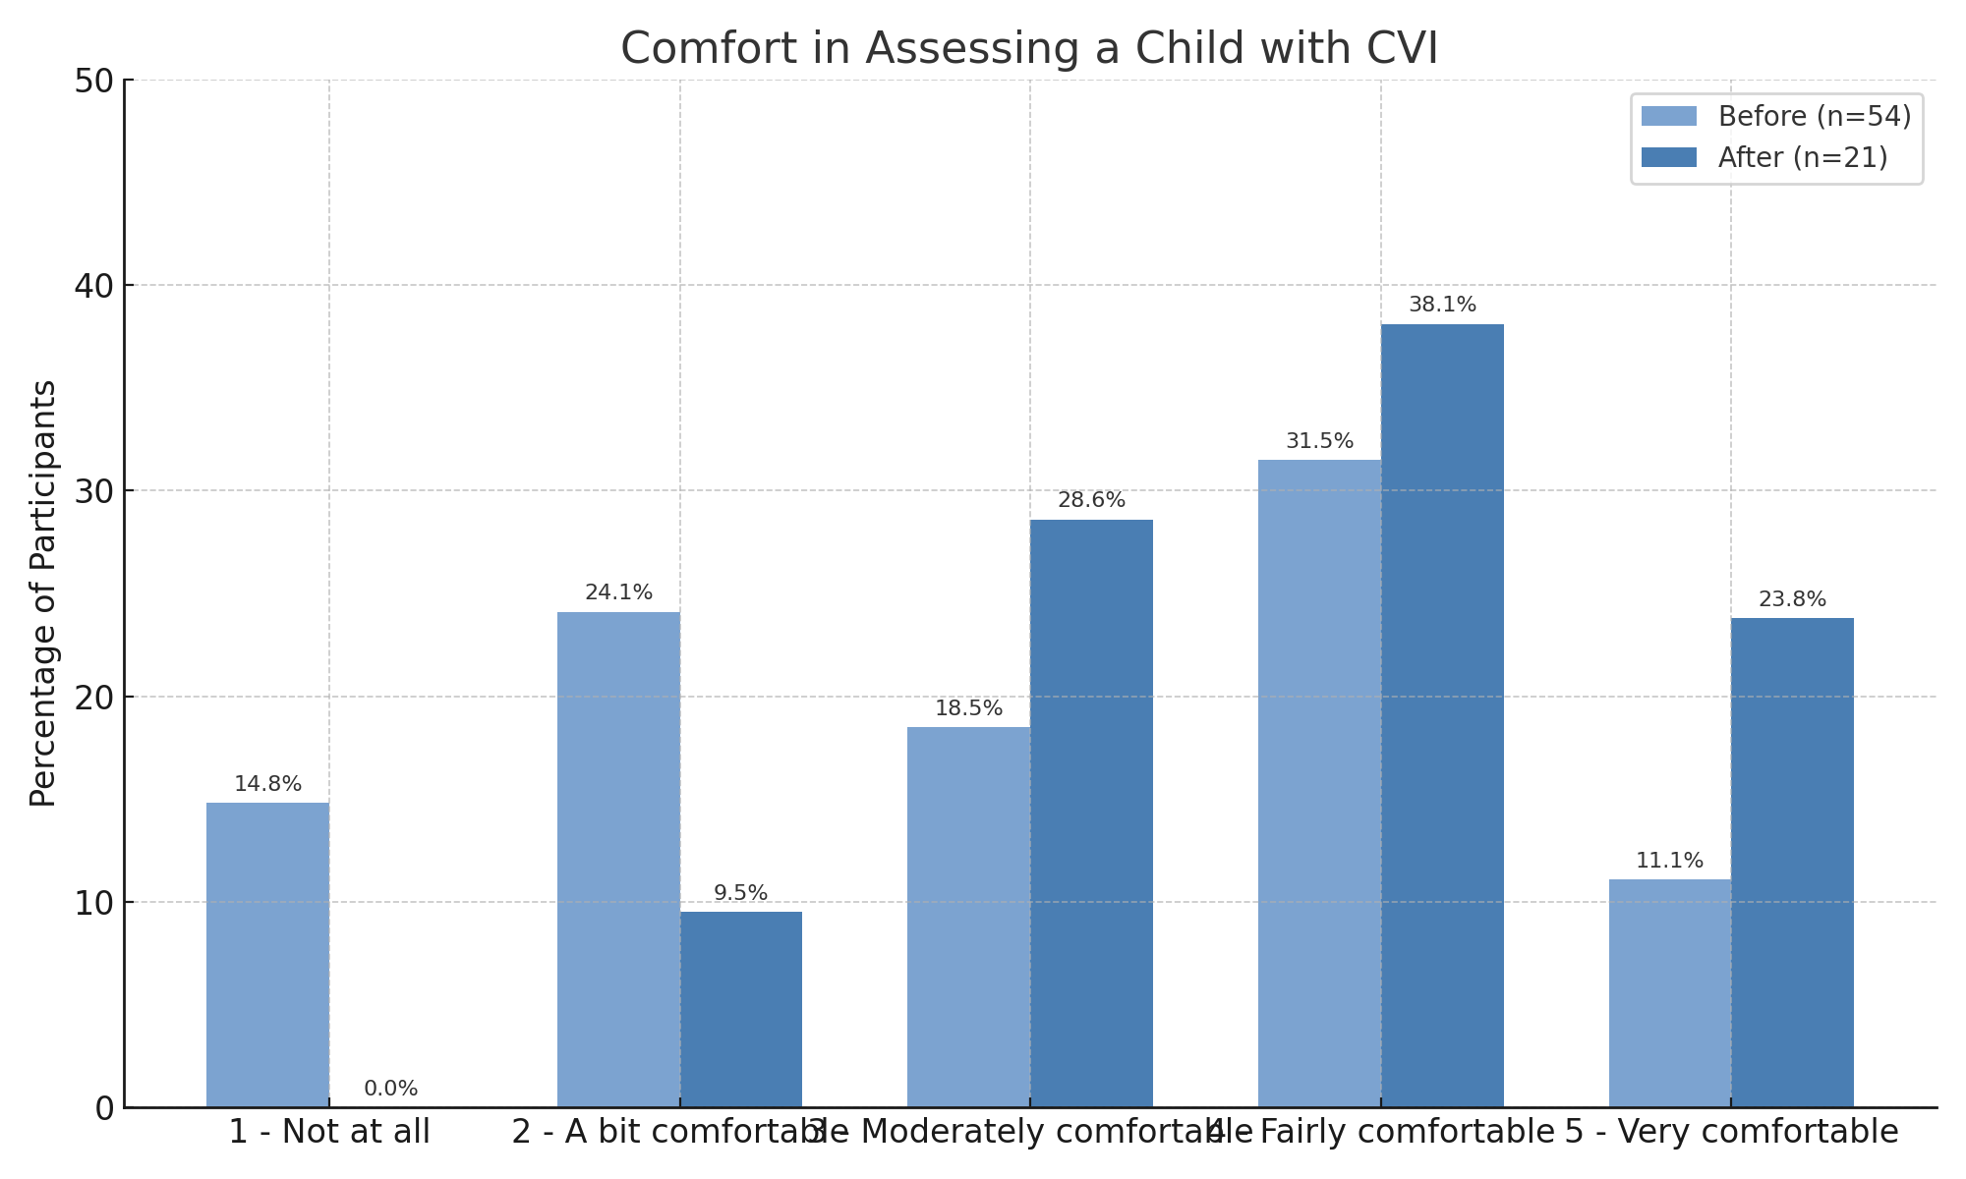
Increased Confidence in Assessing Students with CVI
Note: After-training data reflects responses from 21 of 54 participants (39%). Additional responses are still being collected.
Notes:
While these after-training results are still coming in, early responses already show a promising shift—participants are reporting significantly higher comfort levels in assessing children with CVI. We expect this trend to hold as more responses are collected.

Slide 65
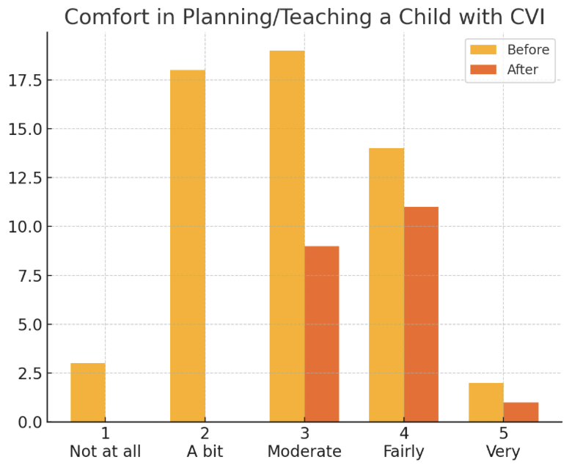
Increased Comfort in Planning/ Teaching
Note: After-training data reflects responses from 21 of 54 participants (39%). Additional responses are still being collected.

Slide 66
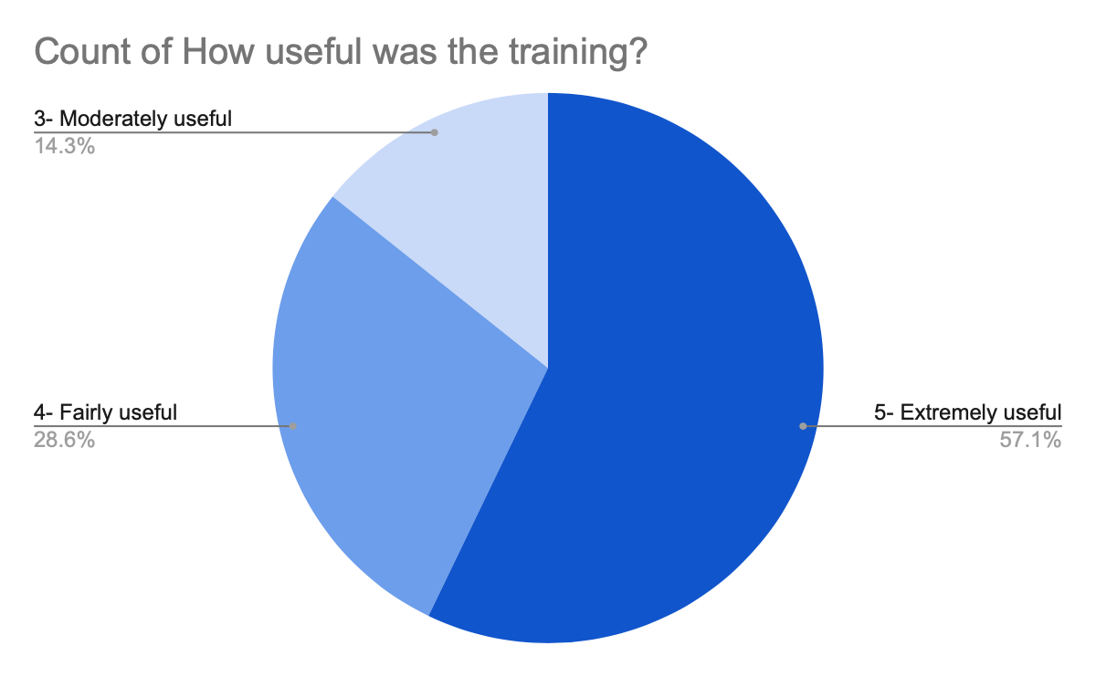
Usefulness of Training
Note: After-training data reflects responses from 21 of 54 participants (39%). Additional responses are still being collected.

Slide 67

Questions?

Slide 68



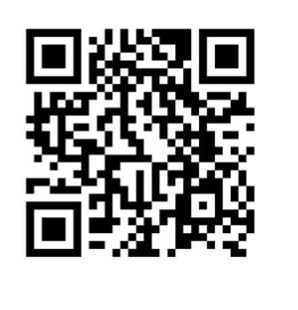
Thank you dawn.l.Anderson@wmich.edu
Stephanie Steffer
Business Director
CViConnect
StephanieS@cviconnect.co

