Slide 1
Functional Vision Assessments
Back to the Basics!
APH’s FVLMA Guidebook and NewT Kit
Notes:
How many Evals and re-evals do we have this year? 1-3? 4-8? 10+?

Slide 2
FVLMA Purpose
Is to determine:
  How a student functions visually in daily activities with a variety of materials.
  Ways to increase visual functioning.
  Student’s primary and secondary learning media.
  The student’s current skills in literacy (reading, writing, listening, keyboarding, assistive technology).
  How the visual impairment affects the student’s performance in the general education curriculum.
Notes:
Above is quoted from FVLMA Practitioner’s Guidebook
Foundations of Low Vision, page 341

Slide 3
Assess, Plan, Instruct Loop
Assess
Plan
Instruct
Notes:
When used deliberately, assessment helps educators make informed decisions about programming, school supports and instruction.
1st – assess to determine NEED
2nd – Use assessment data, create an instructional plan that highlights the student's strengths and targets the students needs.
3rd – The plan is implemented (Instruct) for a period of time.
Finally, assessment is conducted to evaluate how well the instruction worked, making any necessary changes to the program based on the results.

Slide 4
THE BASICS:
Where do we start?
Notes:
Where do we begin? Do we roll in and start testing the student?

Slide 5
First Steps First!
Review the Eye Medical Report
  Including Low Vision Evaluation, if completed
  Research the diagnosis – new information comes out regularly from medical advances.
Review Medical Reports
  Other diagnosis?
Notes:
From: FVLMA Practitioner’s Guidebook and NewT Quickstart Guidebook.
See FVLMA Practitioner’s Guidebook page 6-7 for a great checklist.

Slide 6
First Steps First! (continued)
Review the student’s educational history
  Cumulative folder
  Pre-academic? Academic?
  Difficulties/Challenges? Areas the student excels?
Can the student…
  Understand verbal directions? One or two-step directions?
  Respond verbally? Match items or point to communicate?
  Read and write?
Notes:
What tools do you need from the kit? What activities should you use? The above questions will help guide you to the answers.
Look at family history, life events, cultural implications.

Slide 7
Next Steps!
Interview
  Parents, Student (as appropriate), and teachers.
  Get started with the FVLMA Practitioner’s Guidebook pg. 13
Observe
  In a variety of settings.
  Be a fly on the wall – not seen or heard.
  Take notes! Trust me, you won’t remember.
  Practitioner’s Guidebook Pages 21-25 has excellent checklists and questions to get you started.
Notes:
Make sure you have noted: family history, life events, cultural implications
RIOT: Review, Interview, Observe, Test (Assess) The first three steps should give you a good chunk of your needed information. Then determine what you need to assess.

Slide 8
Materials Preparation
Unpack and organize the materials you will need.
Location, location, location.
Do you need assistance?
Identify distances within the space you’ll be utilizing.
Make note of the type of lighting in the assessment space.
Notes:
From NewT Description and uses of tools
RIOT: Review, Interview, Observe, Test (Assess) The first three steps should give you a good chunk of your needed information. Then determine what you need to assess.

Slide 9
Your Student
Should be assessed utilizing all optical devices
  Glasses, video magnifier, magnifier/monocular, etc
Is the student alert?
  Not hungry, sleepy, improperly medicated, etc.
Provide the student with appropriate positioning and support as needed.
  Back, head, neck support; proper seating arrangement
Give breaks as needed.
  Have a music/dance session!
Notes:
From NewT Description and uses of tools

Slide 10
Student Preparation
Build rapport first.
Explain (appropriately for student’s need) the purpose of the activity.
This is not a test. There are no right or wrong answers.
  Avoid using words or responses that might indicate that the student is doing better if they see more.
Notes:
From NewT Description and uses of tools

Slide 11
Helpful Tools

Slide 12
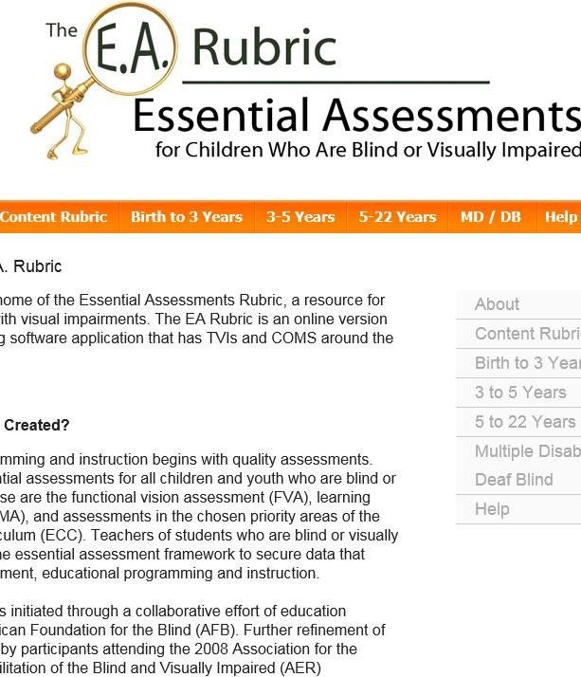
Essential Assessments Rubric
www.EArubric.com

Slide 13
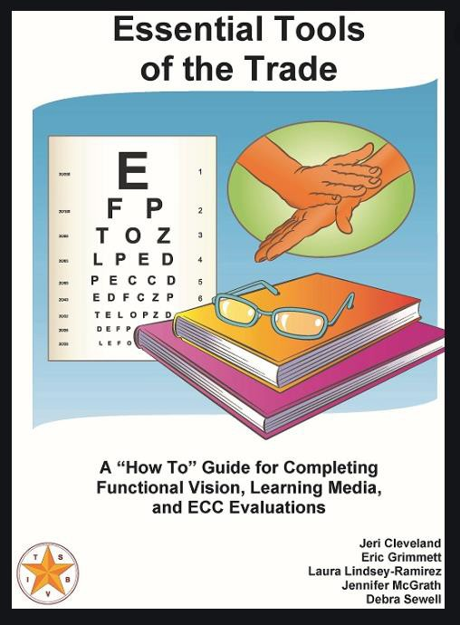
Essential Tools of the Trade
Essential Tools of the Trade:
A “How To” Guide for Completing Functional Vision, Learning Media and ECC Evaluations
From TSBVI
Notes:
ND did a training on this previously

Slide 14

NewT Kit
Lots of the goodies you will need and more!
Notes:
https://www.youtube.com/watch?v=yhLkHXw8lXQ

Slide 15
FVLMA Guidebook
Includes:
  Practitioner’s Guidebook
    Interviews and Observations
    FVLMA Report
  FVA forms
  LMA forms
  O&M Screening record
  ECC Screening record

Slide 16
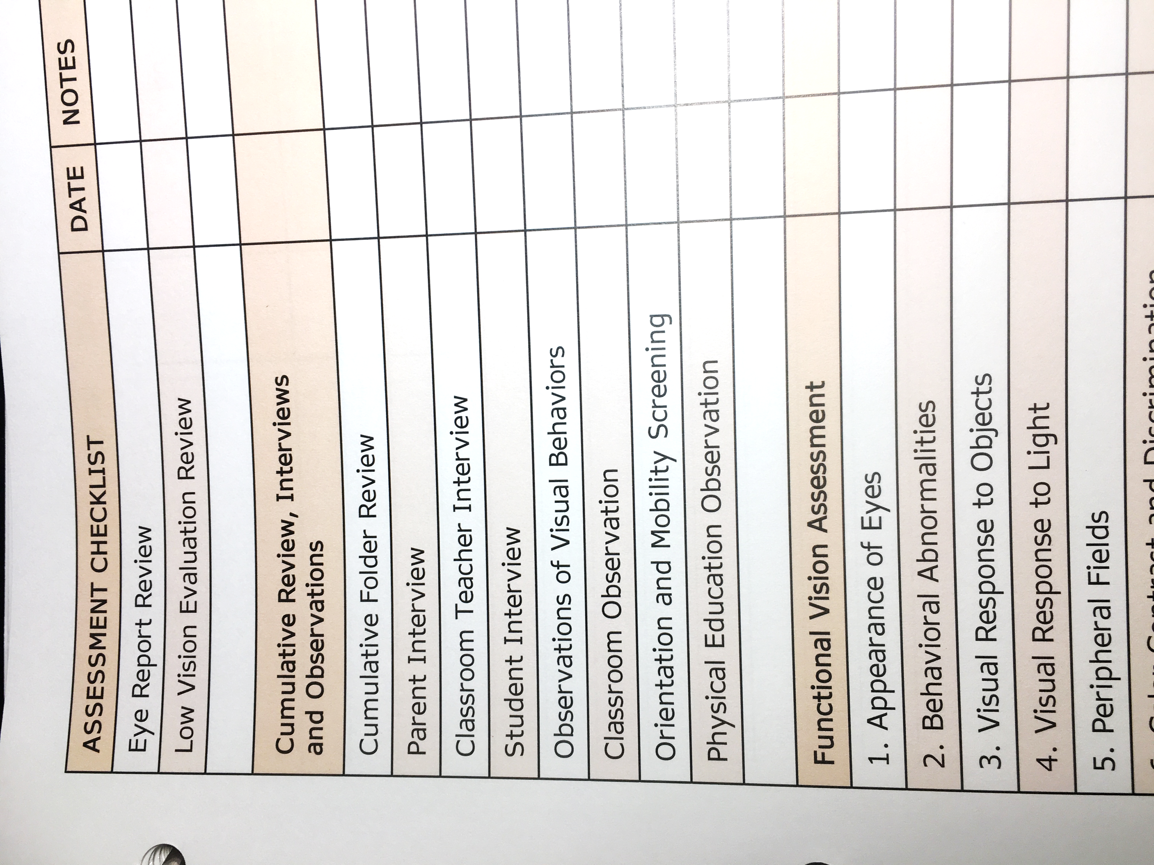
FVLMA GUIDEBOOK
ASSESSMENT CHECKLIST FOUND ON PAGE 7 OF GUIDEBOOK
Notes:
We already set ours up, if you still have yours in the packaging – get with a peer to go through it!

Slide 17
Materials for your FVA Kit
Notes:
https://www.youtube.com/watch?v=yhLkHXw8lXQ

Slide 18
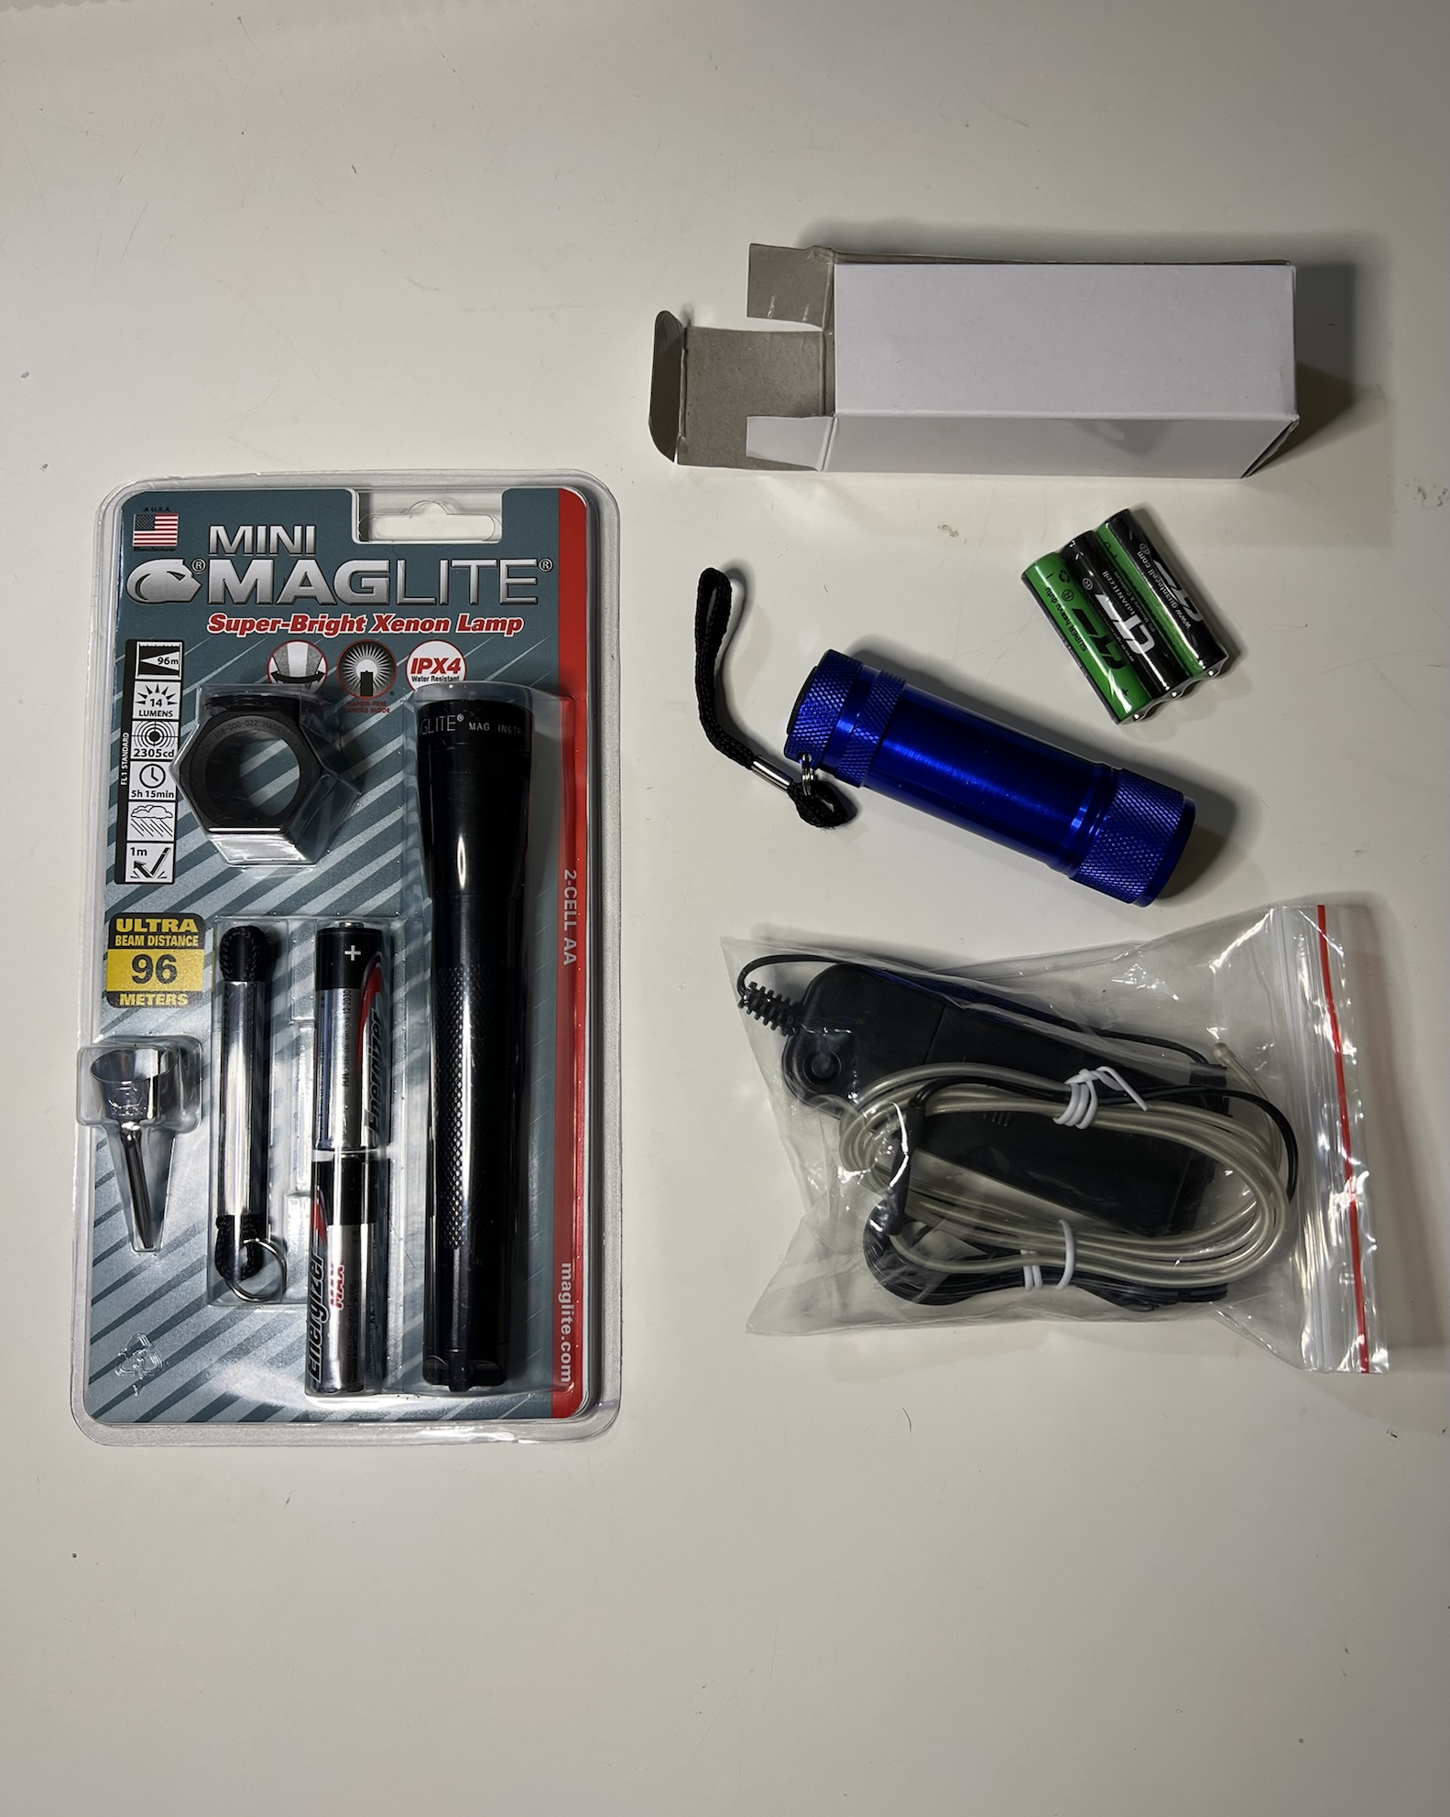
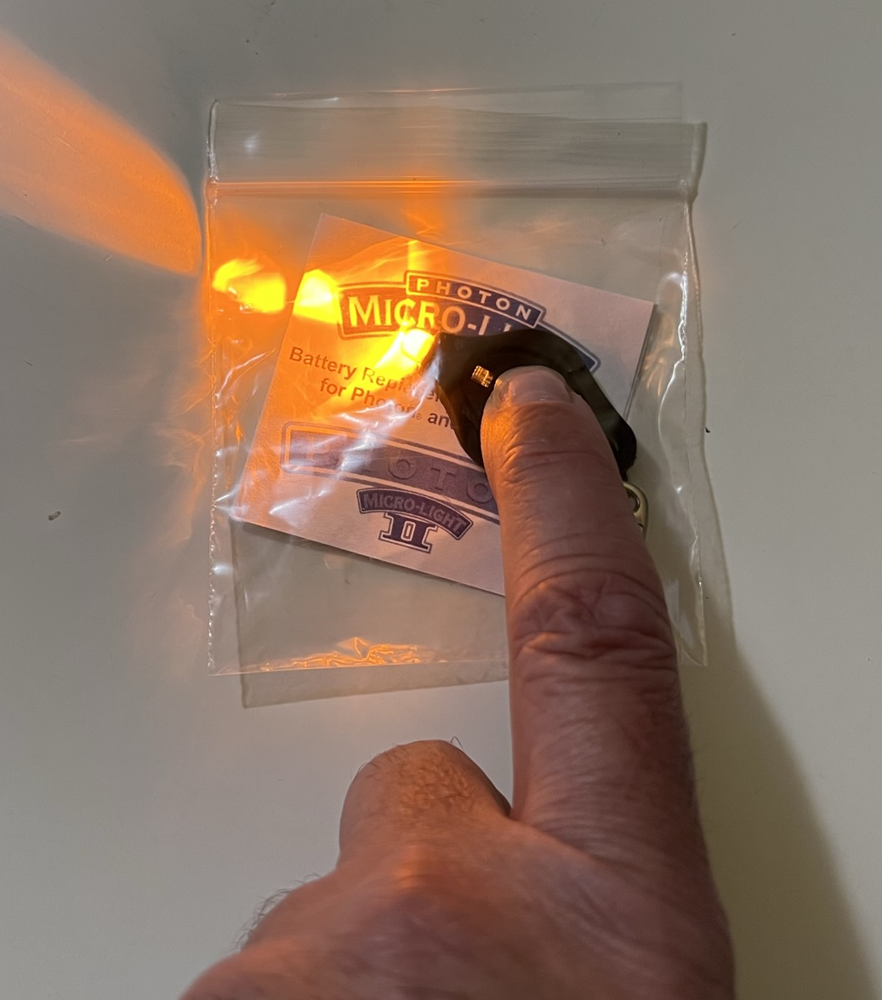
Visual Response to Light
Materials in NewT
ToAD Flashlight w/attachments, ToAD aqua string light
Penlight
Child’s & adult’s Ultra Lens
Provided by the TVI
None!
* Caution with students who are sensitive to light. Bright or flickering light could possibly trigger seizures in some students.
Notes:
These are out of order from the FVLMA.
You will also find support in the FVLMA Practitioner’s Guidebook (Some are combined with Visual Response to Objects):
Materials in FVLMA Guidebook
Background
Assessment Procedures
Checklist
Typical/Atypical Examples
Examples of Functional Problems
Educational Implications

Slide 19
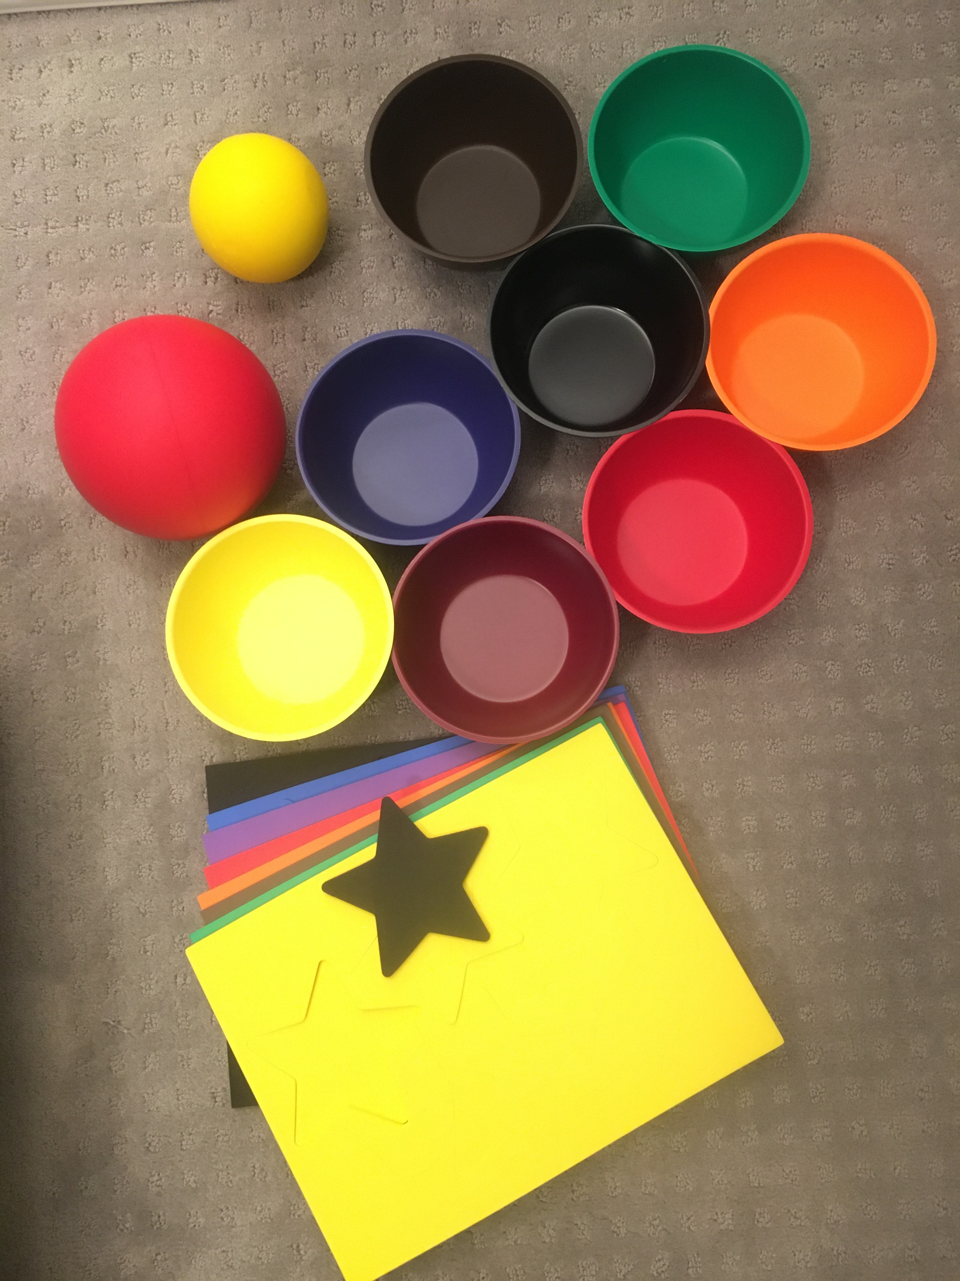
Visual Response to Objects
Materials in NewT
Balls, bowls and stars of varying sizes and colors (red, blue and white)
Provided by the TVI
None!
Notes:
Quietly. Silently. We’re testing for visual skills, not auditory localization or recognition!

Slide 20
Implications for light/object recognition?
Functional Problems
Difficulty traveling.
Difficulty detecting, locating and identifying objects.
Inability to learn through visual channel.
Educational Implications
Must learn through their remaining senses.
Compensatory skills such as braille, tactile modes of learning, auditory skills, etc must be taught.
Notes:
From FVLMA Practitioner’s Guidebook.
Students who are unable or have great difficulty locating, attending, and identifying objects or light sources will not have vision as their primary learning mode and must learn through their remaining senses. They are considered to be functionally blind. Compensatory skills such as braille, tactile modes of learning, auditory skills, etc must be taught in order to access printed information.

Slide 21
Functional Blindness
Students who are unable or have great difficulty locating, attending to, or identifying objects or light sources will not have vision as their primary learning mode.
They are considered functionally blind. Compensatory skills such as braille and listening must be taught in order to access printed information.
Notes:
Page 42-43 of FVLMA Practitioner’s Guidebook

Slide 22
Light Sensitivity and Preference
Materials in NewT
None
Provided by the TVI
Ordinary lamp w/incandescent or florescent bulb with on/off switch
Classroom with windows and adjustable overhead lighting
Notes:
Starting with Lighting and Visual Fields will give you the best conditions for the next areas of the FVA. Present items in the best viewing field of vision and with correct lighting.

Slide 23
Light Sensitivity Observations
Work on tasks that are meaningful to the student in different areas/lighting within the classroom.
Observe student’s visual behavior of squinting, avoiding light, shading eyes, etc.
Note light adaptation time needed for comfort when coming in from/going outside.

Slide 24
Educational Implications – why is this important to know?
Functional Problems
Photophobia or discomfort
Issues with glare
Decreased vision in low or bright light
Headaches or pain
Educational Implications
Modifications to classroom setting
Teach self-determination skills
Preferential seating

Slide 25
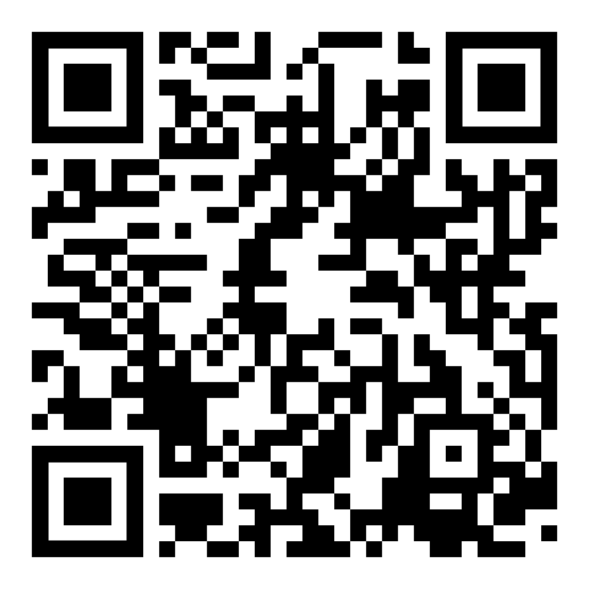
Peripheral Fields
Materials in NewT
Objects in kit may be of use
Provided by the TVI
Unfamiliar furnished classroom
Confrontational field testing with 2 persons
Notes:
Starting with Lighting and Visual Fields will give you the best conditions for the next areas of the FVA. Present items in the best viewing field of vision and with correct lighting.
Assessment of Visual Fields Video: Diane Dirette|MedBridge: https://www.youtube.com/watch?v=liSMzhZJ63Q
Participants can use their phone/device to access the QR Code and save the video for future viewing.

Slide 26
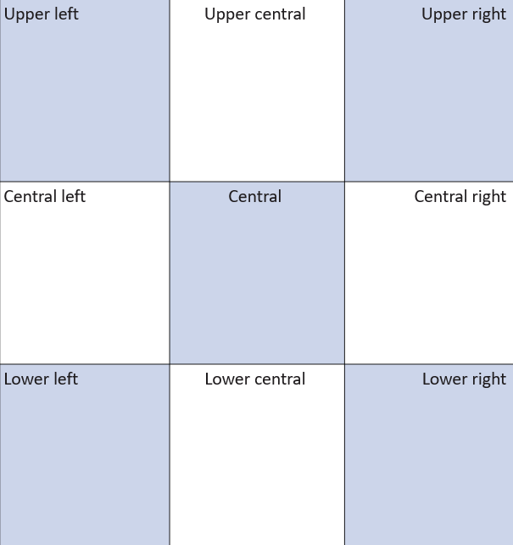
CONFRONTATIONAL FIELD TESTING
2 people (examiner & observer)
Use environment for general information on field
Use target approach from behind for checking data
Important for students with conditions impacting peripheral vision

Slide 27
Try it out!
Find an object near you for peripheral field testing. Groups of 3!

Slide 28
Why would field loss be important to know?
Functional Problems
Difficulty with mobility and safe travel.
Atypical visual behaviors such as frequent eye and head movements.
Difficulty locating objects.
Educational Implications
Preferential seating to increase use of functional fields.
Training in scanning systematically.
Caution with fast moving objects (Physical Education)

Slide 29
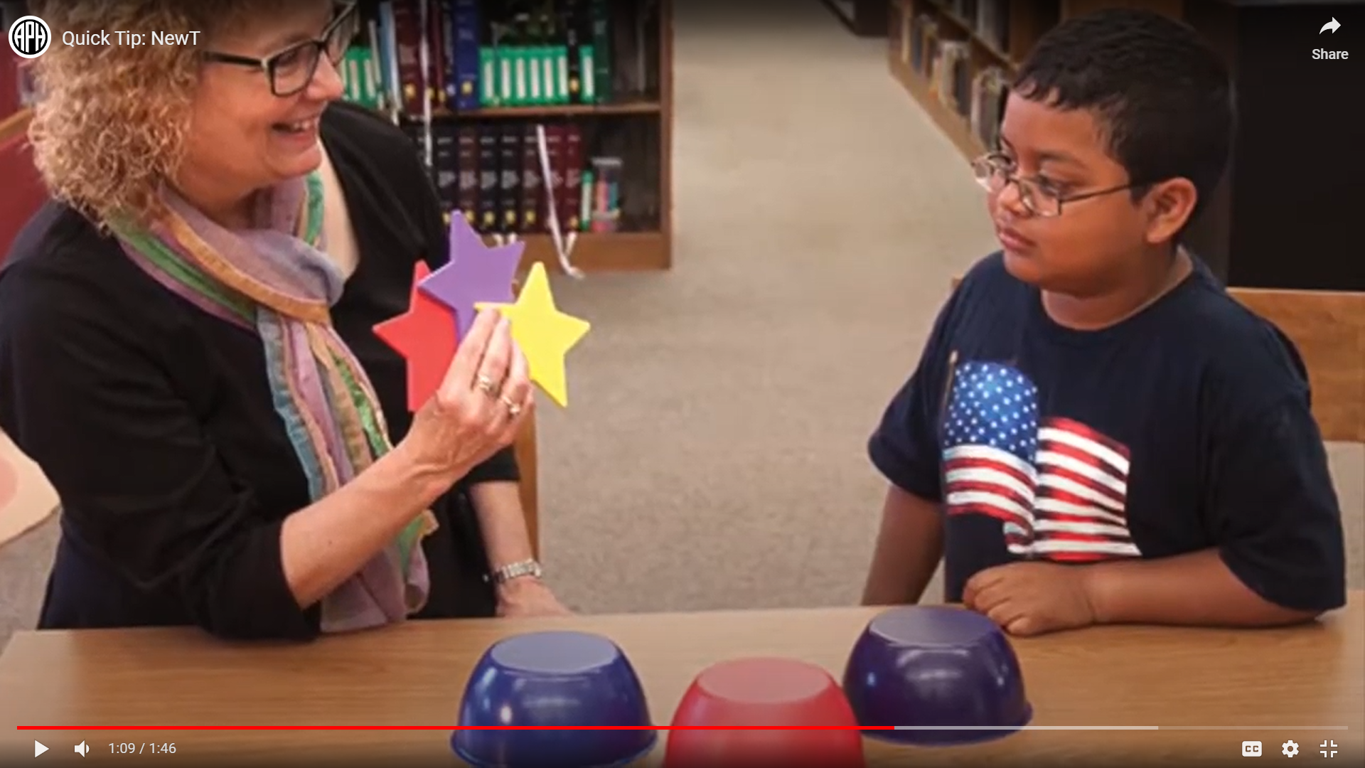
Color and Contrast
Materials in NewT
Broad-tipped, colored markers (red, blue, green, orange, yellow, purple, brown and black)
Color card samples of dark, medium and light shades of various colors
Set of six colored bowls & objects
Provided by the TVI
White 8 ½ by 11” copy paper
Goodlite Color Check
LEA Symbols Contrast sensitivity or Hiding Heidi

Slide 30
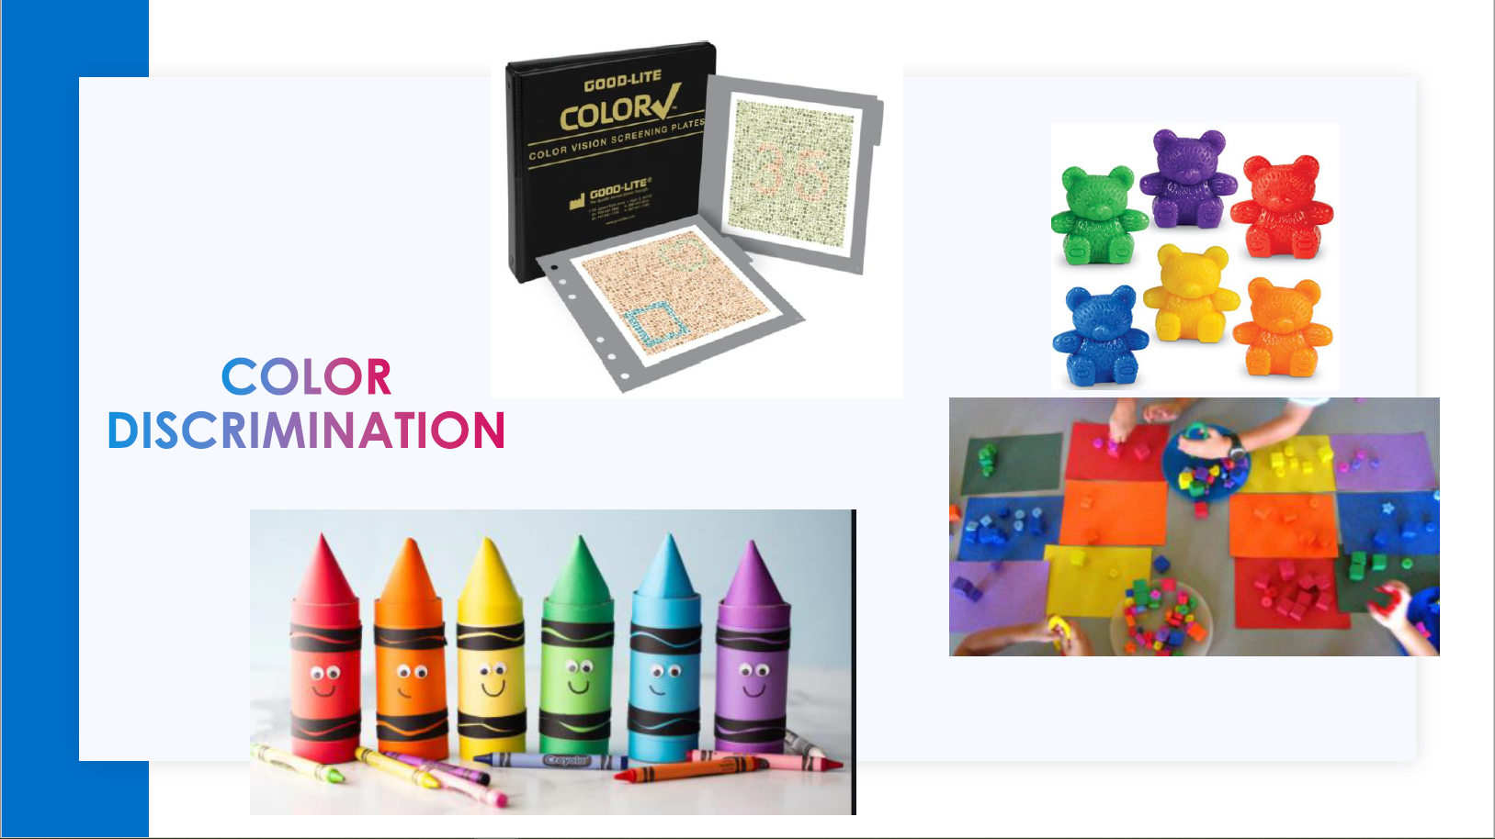
Other Color Ideas
Get creative!
Standardized tools are important to include.
Remember to not rely on students naming colors to determine their ability to recognize color.
Notes:
APH Lightbox with translucent pieces

Slide 31
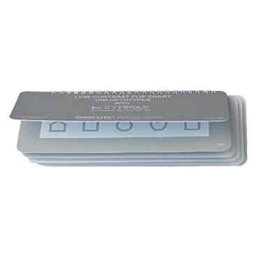

Contrast
LEA Symbols Low Contrast Flip Book
Hiding Heidi Low Contrast Face Test
Notes:
LEA Symbols low contrast flip book

Slide 32
How might color/contrast difficulties affect our students’ learning?
Functional Problems
Difficulty with tasks requiring color discrimination.
Difficulty with low contrast digital information.
Difficulty distinguishing door frames, stairs, etc.
Difficulty matching clothing.
Educational Implications
Alternate labeling techniques for maps.
Teach and encourage assertiveness (Self-Determination).
Modify/Adapt classroom activities as needed.

Slide 33
Developmental Visual Perception Screening
Materials in NewT
Look through Nigel Newt Goodies!
Provided by the TVI
Samples of student’s work
Notes:
Visual Discrimination and Form Perception:
This is the awareness of distinctive features of forms including shape, orientation, size, and color. This is an important skill in reading and math.
•matches/sorts objects, shapes, letters, numbers
•Figure Ground:
The ability to attend to specific feature or form while maintaining an awareness of the relationship of this form to background information
•finds hidden objects when given pictures (book or electronic device), symbols, or real objects
•regards own hand or familiar face, looks at/points/identifiesrequested items/actions in pictures
•Visual Memory:
This is the ability to recognize and recall visually presented information. Spelling requires recall of visual information, reading and math require matching the word/number on the page with a stored image.
•imitates actions
•visually searches for missing/hidden item
•recognizes name, letters, numbers
•Eye-Hand Coordination:
The ability to develop normal internal and external spatial concepts used to interact with and organize the environment, make judgements about location of objects and the student’s body.
•reaches for objects
•stringing beads
•colors within lines
•cuts simple shapes
•Visual Closure:
The ability to visualize a complete whole when given incomplete information or a partial picture. This skill helps children read and comprehend quickly; their eyes don't have to individually process every letter in every word for them to quickly recognize the word by sight.
•identifies/draws missing parts to complete picture
•Visual Sequencing:
The ability to observe, remember, recall and reproduce the sequence of objects, symbols, etc. in whatever means appropriate for the student.
•arrange items/pictures in requested order

Slide 34
Visual Perception
The following areas should be assessed for students who are pre-readers or struggling readers.
  Visual Discrimination and Form Perception
  Figure Ground
  Visual Memory
  Eye-Hand Coordination
  Visual Closure
  Visual Sequencing
Notes:
Depending on the physical and cognitive abilities of the student, some of the areas below may or may not be able to be assessed.

Slide 35
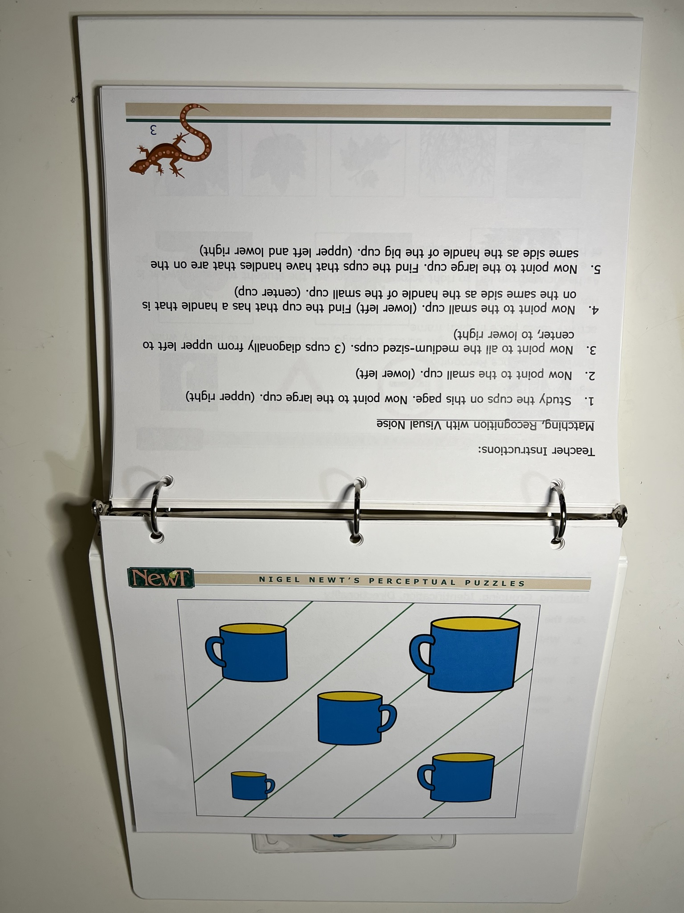

Nigel NewT’s Goodies

Slide 36
What are the impacts of low visual perception skills?
Functional Problems
Difficulty comprehending information in pictures.
Difficulty in fine motor tasks.
Difficulty learning to read and write.
Educational Implications
Direct instruction in these skills.
And/Or
Accommodations to materials and instructions.
*Use caution in attributing difficulties only to “impaired vision” with students who have cognitive delays, learning disabilities and/or motor problems.
Notes:
TADPOLE Kit: Tools and Activities for the Development of Visual Skills

Slide 37
Near Acuity and Discrimination
Materials in NewT
Lea near eye chart
Lighthouse near eye chart
Occluder Pop Pack
5” scissor
Silver colored Flatware
Colored photos of familiar famous people, animals, and objects
Colored illustrations
Measuring tape
Provided by the TVI
Money: 2 pennies, 2 nickels, 2 dimes, 2 quarters, $1.00, $5.00
White cloth and black cloth
Classroom textbooks

Slide 38
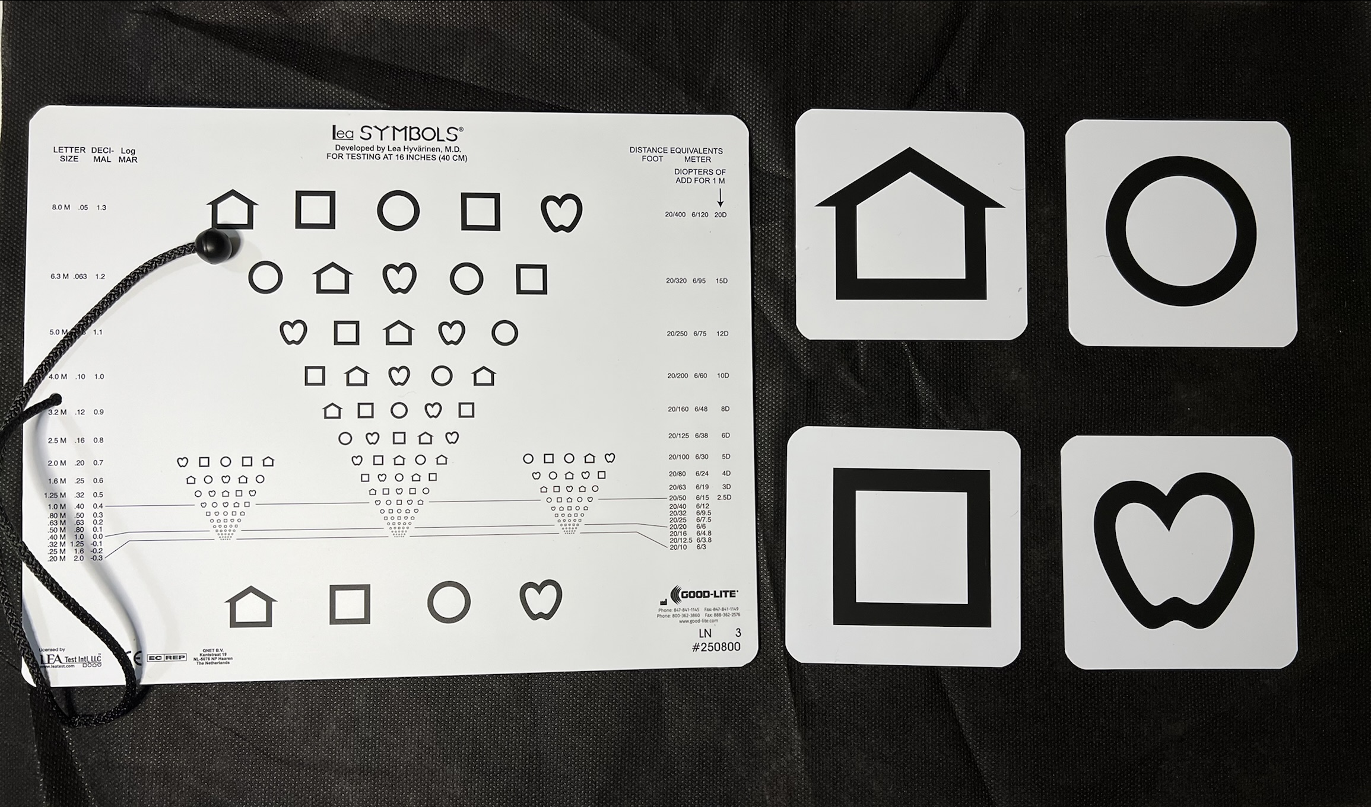

Near Acuity & Discrimination
Notes:
Start at the normed distance and move closer if necessary. If you move closer, be sure to document the actual distance.
➢Review the shapes before beginning.

Slide 39
Distance Acuity and Discrimination
Materials in NewT
Lea distance eye chart
Snellen distant eye chart
Occluder Pop Pack
Measuring tape
Dry erase markers and whiteboard
Chalk & eraser
Provided by the TVI
Objects in the environment and classroom.

Slide 40
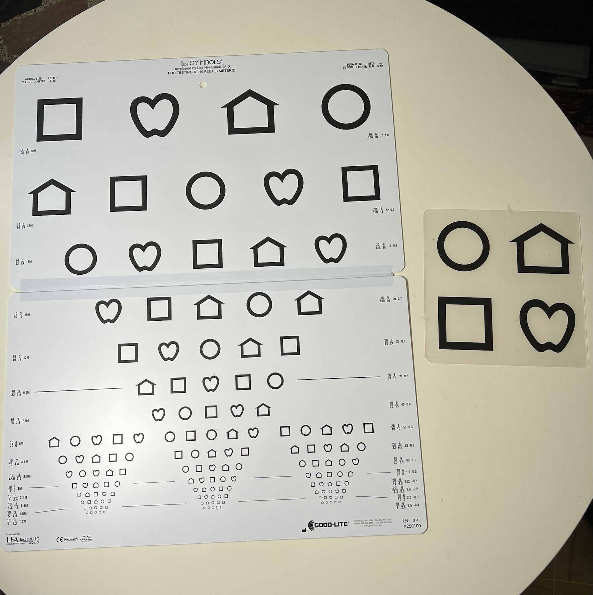
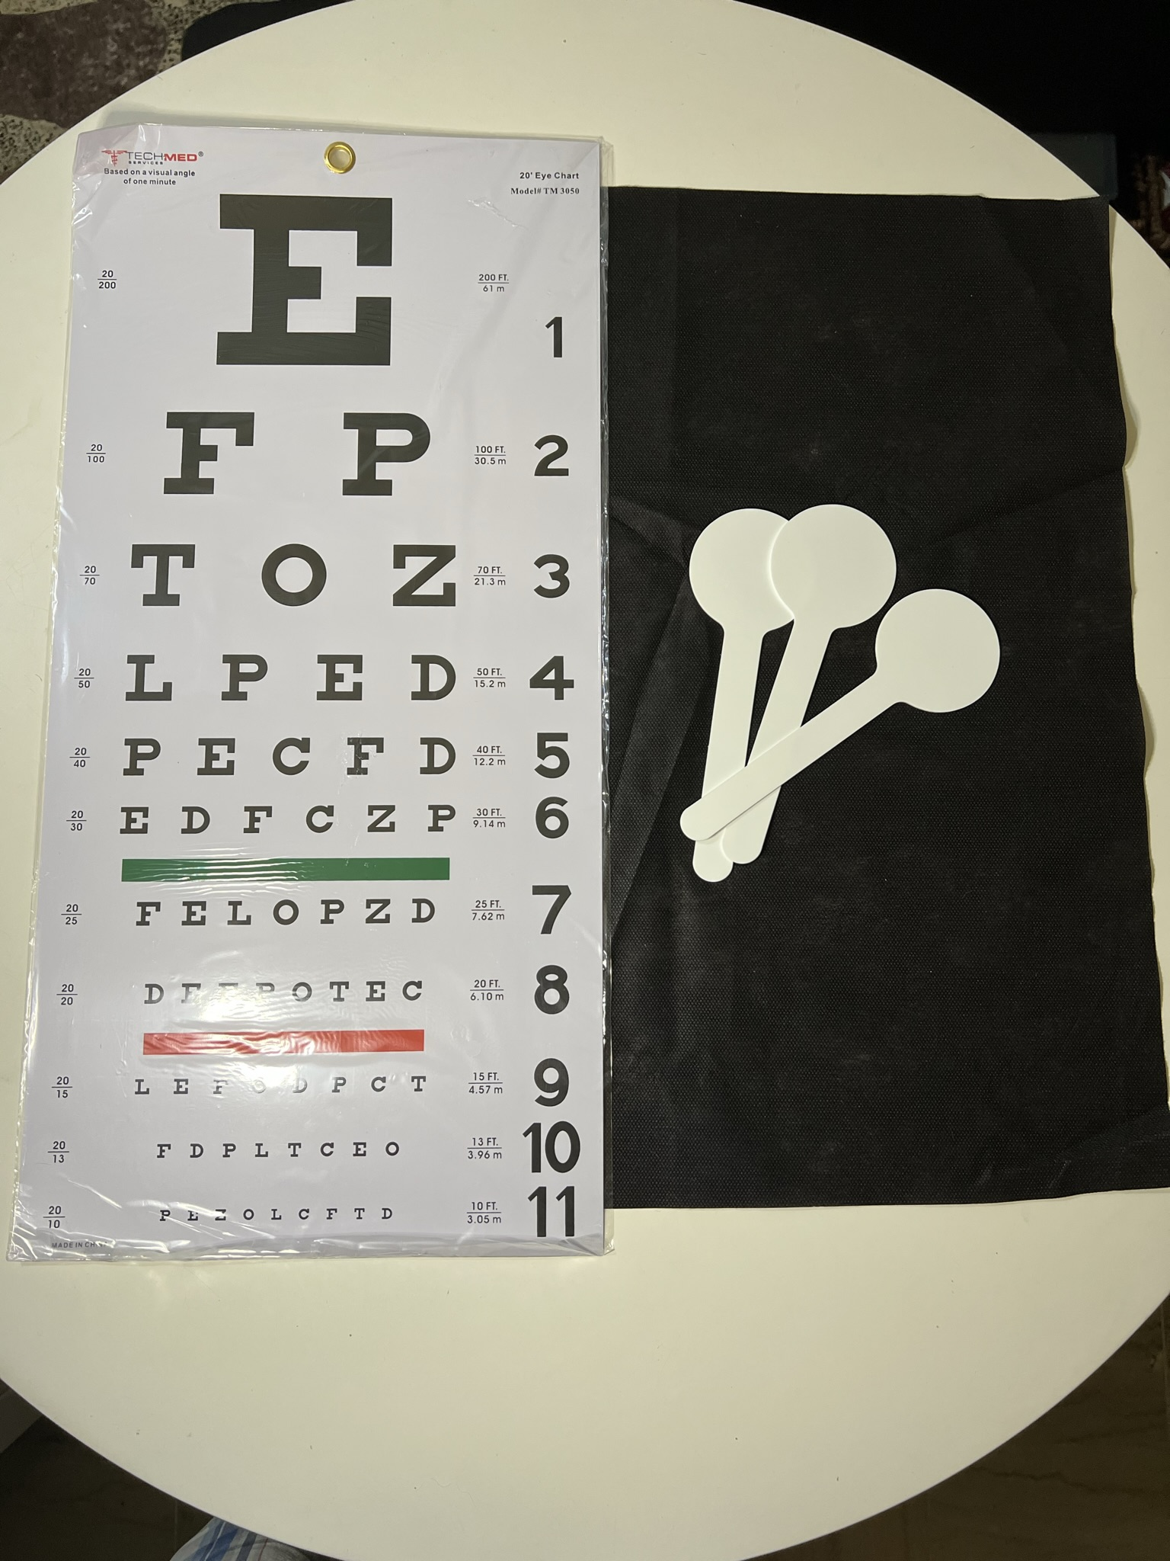
Distance Acuity (continued)
Notes:
Start at furthest distance and move closer. If you move closer, be sure to document the actual distance.
➢Review the shapes before beginning.

Slide 41
Appearance of Eyes & Behavioral Considerations
Materials in NewT
None
Materials in FVLMA Guidebook
Checklist
Typical/Atypical Examples
Examples of Functional Problems
Educational Implications
Provided by the TVI
You are the Observer/Assessor

Slide 42
Appearance of Eyes (continued)
Atypical Appearance Examples
eyes appear to be reduced in size (microphthalmos)
eyes appear to be enlarged (buphthalmias)
one or both eyes are completely missing (anophthalmia)
(and more)
Typical Appearance Examples
eyes are directed straight with coordinated movements
corneas are clear and transparent
irises and pupils are circular and equal in size
pupils appear black

Slide 43
Why is appearance of eyes important to know?
Examples of Functional Problems
Self-conscious about appearance
Difficulty with social relationships
Isolation from peers
Physical pain or discomfort
Educational Implications
Counseling may be necessary to deal with comments by peers and others.
Education regarding the eye condition so that they can explain their eye condition to others.
Social Skills training.
Self-care/hygiene instruction.

Slide 44
Why are behaviors important to include?
Functional Problems
May further damage the eye or other parts of their body (e.g., bangs head)
Social isolation and stigma
Decreased time on task leading to less opportunity to learn.
Educational Implications
Activities and experiences to replace or decrease the abnormal behaviors.
Understanding of their behaviors.
Social Skills training.

Slide 45
Try it out!
In small groups, explore the NewT Kits and FVLMA Practitioner’s Guidebook.
Test out the materials for:
      Peripheral Fields
      Near Acuity
      Distance Acuity

Slide 46

Questions? Thoughts?
Share Ideas!

Slide 47
CONTACT APH OUTREACH SERVICES
Jennifer Brooks
Regional Outreach - Northcentral
jbrooks@aph.org
1839 Frankfort Avenue • Louisville, KY 40206
aph.org • outreach@aph.org

Slide 48
References and Resources
Foundations of Low Vision
Looking to Learn
FVLMA Practitioner’s Guidebook
NewT Kit Guidebook
Essential Tools of the Trade - TSBVI
FIMCVI – Overview of Essential Assessments
Jeff Schwartz – APH Regional Specialist
Alicia Wolfe – APH Regional Specialist

