Slide 1
ECC: Recreation & Leisure to Sports Camp Models
Dakota’s Aer 2023

Slide 2
Physical Education is…
education that emphasizes all children can succeed regardless of ability or skill level.
~Dr. Robert P. Pangrazzi & Dr. Aaron Beighle, authors of Dynamic Physical Education
Gym is the location, Physical Education
is the class

Slide 3
Objectives today
Touch on differences between APE vs R&L
Explain the importance of motor learning development across the ages
Applying ideas for ECC into Recreation and Leisure component
IEP Checklist for Physical Education Services
Sports camp model

Slide 4
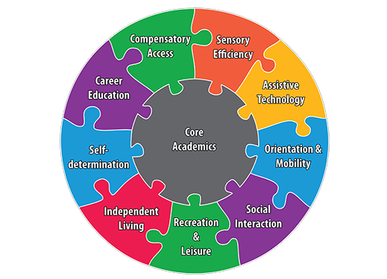
Let’s get started
ECC pop quiz, which ECC Components are demonstrated here:
https://www.youtube.com/watch?v=D9ZrdDh7wJc
To the right: Circular puzzle image of ECC Components surrounding Core Academics in the center, image take from Perkins School for the Blind

Slide 5

OCTOBER IS…
Follow USABA on Facebook for insights on Blind sports and development of US Paralympic Teams:
https://www.facebook.com/UnitedStatesABA

Slide 6
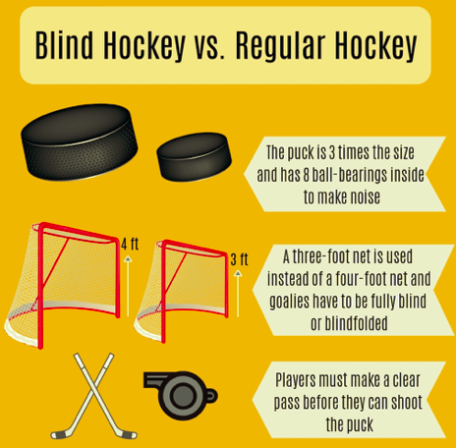
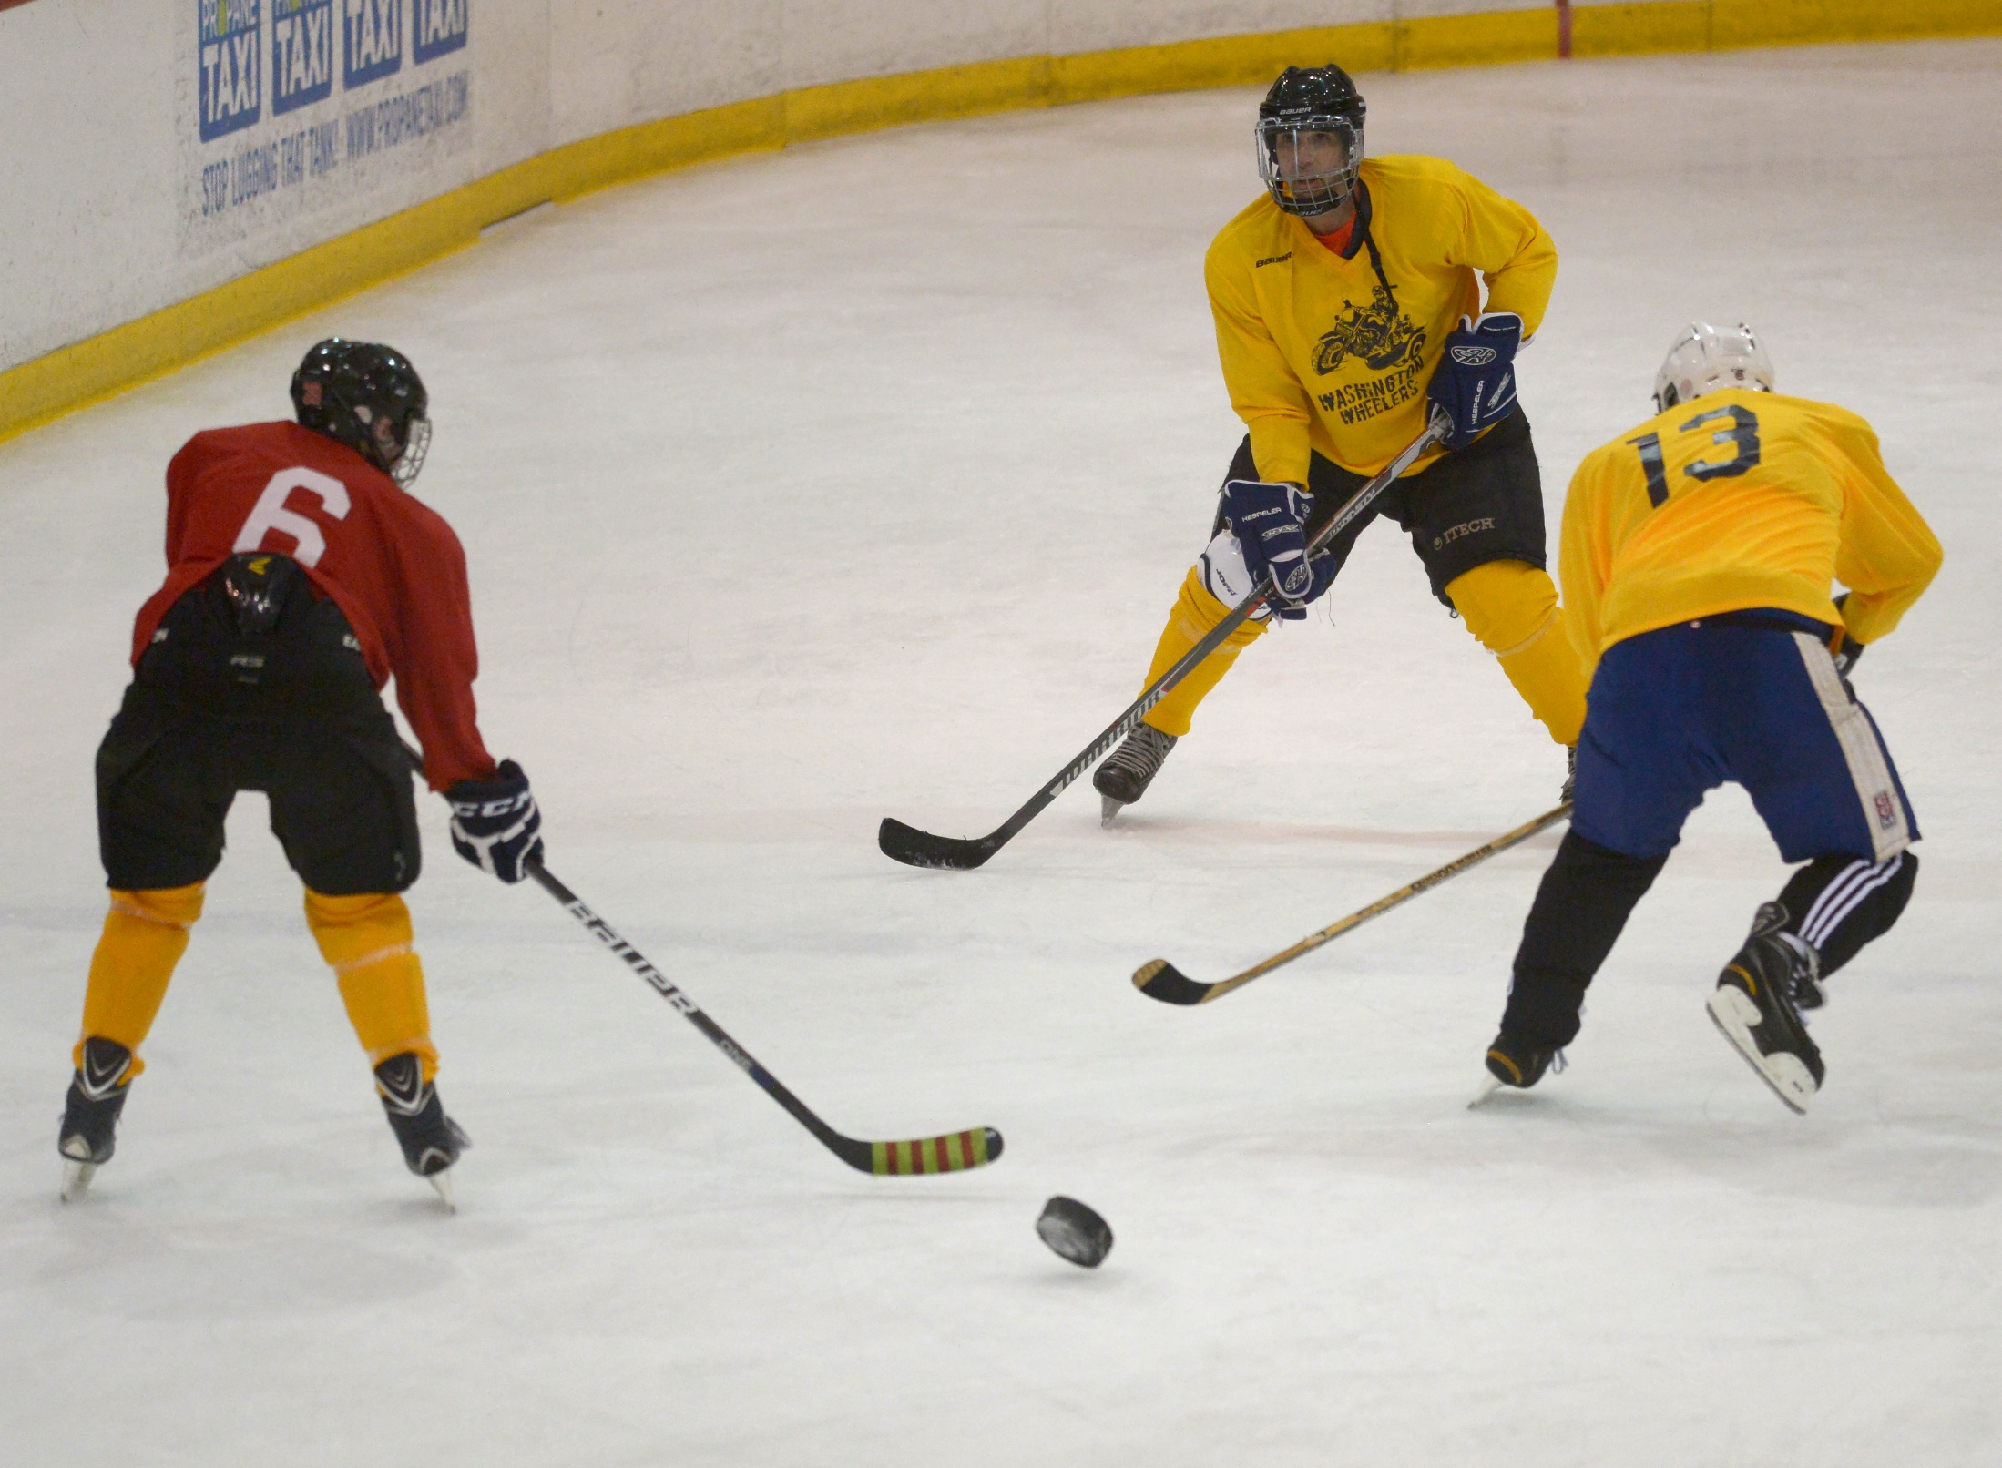
Blind sports, newest development…

Slide 7
What are your favorite activities?
Musical Timers on YouTube!!!
90 second timer
https://www.youtube.com/watch?v=1iD-zvOc5Tw&list=RD1iD-zvOc5Tw&start_radio=1

Slide 8
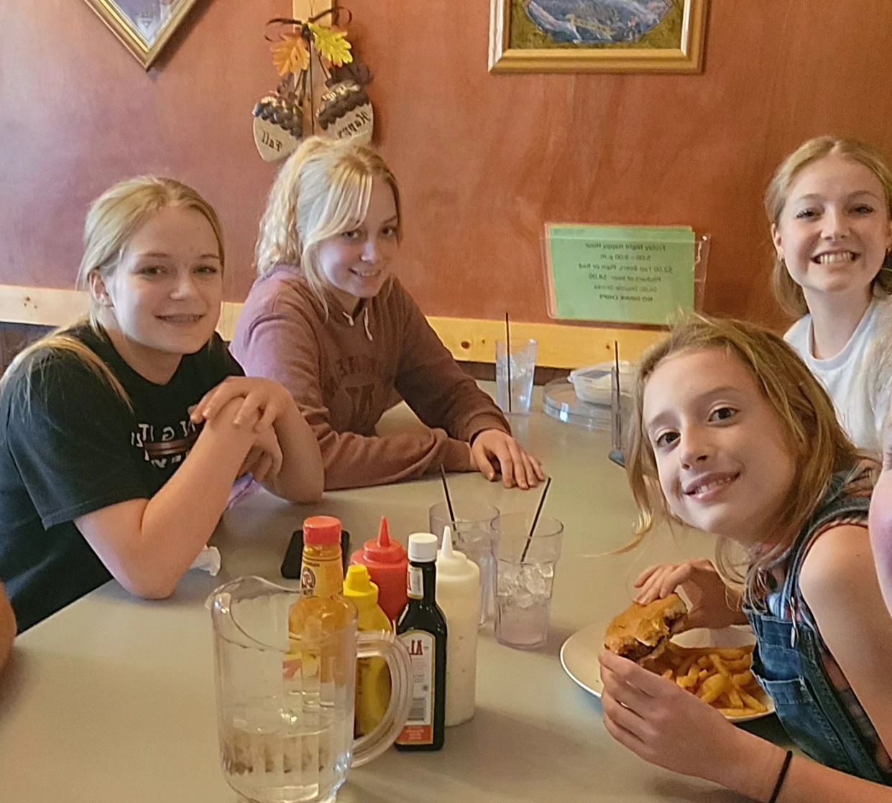
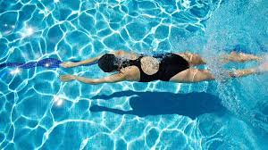
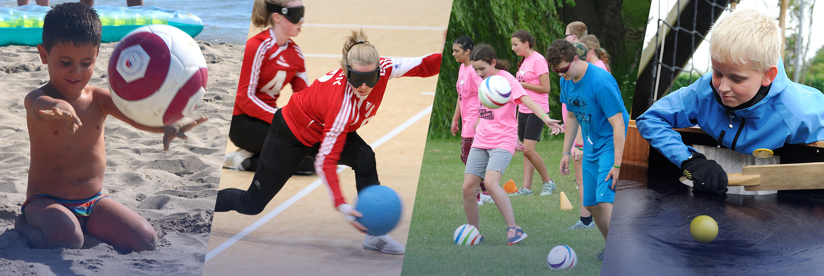

Let’s share…
What are your favorite things
to do?

Slide 9
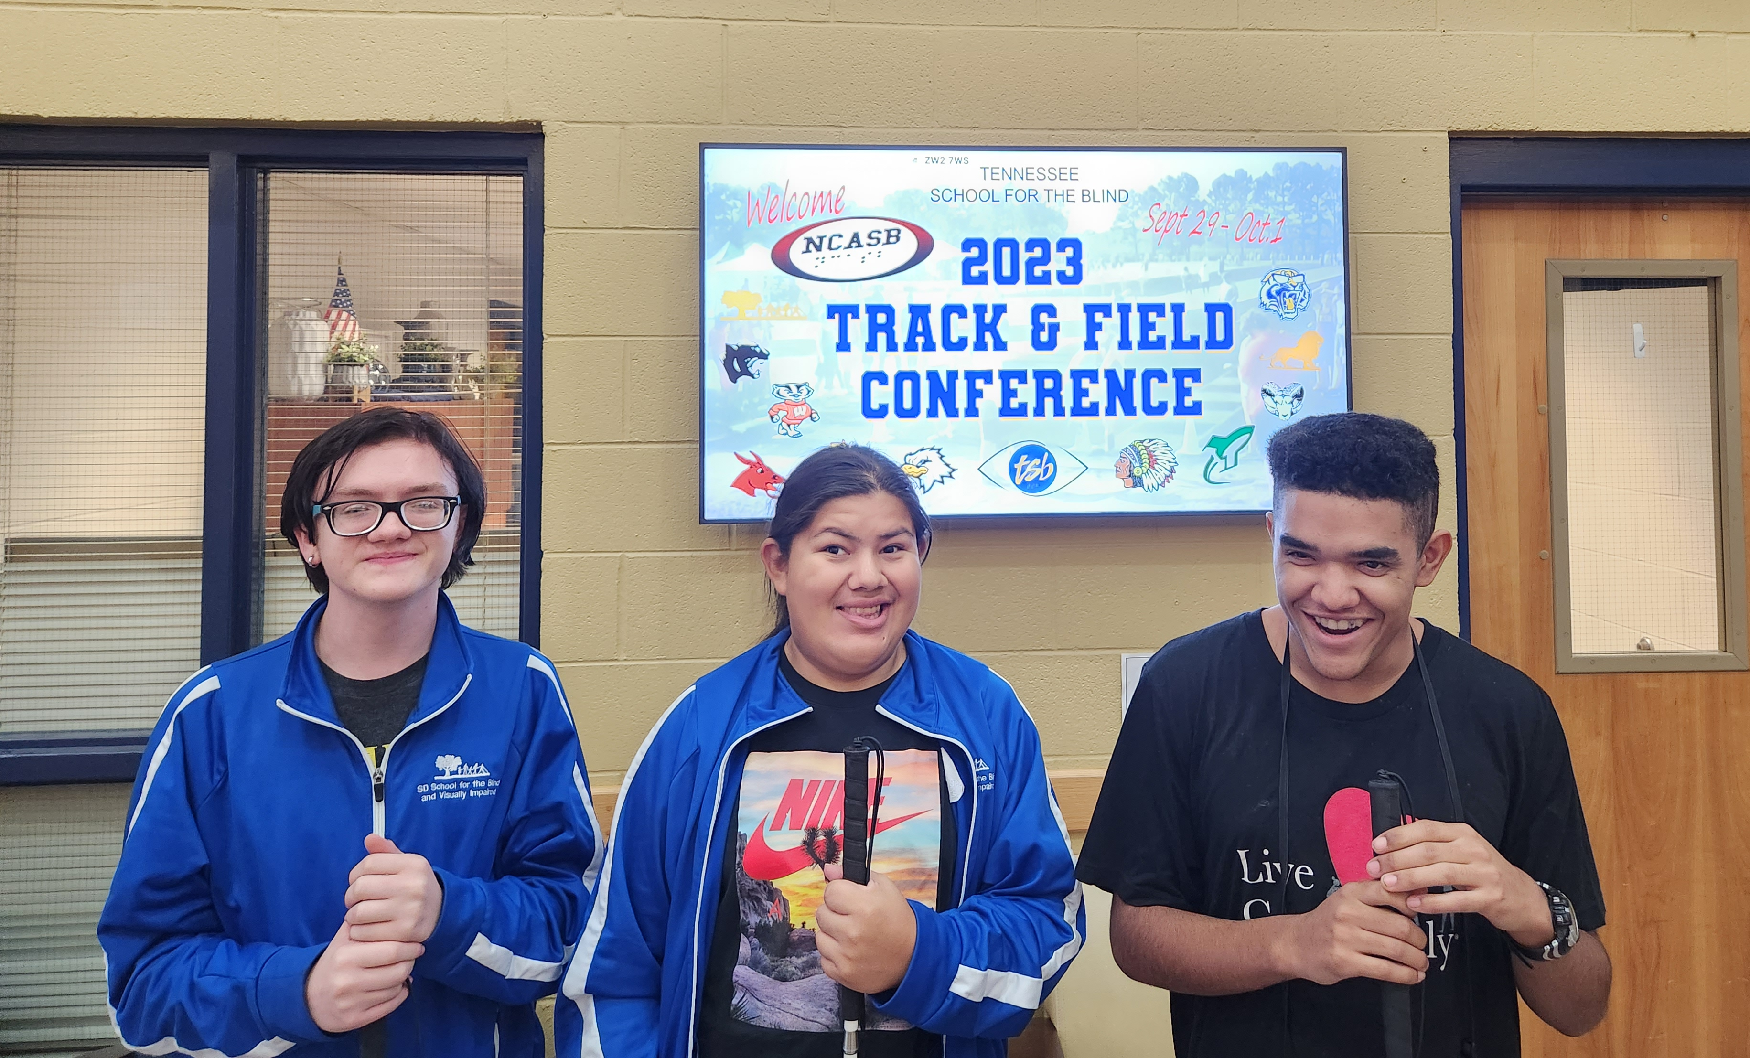
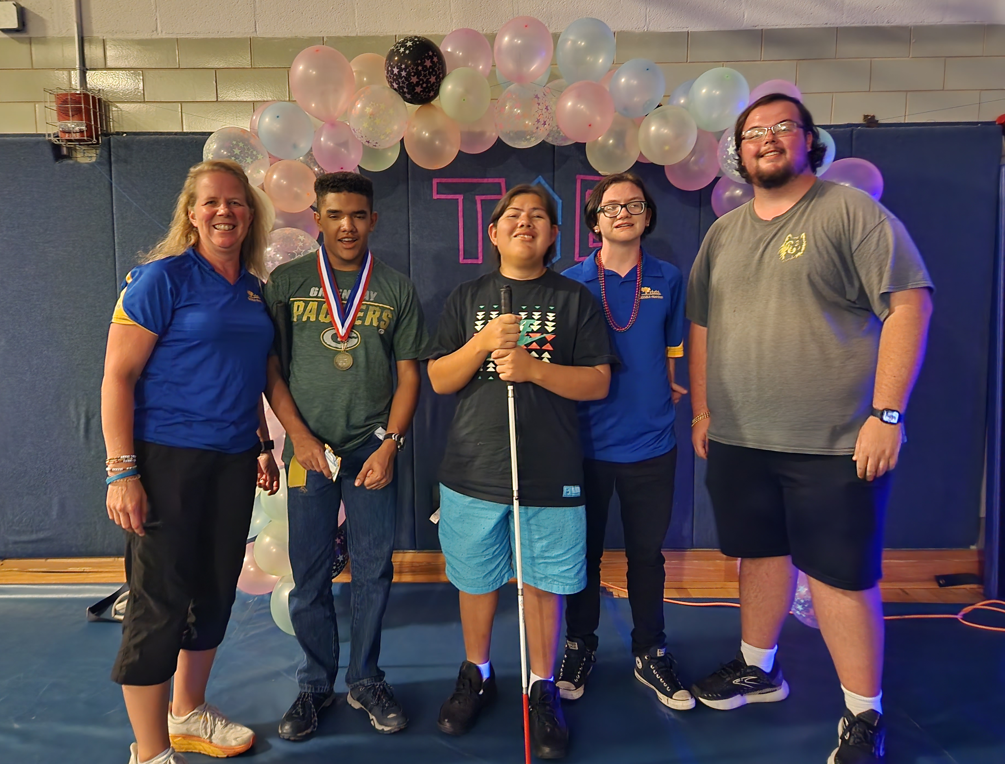
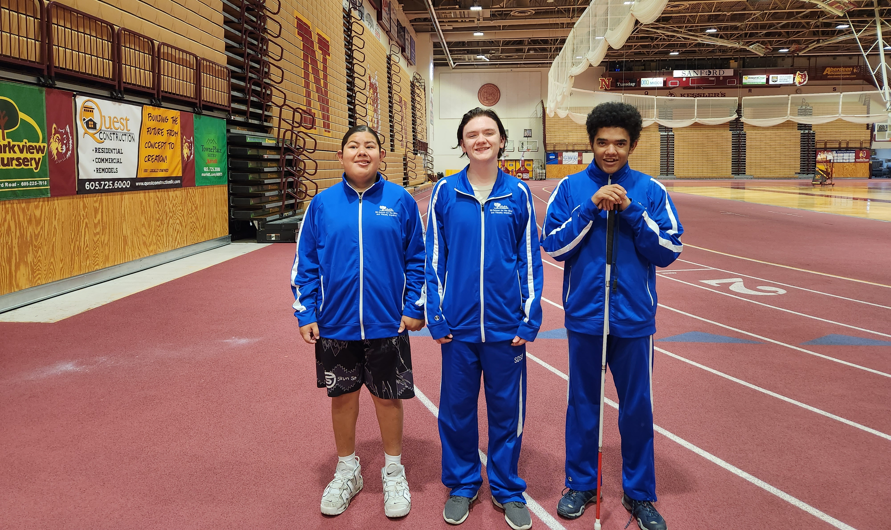
One of my passions…
Follow us on Facebook - Team SD: NCASB Events

Slide 10
Let’s hear from the students…
Dr. Lauren Lieberman, Leading professional in the B/VI field for physical activity/sport
  Her profile:
https://www2.brockport.edu/live/profiles/1486-lauren-lieberman
  Her various scholarly journals: https://scholar.google.com/citations?user=5ihIDGgAAAAJ&hl=en
  Video: I Feel Included When…
  https://www.youtube.com/watch?v=qZfjrd-B0ho&t=6s

Slide 11
Infusing the ECC into PE for Children with Visual Impairments
Reference article:
  By Dr. Lieberman and others
  https://www.researchgate.net/publication/276206901_Infusing_the_expanded_core_curriculum_into_physical_education_for_students_with_visual_impairments

Slide 12
Adapted Physical Education vs.
Recreation and Leisure
APE
R&L
An individualized program including:
  Physical & motor fitness
  Fundamental motor skills & patterns
  Skills in aquatics & dance
  Individual & group games
  Sports designed to meet unique needs of individuals
  Source: Adaptive Physical Education and Sport, Human Kinetics. Winnick & Porretta
Recreation refers to all those activities that people choose to do to refresh their bodies and minds and make their leisure time more interesting and enjoyable.
Leisure refers to the free time that people can spend away from their everyday responsibilities (e.g. work and domestic tasks) to rest, relax and enjoy life.

Slide 13
Developmental Progression of Locomotor Skills
Taken from Adapted Physical Education and Sport by Winnick & Porretta
Running
Mature* by Grade 1
Jumping
Mature by Grade 3**
Galloping
Mature by Grade 1
Hopping
Mature by Grade 1
Sliding
Mature by Grade 1
Skipping
Mature by Grade 2
*Mature by…According to SD State PE Standards
**This is ALL 5 elements of jumping, both planes – vertical and horizontal
Notes:
Jessica

Slide 14
Foundation to Fitness
Physical activity levels at each life stage influence the child’s level of engagement in sports, fitness, and recreational activities to be enjoyed throughout a lifetime.
Children’s fundamental skill competence is the primary, underlying mechanism that promotes engagement in physical activity. How does incidental learning play a part in this?

Slide 15
Physical activity related to vision
Help youth who are B/VI to recognize healthy habits early on.
  Physical Activity Guidelines for Americans, 2nd edition (health.gov)
    Children and adolescents ages 6 through 17 years should do 60 minutes (1 hour) or more of moderate-to-vigorous physical activity daily, this includes: Aerobic, Muscle-Strengthening, and Bone-Strengthening
  https://www.ncbi.nlm.nih.gov/pmc/articles/PMC6085324/
    Individuals with diseases of Age-Related Macular Degeneration, Diabetic Retinopathy, Glaucoma, particularly at more advanced stages, also largely identify persons as being at higher risk of poor activity. This suggests that an emphasis on maintaining healthy physical activity levels is especially important in individuals with vision loss.

Slide 16
Gross Motor & Fitness Evals, Birth to 8yrs
Other GM Eval Options/Companions
Insight
The Insight Developmental Checklist is a comprehensive developmental checklist for multihandicapped sensory impaired infants and young children; includes gross motor skills category
Oregon
Inventory that assesses a visually impaired student’s developmental level in eight categories, includes gross motor skills category
Others:
-Battelle (only score) - children 6 months to 8 years old
-BOT and Peabody – used by PT’s

Slide 17
Gross Motor & Fitness Evals: Elementary Age
The Test of Gross Motor Development–Third Edition (TGMD-3)
  Norm-referenced test used to identify children with gross motor deficits.
  Composed of two subtests that measure gross motor abilities that develop early in life (Ages: 3-0 to 10-11).

Slide 18
Gross Motor & Fitness Evals: Elementary Age, cont’d
Locomotor subtest measures the gross motor skills that require fluid coordinated movements of the body as the child moves in one direction or another.
Locomotor subtests: run, gallop, hop, skip, horizontal jump, slide
Object Control subtest measures gross motor skills that demonstrate efficient throwing, striking, and catching movements.
  Ball Skills subtests: two-hand strike of stationary ball, one-hand forehand strike of the self-bounced ball, one-hand stationary dribble, two hand catch and kick a stationary ball, underhand toss of object.

Slide 19

Gross Motor & Fitness Evals: MS to HS age
Brockport Physical Fitness Test
Winnick and Short. Brockport Physical Fitness: A Health-Related Test for Youth with Physical and Mental Disabilities (2nd Ed). 1999. This criterion-referenced fitness standard is designed for youth ages 10 to 17 years and up with special needs. This assessment provides health standards for the areas of:
Aerobic endurance
Body composition
Flexibility
Muscular strength and endurance
PowerPoint on BPFT: https://www.moshape.org/assets/resources/PE/PHYSICAL%20FITNESS%20BROCKPORT%20PRESENTATION.pdf

Slide 20
Expanded Core Curriculum in Physical Education
The Expanded Core Curriculum (ECC) has been adopted by teachers of students with visual impairments (TVIs) in order to provide students who are blind or visually impaired with the support they need to become independent and successful adults.
Physical education is an educational setting where teachers can infuse the nine components of the ECC into their everyday lessons.

Slide 21
ECC in Physical Education
Visual impairment itself does not cause poor physical skills or lack of fitness, it may create obstacles to participating in activities. (Conroy, 2012; Lieberman et al., 2013)
ECC (Sapp & Hatlen, 2010), is for children with visual impairments to leave school with the necessary skills to be independent and self-determined adults. PE programs can contribute significantly to instruction of the nine components of the ECC if implemented correctly (Sapp & Hatlen, 2010).
The ECC refers to the necessary nine areas of instruction that individuals with visual impairments need to be successful in school, the community, and the workplace (Sapp & Hatlen, 2010).
The nine components of the ECC include:

Slide 22
Compensatory or functional academic skills, including communication modes
Compensatory and access skills vary on the basis of the students’ needs and must be taught on an individualized level.
An example of supporting compensatory skills in PE class
  Equipment storage accommodations – should be well organized and stored in consistent/familiar location
  Place appropriate styles of markings on cardio equipment panel

Slide 23
Career Education
In addition to teaching students about available careers, PE teachers can work with their students to increase their fitness level according to the type of job they will be performing.
Some jobs require a certain level of fitness to be successful:
  job requires that the student stand and walk for a long period of time, such as in a hospital or grocery store
  a supervised program can be developed to work on muscular strength and endurance.

Slide 24
Independent Living Skills
Activities that promote ILS
Skills gained
  Bowling
  Swimming
  Ice Skating
  Rollerskating
  Bike rentals
  Fitness clubs
  Transportation to and from facilities
  Changing skills
  How to pay for activities
  Organizing time

Slide 25
O&M
Verbally describing the activity area
Allowing the student to explore the venue ahead of time
Pre-teaching by addressing prerequisite skills, including orientation skills, before the activity begins (Perkins, Columna, Lieberman, & Bailey, 2013)

Slide 26
Recreation & Leisure Skills
Includes sport and exercise
  Must be planned and taught deliberately to children with visual impairments.
  Sighted students may decide to try an activity because they have observed others participating
  Students with visual impairments may not know whether an activity is enjoyable unless they have been taught in an accessible manner.
Locomotor and object control skills contributes to future participation in recreation and leisure for ALL students.

Slide 27
Self-determination Skills
Teachers must also include students in the process of making accommodations for activities, so they have the knowledge needed to advocate for future activity in other environments.
Increase problem-solving skills
Goal-setting in sports or exercise
Examples:
  Obtaining a new personal best in track & field
  PE teacher can assist student to track progress in weightlifting goals

Slide 28
Social interaction skills
Children with visual impairments often miss out on learning basic and complex social interaction skills:
  making eye contact
  joining a group of peers for a conversation
  initiating a conversation
  reading nonverbal cues such as body language and facial expressions.
PE provides many natural opportunities:
  participating in team sports, where students with visual impairments can practice social interaction skills.

Slide 29
Assistive Technology
Assistive technology makes information that may be inaccessible readily available and expands the world of assistive technology that can be related to:
  students’ future social activities,
  continuation to postsecondary education,
  paid employment (Wolffe & Kelly, 2011)
Equipment:
  Talking pedometers
  Talking heart rate monitors
  Modifed Wii games (See Vifit.org) are examples of common technology used in PE that has been modified for use

Slide 30
Sensory Efficiency Skills
Auditory and tactile learning are essential for students with visual impairments to access information through listening skills and to learn braille if appropriate.
  Examples:
    Listening to and following directions to music (Learning Station)
    Beep baseball
    Goalball

Slide 31
Leisure activities:
Board games
Card games
Crafting
Listening to music
Video games
Video game networks
Audiobooks
Descriptive movies
Radio/weather
Sporting events
Walking
Yoga
Car rides
Trails

Slide 32
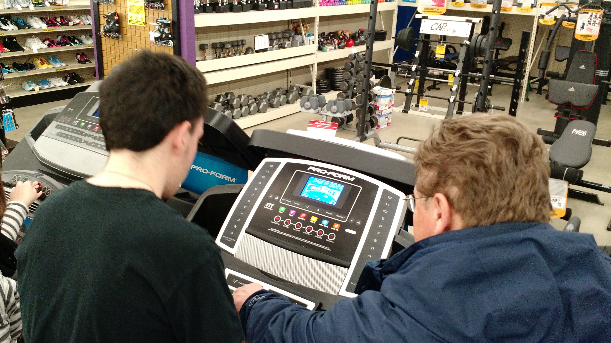
Examples of using ECC’s skills:

Slide 33
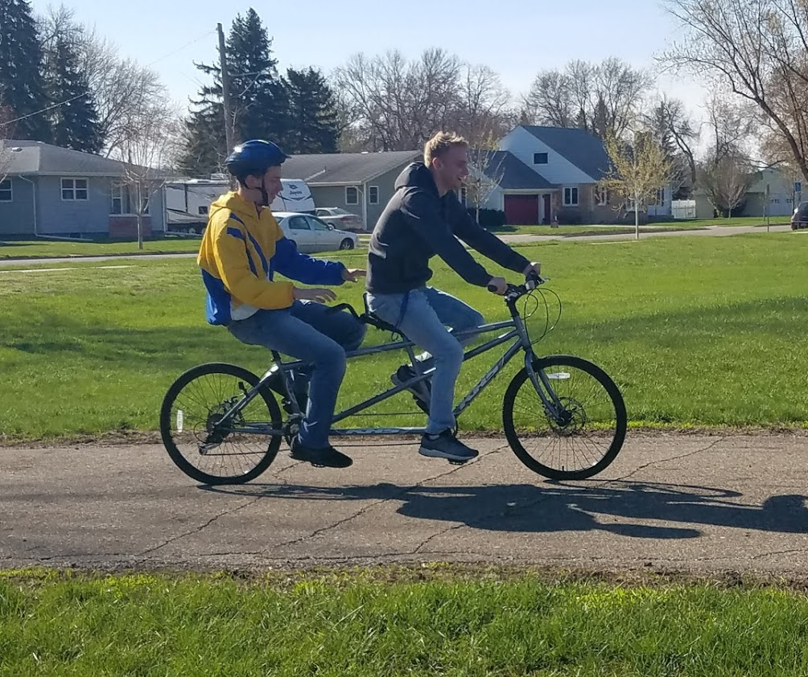

Slide 34
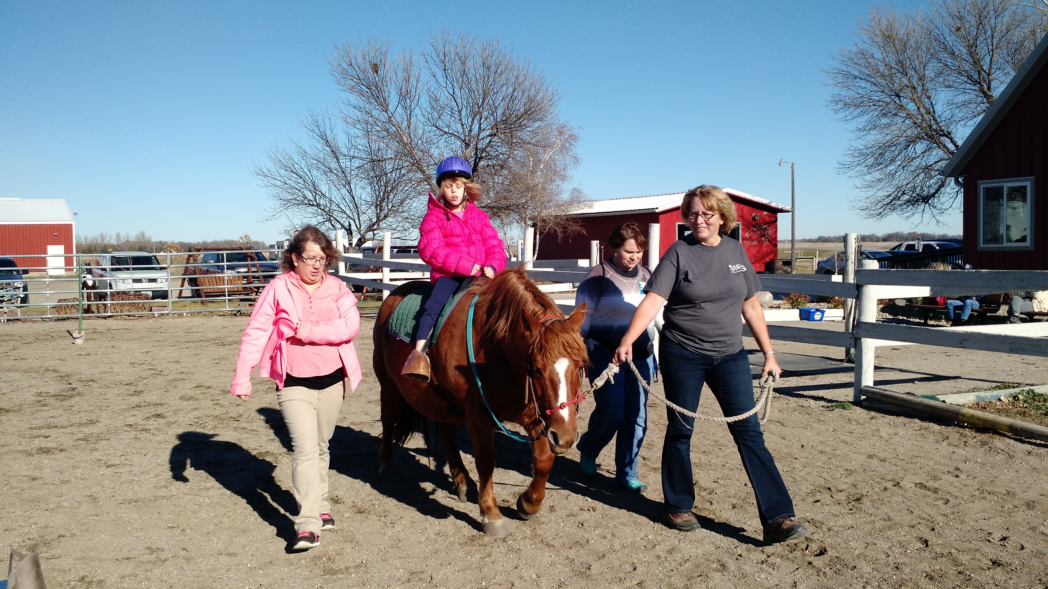

Slide 35
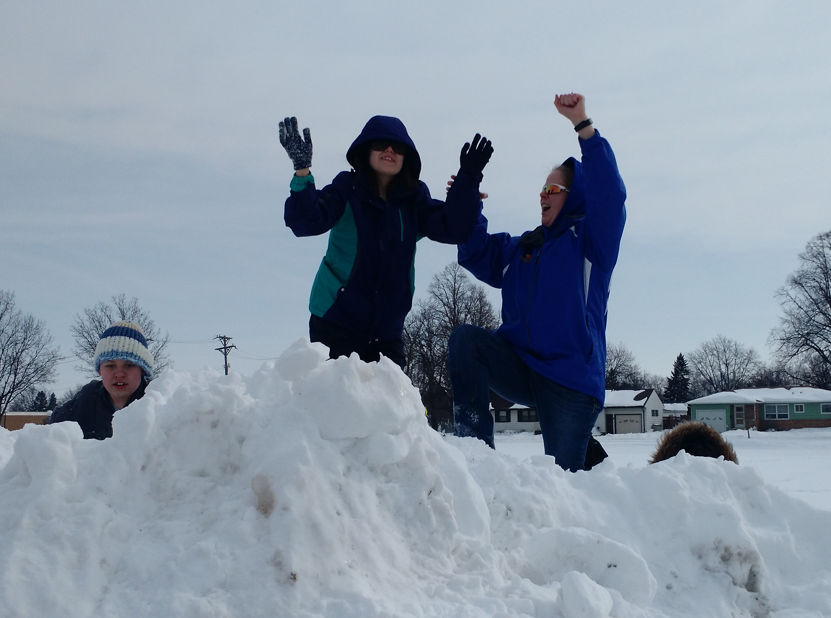

Slide 36
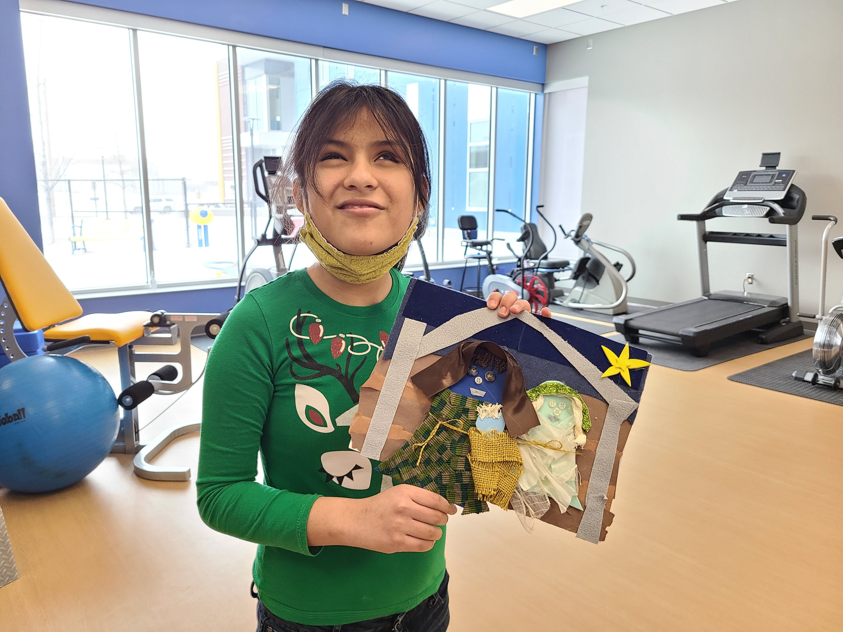

Slide 37
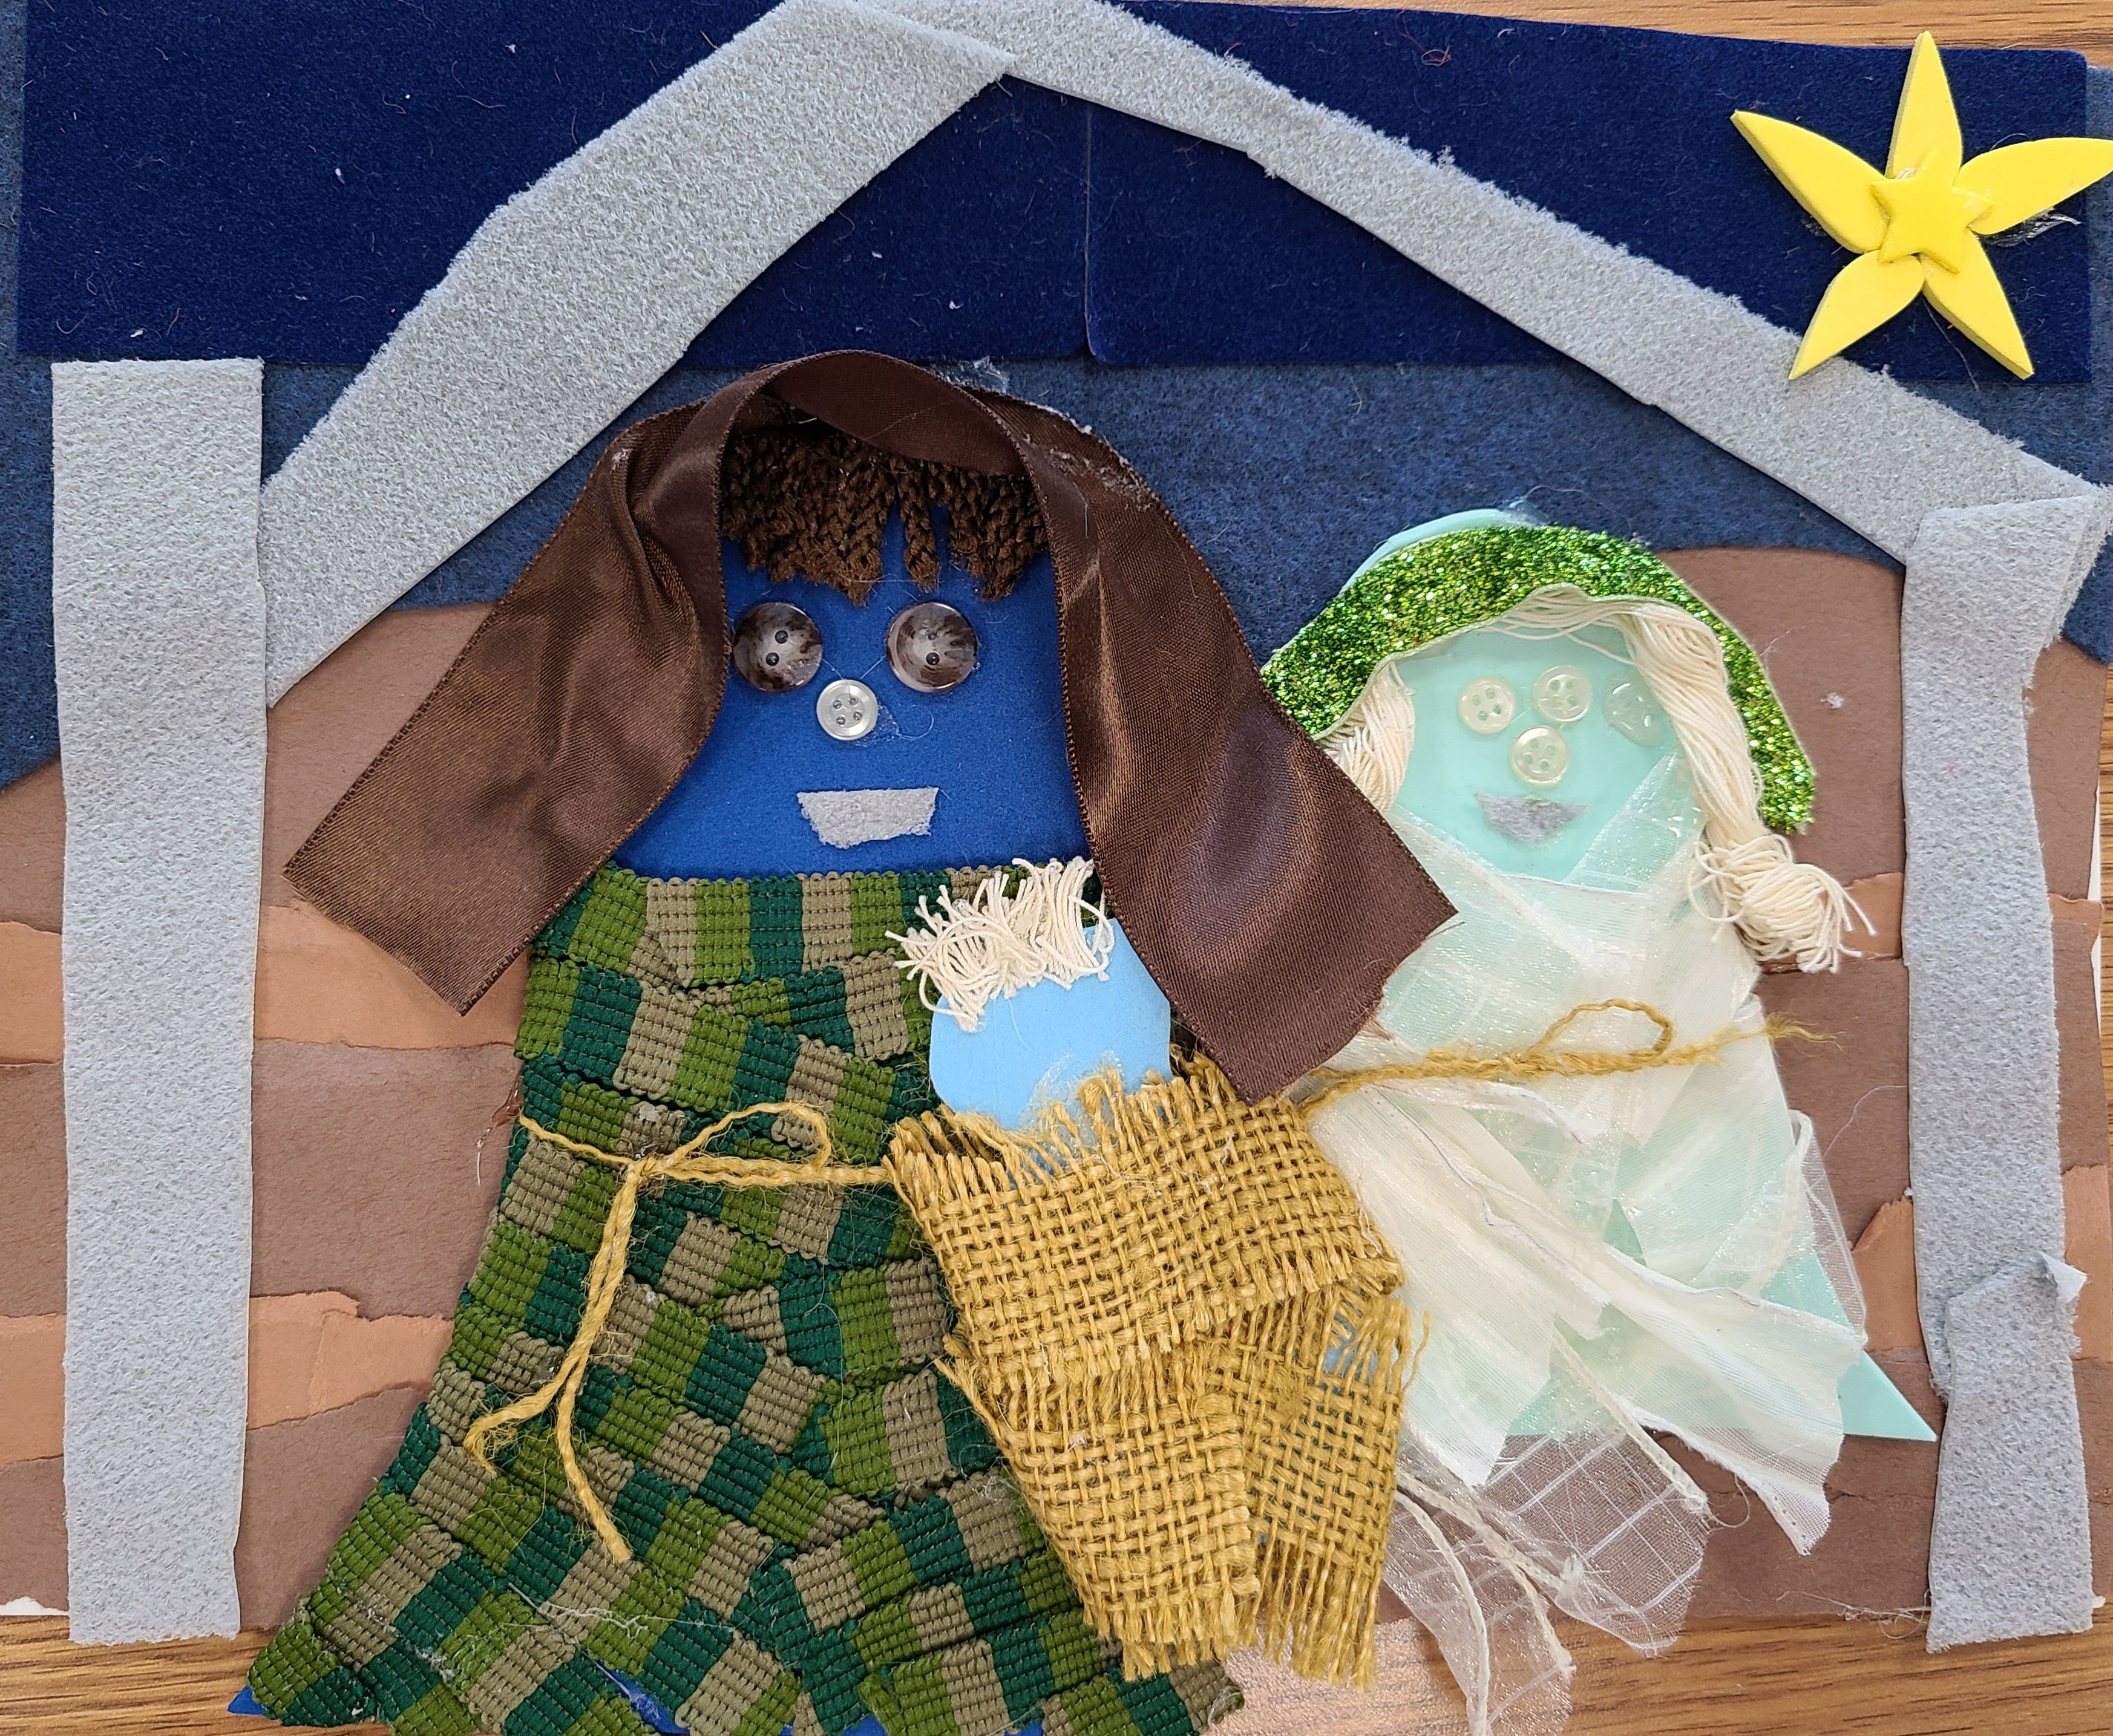

Slide 38
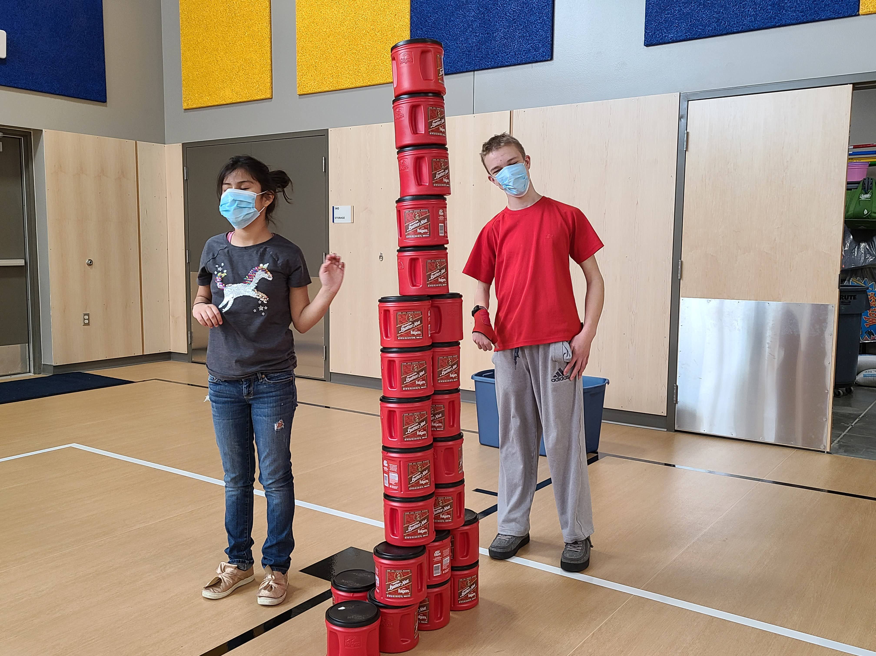

Slide 40
Tools for Adapted Physical Education
IEP Checklist:
  https://www.ncpeid.org/iep-checklist
Example from MNDOE: Development Adapted Physical Education
  https://www.ncpeid.org/assets/1.%20IEP%20checklist.pdf
Instructional Materials:
  http://www.campabilities.org/instructional-materials.html
  Go to very bottom of page under Assessment and Modification Checklist
  Click on: Physical Activity Barriers Questionnaire for Youth with VI

Slide 41
How do we get students more ECC?
NDVS/SB hosts Family Weekend that takes place in Early Spring plus Summer Camps
  https://www.ndvisionservices.com/events/family-weekend-2023
SDSBVI hosts Family Weekend that takes place after June & July ESY
  https://sdsbvi.org/Activities/Family-Activities

Slide 42
How do we get students more ECC?
Today’s trend has been adapted sports camps…AKA Camp Abilities and others such as Camp Spark through NWABA:
  http://www.campabilities.org/ OR https://nwaba.org/programs/camp-spark/
Real Sport HBO: Camp Abilities
  https://www.youtube.com/watch?v=Xnbdp35NvEo
Follow-up: Fields of Vision
  https://www.facebook.com/watch/?v=928267614713056

Slide 43
What I learned from IESBVI
My first-time attending Camp Abilities was in Iowa, Summer 2021
  https://www.iesbvi.org/student-services/activities-camps-sports/
  Location: University of Northern Iowa (UNI)
  (UNI) Campus has: Waterpark/Pool, Football/Soccer, Dorms, Tennis/Basketball Courts, Track & Field space, Gymnasium, Dinning space, Field House, Walking distance
  Students need to be 9+ and fully capable of caring for self: shower, clothing, feeding,
  Since Summer 2021 to Summer 2023 camp numbers have grown from 24 campers to 32, cap at 32 – quite a few on waitlist
  Summer 2024 projection 40-50 campers, with possibility of up to 2 camps.
  Summer 2023 added sights such as a community beach and waterfront

Slide 44
What I learned from IESBVI, cont’d
Who it takes (all with background checks):
  Volunteers (high school students)
  Summer interns (college students)
  Nursing staff
  Overnight staff
  Certified staff: COMS/TVI’s
    In all 36 individuals on the rotating schedule
    12- 15 per day shift
    4 night staff
    Key factor: they need to have an investment – credit hours or monetary

Slide 45
What I learned from IESBVI, cont’d
Budget: $40,000 for this one camp
  Room, Board, Staff
  Covered by: 90% of future IESB TVI’s/COMS were Interns at CA
    Creates a strong hiring pool
Funding sources:
  Part of the Iowa state budget
  Most expensive portion – start up costs

Slide 46
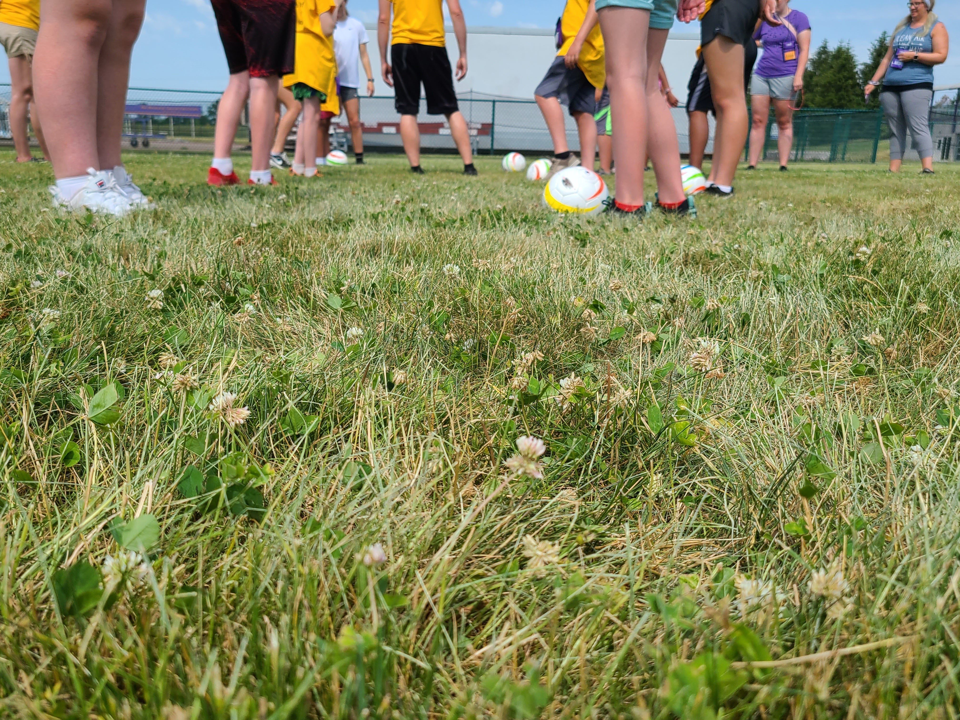
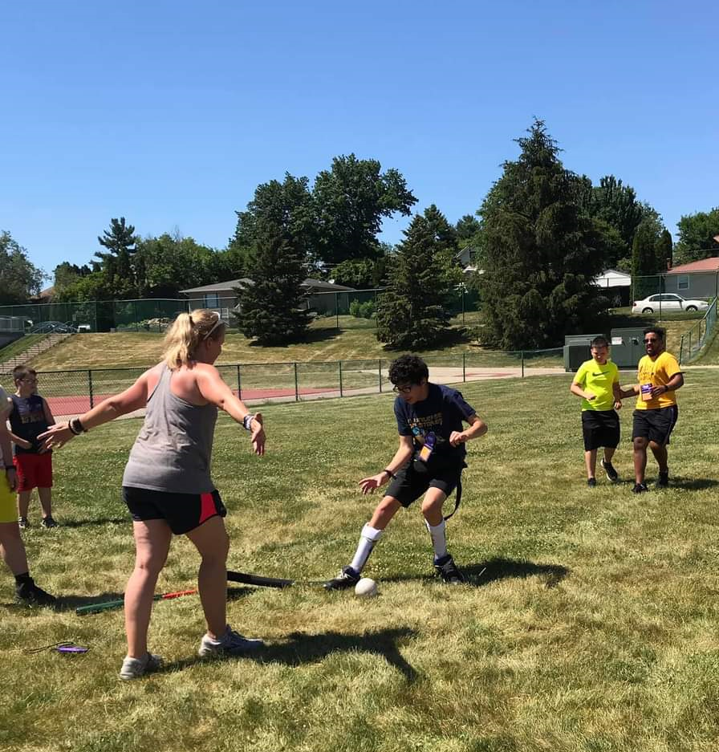
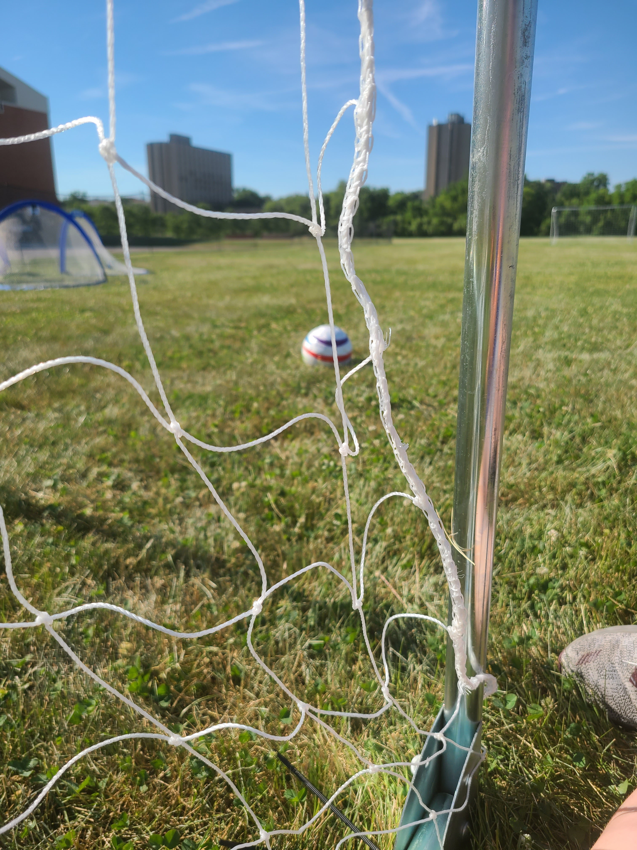
Camp Abilities Iowa, my first exposure to blind soccer!
Media releases have been completed

Slide 47
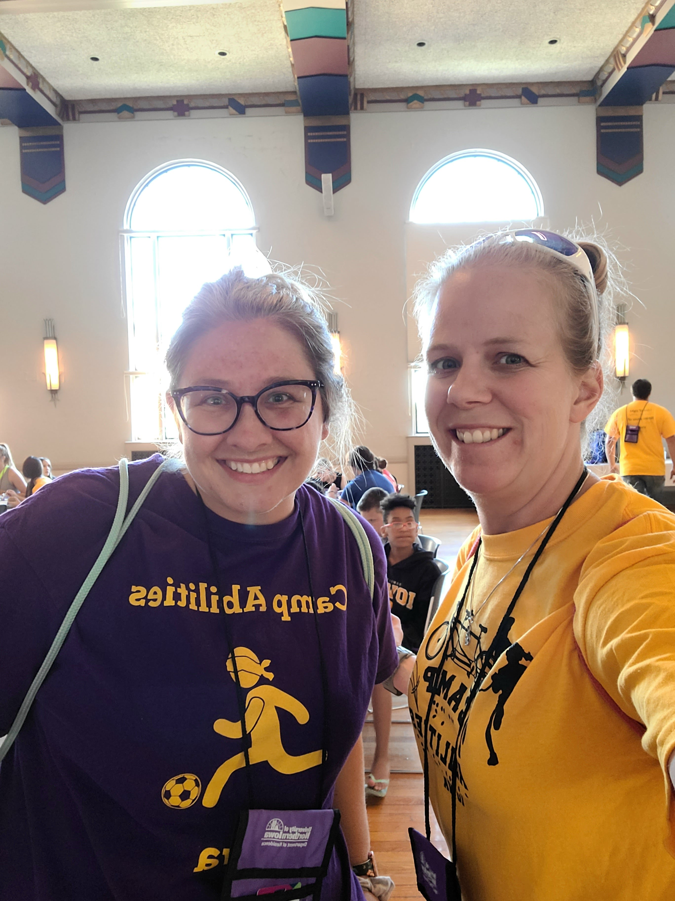
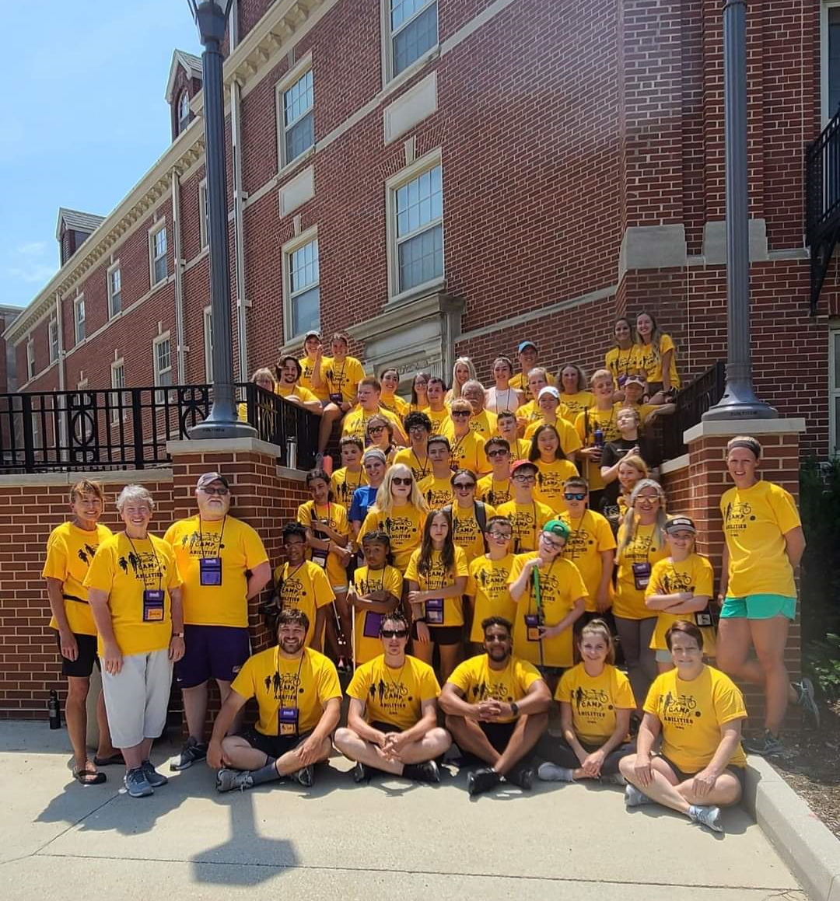
Camp Abilities Iowa
Crystal Beighley
~IESBVI Extended Learning Program Coordinator
~Athletic Director
~Vice President of North Central Association of Schools for the Blind (NCASB)
Camp 2021, first time together since Covid shutdown in March 5, 20

Slide 48
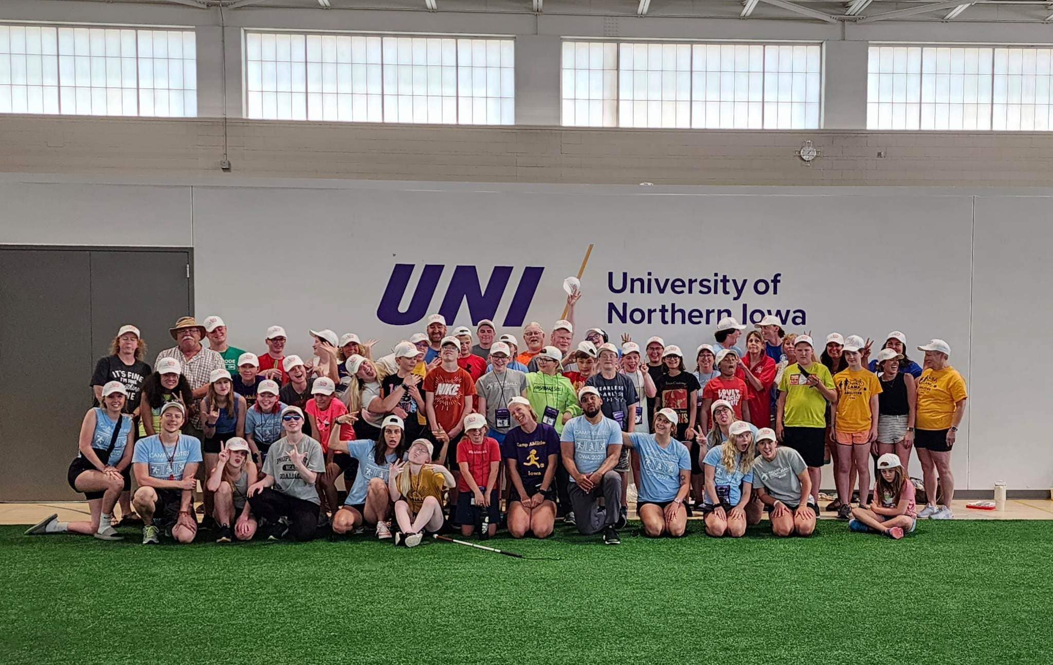
Camp Abilities Summer 2023

Slide 49
Camp Abilities can lead to so much…
Follow-up – Fields of Vision: https://www.facebook.com/watch/?v=928267614713056
Sight School: https://www.newschannel5.com/news/sight-school-teaches-sprinting-to-blind-athletes
Sight School Facebook: https://www.facebook.com/SightSchool
  BUT supportive parents can lead to more…
  Jaxon Scheff: https://www.dakotanewsnow.com/2023/04/18/meet-south-dakotas-first-ever-known-blind-athlete-compete-state-sanctioned-event/

Slide 50

SDSBVI Mission
Preparing Students to Step Forward with Confidence and a Vision of Lifetime Success

Slide 51
Equipment and Resources
APH Equipment:
https://www.aph.org/educational-resources/physical-education/
Adapted PE Games/Equipment: https://www.youtube.com/watch?v=PB9eCkh4Ryk
Beep Baseball - https://www.nbba.org/
Beep Kickball - http://beepkickball.com/

Slide 52
Equipment and Resources, cont’d
Soccer, Basketball, Volleyball, Football: http://www.braillebookstore.com/search.php
Jingle Bell Balls and variety of sports balls: https://www.flaghouse.com/Special-Needs/Adapted-PE/#page_no=1&src=&_=1608327099960
Frisbee: https://www.flaghouse.com/Physical-Education/Toss-Target-Games/Tossing-Items/Giant-Beamo.axd
Soft frisbee: https://www.autism-products.com/product/sportime-gradestuff-foam-fliers-set-of-6/?keyword_session_id=vt~adwords|kt~|mt~|ta~170573294043&_vsrefdom=wordstream&gclid=Cj0KCQiAw_H-BRD-ARIsALQE_2NRM1iPOwuOfQmXvnsewlxPh-OmG3lVyHHEZjNLvWAN0hAGwzAtTdsaAiiFEALw_wcB

Slide 53
Resources, cont’d
Camp Abilities: https://www.campabilities.org/
NW Association for Blind Athletes: https://nwaba.org/
APH: https://sites.aph.org/physical-education/articles/adapted-physical-education-for-the-blind-and-visually-impaired/ OR
https://sites.aph.org/physical-education/programs/
APENS: https://apens.org/15standards.html OR
http://www.cortland.edu/apens/15standards.htm

Slide 54
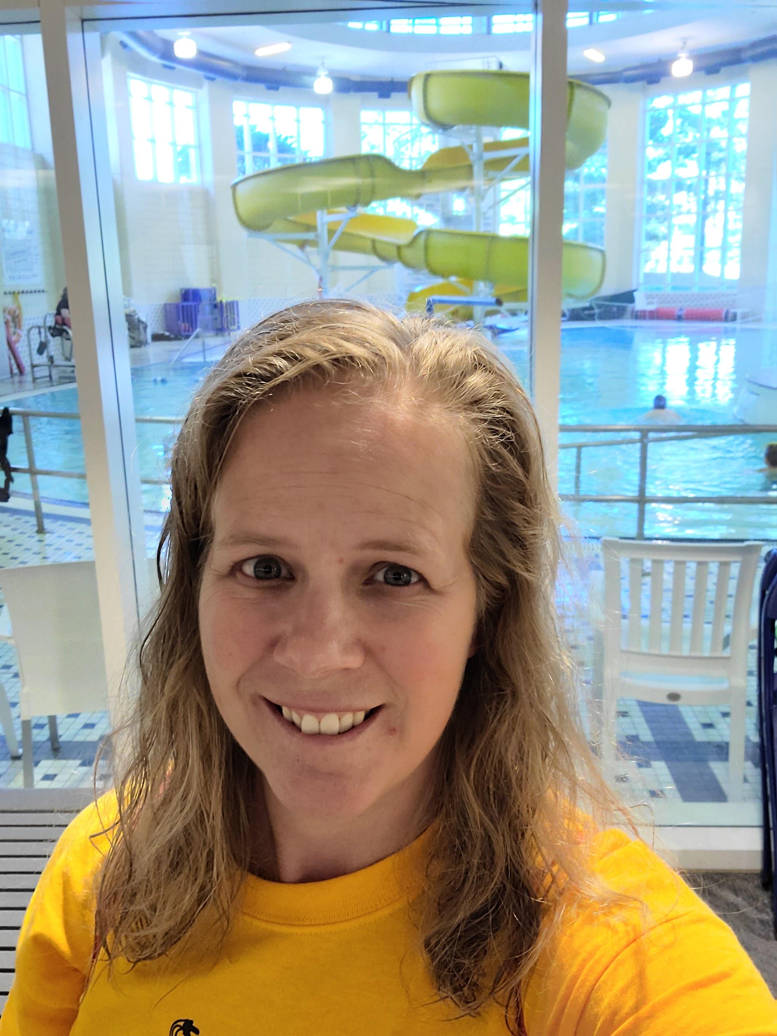
Contact me, Christy Hulscher
SDSBVI, CAPE/TVI, Coach
christy.Hulscher@sdsbvi.northern.edu
NSU Adapte Physical Activity
Sports Sciences Adjunct
christina.Hulscher@northern.edu
Ph: 605-715-5369, call or text

