Slide 1
DAKOTAS AER CONFERENCE
O&M Intersections with Intelligence Testing
Melody Brown, Ed. S
Psychometrist/ COMS
TVI/ VRT

Slide 2
LEARNING OBJECTIVES
Participants will be able to identify 3 O&M strategies to bolster
a consumers understanding in at least 3 intelligence subtests

Slide 3
PURPOSE OF O&M
The purpose of O&M is to teach students with visual impairments how to use their sensory/physical/cognitive abilities:
to gain information about the environment,
to interpret information from the environment,
to use information from the environment
to make decisions that reflect a knowledge of the appropriate safety, social, self-advocacy, and travel skill.

Slide 4
Psychometry/ Psychometrics
Psychometrics is a field of study within psychology concerned with the theory and technique of measurement. Psychometrics generally refers to specialized fields within psychology and education devoted to testing, measurement, assessment, and related activities
Psychometrists have been utilized by psychologists and neuropsychologists since the 1930’s.
https://en.wikipedia.org/wiki/Psychometrics
WE CAPTURE THE INFORMATION FOR CLINICAL ANAYLYSIS

Slide 5
National Association of Psychometrist (NAP)
The National Association of Psychometrists (NAP) is a non-profit professional organization dedicated to achieving excellence in psychometry. Our charter is to establish a communications network, provide venues for professional networking, and promote the psychometry profession as a whole. Membership is open to psychology students and professional psychometrists.
https://napnet.org/

Slide 6
Before we begin...
What does it mean when:
We omit the visual portions of the test
We don't have a current eye report
We need a Functional Visual Assessment
We need to determine a Learning Medium

Slide 7
Common Psychometric Tools
Differentiated Ability Scale 2:6 to 17:11
WAIS – Wechsler Adult Intelligence Scale®
WISC V- Wechsler Intelligence Scale for Children® Fifth Edition

Slide 8
Common Psychometric Tool 1
THE DAS
Differentiated Ability Scale 2:6 to 17:11

Slide 9
Special Nonverbal Composite
Ages 2:6-3:6 : Block Building; Picture Similarities
Ages 3:6 –5:11: Copying, Pattern Construction; Pattern Similarities
Ages 6:00-17:11- Pattern Construction; Design Recall; Matrices; Sequential & Quantitative Reasoning
DAS
Differentiated Ability Scale
2 years: 6 months - 17 years: 11 months

Slide 10
What other intersections can you think of...
On the corner of
MAKING MAPS &___________
On the corner of
_______________ & Block Building
On the corner of
PICTURE SIMILARITIES & ___________

Slide 11
What other intersections can you think of...
On the corner of
MAKING MAPS & COPYING
On the corner of
POSITIONAL CONCEPTS & Block Building
On the corner of
PICTURE SIMILARITIES & GEOMETRIC SHAPES

Slide 12
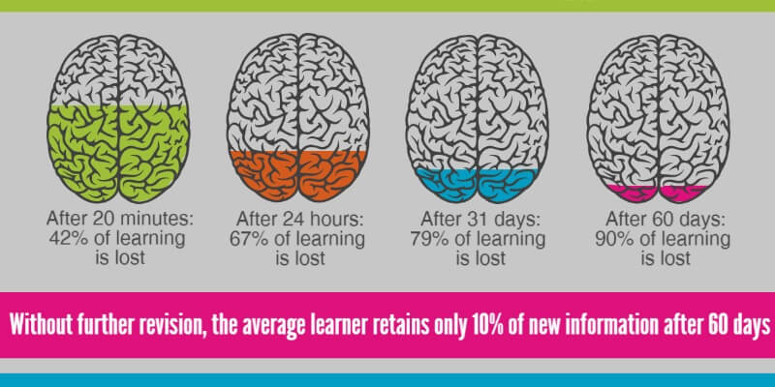

Slide 13
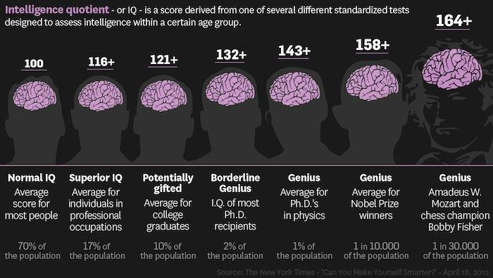
Slide Showing 7 Brains. Intelligence quotient or IQ is a score derived from one of several different standardized test designed to assess intelligence within a certain age group. 100- Normal IQ. Average score most people. 70% of population. 116+ Superior IQ. Average for individual in professional occupations. 17% of population. 121+ Potentially gifted. Average for college graduates; 132+ Borderline Genius. I.Q. of most Ph.D. recipients. 2% of the population. 143+ Genius Average for Ph.D. in physics. 1% of the population. 158+ Genius-Genius. Average for Nobel Prize Winners. 1 in 10,000. 164+ Genius-Genius-Genius. Average Amadeus W. Mozart & chess champion Bobby Fisher, 1 in 30,000.

Slide 14
Common Psychometric Tool 2
WAIS
Wechsler Adult Intelligence Scale®

Slide 15
WAIS
Wechsler Adult Intelligence Scale®
16 - 90 year-olds
Verbal IQ (VIQ)
Verbal Comprehension Index (VCI)
Similarities
Vocabulary
The Working Memory Index (WMI)
Arithmetic
Digit Span
Letter-Number-Sequencing
Comprehension

Slide 16
What other intersections can you think of...
On the corner of
ROOM FAMILIARITY &___________
On the corner of
_______________ & Letter-Number-Sequencing
On the corner of
________________ & Comprehension

Slide 17
What other intersections can you think of...
On the corner of
ROOM FAMILIARITY & DESIGN RECALL
On the corner of
MONOCULAR TRAINING & Letter-Number-Sequencing
On the corner of
COMMUNITY EXPERIENCES & Comprehension

Slide 18
Common Psychometric Tool 3
WISC V-
Wechsler Intelligence Scale for Children® Fifth Edition

Slide 19
WISC-V
Wechsler Intelligence Scale for Children
6-16 year-olds
Verbal Comprehension Index (VCI)
Similarities; Vocabulary –Information ;Comprehension –
Visual Spatial Index (VSI)
Block Design and Visual Puzzles
The VSI is a measure of visual spatial processing.
Fluid Reasoning Index (FRI)
Matrix Reasoning
Figure Weights
Picture Concepts
Arithmetic

Slide 20
What other intersections can you think of...
On the corner of
SIMILARITIES &___________
On the corner of
_______________ & QUANTATIVE CONCEPTS
On the corner of
INFORMATION & ___________________
On the corner of
__________________& COMPREHENSION

Slide 21
What other intersections can you think of...
On the corner of
SIMILARITIES & GEOMETRIC CONCEPTS
On the corner of
VOCABULARY & QUANTATIVE CONCEPTS
On the corner of
INFORMATION & EXPRESSIVE LANGUAGE
On the corner of
EXPRESSIVE LANGAUGE & COMPREHENSION

Slide 22
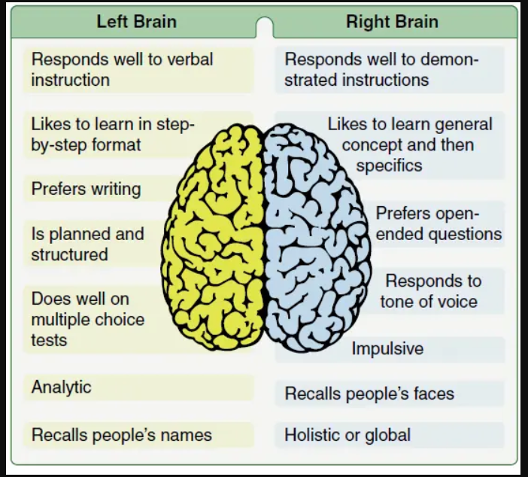
Left Brain responds will to verbal instruction; likes to learning step-by-step format, prefers writing; is planned & structured; does will on multiple choice test; analytic; recalls people's names. Right Brain responds well to demonstrated instructions; likes to learn general concept then specifics; prefers open-ended questions, responds to tone of voice, impulsive, recalls people's faces; holistic or global.

Slide 23
AREAS OF O&M THAT SEEM TO HAVE A HIGH CORRELATION WITH HIGHER IQ SCORES
Vocabulary: identify body parts relevant to O&M; point or hold object up, down, to the side, in front, behind; move forward, back, to the side; move slow, fast; respond to 'stop' quickly and in multiple contexts

Slide 24
AREAS OF O&M THAT SEEM TO HAVE A HIGH CORRELATION WITH HIGHER IQ SCORES
Laterality: identify people as having left and right sides; consistently identify left/right hand; point or hold object to the left/right; follow route based on single left/right direction; follow route based on several left/right directions; put wall or object on left/right (e.g walk with wall on left); identify that left/right changes by making 180° turn; identify that people facing one another have opposite left/right

Slide 25
AREAS OF O&M THAT SEEM TO HAVE A HIGH CORRELATION WITH HIGHER IQ SCORES
Parallel/Perpendicular: identify parallel environmental features (e.g. walls of hallways) and perpendicular environmental features (such as intersecting sidewalks/hallways/streets);identify that parallel/perpendicular changes by making a 90°turn; identify clockface numbers for use in orienting to environmental features; develop precision with clockface numbers (e.g. 7 vs 8)

Slide 26
AREAS OF O&M THAT SEEM TO HAVE A HIGH CORRELATION WITH HIGHER IQ SCORES
Cardinality: identify names of cardinal directions (their opposites & intermediates); use clues (e.g. position of sun, noise from passing train) or landmark (e.g. mountains) to determine one direction; identifying direction (inside or outside)Time & Distance: develop an awareness of the amount of time needed to cross quiet residential/ commercial street; develop awareness of the amount of time it takes to walk a block;

Slide 27
AREAS OF O&M THAT SEEM TO HAVE A HIGH CORRELATION WITH HIGHER IQ SCORES
Time & Distance: identify common units of length (e.g. inch/centimeter, foot, yard/meter, mile/kilometer);identify most appropriate unit of measurement for common objects (e.g. inch/centimeter for pencil, mile/kilometer for street); identify tie between time and distance as it relates to walking or driving (e.g. 5-minute drive can translate into 30-minute walk)

Slide 28
USEFUL TOOLS
https://youtu.be/EPd4zcttBuQ?feature=shared
HOW TALL
HOW SHORT
HOW FARAWAY
BY DAVID ADLER
https://www.amazon.com/How-Tall-Short-Far-Away/dp/0823416321

Slide 29
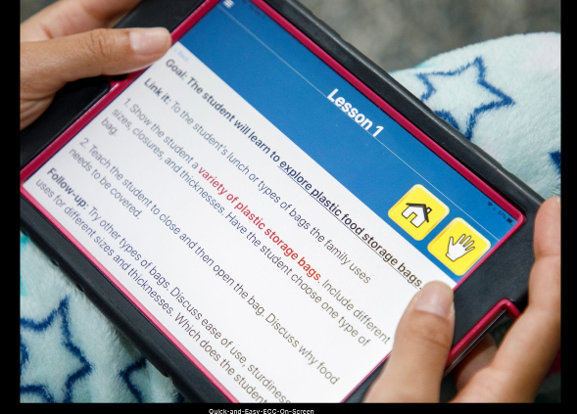
USEFUL TOOLS
Quick and Easy Expanded Core Curriculum: (App Activation) For Quota Customers
Made for convenience and portability, and developed for iOS and Android devices, this mobile app offers over 140 lessons to address the nine areas of the Expanded Core Curriculum (ECC). This application is a new format of the physical
Apple Store Download
Google Play Download
Cost 14.99
Federal Quota Eligible Catalog Number: D-30038-ED

Slide 30
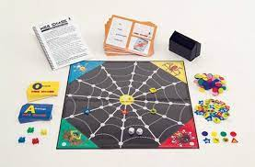
USEFUL TOOLS – American Printing House
Webchase Board Game
Catalog Number: 1-08460-00

Slide 31
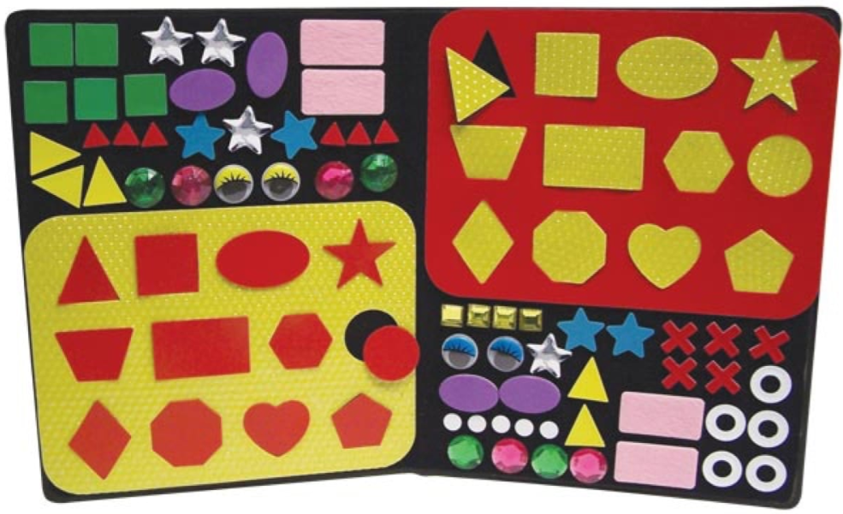
USEFUL TOOLS – American Printing House
Picture Maker Geometric Textured Shapes
Catalog Number: 1-08838-01

Slide 32
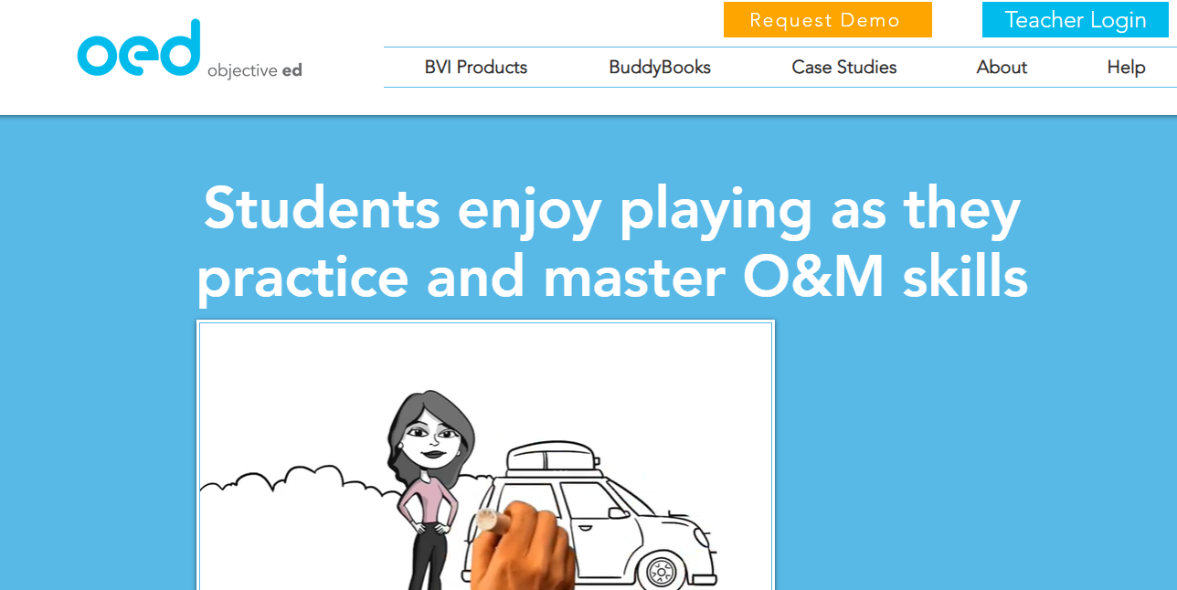
USEFUL TOOLS – Objective ED
Simple Directionality
Advanced Directionality
Sound Identification.
Sound Identification & Grid Concepts
Sound Localization
Listening Skills
Mental Mapping of Local Neighborhood
Wayfinding and Mental Mapping
Positive Reinforcement

Slide 33
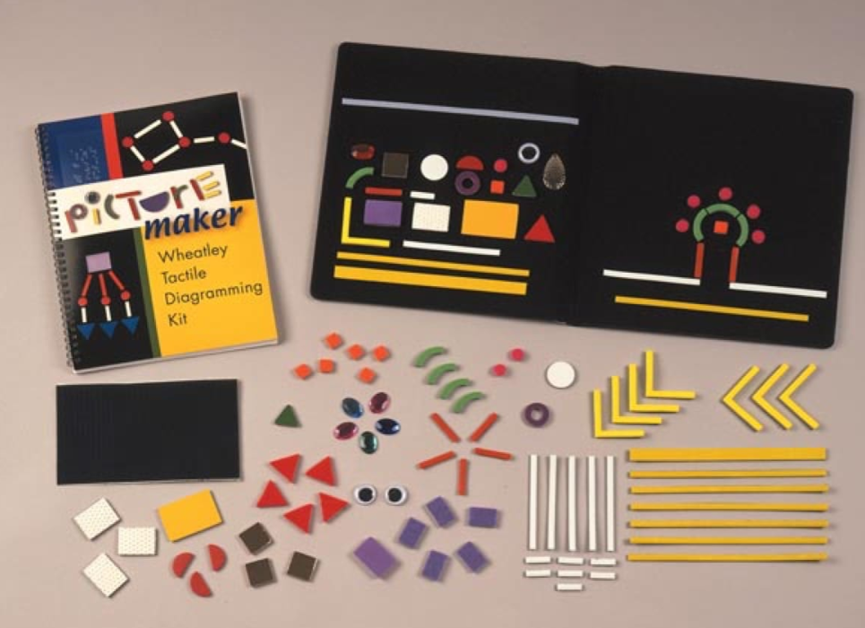
USEFUL TOOLS – American Printing House
Picture Maker Wheatley Tactile Diagramming Kit
Catalog Number: Catalog Number: 1-08838-00

Slide 34
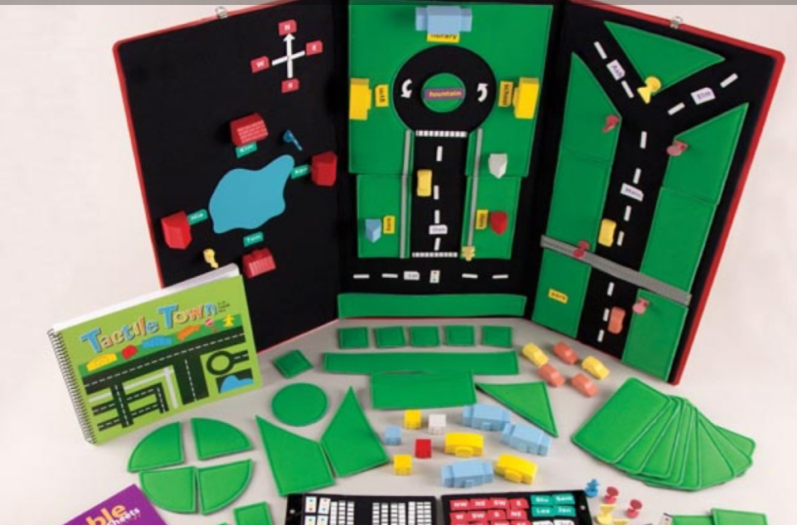
USEFUL TOOLS – American Printing House
Tactile Town: 3-D O&M Kit
Catalog Number: 1-03135-00

Slide 35

QUESTIONS & DISCUSSIONS

Slide 36
References
O’Callaghan, F., O’Callaghan, M., Williams, G., Bor, W., & Najman, J. (2012). Physical Activity and Intelligence: A Causal Exploration, Journal of Physical Activity and Health, 9(2), 218-224. Retrieved Jan 8, 2023, from https://journals.humankinetics.com/view/journals/jpah/9/2/article-p218.xml

Slide 37
References
Kasneci, E., Kasneci, G., Trautwein, U., Appel, T., Tibus, M., Jaeggi, S. M., & Gerjets, P. (2022). Do your eye movements reveal your performance on an IQ test? A study linking eye movements and socio-demographic information to fluid intelligence. PloS one, 17(3), e0264316. https://doi.org/10.1371/journal.pone.0264316
Laurence, P. G., Mecca, T. P., Serpa, A., Martin, R., & Macedo, E. C. (2018). Eye movements and cognitive strategy in a fluid intelligence test: Item type analysis. Frontiers in Psychology, 9. https://doi.org/10.3389/fpsyg.2018.00380

Slide 38
References
Saw, S. M., Tan, S. B., Fung, D., Chia, K. S., Koh, D., Tan, D. T., & Stone, R. A. (2004). IQ and the association with myopia in children. Investigative ophthalmology & visual science, 45(9), 2943–2948. https://doi.org/10.1167/iovs.03-1296
Shalev, I. (2013, June 3). Blood vessels in the eye linked with IQ, cognitive function. Association for Psychological Science - APS. Retrieved January 19, 2023, from https://www.psychologicalscience.org/news/releases/blood-vessels-in-eye-linked-with-iq-cognitive-function.html

Slide 39
THANK YOU
THE END

